Slide 1
Understanding The Value Of Insurance
Establishing Economic Resilience In The Wake Of Natural Catastrophes

Slide 3
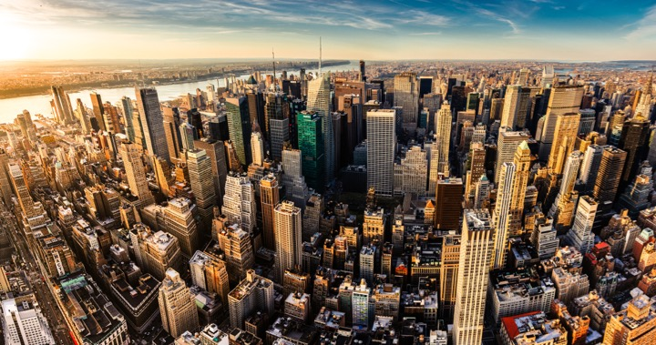
I.I.I. Mission Statement
Improving public understanding of insurance...
…what it does and how it works
3

Slide 4
Over The Past 18 Months, However, Insurance Coverage Has Focused On…
Insurance Lawsuits
Travel & Pet Insurance
3%
Mortgage & Title Insurance
3%
18% on other P/C and life products
Crop Insurance
3%
Life Insurance & Long-Term Care
Auto Insurance
Wildfires
2%
Flood & Storms
Homeowner Insurance
28% on Nat Cat risks
NFIP
Cyber Insurance
30% on cyber insurance and digital trends
InsurTech
Count
Source: Quid, HPS Analysis, Excludes Health Insurance And Company Performance

Slide 5
Social Media Focuses More On NatCat Than Cyber, Auto and InsurTech
Traditional Media Coverage vs Social Shares
NFIP
Flood & Storms
Homeowner Insurance
Average Social Share
Travel Insurance
Insurance Lawsuits
Wildfires
Life Insurance & Long-Term Care
Crop Insurance
Cyber Insurance
Auto Insurance
InsurTech
Publisher Count

Slide 6
Insurance As Economic Capital
Financial First Responders

Slide 7










10 Key Ways Insurance Drives Economic Growth
Safety/
Security
Economic/ Financial Stability
Development
Insurers are financial first responders
Insurers are capital protectors
Insurance is a partner in social policy
Insurers are community builders
Insurance enables infrastructure improvements
Insurers are risk mitigators
Insurance sustains the supply chain
Insurers are capital infusers
Insurers are innovation catalysts
Insurers are credit facilitators

Slide 8
The Insurance Sector Is A Meaningful Component Of U.S. Gross Domestic Product
% Contribution To U.S. GDP
Insurance Carriers
& Related Activities
Banks
& Credit Intermediaries
Broadcasting
& Telecommunications
National Defense
Internet
Mining
Securities
& Commodities Contracts
Insurance is a critical provider of economic capital in the modern economy.
Since 2015, the insurance industry has generated roughly 3% of U.S. GDP.
The sector's contribution to GDP is more than twice the size of the securities industry's contributions, and is on par with banks and other financial lenders' share of U.S. GDP.
Source: Bureau of Economic Analysis

Slide 9
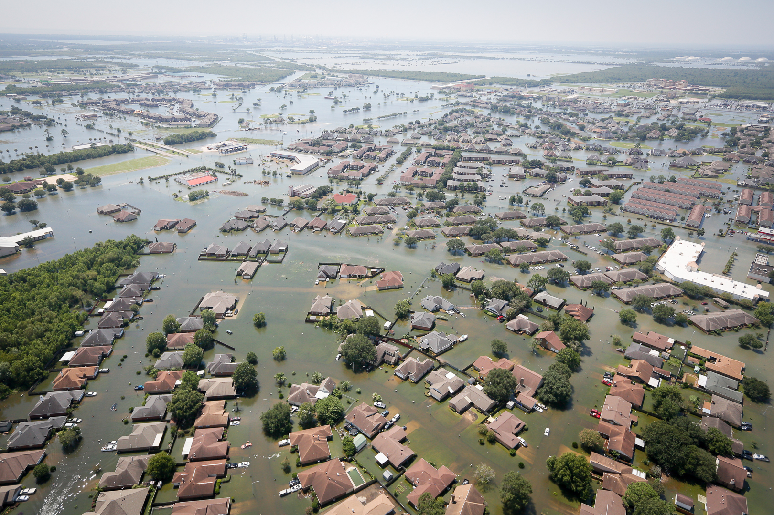
Insurers Function As Financial First Responders After Natural Disasters And Emergencies
Insurance Organizations Inject Communities With The Capital They Need To Recover In The Wake Of A Catastrophe

Slide 10
Insurance Also Boosts U.S. Consumer Spending By Reducing The Need For A Rainy Day Fund
1:31
1:31
1:30
1:29
1:30
2011
2012
2013
2014
2015
Average Cost Of Bodily Injury In Auto Accident
Countrywide Average Annual Auto Premium
Source: NAIC; I.I.I. Auto Insurance Factbook

Slide 11

A Confluence Of Disruptive Forces Continue To Impact Traditional Global Market Dynamics
Catastrophes
Economics
Geopolitical
Technology

Slide 12
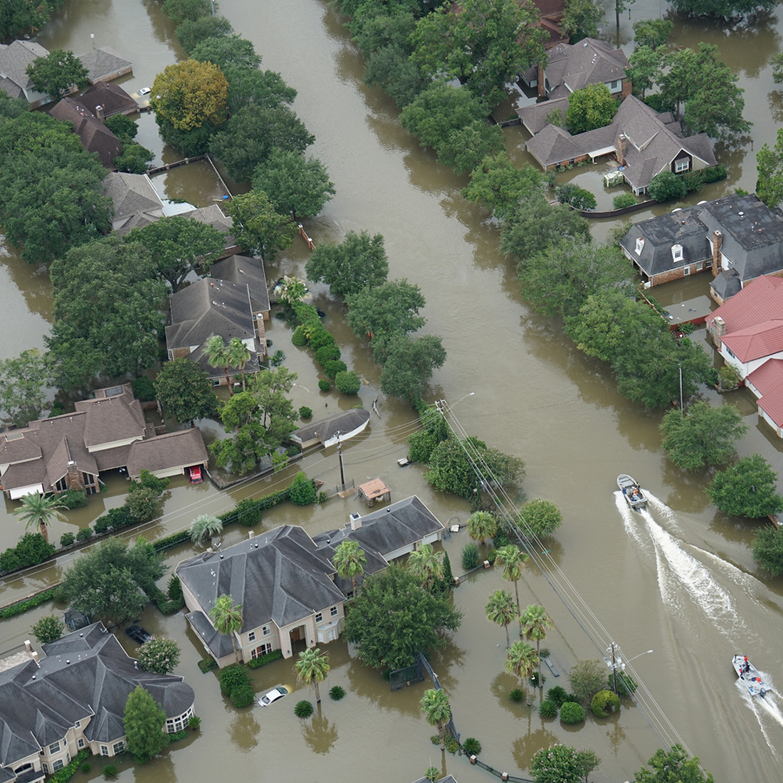
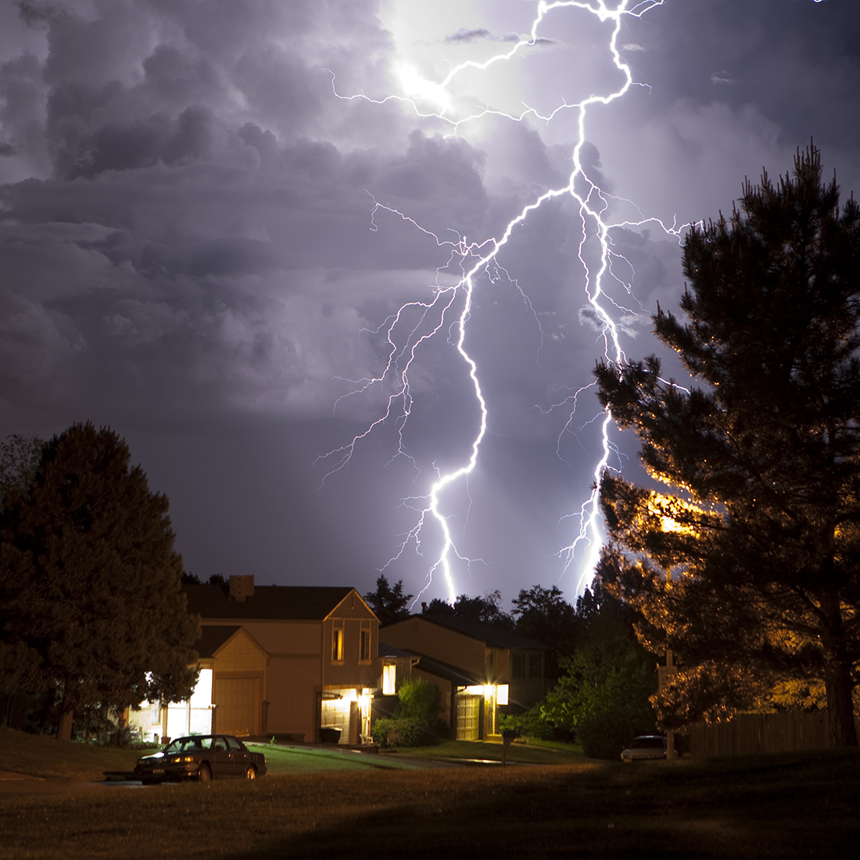

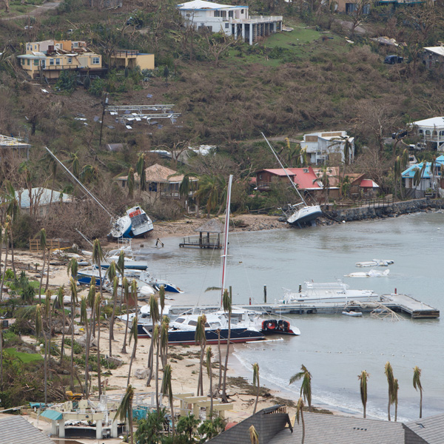

2017: A Record Year Of Catastrophe Losses
Flooding events spurred 73% of federal disaster declarations
Thunderstorm related losses 2nd highest ever in U.S.
$14 billion insured wildfire losses; California damage estimated ~$11 billion
N.A. hurricane season record-breaking insured & economic losses; disasters affected >25 million Americans
Cyber: Risk continuing to increase
Auto: Reaching epidemic proportions

Slide 13
Rising Insurance Gap

Slide 14
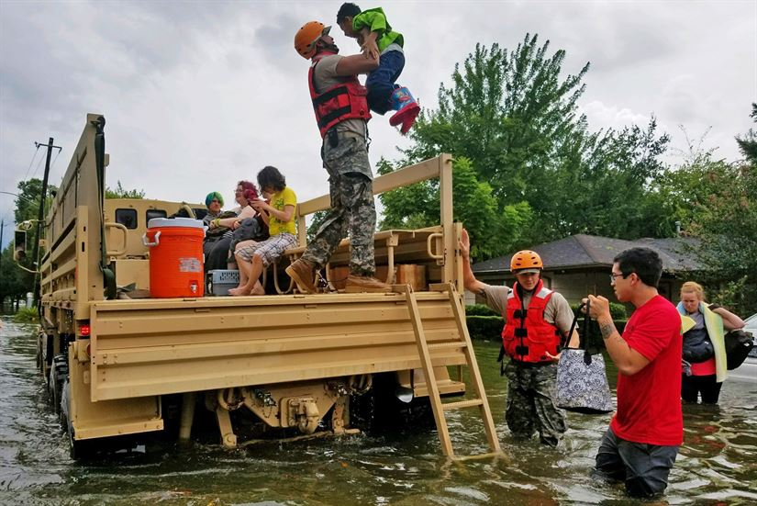
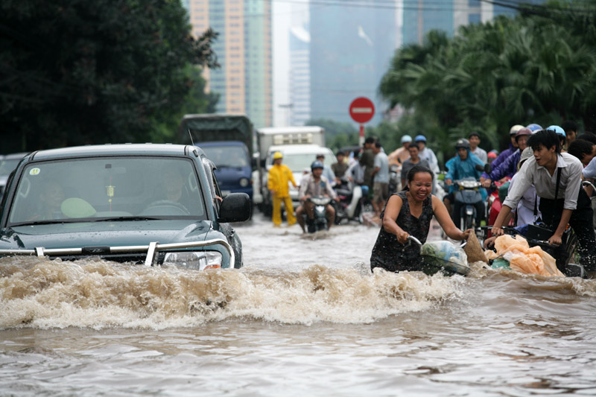
The Insurance Coverage Gap Cost Consumers An Estimated $1.3 Trillion From 2005-2015
Over the last decade, more than 70 percent of all catastrophes losses worldwide were uninsured.
Flooding is not covered by standard homeowners insurance or commercial insurance policies, making it one of the largest uninsured risks for consumers.
Source: Swiss Re; Wikimedia Commons; DOD

Slide 15
NFIP Payouts To The Small Group Of Americans With Flood Insurance Have Skyrocketed
78% Of NFIP's Payouts Have Occurred In The Last 13 Years
Cost of Paid NFIP Claims
Aug 2005:
Hurricane Katrina
$18,000,000
$16,000,000
$14,000,000
$12,000,000
Oct 2012:
Superstorm
Sandy
$10,000,000
Aug 2017: Hurricane Harvey
$8,000,000
$6,000,000
$4,000,000
1979:
FEMA Created
$2,000,000
0
Source: FEMA NFIP
Year

Slide 16
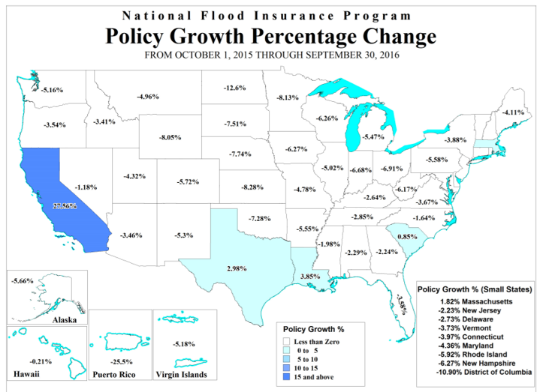
Coverage Gaps Have Serious Consequences For American Families And Businesses
88% Of American Households Lack Flood Insurance
Major Populations Without Flood Insurance (%):
Texas
80%
Florida
60%
Puerto Rico
99%
Source: McKinsey; FEMA NFIP
Notes:
73% of all federally declared disasters were a result of flooding from 2008-2017, according to Pew Charitable Trust.

Slide 17
Bridging The Insurance Gap

Slide 18


Successes In The Private Market Demonstrate The Viability Of Public/Private Partnerships
Private Industry
Case Studies
FEMA Reinsurance
Through a $150 million purchase of private reinsurance products, FEMA was able to recover approximately $1 billion, or an eighth of its total 2017 loses.
40%
2018 FEMA Reinsurance
NFIP NatCat Bonds
By issuing new natural catastrophe bonds geared towards institutional investors, the NFIP can bring an estimated $500 million of additional reinsurance coverage.
Swiss Re Flood Products
Swiss Re recently announced a flood insurance program that delineates premiums based on location, house construction, and insured value, rather than relying on traditional rating tables.
Source: Insurance Journal; Houston Chronicle; Swiss Re

Slide 19




Using The Power Of Insurance Marketing, The Industry Can Address The Coverage Gap

Slide 20
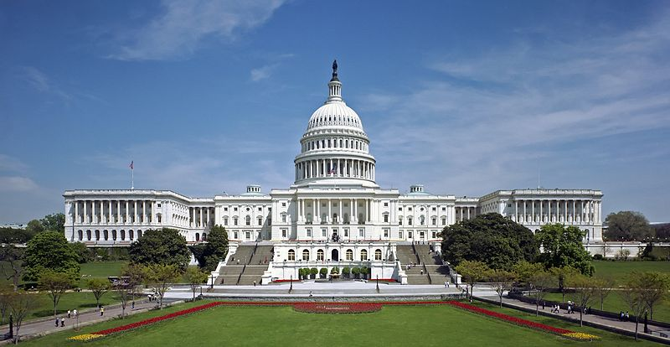
We Must Overcome Political Gridlock
Economic and Actuarially Sound Action Is Needed To Adapt Policies To The Realities Of 21st Century Natural Catastrophes
“ALL POLITICS IS LOCAL”

