Slide 1
Overview of US
Workers Compensation System
James Lynch, Chief Actuary
Insurance Information Institute  110 William Street  New York, NY 10038
212.346.5533  jamesl@iii.org  www.iii.org
Notes:
Introduction

Slide 2

I.I.I. Mission Statement
Improving public understanding
of insurance...
…what it does and how it works
2

Slide 3
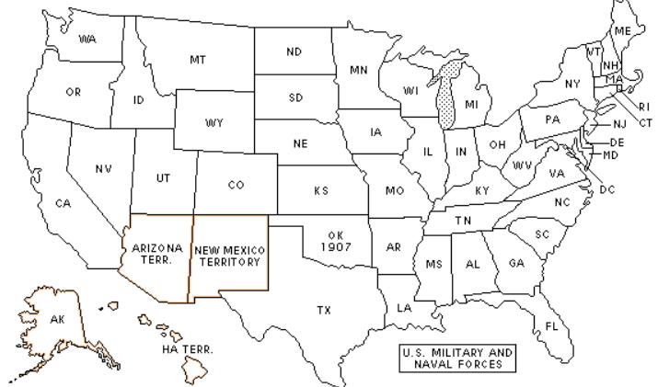
1910: Before Workers Compensation
Notes:
Important Facts Before We Begin
In the old days, when workers got hurt, what happened?
No health insurance
No disability programs
Liability system
Responsibility for accident placed on those who caused accident
Insurance regulated by states (been that way since 1830s)
Dangerous workplace – factories, coal mines, rail yards

Slide 4
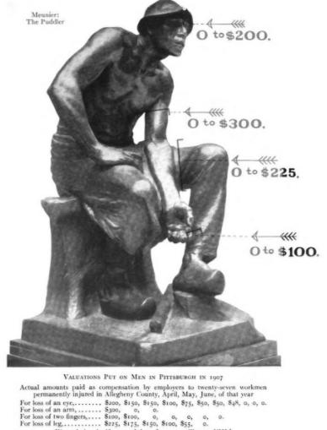
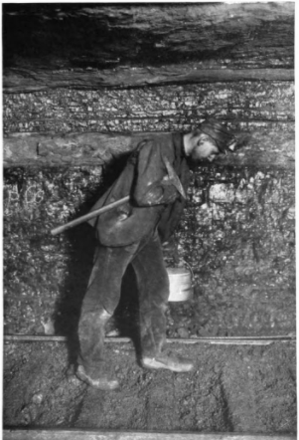
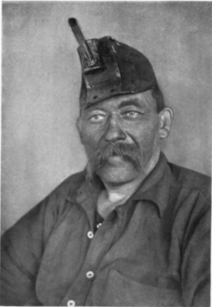
The Worker’s Plight
Source: Crystal Eastman, “Work Accidents and the Law.” (published 1910.)
Notes:
In US, precedent was British law
Law overwhelmingly favored the employer
Contributory Negligence: Worker was partly responsible
Assumed Risk: You saw the risks when you took the job, so you assumed the risk
Fellow Servant Rule: If another employee caused your injury, that employee was at fault. Go sue him.
Industrialization + progressive politics - this became untenable
Dramatic stories in newspapers and magazines
Upton Sinclair - the Jungle
Crystal Eastman – Work Accidents and the Law
Rise of labor unions
Workers still lost their lawsuits – but when they won, they won enormous amounts
States began passing laws to broaden worker rights

Slide 5
The Grand Bargain
(No. of States with Workers Compensation Laws)
SOURCE: Insurance Information Institute research.
Notes:
"Grand Bargain”
Workers give up much of the right to sue for work injuries
Employers cover all injuries arising out of employment, regardless of fault
Workers comp laws
Begun in Germany, 1880s, grew in Europe
First U.S. efforts unconstitutional (violated due process – employers lost their day in court – right to defend selves)
Began to pass in 1910 era; new court interpretations, constitutional amendments
1917: US Supreme Court said states could require employers to have WC
All states have workers compensation insurance
Required in every state - except Texas
Federal employees and certain private industries have own plans (pre-date WC)
Some exceptions – sole proprietors, family businesses – varies by state

Slide 6
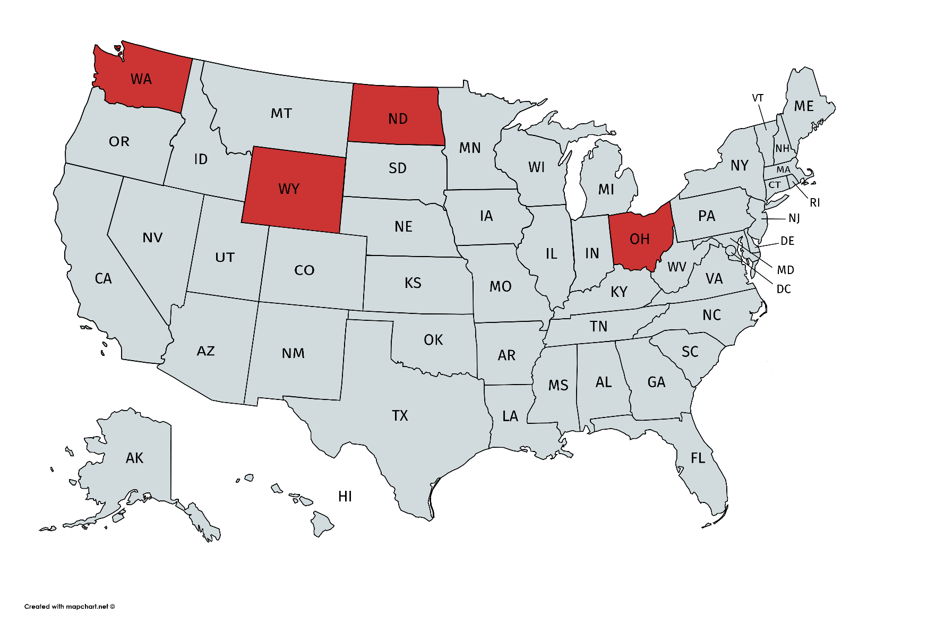
The Role of the States
States with Monopolistic WC Systems
SOURCE: Insurance Information Institute.
Notes:
Four states prohibit competition
Washington
Montana
North Dakota
Ohio
Most states allow private WC Insurers
Competitive marketplace keeps costs down
Less potential for political abuse
No political favoritism in rating
Politicians sometimes abuse the insurer (Ohio)

Slide 7
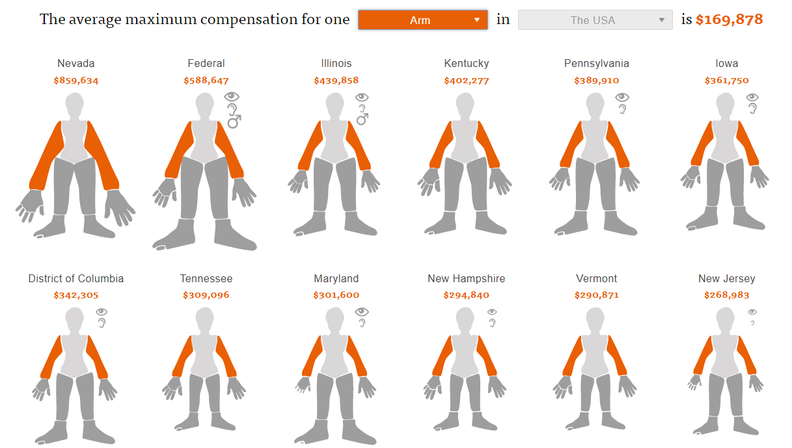
Benefits Varies by State
SOURCE: ProPublica.org, https://projects.propublica.org/graphics/workers-compensation-benefits-by-limb
Notes:
What are benefits
Unlimited medical (extremely unusual in US)
Indemnity
Lost wages
usually 2/3 of salary, though salary is capped
Sometimes capped by time
Schedule benefit – loss of limb
Death
Burial

Slide 8
Does the System Work?
Number of Fatal Injuries
SOURCE: U.S. Bureau of Labor Statistics, National Census of Fatal Occupational Injuries in 2015, released December 16, 2016, and previous reports.
8
12/01/09 - 9pm
eSlide – P6466 – The Financial Crisis and the Future of the P/C
Notes:
8

Slide 9
Does the System Work?
(Number of Work-Related Injuries and Illnesses)
Source: U.S. Bureau of Labor Statistics, National Occupational Injuries and Illnesses Requiring Days Away from Work, 2015, Table 1, released November 10, 2016, and earlier releases.
9
12/01/09 - 9pm
eSlide – P6466 – The Financial Crisis and the Future of the P/C
Notes:
9
Lower death rates
In 1930s, 13 deaths per 100,000 workers
Now less than 2 per 100,000
How does comp do it
Rates
Safer industries pay lower rates
Safer companies within an industry pay lower rates (experience mods)
Companies that underwriters adjudge to be safe pay lower rates (schedule mods)
Loss control
Risk professionals
Hired by insurers
They visit a company, assess exposures, make recommendations
Safety Training
Classroom sessions
Webinars
Insurers have much wider scope
Can spread news of government findings efficiently
Have both carrot and stick incentives
Financial benefit (lower premiums)
Financial penalty (higher premiums, loss of insurance)
Compensation stretches beyond comp
Employer life insurance
Employer disability insurance
Only comp actively tries to reduce injury rates
More regulation
Occupational Safety and Health Administration
State Agencies
Industry associations (American Society of Safety Engineers)

Slide 10
Current Issues
The Opioid Epidemic
Overall Drug Abuse Deaths
Opioid-Related Deaths
¹Opioids less synthetic opioids
²Fentynyl and other non-methadone synthetic opioids
SOURCE: National Institute on Drug Abuse.
Notes:
Drug deaths have tripled in a generation, more than 60,000 in 2016 (40,000 traffic deaths)
WC includes prescription drugs
Heavy levels of abuse
Injured workers out of work longer

Slide 11
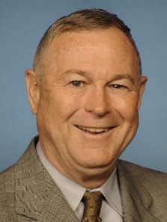
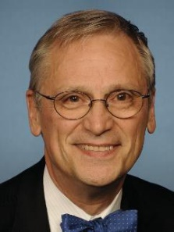
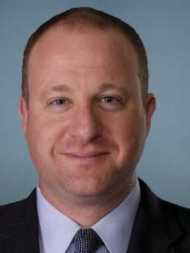
Current Issues
Medical Marijuana
■ Fully legal ■ Medical use legal and recreational use decriminalized ■ Medical use legal ■ Recreational use decriminalized ■ Fully illegal
Congressional Cannabis Caucus
WA
MT
ND
VT
ME
OR
MN
ID
SD
WI
NY
NH
WY
MI
NV
NE
IA
PA
UT
IL
IN
OH
WV
CA
CO
KS
MO
VA
MA
KY
Rohrbacher (CA)
Bluemenauer (OR)
TN
NC
RI
AZ
NM
OK
AR
CT
SC
MS
AL
GA
NJ
AK
TX
LA
DE
FL
MD
DC
HI
Young
(AK)
Polis
(CO)
SOURCE: National Journal.
Notes:
There is conclusive evidence or substantial evidence that marijuana:
Improves the lot of adults in chronic pain.
Increases the risk of motor vehicle crashes.
Increases the risk of developing schizophrenia and other psychoses.
There is moderate support suggesting that marijuana:
Improves short-term sleep outcomes for people with fibromyalgia or chronic pain.
Increases impairment of learning, memory and attention span.
Increases dependence on alcohol, tobacco and illicit drugs.
There were 9 referenda on marijuana legalization. Only one failed – recreational use in Arizona.
Six states require use of medical marijuana in WC claims – CT, ME, MA, MN, NJ, NM
Six states forbid use of medical marijuana in WC claims – AZ, CO, MI, MT, OR, VT
It is illegal to use the banking system to purchase marijuana. So an insurer can’t write a check against to pay for the drug. They use cash.
Trump OK with med mare. Sessions, not so much. We wind up with one more conflict, Trump vs. his Cabinet.
It is not possible to determine whether marijuana use is statistically correlated with occupational injuries.

Slide 12
Summary
Workers Compensation Has Worked in United States for More Than A Century.
Law Is Result of Grand Bargain Between Labor and Management.
Every State Has Its Own Workers Compensation System.
The System Evolves to Address Emerging Issues.

Slide 13
Thank You!
Questions?

