Slide 1
Insurance Leading Through Disruption
Sean Kevelighan
Chief Executive Officer
October 2020
Insurance Information Institute  110 William Street  New York, NY 10038
seank@iii.org  212.346.5520  www.iii.org

Slide 2
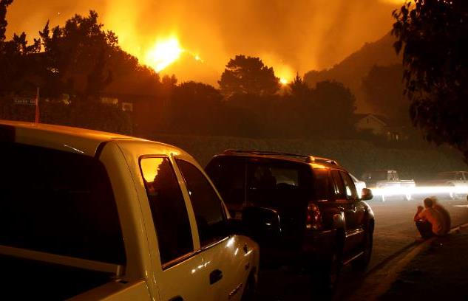





The Disruption Continuum
Catastrophes
COVID
Economics
INSURANCE
Geopolitical
Social Unrest
Technology

Slide 3
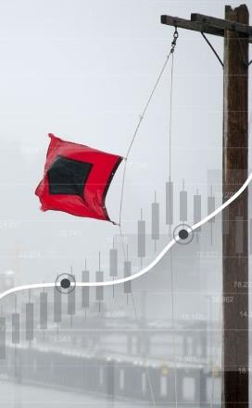

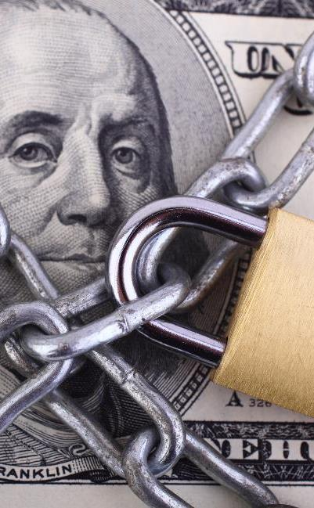





A New Milestone for Measuring Success
Economic Growth
Community
Well-being
Capital Protections
Resilience
Fairness & Equality

Slide 4
Stepping Up
America's Insurers:
for Customers, Communities, and Employees
The insurance Industry is Applying Forward-thinking Solutions to Take Care of Its Customers, Communities, and Employees During the COVID-19 Crisis
Customers
Community
Employees
Industry
Auto insurers have returned $14 billion so far to customers' pockets around the country through premium relief
Insurers have pledged more than an estimated $280 million (according to III/Insurance Industry Charitable Foundation) in donations to the national and local organizations fighting this pandemic on the frontlines
Employing more than 2.8 million Americans, Insurers are taking care of their employees–many pledging no layoffs during the ongoing crisis
Insurers are implementing innovative solutions to carrying out daily operations while respecting social distancing

Slide 5

Underwriting Trends

Slide 6
COVID-19’s Impact
Unprecedented Spread of Loss, Deterioration of Exposure
Potential Loss Impact
Exposure Impact
$14B auto premium
Employment related exposures (GL, WC)
Loss estimates range from $30B
(≈ bad hurricane) to $140B (2-3 Katrinas)
Investment
Volatile stocks, bond yields plunging
Lloyd’s estimate: $96B in investment losses
Source: Willis Towers Watson, Insurance Information Institute..

Slide 7
Industry Outlook
Commercial Lines Rate Change
Calendar Year Written Premium and Net Combined Ratio Projections
Growth in Nominal GDP (Real GDP + Inflation)
2020 Commentary
Overall premium projected to be flat. Underwriting result deteriorates.
Pandemic and recession reduce exposure in personal auto, several commercial lines.
Rate increases make up for lower exposures somewhat.
Tremendous uncertainty due to pandemic’s impact on several lines.
We assume normal cat year, despite bleak hurricane forecast.
Data sources: NAIC data sourced through S&P Global Market Intelligence, MarketScout, Blue Chip Economic Indicators, Congressional Budget Office, PCS, Aon, Munich Re, Energy Information Agency, FRED (Federal Reserve Bank of St. Louis).
Analysis: Insurance Information Institute, Milliman.

Slide 8

Financial Trends

Slide 9
Policyholder Surplus by Quarter
Amount of Surplus ($ Billions)
Change from Prior Quarter
Surplus Has Rebounded from Q1 Decline Caused by Unrealized Capital Losses (Stock Declines).
78 Cents of Premium per Dollar of Surplus.
Sources: ISO, A.M. Best, Insurance Information Institute.
9
Notes:
9

Slide 10
Employment in Major Subsectors of the Insurance Industry:
A Surprise
Over the Last Two Years, All Four Major Insurance Industry Subsectors Have Grown Employment Despite the Recession That Began in February 2020
Thousands
2,319.5
2,238.9
Data are seasonally adjusted
Sources: BLS; Triple-I

Slide 11

COVID-19
Economic and Cultural Impacts:
An Industry’s Response

Slide 12


Global Pandemics Are Uninsurable
Economic Impact of 9/11

Slide 13

Global Pandemics Are Uninsurable
Economic Impact of Coronavirus

Slide 14
Monthly Costs of Retroactive Changes to SME BI Policies
Regardless of Scenario, Retroactive Attempts to Include Pandemics in BI Causes Bankruptcy
Retroactive BI Scenarios
Higher
Median
Lower
Higher
Median
Lower
1
Virus / Bacteria Exclusion Removal
2
Expanded BI to
All SMEs
Key Assumptions
Scenario 1: 40% take-up rate
Scenario 2: 100% take-up rate
Loss basis: Compensation, profits, adjustment costs 7 days waiting period
Retained loss of 10% of total loss
Median estimates are model-driven. The higher and lower estimates assume a standard distribution for BI losses anchored in the mode-driven median loss estimates.

Slide 15
The Surge in Business Interruption Media Coverage Created an Opportunity for Triple-I to Serve as Industry Voice and Educator
Count of Stories Mentioning Business Interruption Insurance & COVID-19
Source: Meltwater

Slide 16
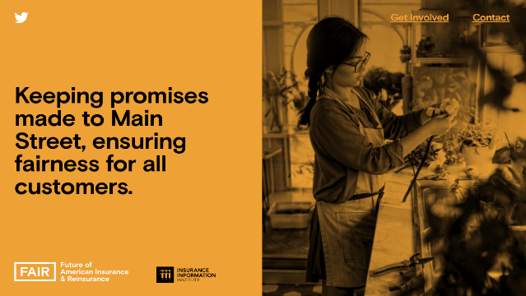


With Increased Attention and Scrutiny on Industry, Triple-I Identified the Need to Launch an Industry Campaign
The ‘Future of American Insurance & Reinsurance’ campaign launched in May and has served as a source of education and information surrounding pivotal industry activity, including Congressional hearings, White House roundtables, state legislation, and media stories.
With a separate website and public presences, this campaign provides the Triple-I with a separate platform and voice.
The campaign will take on overarching industry issues and emphasize its essential role in supporting and rebuilding communities in these uncertain times.
www.fairinsure.org

Slide 17

Fairness and Equality

Slide 18
Employed Persons by Occupation, Sex, Race, and
Hispanic or Latino Ethnicity, 2019
Occupation | Total Employed (in 000s) | % of Total Employed
 |  | Women | Black or African American | Asian | Hispanic or Latino
Total, 16 Years and Over | 157,538 | 47.0% | 12.3% | 6.5% | 17.6%
Business and Financial Operations Occupations | 7,996 | 54.0% | 9.9% | 9.0% | 9.5%
Insurance Sales Agents | 595 | 50.6% | 10.1% | 5.6% | 13.4%
Claims Adjusters, Appraisers, Examiners, and Investigators | 318 | 62.1% | 19.5% | 4.4% | 9.5%
Insurance Claims and Policy Processing Clerks | 269 | 81.7% | 21.8% | 2.4% | 15.5%
Insurance Underwriters | 105 | 51.1% | 5.9% | 5.4% | 6.2%
Actuaries | 33 | N/A | N/A | N/A | N/A
The Industry is More Diverse and Inclusive Than It Was 20 Years Ago, But Women, People of Color and Other Minority Groups Are Still Significantly Underrepresented at Senior Levels
Source: Bureau of Labor Statistics

Slide 19

Solutions?
The NAIC's newly formed committee on race and insurance will address practices that potentially disadvantage minorities – the industry will engage with the NAIC to review the recommended steps
SOLUTION

Slide 20

Working in Tandem to Overcome Unprecedented Challenges
The insurance industry is proud of its continued success in these areas—in large part because this success is built on a foundation of working in close partnership with consumers and regulators

