Slide 1

Quarterly P/C Industry Snapshot April 2020
Information and analysis provided by the Insurance Information Institute
Steven Weisbart, Ph.D., Chief Economist
stevenw@iii.org | T 212.346.5540 | M 917.494.5945

Slide 2
Key Insurance Economic Indicators

Slide 3
The U.S. economy, pertinent to the P/C insurance industry
The 53 Blue Chip forecasts underlying this chart see a remarkable range for nominal GDP. Some foresee a two-quarter recession.
P/C premium growth usually follows nominal GDP.
Nominal 2020 GDP Forecasts, Annual Rates
Source: Blue Chip
Economic Indicator | Indicator Value (2019:Q4) | Indicator Value (2020:Q1) | Analysis
% Change in Real GDP (vs. prior quarter, at annual rate) | 2.1% | -4.8% | Q1 GDPNow estimate is as of April 16. Blue Chip forecasts range widely..
Housing Unit Starts (thousands of units) | 327 | 324 | Essentially flat, and at a low level. This is a weak indicator.
Employment Change (thousands) | 630 | -212 | Virtually all of the plunge came in the last two weeks of March. More unemployment coming.
Nonresidential Fixed Investment, growth rate | -0.6% | -8.6% | Components: Investing in structures -9.7%; in equipment –15.2%; in software +0.4%
Hospital Services Price Increases (y-o-y) | 3.3% | 4.3% | Rising; supply scarcities driven by COVID-19
Interest Rates (10-Year U.S. Treasury) quarterly average | 1.8% | 1.4% | Still falling. No relief for insurer investment income

Slide 4
P/C insurance industry
Insurance Industry Indicator | 2018 | 2019 | Analysis
Industry Operating Ratio | 89.8 | 90.0 | Slight deterioration likely due to slightly lower investment income.
Natural Catastrophe Losses ($ billions) | $43.3 | $28.4 | 2019 was a decent year. Catastrophe losses in the better years this decade ranged $13 billion to $22 billion.
Industry After-Tax Profits ($ billions) | $59.63 | $61.45 | Profit rose on lower catastrophe claims.
Over the last two years, life carrier employment was flat, P/C and health carrier employment grew, and agent employment grew strongly.
Employment in Thousands, Major Insurance Industry Sectors

Slide 5
Some Economic Forces Affecting P/C Insurance
The Growth of Exposures Through 2019 Will End in the 2020 Recession, but the Latest Economic Data Don’t Show That Yet

Slide 6
Business Starts vs. Closings
(000s)
2001 Recession
Great Recession

Slide 7
Price changes,* medical care vs. hospital care
Affordable Care Act
For BI Liability and WC, hospital care prices are more relevant than general medical care prices. Hospital prices generally rose several percentage points faster than medical care, but that spread shrank under the Affordable Care Act and reversed since August 2019.
*Percentage change from same month in prior year; through November 2019; seasonally adjusted.
Sources: US Bureau of Labor Statistics; National Bureau of Economic Research (recession dates); Insurance Information Institute.
Notes:
7

Slide 8
Change in number of occupied residences => Demand for home and renters insurance
Net Change in Number of Occupied Residences (Thousands)
A spike, not a trend
Housing bubble
Bubble burst
Sources: Census Bureau; CoreLogic; Insurance Information Institute.

Slide 9
Home renters vs. owners, 2016 to present
Millions of renter-occupied housing units
Millions of owner-occupied housing units
Since 2016:Q1 the number of owner-occupied housing units grew by about 6.6 million, but the number of renter-occupied housing units grew by only 0.4 million in that span. This is good news for Homeowners insurance premium growth.
Sources: U.S. Census Bureau at http://www.census.gov/housing/hvs/data/histtabs.html, Table 8; Insurance Information Institute..
Notes:
9
Homeowners and renters
The chart shows: The orange line is the number of owner-occupied residences. The blue line is the number of rentals.
The back story: Growth in homeownership drives HO premiums, while rental growth drives the (considerably smaller) rental market.
The takeaway: There are slight signs that millennials are finally moving out of rentals and into owned homes. HO premium growth should benefit.

Slide 10
WC exposure base rose steadily through 2019 Nonfarm payroll (wages and salaries): quarterly
Billions
Latest (2019:Q4) was $9.4 trillion, a new peak
Recent trough (2009:Q1) was $6.23 trillion, down 5.3% from prior peak
Prior peak was 2008:Q3 at $6.54 trillion
Y-o-Y growth rates
2015:Q4 over 2014:Q4: 4.2% 2016:Q4 over 2015:Q4: 3.2% 2017:Q4 over 2016:Q4: 5.3% 2018:Q4 over 2017:Q4: 4.0% 2019:Q4 over 2018:Q4: 4.5%
Note: Recession indicated by gray shaded column. Data are seasonally adjusted annual rates.
Sources: http://research.stlouisfed.org/fred2/series/WASCUR; National Bureau of Economic Research (recession dates); Insurance Information Institute.
Notes:
10

Slide 11
New vehicle sales are back in recession mode, as are private passenger auto premiums
Millions of Units Sold
New car sales were trending down since 2016 but the pandemic-driven recession that began in March will sharply cut sales for the rest of 2020 despite near-zero interest rates. PP auto premiums will fall, too.
Sources: Blue Chip Economic Indicators; Insurance Information Institute.

Slide 12
Special Topic: Covid-19 and Business Interruption Insurance

Slide 13
Four Key Takeaways on Business Interruption Insurance and Pandemic-Driven Claims
Global pandemic risks are uninsurable
Retroactive payouts would bankrupt insurers
A pandemic impacts all lines of insurance at once
Only the federal government has the financial wherewithal to cover pandemic risks
Only a handful of business interruption policies cover communicable disease contamination; very few U.S. businesses purchase them
Rewriting contracts after they have been agreed to is unconstitutional – Article I
Requiring an insurer to pay for losses it never insured would cause irreparable harm to the industry
Mandating business interruption payouts would eliminate the surplus sets aside for covered claims in a matter of months
Insurers ready and actively paying covered claims
Policies clearly explain “virus and bacteria” exclusions
Insurer stability is essential in meeting all the covered losses from people, businesses and communities
Covered losses include accidents, injuries, liability lawsuits, fires, and disasters such as windstorms
The industry’s financial strength is especially important in an era of more frequent and severe hurricanes, tornadoes and wildfires
Business interruption policies generally require the losses to be caused by physical damage to the property
The threat of a virus is generally not considered physical damage to the property
Policies typically have exclusions saying an insurer will not “pay for loss or damage caused by or resulting from any virus, bacterium or other microorganism that induces or is capable of inducing physical distress, illness or disease”
Notes:
Just briefly 4 areas we want you to focus on:
Global pandemics
Retroactive payments
Nonetheless insurers are ready and currently paying claims
Nat claims…. Were ready for those and will be paying those
But again, pandemics …. Excluded…. Virus not considered a threat to property

Slide 14
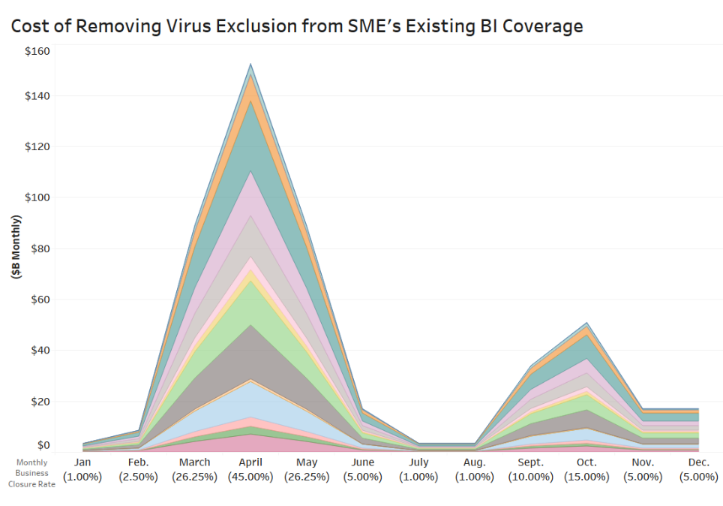
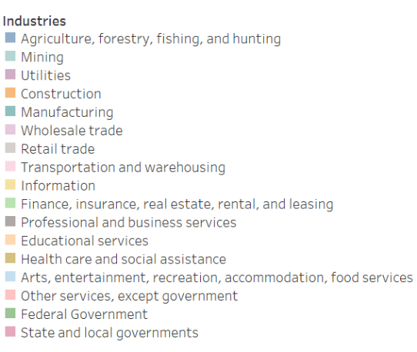
Estimated Claims in 2020 in Existing SMEs* BI Policies if the Virus/Bacteria Exclusion is Overridden
*Small- and Medium-Sized Enterprises
April Estimated to be Highest Month: $150 billion
SME Industries Hardest Hit manufacturing, wholesale & retail trade, transportation, real estate, business services, entertainment/hospitality
Cumulative 2020 cost: $485 billion
Assumes a second wave of the pandemic in the Fall. Assumes that only about 40% of SMEs have BI coverage now. Triple-I estimates that, at most, $300 billion of surplus could be available before the industry, collectively, reached the RBC Company Action Level.

Slide 15

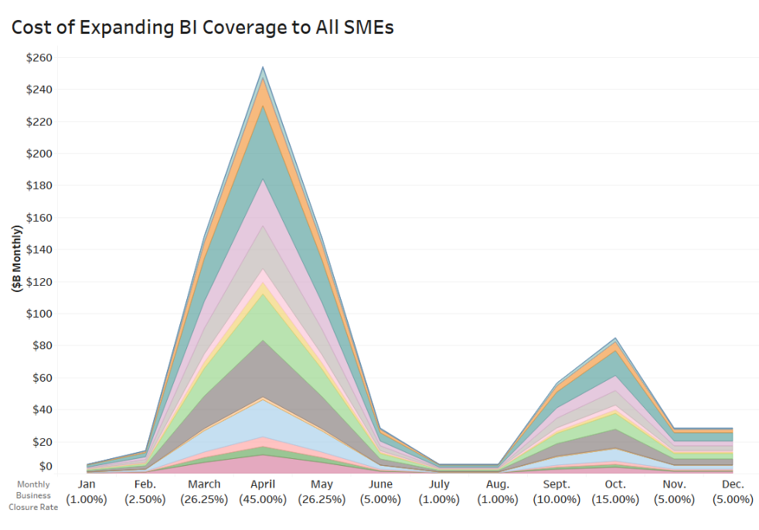
Estimated Claims in 2020 if All SMEs* Could Seek BI Recovery for Pandemic-Related Losses
*Small- and Medium-Sized Enterprises
April Estimated to be Highest Month: $350 billion
SME Industries Hardest Hit manufacturing, wholesale & retail trade, transportation, real estate, business services, entertainment/hospitality
Cumulative 2020 cost: $1.2 trillion
Assumes a second wave of the pandemic in the Fall. Assumes that 100% of SMEs get BI recoveries. Triple-I estimates that, at most, $300 billion of surplus could be available before the industry, collectively, reached the RBC Company Action Level.

