Slide 1
Insurance Trends & COVID-19
Leading Through Disruption

Slide 2
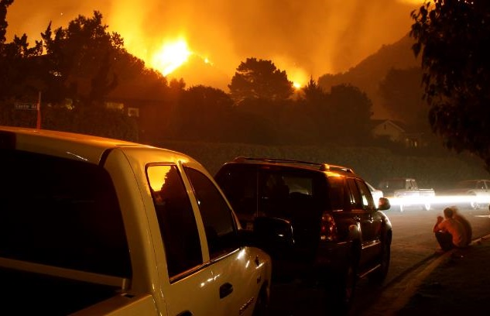

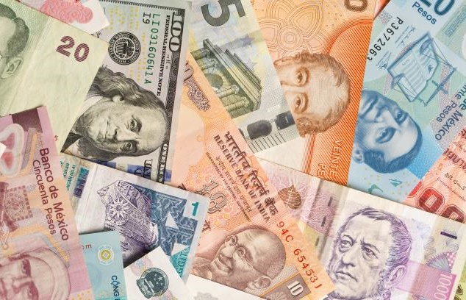



The Disruption Continuum
Catastrophes
COVID
Economics
INSURANCE
Geopolitical
Social Unrest
Technology

Slide 3
Stepping Up
America's Insurers:
for Customers, Communities, and Employees
The insurance industry is applying forward-thinking solutions to take care of
its customers, communities, and employees during the COVID-19 crisis
Customers
Community
Employees
Industry
Auto insurers have returned $14 billion so far to customers' pockets around the country through premium relief
Insurers have pledged more than an estimated $280 million (according to III/Insurance Industry Charitable Foundation) in donations to the national and local organizations fighting this pandemic on the frontlines
Employing more than 2.8 million Americans, Insurers are taking care of their employees–many pledging no layoffs during the ongoing crisis
Insurers are implementing innovative solutions to carrying out daily operations while respecting social distancing

Slide 4
Emerging News Cycles Created New Opportunities For The Triple-I To Engage Media
Media Citations By Category
Over the last six months, business interruption and civil unrest remain two key topics that Triple-I has been mentioned on, along with historically owned areas including auto, homeowners, and natural catastrophes.
Auto & Transportation
COVID-19 & Business Interruption
Homeowner/Rental
Natural Catastrophe
Civil Unrest
3
General Industry
Life Insurance
16
Dog Bites & Pets
Workers Compensation
Flooding & NFIP
Institutes Merger
0
12/19 - 5/2020
Fraud
10
6/2020-11/2020
Source: Meltwater

Slide 5
Initial News/Calls for Retro BI Contracts “Touch and Go”
Regardless of scenario, retroactive attempts to include pandemics in BI causes bankruptcy
Retroactive BI Scenarios
Higher
Median
Lower
Higher
Median
Lower
1
Virus / Bacteria Exclusion Removal
2
Expanded BI to
All SMEs
Key Assumptions
Scenario 1: 40% take-up rate
Scenario 2: 100% take-up rate
Loss basis: Compensation, profits, adjustment costs 7 days waiting period
Retained loss of 10% of total loss
Median estimates are model-driven. The higher and lower estimates assume a standard distribution for BI losses anchored in the mode-driven median loss estimates.
Source: Insurance Information Institute.

Slide 6



The FAIR Campaign Provided A Credible, Uniform Industry Voice Amid Increased Scrutiny
The "Future of American Insurance & Reinsurance (FAIR)" campaign, launched during a pivotal week of increased scrutiny for the industry, has been critical in the business interruption debate.
FAIR's platform has grown to include a collection of valuable digital assets, presenting key messaging in a digestible manner to stakeholders via various channels (i.e. website, outreach, social media, digital campaigns).

Slide 7
The FAIR Campaign Educated The Media And Created Positive Media Coverage For Insurers
Number Of Stories
BI Lawsuit Coverage Overall
BI Lawsuit Coverage Referencing
States With Favorable Rulings
7/23-7/29
7/30-8/5
8/6-8/12
8/13-8/19
8/20-8/26
8/27-9/2
9/3-9/9
9/10-9/16
9/17-9/23
9/24-9/30
10/1-10/7
10/8-10/14
10/15-10/21
10/22-10/28
10/29-11/4
11/5-11/11
11/12-11/18
11/19-11/25
11/26-12/2
12/3-12/9
12/10-12/16
Through education and outreach to reporters, FAIR has been able to better contain spikes in negative coverage on pandemic-related business interruption lawsuits.
The FAIR campaign also prompted a steady stream of content highlighting favorable court rulings for insurers and advocating for government-led solutions to pandemic insurance.
Given the decrease in coverage volume, FAIR will continue to campaign in maintenance mode, monitoring for media opportunities.
Source: Meltwater

Slide 8
Industry Economic Impact
February 2021
Notes:
Thank you, Sean. In this section, we will discuss industry results for the first three quarters of 2020; Q3 being the last quarter for which we have actual numbers.
We are focusing on 7 metrics using data from S&P
Of those, 4 are neutral, 1 is negative, and 2 as positive.
The positive are net income and policyholder surplus, speaking to continued financial strength and systemic stability

Slide 9
The Economy Drives P/C Insurance Industry Premiums:
Direct Premium Growth (All P/C Lines) vs. Nominal GDP: Quarterly Y-o-Y Pct. Change
Economic Environment: Negative
Sources: NAIC data sourced through S&P Global Intelligence; Federal Reserve Bank of St. Louis (FRED); Insurance Information Institute.
Notes:
Continued industry strength is even more significant when taking into consideration the uniquely challenging headwinds facing the industry from macroeconomic (for example GDP growth), public health (COVID-19), and civil unrest and political uncertainty.
Industry performance, including premium written and returns on investments, is largely dependent on GDP growth
As the graph indicates, GDP growth in Q3 2020 was recovering after collapsing in Q2 due to COVID-19

Slide 10
Net Written Premium Growth
2008-2019 Yearly as of Q3 (All P/C Lines)
Premium Growth: Neutral
Sources: NAIC data sourced through S&P Global Intelligence; Insurance Information Institute.
Notes:
Premium growth: Neutral
Net Premium Written and Growth: Industry performance in line with economy; near 10-year historical average
Regardless of Q2/Q3 GDP, COVID-19
We expect Q4’20 to continue improve though on a slower pace than Q3
Also want to comment here on Policyholder dividends: Neutral
Highest on record (need to factor in policy give backs)

Slide 11
Combined Ratio
2001-2020 Yearly as of Q3 (All P/C Lines)
3 Consecutive Years of U/W Profits; 1st time since 1971-73
Heavy Use of Reinsurance Lowered Net Losses.
Higher CAT Losses, Shrinking Reserve Releases, Toll of Soft Market
Hurricanes, Wildfires Drive CR Higher.
Best Combined Ratio Since 1949 (87.6)
Sandy
Combined Ratio: Neutral
Data through Q3
Sources: NAIC data sourced through S&P Global Intelligence; Insurance Information Institute.
Notes:
Combined Ratio: Neutral
Worsened Q3 20 compared to Q3 19 but is above historical average
Also want to comment here on Net Underwriting Gains (Loss): Neutral
Worsened Q3 20 compared to Q3 19 but is above historical average
Cat losses: Worth noting the absence of significantly above average losses from natural catastrophes

Slide 12
Key sources of P/C insurer profits
$ Billions
Lower investment income means UW income has to grow.
Through third quarter. Not adjusted for inflation.
Data are before taxes and exclude extraordinary items.
Source: NAIC data, sourced from S&P Global Market Intelligence.
Notes:
Gap between sum of UW and Investment gains and net income: premium balances charged off, finance charges, dividends, income taxes and a few other items.

Slide 13
Net Income After Taxes
2010-2020 Yearly as of Q3
Billions
Net Income After Tax: Positive
Sources: NAIC data sourced through S&P Global Intelligence; Insurance Information Institute.
Notes:
Net Income: Positive
Below 10-year average but, regardless of economic trends, stronger than expected

Slide 14
Policyholder Surplus
2007-2020 Quarterly
Surplus as of 9/30/20 stood at $875.6B, an all-time high
($ Billions)
Policyholder Surplus: Positive
Sources: NAIC data sourced through S&P Global Intelligence; Insurance Information Institute.
14
12/01/09 - 9pm
eSlide – P6466 – The Financial Crisis and the Future of the P/C
Notes:
14
Policyholder Surplus: Positive
Up in Q3 ‘20 from Q3 ‘19, highest in 10-year ytd, indicative of industry financial health
Conclusion
We are encouraged by the continued resilience and financial stability of the industry and its ability to pay legitimate losses on existing policies.
The first 3 quarters of 2020 were a “real-life” stress test and the industry performed as it should have.
As we do each quarter, we will be updating this analysis of actual results with Q4 numbers and providing an overview of performance for the full 2020 year when this data becomes in Q2 of this year.

Slide 15
Forecasting Trends
February 2021
Notes:
Thank you, Sean. In this section, we will discuss industry results for the first three quarters of 2020; Q3 being the last quarter for which we have actual numbers.
We are focusing on 7 metrics using data from S&P
Of those, 4 are neutral, 1 is negative, and 2 as positive.
The positive are net income and policyholder surplus, speaking to continued financial strength and systemic stability

Slide 16
Industry Outlook
Commercial Lines Rate Change
Calendar Year Written Premium and Net Combined Ratio Projections
Growth in Nominal GDP (Real GDP + Inflation)
2021 Commentary
Healthy premium growth this year thanks to recovery and hard market
Interest rates will stay low, pressuring rates and the need for underwriting profits.
Uncertainty from COVID will continue to put pressure on rates.
We assume an average year for cats.
Data sources: NAIC data sourced through S&P Global Market Intelligence, MarketScout, Blue Chip Economic Indicators, Congressional Budget Office, PCS, Aon, Munich Re, Energy Information Agency, FRED (Federal Reserve Bank of St. Louis).
Analysis: Insurance Information Institute, Milliman.

Slide 17
Homeowners
PPI for Homeowners Insurance
Calendar Year Written Premium and Net Combined Ratio Projections
Thousands of New Privately-Owned Housing Units
2020/2021 Commentary
Minimal impact from pandemic, recession
Multiple small- to medium-sized cats hurt 2020 results
    Watch for:
    An early take: La Niña portends above-average hurricane season.
Data sources: NAIC data sourced through S&P Global Market Intelligence, MarketScout, Blue Chip Economic Indicators, Congressional Budget Office, PCS, Aon, Munich Re, Energy Information Agency, FRED (Federal Reserve Bank of St. Louis).
Analysis: Insurance Information Institute, Milliman.

Slide 18
Personal Auto
YTD Vehicle Miles Traveled Through November
Calendar Year Written Premium and Net Combined Ratio Projections
Total Vehicle Sales
2020/2021 Commentary
Excellent 2020 results from changes in driving patterns.
Premium growth and underwriting results will return to normal.
    Watch for:
    Interest remains high in telematics; will post-pandemic stay-at-homes drive more near home?
Data sources: NAIC data sourced through S&P Global Market Intelligence, MarketScout, Blue Chip Economic Indicators, Congressional Budget Office, PCS, Aon, Munich Re, Energy Information Agency, FRED (Federal Reserve Bank of St. Louis).
Analysis: Insurance Information Institute, Milliman.

Slide 19
Commercial Auto
Commercial Auto Rate Changes
Calendar Year Written Premium and Net Combined Ratio Projections
4 Week Moving Average US Distillate Fuel Oil (Diesel) Supplied
2020/2021 Commentary
Q2-Q3 close in on underwriting profis!
Line was hard-hit by fall in exposures but will bounce back in 2021.
    Watch for:
    Were Q2/Q3 a fluke?
Data sources: NAIC data sourced through S&P Global Market Intelligence, MarketScout, Blue Chip Economic Indicators, Congressional Budget Office, PCS, Aon, Munich Re, Energy Information Agency, FRED (Federal Reserve Bank of St. Louis).
Analysis: Insurance Information Institute, Milliman.

Slide 20
Commercial Property
Commercial Property Rate Change
Calendar Year Written Premium and Net Combined Ratio Projections
Commercial Real Estate Prices for the US
2020/2021 Commentary
Not just hurricanes – wildfires, derechos, tornadoes made it a record for number of cat events.
Hard market brightens results – if cats stay calm.
    Watch for:
    Vacancies could slowly rise as businesses adjust their need for space in the new flexible workplace.
Data sources: NAIC data sourced through S&P Global Market Intelligence, MarketScout, Blue Chip Economic Indicators, Congressional Budget Office, PCS, Aon, Munich Re, Energy Information Agency, FRED (Federal Reserve Bank of St. Louis).
Analysis: Insurance Information Institute, Milliman.

Slide 21
General Liability
Liability Rate Changes
Calendar Year Written Premium and Net Combined Ratio Projections
Advance Retail Sales
2020/2021 Commentary
Social inflation has been expanding from commercial auto to this line, but rate increases will improve results.
Pandemic liability will affect results.
    Watch for:
    Continued rate increases, especially in lines whose rates run hot and cold, like D&O.
Data sources: NAIC data sourced through S&P Global Market Intelligence, MarketScout, Blue Chip Economic Indicators, Congressional Budget Office, PCS, Aon, Munich Re, Energy Information Agency, FRED (Federal Reserve Bank of St. Louis).
Analysis: Insurance Information Institute, Milliman.

Slide 22
Workers Compensation
Rate Changes
Calendar Year Written Premium and Net Combined Ratio Projections
Employee Compensation
2020/2021 Commentary
Through Q3, 2020 results look just like 2019.
WC exposures usually recover from recession more slowly than other lines.
Exposures further depressed by the stay-at-homes who stay at home post pandemic.
Watch for:
Expansion of presumptive claims; long-haul COVID cases. How will the variant coronavirus affect the return to work?
Data sources: NAIC data sourced through S&P Global Market Intelligence, MarketScout, Blue Chip Economic Indicators, Congressional Budget Office, PCS, Aon, Munich Re, Energy Information Agency, FRED (Federal Reserve Bank of St. Louis).
Analysis: Insurance Information Institute, Milliman.

Slide 23
Final Thoughts:
2020 Proved How Insurance Leads Through Disruption
Opportunities and Challenges Ahead in Coming Years
Continued Proactive Communications and Engagement → Success Drivers

