Slide 1
How to Live to Be 100 in the P/C Insurance Industry And What it Takes to Survive the Next 100
Insurance Information Institute
May 6, 2014
Robert P. Hartwig, Ph.D., CPCU, President & Economist
Insurance Information Institute ♦ 110 William Street ♦ New York, NY 10038
Tel: 212.346.5520 ♦ Cell: 917.453.1885 ♦ bobh@iii.org ♦ www.iii.org

Slide 2
Presentation Outline
What Does it Take to Live to 100 in the Insurance Business?
Challenges and Opportunities for the Next 100 Years
Q&A

Slide 3
Lessons from Nature: What Would Darwin Would Say?
Longevity in the Business World Has Parallels in the Natural World
3

Slide 4
On the Life Cycle of Businesses: Lessons from Nature
Most Businesses, Like Living Species, Eventually Become Extinct
99.5% of all living species to ever exist on Earth are now extinct; The proportion is higher for business and extinctions occur over a much compressed timespan.
Changes in the natural environment (not external forces like humans) were responsible for almost all extinctions
This means that despite millions of years of evolution and adaptation, virtually every species eventually confronts a change in its environment to which it cannot adapt
It is the same in business
Business Cycle Gives Rise to “Creative Destruction”
Mass extinctions in business are common
Economy is constantly reinventing itself
New industries and businesses spring from the ashes of the previous generation, fill voids and occupy niches

Slide 5
Business Bankruptcy Filings, 1980-2013
% Change Surrounding Recessions
1980-82 58.6%
1980-87 88.7%
1990-91 10.3%
2000-01 13.0%
2006-09 208.9%
2013 bankruptcies totaled 33,212, down 17.1% from 2012—the fourth consecutive year of decline. Business bankruptcies more than tripled during the financial crisis.
Significant Exposure Implications for All Commercial Lines as Business Bankruptcies Begin to Decline
Sources: American Bankruptcy Institute (1980-2012) at http://www.abiworld.org/AM/AMTemplate.cfm?Section=Home&TEMPLATE=/CM/ContentDisplay.cfm&CONTENTID=61633; 2013 data from United States Courts at http://news.uscourts.gov; Insurance Information Institute.
5
12/01/09 - 9pm
eSlide – P6466 – The Financial Crisis and the Future of the P/C
Notes:
5

Slide 6
Number of Recessions Endured by P/C Insurers, by Number of Years in Operation
Number of Recessions Since 1860
Insurers are true survivors—not just of natural catastrophes but also economic ones
Number of Years in Operation
Centenarian Insurers Have Weathered Many Economic Storms
Sources: Insurance Information Institute research from National Bureau of Economic Research data.
6
12/01/09 - 9pm
eSlide – P6466 – The Financial Crisis and the Future of the P/C
Notes:
6

Slide 7
Real GDP Growth vs. Real P/C Premium Growth: Modest Association
Inflation-adjusted premium growth was negative for 6 years in a row before and during the Great Recession
Real GDP Growth vs. Real P/C (%)
P/C Insurance Industry’s Growth is Influenced Modestly by Growth in the Overall Economy
Sources: A.M. Best, US Bureau of Economic Analysis, Blue Chip Economic Indicators, 4/14; Insurance Information Institute

Slide 8
Lessons from History: What Types of Business Live a Very Long Time (500+ Years) and Why?
Longevity in the Business World Requires Focus, Long-Term Objectives
8

Slide 9
Number of Firms More than 500 Years Old, by Industry*
The brewery industry appears to have the greatest longevity with 35 firms 500+ years old.
Total Number
BENEATH THE SURFACE Most of these companies are:
Family Owned/Mutuality
Highly focused on one specific business
Have some geographic focus (product or client)
Source: http://en.wikipedia.org/wiki/List_of_oldest_companies

Slide 10
Characteristics of Firms That Stand the Test of Time
Business Model: Highly Focused
Firms tend to remain true to core business
Avoid businesses you don’t understand
Some diversification is usually good, but leads to an exponential increase in complexity and unforeseen interactions across units
Ownership Structure: There Exists Some Concept of Mutuality
Some of the world’s oldest firms are family owned (artisans, craftsman)
Others have some form of cooperative arrangement (agricultural)
Such organizations also exhibit altruistic behavior, a proven survival trait
Communal Interest: A Concern for the Greater Common Good
Perpetual of the species (i.e., the industry) is evident in behaviors
Concept of mutuality extends beyond organization to communal interest
A strong willingness to work for the common good

Slide 11
Characteristics of Firms That Stand the Test of Time (cont’d)
Growth: Tend to Grow Slowly
As with living species, the longest lived businesses in the world tend to grow only slowly, if at all
Size: Tend to Be Small Relative to Competition
Size seems to matter when it comes to species longevity: smaller = longer
Also true among living species (e.g., bacteria, insects)
Profitability: Healthy Margins Are Important, But Not Paramount
Object of continuous profit maximization is not consistent with longevity
A “will to survive” is still necessary
Perpetuation/continuity is critical objective

Slide 12
The Centenarians: Who Lives to Be 100+ in the P/C Insurance World?
Characteristics of An Exclusive Club of Insurers
12

Slide 13
100+ Year Old Insurers as a Share of All P/C Insurers
About 12% of P/C insurance companies (fewer than 1-in-8) today (2013) are 100+ years old. This is a surprisingly high percentage.
Insurers at Least 100 Years Old, 12.3%
(287)
Insurers Less than 100 Years Old, 87.7%
(1,979)
Odds of a Human Living to 100
Born 1900: ~0.25% (1-in-400)
Born Today: ~2% (1-in-50)
Source: National Association of Insurance Commissioners (NAIC) Annual Statement Database, via Highline Data LLC; CDC

Slide 14
Decade of Formation for P/C Insurers at Least 100 Years Old in 2014
Of the Centenarian p/c insurers in existence today, 64% were formed since 1870. There was a post-Civil war spike in formations in the 1870s and another in the 1890s. Another spike occurred in the 1910s after the financial crises of the 1900-1909 era and as workers compensation systems were adopted.
77 insurers formed in the decade 1910-1919 are still in existence; 32 were formed between 1910 and 1914
As of Jan. 1, 2014 there were 296 P/C that were at least 100 years old.
Source: insurance Information Institute analysis of National Association of Insurance Commissioners (NAIC) Annual Statement Database, via Highline Data LLC.

Slide 15
100-Year-Old Insurers: Independent vs. Part of Group/Holding Company*
The number of 100-year-old insurers that are independent vs. part of a more diversified group structure is split almost evenly.
Independent, 48.8%
(140)
Part of Holding Company, 51.2%
(147)
*As of 2010.
Source: National Association of Insurance Commissioners (NAIC) Annual Statement Database, via Highline Data LLC.

Slide 16
100-year-old Insurers: Mutual vs. Stock vs. Reciprocal
The vast majority (62.4%) of 100-year-old insurers are mutual insurers, while stock insurers account for 35.9% of the total.
Reciprocal, 1.4%,
(4)
Other, 0.3%,
(1)
Mutual, 62.4%,
(179)
Stock, 35.9%,
(103)
*As of 2010.
Source: National Association of Insurance Commissioners (NAIC) Annual Statement Database, via Highline Data LLC.

Slide 17
Premium to Surplus Ratios, “Centenarians” vs. Overall P-C Industry, 1998, 2008 and 2013
NWP/Surplus
Insurers that are 100+ years old hold nearly $2 in surplus for every $1 dollar in premium they write
Premiums are a rough measure of risk accepted; surplus is funds beyond reserves to pay unexpected losses. The larger surplus is in relation to premiums—the lower the ratio of premiums to surplus—the greater the capacity to handle the risk it has accepted.
“Centenarians” are companies at least 100 years old with positive NWP in 2013.
Sources: National Association of Insurance Commissioners’ Annual Statements, via Highline; I.I.I. calculations

Slide 18
Why Do Insurers Fail?
Leading Reasons Why Most Insurers Never Make it to 100
18

Slide 19
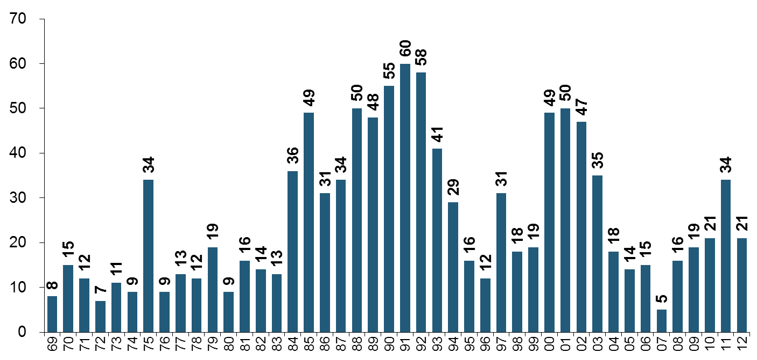
P/C Insurer Impairments, 1969–2012
Since most failures are due to inadequate pricing, underreserving and excessive growth (factors under management control), the leading cause of death in the p/c insurance industry amounts to suicide
Impairments among P/C insurers remain infrequent
The Number of Impairments Varies Significantly Over the P/C Insurance Cycle, With Peaks Occurring Well into Hard Markets
Source: A.M. Best Special Report “Pace of P/C Impairments Slowed in 2012; Auto Writers, RRGs Continued to Struggle,” June 2013; Insurance Information Institute.

Slide 20
P/C Insurer Impairment Frequency vs. Combined Ratio, 1969-2012
2012 impairment rate was 0.69%, down from 1.11% in 2011; the rate is lower than the 0.82% average since 1969
Impairment Rates Are Highly Correlated With Underwriting Performance and Reached Record Lows in 2007; Recent Increase Was Associated Primarily With Mortgage and Financial Guaranty Insurers and Not Representative of the Industry Overall
Source: A.M. Best; Insurance Information Institute

Slide 21
Five Deadliest Sins for P/C Insurance Companies
OPERATIONAL ISSUES
Underpricing/Underreserving (~43% of failures)
Leading cause of p/c insurer death according to A.M. Best
Excessive Growth (~13%)
Too much growth too fast (organically or via M&A) can be fatal
Excessive Catastrophe Exposure (~7%)
Too much underpriced exposure, too little reinsurance, insufficient diversification
Investment Problems (~7%)
Investments are too risky, too illiquid or insufficiently understood
Affiliate Problems (~8%)
Non-core operations can cause problems for parent (e.g., AIG)
Source: I.I.I. research.

Slide 22
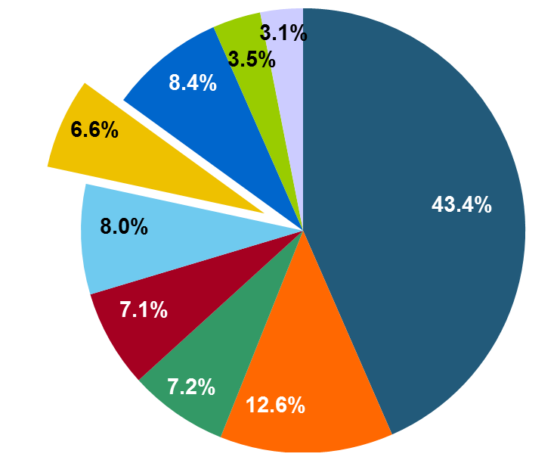
Reasons for US P/C Insurer Impairments, 1969–2012
Historically, Deficient Loss Reserves and Inadequate Pricing Are By Far the Leading Cause of P-C Insurer Impairments. Investment and Catastrophe Losses Play a Much Smaller Role
Reinsurance Failure
Sig. Change in Business
Misc.
Investment Problems (Overstatement of Assets)
Deficient Loss Reserves/ Inadequate Pricing
Affiliate Impairment
Catastrophe Losses
Alleged Fraud
Rapid Growth
Source: A.M. Best Special Report “Pace of P/C Impairments Slowed in 2012; Auto Writers, RRGs Continued to Struggle,” June 2013; Insurance Information Institute.

Slide 23
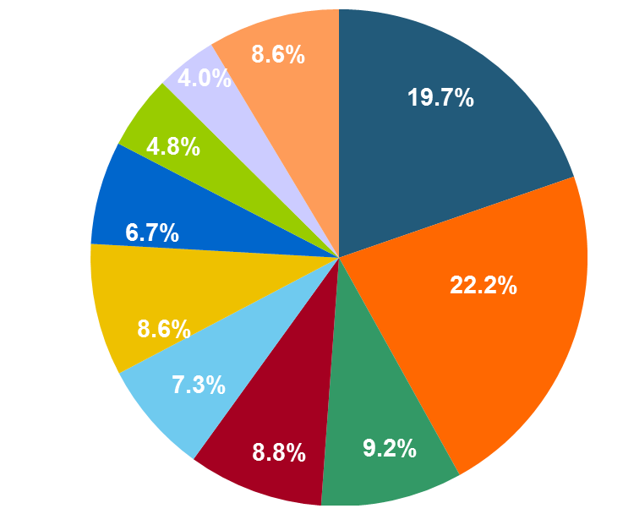
Top 10 Lines of Business for US P/C Impaired Insurers, 2000–2012
Workers Comp and Pvt. Passenger Auto Account for More Than 40 Percent of the Impaired Insurers Since 2000
Other
Title
Surety
Workers Comp
Med Mal
Other Liability
Pvt. Passenger Auto
Commercial Auto Liability
Commercial Multiperil
Homeowners
Source: A.M. Best Special Report “Pace of P/C Impairments Slowed in 2012; Auto Writers, RRGs Continued to Struggle,” June 2013; Insurance Information Institute.
.

Slide 24
Mergers & Acquisitions
Waves of Consolidation Periodically Reduce the Number of Insurers
24

Slide 25
U.S. INSURANCE MERGERS AND ACQUISITIONS, All Sectors, 1989-2013 (1)
M&A activity recovered to pre-crisis levels but deal values dropped sharply in 2013
($ Billions)
$165.4
(1) Includes transactions where a U.S. company was the acquirer and/or the target.
Source: Conning proprietary database.

Slide 26
U.S. INSURANCE MERGERS AND ACQUISITIONS, P/C SECTOR, 2002-2013 (1)
M&A activity in the P/C sector remains below pre-crisis levels.
($ Millions)
(1) Includes transactions where a U.S. company was the acquirer and/or the target.
Source: Conning proprietary database.

Slide 27
U.S. INSURANCE MERGERS AND ACQUISITIONS, LIFE/ANNUITY SECTOR, 2002-2013 (1)
Life/Annuity sector M&A activity is highly volatile
($ Millions)
(1) Includes transactions where a U.S. company was the acquirer and/or the target.
Source: Conning proprietary database.

Slide 28
Leadership Attributes Found in Insurers that Reach 100+ Years
Secrets of the Ancients
28

Slide 29
Leadership Attributes Inherent in Long-Lived Insurance Companies
Management Acts as a Steward of the Enterprise
Objective is to pass a healthy firm safely and securely to the next generation of management and policyholders
Management Financial Incentives
In line with the goal of providing the protection purchased
There is typically no 3rd party (shareholders) to compensate
Objective if public company is to maximize profits
CEO (total) comp is a smaller multiple relative to average employee
Nimble: Environment for Small Insurers Can & Does Change
Not likely first to change, but adaptation occurs within reasonable timeframe
Customer Focus & Relationship Driven
Customer is the #1 priority
Committed to agency form of distribution, with 21st century enhancements
Regulation
In favor of comprehensive but local regulation (contrast with banks)

Slide 30
What Do I Admire in an Insurer and Its Management?
A Firm Whose Management’s Incentives are Strictly Aligned With the Insurer’s Principal Stakeholders
Customers, agents, employees, community
These include financial and operational objectives
Management Is Knowledgeable
Management of small, long-lived insurer is no less knowledgeable about industry trends, opportunities and threats than larger competitors
Intuitive and Comprehensive Understanding of Enterprise Risk Management
Much is made of ERM today, but long-lived insurers practiced it well before it had a name

Slide 31
What Do I Admire in an Insurer and Its Management?
CEO is Willing to Seek Advice and Counsel
No imperial CEOs; Self-aggrandizement is rare
CEO is a listener and consensus builder
Commitment to Core Constituencies
Customer is the #1 priority
Committed to agency form of distribution, with 21st century enhancements
Lack of a “Wandering Eye”
Disciplined enough to stick with the business you know, but also adapting to changing business conditions and seizing opportunities as necessary

Slide 32
Challenges for the Next 100 Years
Staying Alive: The Decades Ahead
32

Slide 33
P/C (Re)Insurance Industry Financial Overview
2013: Best Year in the Post-Crisis Era
Performance Improved with Lower CATs, Strong Markets
33

Slide 34
P/C Net Income After Taxes 1991–2013 ($ Millions)
2005 ROE*= 9.6%
2006 ROE = 12.7%
2007 ROE = 10.9%
2008 ROE = 0.1%
2009 ROE = 5.0%
2010 ROE = 6.6%
2011 ROAS¹ = 3.5%
2012 ROAS¹ = 6.1%
2013 ROAS¹ = 10.3%
Net income in 2013 was up substantially (+81.9%) from 2012
2013 ROAS was 10.3%
ROE figures are GAAP; ¹Return on avg. surplus. Excluding Mortgage & Financial Guaranty insurers yields a 9.8% ROAS in 2013, 6.3% ROAS in 2012, 4.7% ROAS for 2011, 7.6% for 2010 and 7.4% for 2009.
Sources: A.M. Best, ISO, Insurance Information Institute

Slide 35
Profitability Peaks & Troughs in the P/C Insurance Industry, 1975 – 2013*
ROE
History suggests next ROE peak will be in 2016-2017
1977:19.0%
1987:17.3%
10 Years
2006:12.7%
1997:11.6%
2013: 9.8 %
10 Years
9 Years
2011: 4.7%
1975: 2.4%
1984: 1.8%
1992: 4.5%
2001: -1.2%
*Profitability = P/C insurer ROEs. 2011-13 figures are estimates based on ROAS data. Note: Data for 2008-2013 exclude mortgage and financial guaranty insurers.
Source: Insurance Information Institute; NAIC, ISO, A.M. Best.

Slide 36
ROE: Property/Casualty Insurance vs. Fortune 500, 1987–2013E*
(Percent)
P/C Profitability Is Both by Cyclicality and Ordinary Volatility
Katrina, Rita, Wilma
Low CATs
Sept. 11
Hugo
Lowest CAT Losses in 15 Years
4 Hurricanes
Sandy
Andrew
Record Tornado Losses
Northridge
Financial Crisis*
* Excludes Mortgage & Financial Guarantee in 2008 – 2013. 2013 Fortune 500 figure is I.I.I. estimate.
Sources: ISO, Fortune; Insurance Information Institute.

Slide 37
A 100 Combined Ratio Isn’t What It Once Was: Investment Impact on ROEs
A combined ratio of about 100 generates an ROE of ~7.0% in 2012, ~7.5% ROE in 2009/10, 10% in 2005 and 16% in 1979
Combined Ratio / ROE
Lower CATs helped ROEs in 2013
Combined Ratios Must Be Lower in Today’s Depressed Investment Environment to Generate Risk Appropriate ROEs
* 2008 -2013 figures are return on average surplus and exclude mortgage and financial guaranty insurers. 2013 combined ratio including M&FG insurers is 96.1; 2012 =103.2, 2011 = 108.1, ROAS = 3.5%.
Source: Insurance Information Institute from A.M. Best and ISO Verisk Analytics data.

Slide 38
RNW for Major P/C Lines, 2003-2012 Average
10-year returns for some lines are excellent, though homeowners is a major laggard, largely due to major catastrophes. WC returns slipped.
Source: NAIC; Insurance Information Institute

Slide 39
RNW All Lines by State, 2003-2012 Average: Highest 25 States
The most profitable states over the past decade are widely distributed geographically, though none are in the Gulf region
Source: NAIC.

Slide 40
RNW All Lines by State, 2003-2012 Average:
Lowest 25 States
Some of the least profitable states over the past decade were hit hard by catastrophes
Source: NAIC.

Slide 41
P/C UNDERWRITING
Underwriting Losses in 2013 Much Improved After High Catastrophe Losses in 2011/12
41

Slide 42
P/C Insurance Industry Combined Ratio, 2001–2013*
Relatively Low CAT Losses, Reserve Releases
Higher CAT Losses, Shrinking Reserve Releases, Toll of Soft Market
As Recently as 2001, Insurers Paid Out Nearly $1.16 for Every $1 in Earned Premiums
Heavy Use of Reinsurance Lowered Net Losses
Relatively Low CAT Losses, Reserve Releases
Avg. CAT Losses, More Reserve Releases
Best Combined Ratio Since 1949 (87.6)
Sandy Impacts
Cyclical Deterioration
Lower CAT Losses
* Excludes Mortgage & Financial Guaranty insurers 2008--2012. Including M&FG, 2008=105.1, 2009=100.7, 2010=102.4, 2011=108.1; 2012:=103.2; 2013: = 96.1.
Sources: A.M. Best, ISO.

Slide 43
Number of Years with Underwriting Profits by Decade, 1920s–2010s
Number of Years with Underwriting Profits
Underwriting Profits Were Common Before the 1980s (40 of the 60 Years Before 1980 Had Combined Ratios Below 100) – But Then They Vanished. Not a Single Underwriting Profit Was Recorded in the 25 Years from 1979 Through 2003
* 2009 combined ratio excl. mort. and finl. guaranty insurers was 99.3, which would bring the 2000s total to 4 years with an u/w profit.
**Data for the 2010s is for the period 2010 through 2013.
Note: Data for 1920–1934 based on stock companies only.
Sources: Insurance Information Institute research from A.M. Best Data.
43
12/01/09 - 9pm
eSlide – P6466 – The Financial Crisis and the Future of the P/C
Notes:
43

Slide 44
Underwriting Gain (Loss) 1975–2013*
Underwriting profit in 2013 totaled $15.5B
($ Billions)
Cumulative underwriting deficit from 1975 through 2012 is $510B
High cat losses in 2011 led to the highest underwriting loss since 2002
Large Underwriting Losses Are NOT Sustainable in Current Investment Environment
* Includes mortgage and financial guaranty insurers in all years.
Sources: A.M. Best, ISO; Insurance Information Institute.

Slide 45
Combined Ratios by Predominant Business Segment, 2013 vs. 2012*
The combined ratios for both personal and commercial lines improved substantially in 2013
(Percent)
*Excludes mortgage and financial guaranty insurers.
Source: ISO/PCI; Insurance Information Institute

Slide 46
P/C Reserve Development, 1992–2015E
Note: 2005 reserve development excludes a $6 billion loss portfolio transfer between American Re and Munich Re. Including this transaction, total prior year adverse development in 2005 was $7 billion. The data from 2000 and subsequent years excludes development from financial guaranty and mortgage insurance.
Sources: A.M. Best, ISO, Barclays Research (estimates for 2013-2015).

Slide 47
PRICING, PREMIUM GROWTH & CYCLES
Surviving the to the Century Mark Means Surviving the Underwriting Cycle
47

Slide 48
Net Premium Growth: Annual Change, 1971—2014F
(Percent)
1975-78
1984-87
2000-03
Net Written Premiums Fell 0.7% in 2007 (First Decline Since 1943) by 2.0% in 2008, and 4.2% in 2009, the First 3-Year Decline Since 1930-33.
2014F: 4.0%
2013: 4.6%
2012: +4.3%
Shaded areas denote “hard market” periods
Sources: A.M. Best (historical and forecast), ISO, Insurance Information Institute.

Slide 49
Average Commercial Rate Change, All Lines, (1Q:2004–4Q:2013)
Pricing as of Q4:2013 was positive for the 10th consecutive quarter. Gains are likely to continue into 2014.
(Percent)
Q2 2011 marked the last of 30th consecutive quarter of price declines
KRW Effect
Note: CIAB data cited here are based on a survey. Rate changes earned by individual insurers can and do vary, potentially substantially.
Source: Council of Insurance Agents & Brokers; Insurance Information Institute

Slide 50
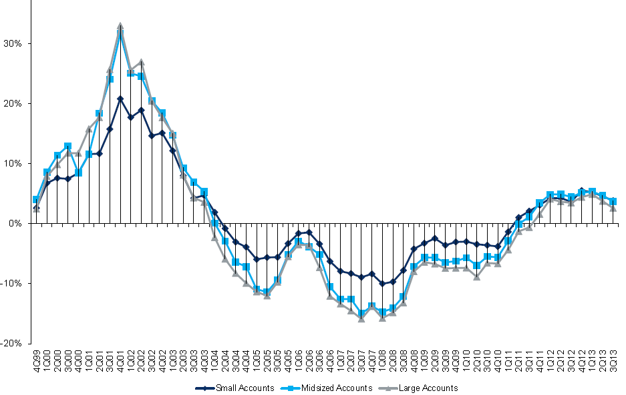
Change in Commercial Rate Renewals, by Account Size: 1999:Q4 to 2013:Q3
Percentage Change (%)
Peak = 2001:Q4 +28.5%
Pricing turned positive in Q3:2011, the first increase in nearly 8 years; Q3:2013 renewals were up 3.4%. Some insurers posted stronger numbers.
Pricing Turned Negative in Early 2004 and Remained that way for 7 ½ years
KRW : No Lasting Impact
Trough = 2007:Q3 -13.6%
Source: Council of Insurance Agents and Brokers; Barclay’s Capital; Insurance Information Institute.
Note: CIAB data cited here are based on a survey. Rate changes earned by individual insurers can and do vary, potentially substantially.

Slide 51
Growth in Direct Written Premium by Line, 2013-2015F*
(Percent)
P/C growth is expected to remain fairly stable through 2015
Source: Conning.

Slide 52
Monthly Change* in Auto Insurance Prices, 1991–2014*
Cyclical peaks in PP Auto tend to occur roughly every 10 years (early 1990s, early 2000s and likely the early 2010s)
Pricing peak occurred in late 2010 at 5.3%, falling to 2.8% by Mar. 2012
“Hard” markets tend to occur during recessionary periods
The Mar. 2014 reading of 3.6% is down from 4.8% a year earlier
*Percentage change from same month in prior year; through March 2014; seasonally adjusted
Note: Recessions indicated by gray shaded columns.
Sources: US Bureau of Labor Statistics; National Bureau of Economic Research (recession dates); Insurance Information Institutes.
52
12/01/09 - 9pm
eSlide – P6466 – The Financial Crisis and the Future of the P/C
Notes:
52

Slide 53
Homeowners Insurance Net Written Premium, 2000–2015F
$ Billions
Homeowners insurance NWP continues to rise (up 128% 2000-2013) despite very little unit growth during the real estate crash. Reasons include rate increases, especially in coastal zones, ITV endorsements (e.g., “inflation guards”), and inelastic demand
Sources: A.M. Best; Insurance Information Institute.

Slide 54
INVESTMENTS: THE NEW REALITY
Investment Performance is a Key Driver of Profitability
A Century of Survival: Investment Environment Varies Wildly Over the Span of 100 Years
54

Slide 55
Property/Casualty Insurance Industry Investment Income: 2000–2013¹
($ Billions)
Investment earnings are running below their 2007 pre-crisis peak
Investment Income Fell in 2012 and 2013 Due to Persistently Low Interest Rates, Putting Additional Pressure on (Re) Insurance Pricing
¹ Investment gains consist primarily of interest and stock dividends...
Sources: ISO; Insurance Information Institute.

Slide 56
P/C Insurer Net Realized Capital Gains/Losses, 1990-2013
Realized capital gains were up sharply as equity markets rallied
($ Billions)
Insurers Posted Net Realized Capital Gains in 2010 - 2013 Following Two Years of Realized Losses During the Financial Crisis. Realized Capital Losses Were the Primary Cause of 2008/2009’s Large Drop in Profits and ROE
Sources: A.M. Best, ISO, Insurance Information Institute.
56
12/01/09 - 9pm
eSlide – P6466 – The Financial Crisis and the Future of the P/C
Notes:
56

Slide 57
Property/Casualty Insurance Industry Investment Gain: 1994–2013¹
($ Billions)
Investment gains in 2013 were their highest in the post-crisis era
Investment Income Continued to Fall in 2013 Due to Low Interest Rates but Realized Investment Gains Were Up Sharply; The Financial Crisis Caused Investment Gains to Fall by 50% in 2008
¹ Investment gains consist primarily of interest, stock dividends and realized capital gains and losses.
* 2005 figure includes special one-time dividend of $3.2B;
Sources: ISO; Insurance Information Institute.

Slide 58
Reduction in Combined Ratio Necessary to Offset 1% Decline in Investment Yield to Maintain Constant ROE, by Line*
Lower Investment Earnings Place a Greater Burden on Underwriting and Pricing Discipline
*Based on 2008 Invested Assets and Earned Premiums
**US domestic reinsurance only
Source: A.M. Best; Insurance Information Institute.
58
12/01/09 - 9pm
eSlide – P6466 – The Financial Crisis and the Future of the P/C
Notes:
58
This shows the drop in Combined Ratio for each line of business that would be needed to maintain a constant ROE, given a 1-percentage-point drop in investment yield

Slide 59
U.S. Treasury Security Yields: A Long Downward Trend, 1990–2014*
Yields on 10-Year U.S. Treasury Notes have been essentially below 5% for a full decade.
U.S. Treasury yields plunged to historic lows in 2013. Only longer-term yields have rebounded.
Since roughly 80% of P/C bond/cash investments are in 10-year or shorter durations, most P/C insurer portfolios will have low-yielding bonds for years to come.
*Monthly, constant maturity, nominal rates, through March 2014.
Sources: Federal Reserve Bank at http://www.federalreserve.gov/releases/h15/data.htm. National Bureau of Economic Research (recession dates); Insurance Information Institute.
59
12/01/09 - 9pm
eSlide – P6466 – The Financial Crisis and the Future of the P/C
Notes:
59

Slide 60
Treasury Yield Curves: Pre-Crisis (July 2007) vs. March 2014
Treasury yield curve remains near its most depressed level in at least 45 years. Investment income is falling as a result. Even as the Fed “tapers” rates are unlikely to return to pre-crisis levels anytime soon
The Fed Is Actively Signaling that it Is Determined to Keep Rates Low Until Unemployment Drops Below 6.5% or Until Inflation Expectations Exceed 2.5%; Low Rates Add to Pricing Pressure for Insurers.
Source: Federal Reserve Board of Governors; Insurance Information Institute.

Slide 61
SURPLUS/CAPITAL/CAPACITY
2013 Recorded Yet Another Record High in the Primary and Reinsurance Sectors
61

Slide 62
Policyholder Surplus, 2006:Q4–2013:Q4
Drop due to near-record 2011 CAT losses
($ Billions)
2007:Q3 Pre-Crisis Peak
Surplus as of 12/31/13 stood at a record high $653.3B
The industry now has $1 of surplus for every $0.73 of NPW, close to the strongest claims-paying status in its history.
2010:Q1 data includes $22.5B of paid-in capital from a holding company parent for one insurer’s investment in a non-insurance business .
The P/C insurance industry entered 2014 in very strong financial condition.
Sources: ISO, A.M .Best.
62
12/01/09 - 9pm
eSlide – P6466 – The Financial Crisis and the Future of the P/C
Notes:
62

Slide 63
US Policyholder Surplus: 1975–2013*
($ Billions)
Surplus as of 9/30/13 was a record $624.4, up 6.4% from $586.9 of 12/31/12, and up 42.9% ($187.3B) from the crisis trough of $437.1B at 3/31/09. Pre-crisis peak was $521.8 as of 9/30/07. Surplus as of 9/30/13 was 19.7% above 2007 peak.
“Surplus” is a measure of underwriting capacity. It is analogous to “Owners Equity” or “Net Worth” in non-insurance organizations
The Premium-to-Surplus Ratio Stood at $0.78:$1 as of 9/30/13, a Near Record Low (at Least in Recent History)*
* As of 9/30/13.
Source: A.M. Best, ISO, Insurance Information Institute.

Slide 64
Global Reinsurance Capital (Traditional and Alternative), 2007 - 2013
Total reinsurance capital reached a record $540B in 2013, up 58.8% from 2008. Of that, $50B (9.3%) is alternative capacity, up 163% from $19B since 2008
Source: Aon Benfield Reinsurance Market Outlook, April 1, 2014; Insurance Information Institute.

Slide 65
Catastrophe Bonds: Issuance and Outstanding, 1997- 2014:Q1*
Risk Capital Amount ($ Millions)
Risk capital outstanding reached a record high in 2013
Financial crisis depressed issuance
CAT bond issuance reached a record high in 2013
Catastrophe Bond Issuance Is Approaching Pre-Crisis Levels While Risk Capital Outstanding Stands at an All-Time Record
*Through Jan. 31, 2014.
Source: Guy Carpenter; Insurance Information Institute.

Slide 66
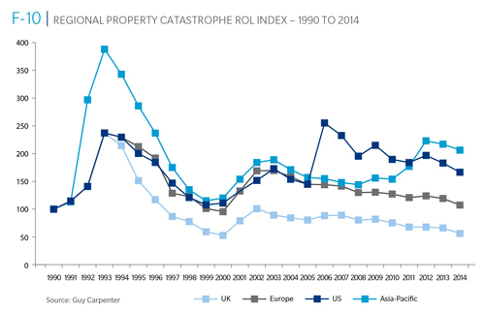
Reinsurance Pricing: Rate-on-Line Index by Region, 1990 – 2014*
Lower CATs and a flood of new capital has pushed reinsurance pricing down in most regions, including the US
*As of Jan. 1.
Source: Guy Carpenter

Slide 67
Shifting Legal Liability & Tort Environment
Could the Tort Pendulum Once Again Swing Against Insurers?
67

Slide 68
Over the Last Three Decades, Total Tort Costs as a % of GDP Appear Somewhat Cyclical, 1980-2013E
($ Billions)
2.21% of GDP in 2003 = pre-tort reform peak
Deepwater Horizon Spike in 2010
Tort costs in dollar terms have remained high but relatively stable since the mid-2000s., but are down substantially as a share of GDP
1.68% of GDP in 2013
Sources: Towers Watson, 2011 Update on US Tort Cost Trends, Appendix 1A

Slide 69
Business Leaders Ranking of Liability Systems in 2012
Best States
Delaware
Nebraska
Wyoming
Minnesota
Kansas
Idaho
Virginia
North Dakota
Utah
Iowa
Worst States
Florida
Oklahoma
Alabama
New Mexico
Montana
Illinois
California
Mississippi
Louisiana
West Virginia
New in 2012
Wyoming
Minnesota
Kansas
Idaho
Newly Notorious
Oklahoma
Drop-offs
Rising Above
Indiana
Colorado
Massachusetts
South Dakota
Arkansas
Source: US Chamber of Commerce 2012 State Liability Systems Ranking Study; Insurance Info. Institute.

Slide 70
The Nation’s Judicial Hellholes: 2012/2013
Watch List
Illinois
Madison County
West Virginia
Maryland
Baltimore
Philadelphia, Pennsylvania
South Florida
Cook County, Illinois
New Jersey
Nevada
Louisiana
California
Dishonorable Mention
New York
Albany and NYC
MO Supreme Court
WA Supreme Court
Source: American Tort Reform Association; Insurance Information Institute

Slide 71
U.S. Insured Catastrophe Loss Update
2013 Was a Welcome Respite from the High Catastrophe Losses in Recent Years
2014 Winter Storm Losses Manageable
71

Slide 72
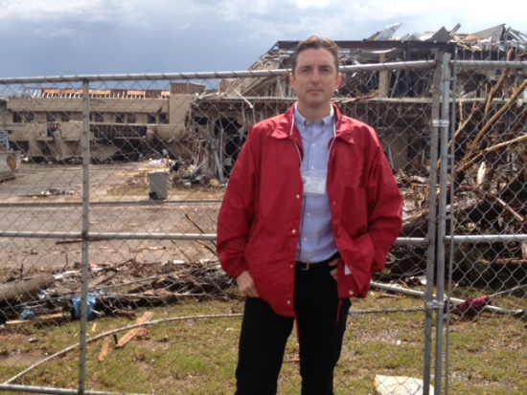
U.S. Insured Catastrophe Losses
($ Billions, $ 2012)
2012 was the third most expensive year ever for insured CAT losses
2012 Was the 3rd Highest Year on Record for Insured Losses in U.S. History on an Inflation-Adj. Basis. 2011 Losses Were the 6th Highest. YTD 2013 Running Well Below 2011 and 2012 YTD Totals.
Record tornado losses caused 2011 CAT losses to surge
*Through 12/31/13.
Note: 2001 figure includes $20.3B for 9/11 losses reported through 12/31/01 ($25.9B 2011 dollars). Includes only business and personal property claims, business interruption and auto claims. Non-prop/BI losses = $12.2B ($15.6B in 2011 dollars.)
Sources: Property Claims Service/ISO; Insurance Information Institute.
72
12/01/09 - 9pm
eSlide – P6466 – The Financial Crisis and the Future of the P/C
Notes:
72

Slide 73
Combined Ratio Points Associated with Catastrophe Losses: 1960 – 2013*
Avg. CAT Loss Component of the Combined Ratio by Decade
1960s: 1.04 1970s: 0.85 1980s: 1.31 1990s: 3.39 2000s: 3.52 2010s: 6.1E*
Catastrophe losses as a share of all losses reached a record high in 2012
Combined Ratio Points
The Catastrophe Loss Component of Private Insurer Losses Has Increased Sharply in Recent Decades
*2010s represent 2010-2013.
Notes: Private carrier losses only. Excludes loss adjustment expenses and reinsurance reinstatement premiums. Figures are adjusted for losses ultimately paid by foreign insurers and reinsurers.
Source: ISO (1960-2011); A.M. Best (2012E) Insurance Information Institute.

Slide 74
Homeowners Insurance Combined Ratio: 1990–2015F
Hurricane Andrew
Record tornado activity
Hurricane Sandy
Hurricane Ike
Homeowners Performance in 2011/12 Impacted by Large Cat Losses. Extreme Regional Variation Can Be Expected Due to Local Catastrophe Loss Activity
Sources: A.M. Best (1990-2011);Conning (2012E-2015F); Insurance Information Institute.

Slide 75
Top 10 States for Insured Catastrophe Losses, 2013
$ Millions
Oklahoma let the country in insured CAT losses in 2013
Source: The Property Claim Services (PCS) unit of ISO, a Verisk Analytics company.

Slide 76
Top 5 States by Insured Catastrophe Losses in 2012*
(2012, $ Billions)
NY and NJ let the US in CAT losses in 2012 due Sandy
*Includes catastrophe losses of at least $25 million.
Sources: PCS unit of ISO; Insurance Information Institute.

Slide 77
Hurricane Sandy: Average Claim Payment by Type of Claim
Commercial (i.e., business claims) are more expensive because the value of property is often higher as well as the impact of insured business interruption losses
The average insured flood loss was nearly 9 times larger than the average non-flood insured loss (mostly wind)
Post-Sandy, the I.I.I. worked very hard to make help media, consumers and regulators understand the distinction between a flood claim and a standard homeowners claim. NFIP is $24B in debt.
*Includes rental and condo policies (excludes NFIP flood). **As of Oct. 31, 2013.
Sources: Catastrophe loss data is for Catastrophe Serial No. 90 (Oct. 28 – 31, 2012) from PCS as of March 2013; Insurance Information Institute.

Slide 78
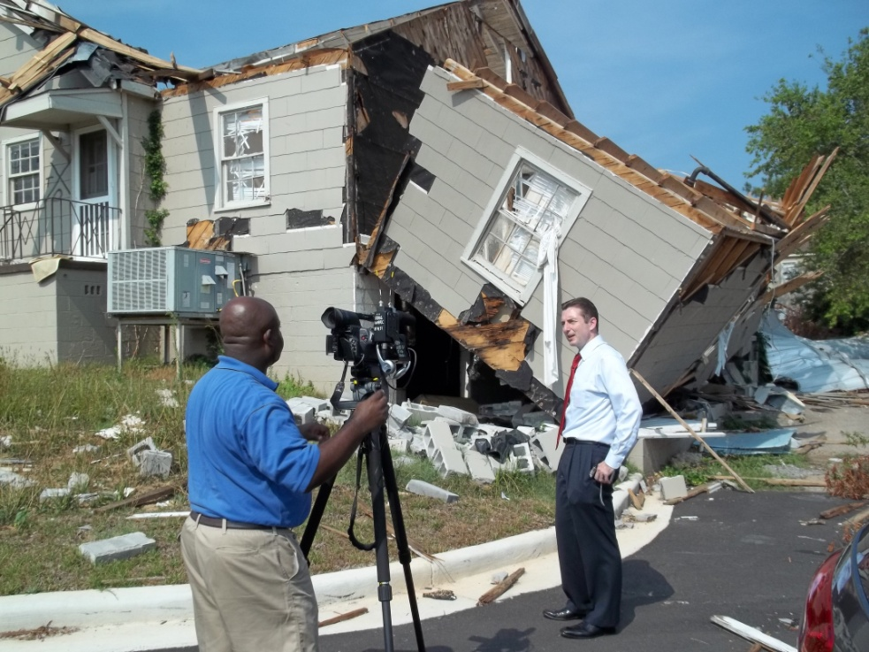
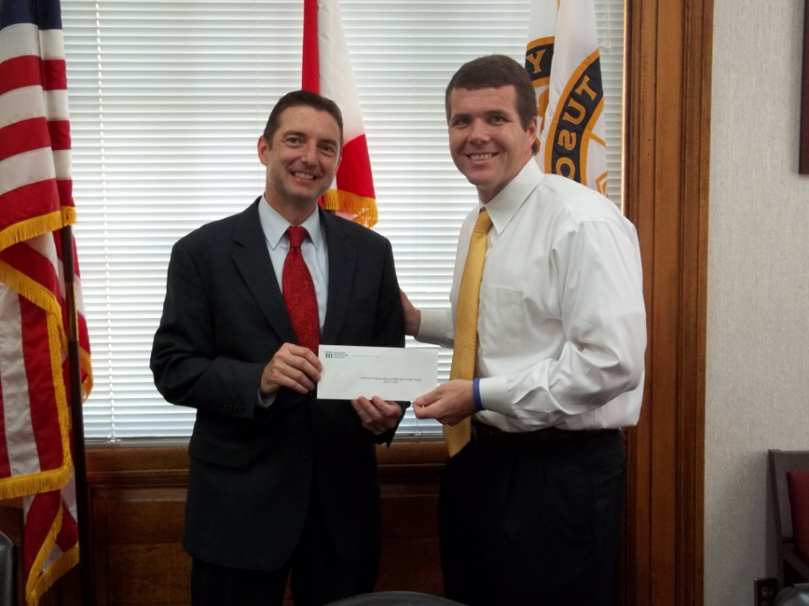

Insurers Making a Difference in Impacted Communities
Destroyed home in Tuscaloosa. Insurers will pay some 165,000 claims totaling $2 billion in the Tuscaloosa/ Birmingham areas alone.
Presentation of a check to Moore, OK, Public School Relief Fund
Presentation of a check to Tuscaloosa Mayor Walt Maddox to the Tuscaloosa Storm Recovery Fund
Source: Insurance Information Institute
78

Slide 79
Top States by Inflation-Adjusted Insured Catastrophe Losses, 1983–2012
Over the Past 30 Years Florida Has Accounted for the Largest Share of Catastrophe Losses in the U.S., Followed by Texas and Louisiana
FL is the most costly state for CATs, with nearly $67B in insured losses over the past 30 years
Louisiana
$42.0B
Texas
$48.8B
Rest of the U.S.
$309.9B
Florida
$66.7B
Total: $467.5 Billion, an average of $16.6B per year or $1.3B per month
Source: PCS unit of ISO, Verisk Company.; Insurance Information Institute.

Slide 80
Inflation Adjusted U.S. Catastrophe Losses by Cause of Loss, 1993–2012¹
Wind/Hail/Flood (3), $14.9
Fires (4), $6.5
Other (5), $0.2
Insured cat losses from 1993-2012 totaled $391.7B, an average of $19.6B per year or $1.6B per month
Geological Events, $18.4
Terrorism, $24.8
Winter Storms, $27.8
Hurricanes & Tropical Storms, $158.2
Tornado share of CAT losses is rising
Wind losses are by far cause the most catastrophe losses, even if hurricanes/TS are excluded.
Tornadoes (2), $140.9
Catastrophes are defined as events causing direct insured losses to property of $25 million or more in 2012 dollars.
Excludes snow.
Does not include NFIP flood losses
Includes wildland fires
Includes civil disorders, water damage, utility disruptions and non-property losses such as those covered by workers compensation.
Source: ISO’s Property Claim Services Unit.

Slide 81
Top 16 Most Costly Disasters in U.S. History
(Insured Losses, 2012 Dollars, $ Billions)
Hurricane Sandy became the 5th costliest event in US insurance history
Includes Tuscaloosa, AL, tornado
Includes Joplin, MO, tornado
Hurricane Irene became the 12th most expense hurricane in US history in 2011
12 of the 16 Most Expensive Events in US History Have Occurred Over the Past Decade
*PCS estimate as of 4/12/13.
Sources: PCS; Insurance Information Institute inflation adjustments to 2012 dollars using the CPI.

Slide 82
Total Value of Insured Coastal Exposure in 2012
(2012, $ Billions)
NY and FL lead the US in the value of insured coastal exposure at $2.9 Trillion
In 2012, New York Ranked as the #1 Most Exposed State to Hurricane Loss, Overtaking Florida with $2.862 Trillion. Texas is very exposed too, and ranked #3 with $1.175 Trillion in insured coastal exposure
The Insured Value of All Coastal Property Was $10.6 Trillion in 2012 , Up 20% from $8.9 Trillion in 2007 and Up 48% from $7.2 Trillion in 2004
Source: AIR Worldwide

Slide 83
Winter Storm and Winter Damage Events in the US and Canada, 1980-2013 (2013 US$)
Three of the four most costly years ever for insured losses from winter storms and damage occurred in the 1990s, led by the “Storm of the Century” in 1993.
Insured Losses (Millions, $ 2013)
5-year running average
Insured losses from severe winter events totaled $2 billion in 2013.
Insured winter storm and damage losses in Jan. 2014 already totaled $1.5 billion. Continued severe weather since then makes it likely that 2014 will become one of the top 5 costliest winters since 1980.
Sources: Munich Re NatCatSERVICE; Insurance Information Institute.
83

Slide 84
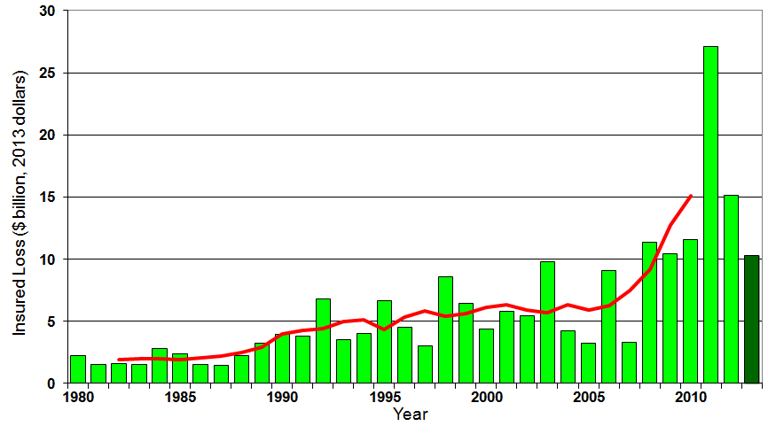
U.S. Thunderstorm Insured Loss Trends, 1980 – 2013
Hurricanes get all the headlines, but thunderstorms are consistent producers of large scale loss. 2008-2013 are the most expensive years on record.
Average thunderstorm losses are up 7 fold since the early 1980s. The 5-year running average loss is up sharply
Thunderstorm losses in 2013 totaled $10.3 billion, the 6th highest on record
Source: Property Claims Service, and MR NatCatSERVICE
84

Slide 85
Terrorism Update
A Challenge Through Which the Industry Has Persevered
Download III’s Terrorism Insurance Report at: http://www.iii.org/white_papers/terrorism-risk-a-constant-threat-2014.html
85
Notes:
85

Slide 86
Loss Distribution by Type of Insurance from Sept. 11 Terrorist Attack ($ 2013)
($ Billions)
Total Insured Losses Estimate: $42.9B**
*Loss total does not include March 2010 New York City settlement of up to $657.5 million to compensate approximately 10,000 Ground Zero workers or any subsequent settlements.
**$32.5 billion in 2001 dollars.
Source: Insurance Information Institute.

Slide 87
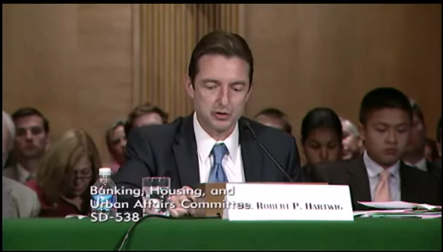
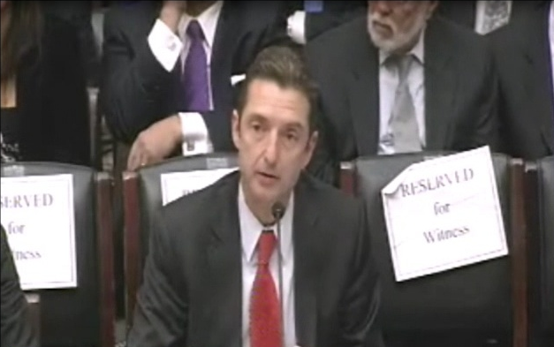
Terrorism Risk Insurance Program
Testified before House Financial Services Nov. 2013
Testified before Senate Banking Cmte. in Sept. 2013
Provided testimony at NYC hearing in June 2013
Provided Capitol Hill Joint House/Senate Staff Briefing in April 2014
I.I.I. Published Several Updates to its Study on Terrorism Risk and Insurance
Working with Trades, Congressional Staff, GAO & Others
House Financial Services Subcommittee, 11/13/13
Senate Banking Committee, 9/25/13
87
12/01/09 - 9pm
eSlide – P6466 – The Financial Crisis and the Future of the P/C
Notes:
87

Slide 88
Terrorism Insurance Take-up Rates, By Year, 2003-2013
TRIA’s high take-up rates, availability and affordability have benefitted businesses, workers and the entire US economy since the program’s enactment
In 2003, the first year TRIA was in effect, the terrorism take-up rate was 27 percent. Since then, it has increased steadily, remaining in the low 60 percent range since 2009.
Source: Marsh Global Analytics, 2014 Terrorism Risk Insurance Report, April 2014 and earlier editions.
88
Notes:
88

Slide 89
I.I.I. White Paper (March 2014): Terrorism Risk: A Constant Threat
Detailed history of TRIA
How TRIA works
Assessing the threat of terrorism
Terrorism market conditions
Global perspective
Download at http://www.iii.org/white_papers/terrorism-risk-a-constant-threat-2014.html
89
12/01/09 - 9pm
eSlide – P6466 – The Financial Crisis and the Future of the P/C
Notes:
89

Slide 90
CAT OF THE FUTURE? CYBER RISK
Cyber Risk is a Rapidly Emerging Exposure for Businesses Large and Small in Every Industry
NEW III White Paper: http://www.iii.org/assets/docs/pdf/paper_CyberRisk_2013.pdf
90

Slide 91





Data Breaches 2005-2013, by Number of Breaches and Records Exposed
# Data Breaches/Millions of Records Exposed
Millions
The Total Number of Data Breaches (+38%) and Number of Records Exposed (+408%) in 2013 Soared
* 2013 figures as of Jan. 1, 2014 from the ITRC updated to an additional 30 million records breached (Target) as disclosed in Jan. 2014.
Source: Identity Theft Resource Center.

Slide 92
The Strength of the Economy Will Influence P/C Insurer Growth Opportunities
Growth Will Expand Insurer Exposure Base Across Most Lines
92

Slide 93
US Real GDP Growth*
The Q4:2008 decline was the steepest since the Q1:1982 drop of 6.8%
Real GDP Growth (%)
Recession began in Dec. 2007. Economic toll of credit crunch, housing slump, labor market contraction was severe
The remainder of 2014 into 2015 are expected to see a modest acceleration in growth
Demand for Insurance Should Increase in 2014/15 as GDP Growth Accelerates Modestly and Gradually Benefits the Economy Broadly
* Estimates/Forecasts from Blue Chip Economic Indicators.
Source: US Department of Commerce, Blue Economic Indicators 4/14; Insurance Information Institute.

Slide 94
Unemployment and Underemployment Rates: Still Too High, But Falling
January 2000 through April 2014, Seasonally Adjusted (%)
U-6 went from 8.0% in March 2007 to 17.5% in October 2009; Stood at 12.3% in Apr. 2014. 8% to 10% is “normal.”
“Headline” unemployment was 6.3% in April 2014. 4% to 6% is “normal.”
Stubbornly high unemployment and underemployment constrain overall economic growth, but the job market is now clearly improving.
Source: US Bureau of Labor Statistics; Insurance Information Institute.
94
12/01/09 - 9pm
eSlide – P6466 – The Financial Crisis and the Future of the P/C
Notes:
94

Slide 95
Auto/Light Truck Sales, 1999-2019F
Job growth and improved credit market conditions will boost auto sales in 2014 and beyond
(Millions of Units)
New auto/light truck sales fell to the lowest level since the late 1960s. Forecast for 2014-15 is still below 1999-2007 average of 17 million units, but a robust recovery is well underway.
Truck purchases by contractors are especially strong
Car/Light Truck Sales Will Continue to Recover from the 2009 Low Point, Bolstering the Auto Insurer Growth and the Manufacturing Sector Along With Workers Comp Exposures
Source: U.S. Department of Commerce; Blue Chip Economic Indicators (4/14 and 3/13); Insurance Information Institute.

Slide 96
New Private Housing Starts, 1990-2019F
Job growth, low inventories of existing homes, low mortgage rates and demographics should continue to stimulate new home construction for several more years
(Millions of Units)
New home starts plunged 72% from 2005-2009; A net annual decline of 1.49 million units, lowest since records began in 1959
Insurers Are Continue to See Meaningful Exposure Growth in the Wake of the “Great Recession” Associated with Home Construction: Construction Risk Exposure, Surety, Commercial Auto; Potent Driver of Workers Comp Exposure
Source: U.S. Department of Commerce; Blue Chip Economic Indicators (4/14 and 3/13); Insurance Information Institute.

Slide 97
Value of New Private Construction: Residential & Nonresidential, 2003-2013*
2013: Value of new pvt. construction hits $667.5B, up 33% from the 2010 trough but still 27% below 2006 peak
New Construction peaks at $911.8. in 2006
Billions of Dollars
Trough in 2010 at $500.6B, after plunging 55.1% ($411.2B)
$15.0
$613.7
$311.5
$298.1
$261.8
$238.8
$356.0
Private Construction Activity Is Moving in a Positive Direction though Remains Well Below Pre-Crisis Peak; Residential Dominates
*2013 figure is a seasonally adjusted annual rate as of December.
Sources: US Department of Commerce; Insurance Information Institute.
97
12/01/09 - 9pm
eSlide – P6466 – The Financial Crisis and the Future of the P/C
Notes:
97

Slide 98
Dollar Value* of Manufacturers’ Shipments Monthly, Jan. 1992—Mar. 2014
$ Millions
The value of Manufacturing Shipments in Mar. 2014 was $494.9B—a new record high.
Monthly shipments in Mar. 2014 exceeded the pre-crisis (July 2008) peak. Manufacturing is energy-intensive and growth leads to gains in many commercial exposures: WC, Commercial Auto, Marine, Property, and various Liability Coverages.
*seasonally adjusted; Data published May 2, 2014. Source: U.S. Census Bureau, Full Report on Manufacturers’ Shipments, Inventories, and Orders, http://www.census.gov/manufacturing/m3/
98
12/01/09 - 9pm
eSlide – P6466 – The Financial Crisis and the Future of the P/C
Notes:
98

Slide 99

Oil & Gas Extraction Employment, Jan. 2010—March 2014*
Oil and gas extraction employment is up 33.1% since Jan. 2010 as the energy sector booms. Domestic energy production is essential to any robust economic recovery in the US.
Highest since Aug. 1986
(Thousands)
*Seasonally adjusted
Sources: US Bureau of Labor Statistics at http://data.bls.gov; Insurance Information Institute.
99
12/01/09 - 9pm
eSlide – P6466 – The Financial Crisis and the Future of the P/C
Notes:
99

Slide 100
12 Industries for the Next 10 Years: Insurance Solutions Needed
Health Care
Health Sciences
Energy (Traditional)
Many industries are poised for growth, though insurers’ ability to capitalize on these industries varies widely
Alternative Energy
Petrochemical
Agriculture
Natural Resources
Technology (incl. Biotechnology)
Light Manufacturing
Insourced Manufacturing
Export-Oriented Industries
Shipping (Rail, Marine, Trucking, Pipelines)

Slide 101
Insurance Information Institute Online:
www.iii.org
Thank you for your time and your attention!
Twitter: twitter.com/bob_Hartwig
Presentation Downloads: www.iii.org/presentations

