Slide 1
Global Insurance & Reinsurance: Trends, Challenges & Opportunities
Insurance Information Institute
April 25, 2014
Robert P. Hartwig, Ph.D., CPCU, President & Economist
Insurance Information Institute ♦ 110 William Street ♦ New York, NY 10038
Tel: 212.346.5520 ♦ Cell: 917.453.1885 ♦ bobh@iii.org ♦ www.iii.org

Slide 2
Outlook: Property/Casualty
Modest growth will continue in 2014 (~ 4.5% DPW)
Exposure growth tied primarily to overall GDP growth/key sector drivers
Rates remain in positive territory
Underlying loss cost trends remain manageable
Very well capitalized
For primary insurers, falling reinsurance pricing and alternative capital are benefits
Traditional reinsurers challenged by continued entry of new capital and accumulation of “organic” capital
Regulatory/Legislative concerns manageable
TRIA, Systemic risk, FIO & general federal “intrusions”
A.M. Best Outlook
Personal Lines: Stable
Commercial Lines: Negative
Reinsurance: Stable

Slide 3
Outlook: Life/Annuity
Major concern has been persistently low interest rates
Remains a headwind, but currently thinking is that life insurers can manage to achieve reasonable rates of return so long as the 10-year Treasury yield > 2.5% in a steep yield curve environment
New Fed Chair Janet Yellen on 4/16 focused on slack in the economy—Dovish outlook suggests short-term rate will remain low
On the margin, life insurers have increased investment allocations to less liquid assets such as pvt. placements, comm. mortgages and alternative assets (hedge funds, PE); more “bbb” bonds; longer maturity
US market is mature and penetration rates suffering
Penetration of younger demographic groups (Gen X) is at 50-yr. low
Group sales/benefits benefiting from increased hiring
Regulatory risks:
SIFI designations (Prudential, AIG, possibly Met)
Unclaimed assets
Consumer protection violations (e.g., NY)

Slide 4
P/C (Re)Insurance Industry Financial Overview
2013: Best Year in the Post-Crisis Era
Performance Improved with Lower CATs, Strong Markets
4

Slide 5
P/C Net Income After Taxes 1991–2013 ($ Millions)
2005 ROE*= 9.6%
2006 ROE = 12.7%
2007 ROE = 10.9%
2008 ROE = 0.1%
2009 ROE = 5.0%
2010 ROE = 6.6%
2011 ROAS¹ = 3.5%
2012 ROAS¹ = 6.1%
2013 ROAS¹ = 10.3%
Net income in 2013 was up substantially (+81.9%) from 2012
2013 ROAS was 10.3%
ROE figures are GAAP; ¹Return on avg. surplus. Excluding Mortgage & Financial Guaranty insurers yields a 9.8% ROAS in 2013, 6.3% ROAS in 2012, 4.7% ROAS for 2011, 7.6% for 2010 and 7.4% for 2009.
Sources: A.M. Best, ISO, Insurance Information Institute

Slide 6
Profitability Peaks & Troughs in the P/C Insurance Industry, 1975 – 2013*
ROE
History suggests next ROE peak will be in 2016-2017
1977:19.0%
1987:17.3%
10 Years
2006:12.7%
1997:11.6%
2013: 9.8 %
10 Years
9 Years
2011: 4.7%
1975: 2.4%
1984: 1.8%
1992: 4.5%
2001: -1.2%
*Profitability = P/C insurer ROEs. 2011-13 figures are estimates based on ROAS data. Note: Data for 2008-2013 exclude mortgage and financial guaranty insurers.
Source: Insurance Information Institute; NAIC, ISO, A.M. Best.

Slide 7
A 100 Combined Ratio Isn’t What It Once Was: Investment Impact on ROEs
A combined ratio of about 100 generates an ROE of ~7.0% in 2012, ~7.5% ROE in 2009/10, 10% in 2005 and 16% in 1979
Combined Ratio / ROE
Lower CATs helped ROEs in 2013
Combined Ratios Must Be Lower in Today’s Depressed Investment Environment to Generate Risk Appropriate ROEs
* 2008 -2013 figures are return on average surplus and exclude mortgage and financial guaranty insurers. 2013 combined ratio including M&FG insurers is 96.1; 2012 =103.2, 2011 = 108.1, ROAS = 3.5%.
Source: Insurance Information Institute from A.M. Best and ISO Verisk Analytics data.

Slide 8
ROE: Property/Casualty Insurance vs. Fortune 500, 1987–2013E*
(Percent)
P/C Profitability Is Both by Cyclicality and Ordinary Volatility
Katrina, Rita, Wilma
Low CATs
Sept. 11
Hugo
Lowest CAT Losses in 15 Years
4 Hurricanes
Sandy
Andrew
Record Tornado Losses
Northridge
Financial Crisis*
* Excludes Mortgage & Financial Guarantee in 2008 – 2013. 2013 Fortune 500 figure is I.I.I. estimate.
Sources: ISO, Fortune; Insurance Information Institute.

Slide 9
ROE: ROEs by Industry vs. Fortune 500, 1987–2012*
Average: 1987-2012
Diversified Finl: 15.0% Commercial Banks: 13.1% All Industries (F500): 13.4% Life/Health Insurance: 8.8% P/C Insurance: 7.6%
(Percent)
* All figures are GAAP.
Sources: ISO, Fortune; Insurance Information Institute.

Slide 10
RNW All Lines by State, 2003-2012 Average: Highest 25 States
The most profitable states over the past decade are widely distributed geographically, though none are in the Gulf region
Source: NAIC.

Slide 11
RNW All Lines by State, 2003-2012 Average:
Lowest 25 States
Some of the least profitable states over the past decade were hit hard by catastrophes
Source: NAIC.

Slide 12
Net Premium Growth: Annual Change, 1971—2014F
(Percent)
1975-78
1984-87
2000-03
Net Written Premiums Fell 0.7% in 2007 (First Decline Since 1943) by 2.0% in 2008, and 4.2% in 2009, the First 3-Year Decline Since 1930-33.
2014F: 4.0%
2013: 4.6%
2012: +4.3%
Shaded areas denote “hard market” periods
Sources: A.M. Best (historical and forecast), ISO, Insurance Information Institute.

Slide 13
Growth in Direct Written Premium by Line, 2013-2015F*
(Percent)
P/C growth is expected to remain fairly stable through 2015
Source: Conning.

Slide 14
Average Commercial Rate Change, All Lines, (1Q:2004–4Q:2013)
Pricing as of Q4:2013 was positive for the 10th consecutive quarter. Gains are likely to continue into 2014.
(Percent)
Q2 2011 marked the last of 30th consecutive quarter of price declines
KRW Effect
Note: CIAB data cited here are based on a survey. Rate changes earned by individual insurers can and do vary, potentially substantially.
Source: Council of Insurance Agents & Brokers; Insurance Information Institute

Slide 15
The Life/Annuities/A&H segment
Five Major Segments
Individual Life Insurance
Individual Annuities
Group Life Insurance
Group Annuities
A&H Insurance
15

Slide 16
Life/Annuity Industry Profits, 2001-2013E
Billions
Best year in post-crisis era
The Life/Annuity industry has produced steady (if unspectacular) profits, except for years in which the industry’s investment results produced significant realized capital losses.
Sources: NAIC, via SNL Financial; Insurance Information Institute estimate for 2013.

Slide 17
U.S. Life/Annuity Insurance Industry Profit Sources, by Percent, 2012
52.1%
17.1%
16.5%
Sources: NAIC Annual Statements, p. 6, from SNL Financial; I.I.I. calculations

Slide 18
Individual Life Insurance & Annuity Premiums Tracked DPl Until 2009
DPI ($ Trillion)
Individual Life Insurance & Annuity Premiums ($ Billion)
Individual Life Insurance & Annuity premiums dropped 31% in 2009 vs. 2008, although DPI rose by 1%
Sources: www.bea.gov and SNL Financial; I.I.I. calculations

Slide 19
Group Insurance Premiums (line) Track Nonfarm Employment (bars)
The spike is mainly in Group Annuity premiums; it represents “de-risking” by a few giant DB plans
*Not seasonally adjusted. Group premiums = group life, group annuities, and group a&h Sources: NAIC Annual Statements, via SNL Financial; http://www.bls.gov/ces/

Slide 20
Pct. Change in Group Insurance Premiums Tracks Nonfarm Employment
The spike is mainly in Group Annuity premiums; it represents “de-risking” by a few giant DB plans
A few employers with large defined-benefit pension plans recently bought group annuities in order to avoid excess longevity risk.
*Not seasonally adjusted. Group premiums = group life, group annuities, and group a&h Sources: NAIC Annual Statements, via SNL Financial; http://www.bls.gov/ces/

Slide 21
Individual Life Insurance: Direct Premiums by Frequency, 2006-2012
Virtually no growth in life insurance premiums in the last 7 years
$Billions
Sources: NAIC Annual Statements, from SNL Financial; I.I.I. calculations.

Slide 22
Individual Annuities: Direct Premiums by Frequency, 2012
Heavy reliance on current-year sales
$Billions
Sources: NAIC Annual Statements, from SNL Financial; I.I.I. calculations.

Slide 23
Deferred + Immediate Individual Annuity Sales, 1999-2010
$ Billions
Fixed annuity sales spike when the stock market tumbles
In inflation-adjusted terms, total sales since 2003 are essentially flat.
Variable sales dropped after the stock market plunge in 2000 but recovered by 2004. 2007 was a record year. 2009 variable sales vs. 2007 dropped by 30.4%.
Source: LIMRA International; I.I.I.

Slide 24
Individual Immediate Annuity Sales, 2003-2012
$ Billions
Almost no one buys variable immediate annuities or indexed immediate annuities
Sources: LIMRA International, U.S. Individual Annuity Yearbook (Table 1); I.I.I.

Slide 25
Ordinary Life Insurance Lapse Rates, 1996-2012
9.0%
Was the 2002 spike in lapse rates related to the 2001 recession?
2008-09 recession
Sources: NAIC Annual Statements, p. 25 line 15 (lapses) and average of lines 1 and 21, from SNL Financial; I.I.I. calculations

Slide 26
P/C UNDERWRITING
Underwriting Losses in 2013 Much Improved After High Catastrophe Losses in 2011/12
26

Slide 27
P/C Insurance Industry Combined Ratio, 2001–2013*
Relatively Low CAT Losses, Reserve Releases
Higher CAT Losses, Shrinking Reserve Releases, Toll of Soft Market
As Recently as 2001, Insurers Paid Out Nearly $1.16 for Every $1 in Earned Premiums
Heavy Use of Reinsurance Lowered Net Losses
Relatively Low CAT Losses, Reserve Releases
Avg. CAT Losses, More Reserve Releases
Best Combined Ratio Since 1949 (87.6)
Sandy Impacts
Cyclical Deterioration
Lower CAT Losses
* Excludes Mortgage & Financial Guaranty insurers 2008--2012. Including M&FG, 2008=105.1, 2009=100.7, 2010=102.4, 2011=108.1; 2012:=103.2; 2013: = 96.1.
Sources: A.M. Best, ISO.

Slide 28
Number of Years with Underwriting Profits by Decade, 1920s–2010s
Number of Years with Underwriting Profits
Underwriting Profits Were Common Before the 1980s (40 of the 60 Years Before 1980 Had Combined Ratios Below 100) – But Then They Vanished. Not a Single Underwriting Profit Was Recorded in the 25 Years from 1979 Through 2003
* 2009 combined ratio excl. mort. and finl. guaranty insurers was 99.3, which would bring the 2000s total to 4 years with an u/w profit.
**Data for the 2010s is for the period 2010 through 2013.
Note: Data for 1920–1934 based on stock companies only.
Sources: Insurance Information Institute research from A.M. Best Data.
28
12/01/09 - 9pm
eSlide – P6466 – The Financial Crisis and the Future of the P/C
Notes:
28

Slide 29
Underwriting Gain (Loss) 1975–2013*
Underwriting profit in 2013 totaled $15.5B
($ Billions)
Cumulative underwriting deficit from 1975 through 2012 is $510B
High cat losses in 2011 led to the highest underwriting loss since 2002
Large Underwriting Losses Are NOT Sustainable in Current Investment Environment
* Includes mortgage and financial guaranty insurers in all years.
Sources: A.M. Best, ISO; Insurance Information Institute.

Slide 30
Combined Ratios by Predominant Business Segment, 2013 vs. 2012*
The combined ratios for both personal and commercial lines improved substantially in 2013
(Percent)
*Excludes mortgage and financial guaranty insurers.
Source: ISO/PCI; Insurance Information Institute

Slide 31
P/C Reserve Development, 1992–2015E
Note: 2005 reserve development excludes a $6 billion loss portfolio transfer between American Re and Munich Re. Including this transaction, total prior year adverse development in 2005 was $7 billion. The data from 2000 and subsequent years excludes development from financial guaranty and mortgage insurance.
Sources: A.M. Best, ISO, Barclays Research (estimates for 2013-2015).

Slide 32
P/C Estimated Loss Reserve Deficiency/ (Redundancy), Excl. Statutory Discount
Line of Business | 2013
Personal Auto Liability | -$3.9B
Homeowners | -$0.4
Other Liab (incl. Prod Liab) | $7.5
Workers Compensation | $11.1
Commercial Multi Peril | $1.9
Commercial Auto Liability | $0.7
Medical Professional Liab. | -$3.5
Reinsurance—Nonprop Assumed | $1.0
All Other Lines* | -$4.6
Total Core Reserves | $9.8
Asbestos & Environmental | $11.2
Total P/C Industry | $21.0B
Source: A.M. Best, P/C Review/Preview 2014; Insurance Information Institute. *Excluding mortgage and financial guaranty segments.

Slide 33
Performance by Key Segment
Large Differences Exist in the Performance and Cyclical Behavior of Key Lines
33
Notes:
33

Slide 34
Homeowners Insurance Combined Ratio: 1990–2015F
Hurricane Andrew
Record tornado activity
Hurricane Sandy
Hurricane Ike
Homeowners Performance in 2011/12 Impacted by Large Cat Losses. Extreme Regional Variation Can Be Expected Due to Local Catastrophe Loss Activity
Sources: A.M. Best (1990-2014F);Conning (2015F); Insurance Information Institute.

Slide 35
Commercial Lines Combined Ratio, 1990-2015F*
Commercial lines underwriting performance is expected to improve as improvement in pricing environment persists
*2007-2012 figures exclude mortgage and financial guaranty segments.
Source: A.M. Best (1990-2014F); Conning (2015F) Insurance Information Institute.

Slide 36
Workers Compensation Combined Ratio: 1994–2014F
WC results have improved markedly since 2012
Workers Comp Results Began to Improve in 2012. Underwriting Results Deteriorated Markedly from 2007-2010/11 and Were the Worst They Had Been in a Decade.
Sources: A.M. Best (1994-2009); NCCI (2010-2012P) and are for private carriers only; Insurance Information Institute (2013-14).

Slide 37
Commercial Auto Combined Ratio: 1993–2015F
Commercial Auto is Expected to Improve as Rate Gains Outpace Any Adverse Frequency and Severity Trends
Sources: A.M. Best (1990-2014F);Conning (2015F); Insurance Information Institute.

Slide 38
Commercial Multi-Peril Combined Ratio: 1995–2015F
Commercial Multi-Peril Underwriting Performance is Expected to Improve in 2013 Assuming Normal Catastrophe Loss Activity
*2013F-2012F figures are Conning figures for the combined liability and non-liability components..
Sources: A.M. Best; Conning; Insurance Information Institute.

Slide 39
General Liability Combined Ratio: 2005–2015F
Commercial General Liability Underwriting Performance Has Been Volatile in Recent Years
Source: Conning Research and Consulting.

Slide 40
Inland Marine Combined Ratio: 1999–2015F
Inland Marine is Expected to Remain Among the Most Profitable of All Lines
Sources: A.M. Best (1999-2011); Conning (2012-2015F)

Slide 41
Other & Products Liability Combined Ratio: 1991–2013F
Liability Lines Have Performed Better in the Post-Tort Reform Era (~2005), but There Has Been Some Deterioration in Recent Years
Sources: A.M. Best ; Insurance Information Institute.

Slide 42
Medical Malpractice Combined Ratio vs. All Lines Combined Ratio, 1991-2015F
MPL insurers in 2013 paid out an estimated $0.96 in loss and expense for every $1 they earned in premiums
The dramatic improvement over the past decade has restored med mal’s viability, though some deterioration is anticipated
In 2001, med mal insurers paid out $1.55 for every dollar earned
Source: AM Best (1991-2014F); Conning (2015F) Insurance Information Institute.

Slide 43
Risk & Insurance
U.S. and Global Perspective
The External Environment:
Is the World Becoming a Riskier & More Uncertain Place?
43

Slide 44





5 Major Categories for External Global Risks, Uncertainties and Fears: Insurance Solutions
Economic Risks
Geopolitical Risks
Environmental Risks
Technological Risks
Societal Risks
While risks can be broadly categorized, none are mutually exclusive
Source: Adapted from World Economic Forum, Global Risks 2014; Insurance Information Institute.

Slide 45

Multitude of Exogenous Factors Influence Growth, Performance & Cyclicality
Economic Issues in US, Europe
Weakness in China/Emerging Economies
Political Gridlock in the US, Europe, Japan
Fiscal Imbalances
Monetary Policy/Tapering/Low Interest Rates
Unemployment
Political Upheaval in the Ukraine, Middle East
Argentina, Venezuela, Thailand
Resurgent Terrorism Risk
Diffusion of Weapons of Mass Destruction
Cyber Attacks
Record Natural Disaster Losses
Climate Change
Environmental Degradation
Income Inequality
(Over)Regulation: Systemic Risk?
Are “Black Swans” everywhere or does it just seem that way?

Slide 46
Top 5 Global Risks in Terms of Likelihood, 2007—2014: Insurance Can Help With Most
In 2014, societal and environ-mental issues dominated frequency concerns
Concerns Shift Considerably Over Short Spans of Time. 2014 Includes a Mix of Environmental Economic, Social and Environmental Risks
Source: World Economic Forum, Global Risks 2014; Insurance Information Institute.
46
12/01/09 - 9pm
eSlide – P6466 – The Financial Crisis and the Future of the P/C
Notes:
46

Slide 47
Top 5 Global Risks in Terms of Impact, 2007—2014: Insurance Can Help With Most
In 2014, economic and environ-mental issues dominated severity concerns
Concerns Over the Impacts of Economics Risks Remained High in 2014, but Societal, Environment and Technological Risks Also Loom Large
Source: World Economic Forum, Global Risks 2014; Insurance Information Institute.
47
12/01/09 - 9pm
eSlide – P6466 – The Financial Crisis and the Future of the P/C
Notes:
47

Slide 48
Globalization: The Global Economy Creates and Transmits Cycles & Risks
Globalization Is a Double Edged Sword—Creating Opportunity and Wealth But Potentially Creating and Amplifying Risk
Emerging vs. “Advanced” Economies
48

Slide 49
GDP Growth: Advanced & Emerging Economies vs. World, 1970-2015F
Emerging economies (led by China) are expected to grow by 5.1% in 2014 and 5.4% in 2015.
GDP Growth (%)
World output is forecast to grow by 3.7% in 2014 and 3.9% in 2015. The world economy shrank by 0.6% in 2009 amid the global financial crisis
Advanced economies are expected to grow at a modest pace of 2.2% in 2014 and to 2.3% in 2015.
Source: International Monetary Fund, World Economic Outlook , January 2014 WEO Update; Ins. Info. Institute.

Slide 50
World Trade Volume: 1948—2013F
Global trade volume will approach $19 trillion in 2013, a 155% over the past decade
$ Billions
Insurance Regulation Will Necessarily Become More Transnational, Following Patterns of Global Economic Growth, the Creation of New Insurable Exposures and International Capital Flows
Sources: World Trade Organization data through 2011; Insurance Information Institute estimate for 2013 based on IMF forecasts as of July 2013.
50
12/01/09 - 9pm
eSlide – P6466 – The Financial Crisis and the Future of the P/C
Notes:
50

Slide 51
Real GDP Growth Forecasts: Major Economies: 2011 – 2015F
US growth should acceleratein 2014
Growth in China has outpaced the US and Europe
The Eurozone is ending
Growth Prospects Vary Widely by Region: Growth Returns to Most Areas Even as China Slows; Some strengthening in Latin America
Sources: Blue Chip Economic Indicators (4/2014 issue); IMF; Insurance Information Institute.
51
Notes:
51

Slide 52
Real GDP Growth Forecasts: Selected Economies: 2011 – 2015F
Strong economies in smaller industrialized nations will bolster demand for products, services, international trade and insure
Growth Is Expected Accelerate in Most of the World in 2014 and 2015
Sources: Blue Chip Economic Indicators (4/2014 issue); Insurance Information Institute.
52
Notes:
52

Slide 53
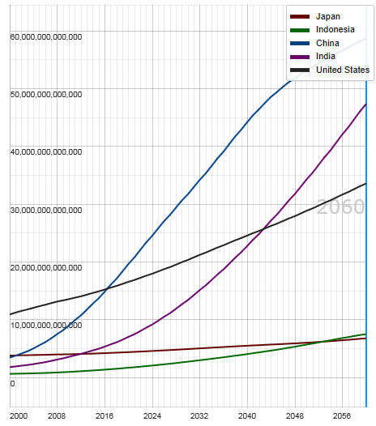
Potential Output of Total Economy: US, China, India, Indonesia and Japan, 2000-2060F
$ 2005 PPP
Growth in economic output will be concentrated in certain developing economies such as China and India
China will likely become the world’s largest economy between 2025 and 2030
Source: OECD; Insurance Information Institute .
53
12/01/09 - 9pm
eSlide – P6466 – The Financial Crisis and the Future of the P/C
Notes:
53

Slide 54
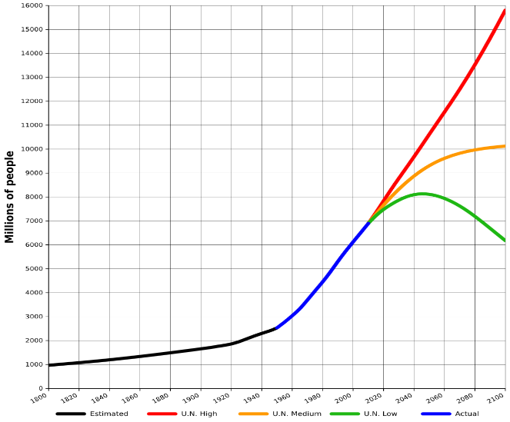
World Population Growth: 2010—2100F
The future of insurance will be tied global population growth—life insurance more closely than nonlife.
Mid-range scenarios suggest a massive slowdown in the number of available lives to insure. Growth will be increasing dependent on product penetration rates in emerging economies
Sources: United Nations, World Population Prospects, June 13, 2013; Insurance Information Institute .
54
12/01/09 - 9pm
eSlide – P6466 – The Financial Crisis and the Future of the P/C
Notes:
54

Slide 55
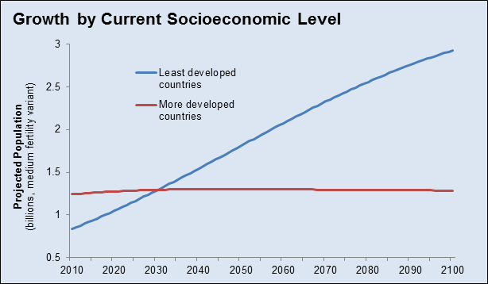
Population Growth: Developed vs. Less Developed Countries 2010—2100F
Virtually all of the world’s population growth through the end of the 21st century will occur in the developing world
Sources: United Nations, World Population Prospects, June 13, 2013; Insurance Information Institute .
55
12/01/09 - 9pm
eSlide – P6466 – The Financial Crisis and the Future of the P/C
Notes:
55

Slide 56
Global Insurance Premium Growth Trends: Non-Life (P/C) and Life
Growth Is Uneven Across Regions and Market Segments
56

Slide 57
Distribution of Global Insurance Premiums, 2012 ($ Trillions)
Total Premium Volume = $4.613 Trillion*
Life insurance accounted for nearly 57% of global premium volume in 2012 vs. 43% for Non-Life
Source: Swiss Re, sigma, No. 3/2013; Insurance Information Institute.

Slide 58
Distribution of Nonlife Premium: Industrialized vs. Emerging Markets, 2012
Emerging market’s share of nonlife premiums increased to 17.3% in 2012 from 14.3% in 2009. The share of premiums written in the $2 trillion global nonlife market remains much larger (82.7%) but continues to shrink.
The financial crisis and sluggish recovery in the major insurance markets will accelerate the expansion of the emerging market sector
Premium Growth Facts
2012, $Billions
Industrialized Economies
$1, 647.5
Emerging Markets
$344.1
Developing markets now account for about 40% of global GDP but just 17.3% of nonlife premiums
Sources: Swiss Re sigma No.3/2013; Insurance Information Institute research.

Slide 59
Premium Growth by Region, 2012
Latin America growth was the strongest in 2012
Growth in Advanced Asia (incl. China) markets was third highest in 2012
Global Premium Volume Totaled $4.613 Trillion in 2012, up 2.4% from $4.566 Trillion in 2011. Global Growth Was Weighed Down by Slow Growth in N. America and W. Europe and Partially Offset by Emerging Markets
Source: Swiss Re, sigma, No. 3/2013.
59
Notes:
59

Slide 60
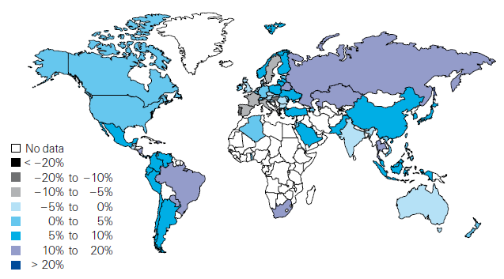
Global Real (Inflation Adjusted) Premium Growth (Life and Non-Life): 2012
Emerging markets in Asia, including China, showed faster growth an the US or Europe
Premium growth in emerging markets was 4 times that of advanced economies in 2012
Market | Life | Non-Life | Total
Advanced | 1.8 | 1.5 | 1.7
Emerging | 4.9 | 8.6 | 6.8
World | 2.3 | 2.6 | 2.4
Source: Swiss Re, sigma, No. 3/2013; Insurance Information Institute.
60
12/01/09 - 9pm
eSlide – P6466 – The Financial Crisis and the Future of the P/C
Notes:
60

Slide 61
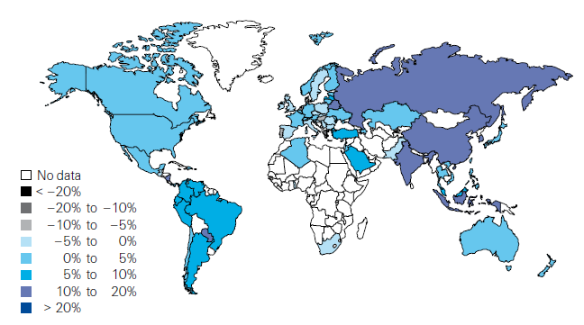
Non-Life Insurance: Global Real (Inflation Adjusted) Premium Growth, 2012
Real growth in non-life insurance premiums was faster in China than the US
Market | Life | Non-Life | Total
Advanced | 1.8 | 1.5 | 1.7
Emerging | 4.9 | 8.6 | 6.8
World | 2.3 | 2.6 | 2.4
Source: Swiss Re, sigma, No. 3/2013.
61
12/01/09 - 9pm
eSlide – P6466 – The Financial Crisis and the Future of the P/C
Notes:
61

Slide 62
Global Real (Inflation Adjusted) Nonlife Premium Growth: 1980-2010
Average: 1980-2010
Industrialized Countries: 3.8%
Emerging Markets: 9.2%
Overall Total: 4.2%
Nonlife premium growth in emerging markets has exceeded that of industrialized countries in 27 of the past 31 years, including the entirety of the global financial crisis..
Real nonlife premium growth is very erratic in part to inflation volatility in emerging markets as well as a lack of consistent cyclicality
Source: Swiss Re, sigma, No. 2/2010.
62
12/01/09 - 9pm
eSlide – P6466 – The Financial Crisis and the Future of the P/C
Notes:
62

Slide 63
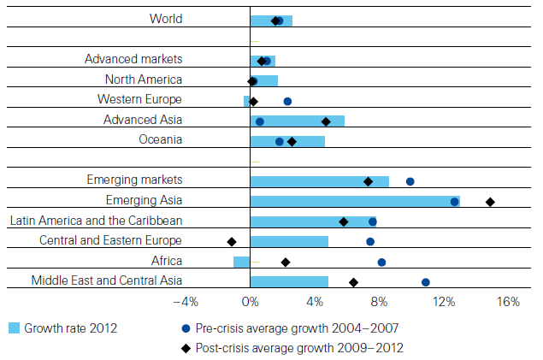
Non-Life Insurance: Global Real (Inflation Adjusted) Premium Growth, 2012
Global Non-Life growth in 2012 exceeded the pre-crisis and post-crisis average. The same is true for advanced Asia economies like China
Source: Swiss Re, sigma, No. 3/2013.
63
12/01/09 - 9pm
eSlide – P6466 – The Financial Crisis and the Future of the P/C
Notes:
63

Slide 64
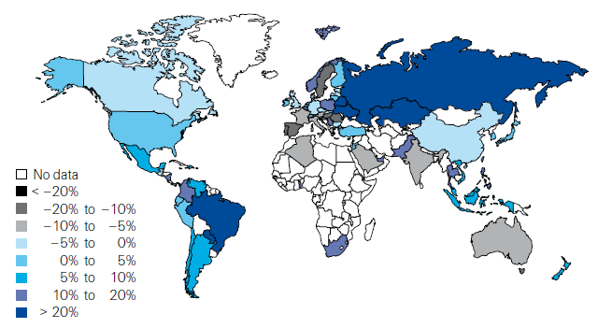
Life Insurance: Global Real (Inflation Adjusted) Premium Growth, 2012
Real growth in life insurance premiums was a bit slower in China than the US
Market | Life | Non-Life | Total
Advanced | 1.8 | 1.5 | 1.7
Emerging | 4.9 | 8.6 | 6.8
World | 2.3 | 2.6 | 2.4
Source: Swiss Re, sigma, No. 3/2013.
64
12/01/09 - 9pm
eSlide – P6466 – The Financial Crisis and the Future of the P/C
Notes:
64

Slide 65
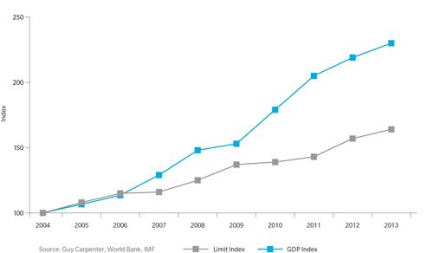
Gap Between GDP Growth and Reinsurance Limit in Asia-Pacific Region: 2004—2013
The gap between GDP and reinsurance limit in Asia is growing—suggesting the region is “under-reinsured”
Sources: Guy Carpenter, World Bank, IMF; Insurance Information Institute .
65
12/01/09 - 9pm
eSlide – P6466 – The Financial Crisis and the Future of the P/C
Notes:
65

Slide 66
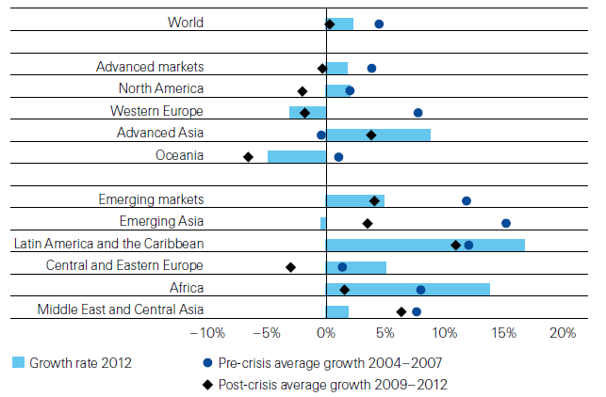
Life Insurance: Global Real (Inflation Adjusted) Premium Growth, 2012
Global Life Insurance growth in 2012 was lower than the pre-crisis average but above than the post-crisis average. Advanced Asia economies like China saw stronger growth on average than before or after the crisis.
Source: Swiss Re, sigma, No. 3/2013.
66
12/01/09 - 9pm
eSlide – P6466 – The Financial Crisis and the Future of the P/C
Notes:
66

Slide 67
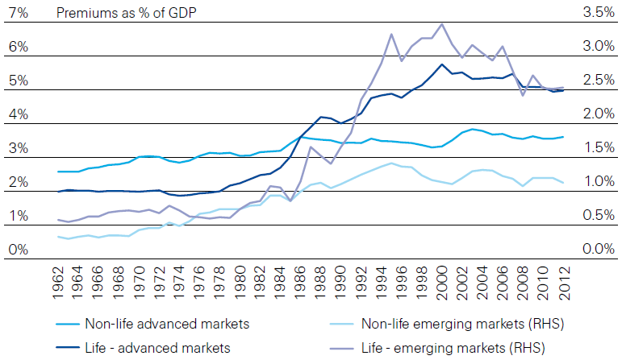
Life and Non-Life Insurance Penetration as a % of GDP: 1962-2012
Life insurance in emerging markets has experienced the fastest in recent decades
Advanced Markets
Emerging Markets
Non-life markets have been slower to grow than life
Source: Swiss Re, sigma, No. 3/2013.
67
12/01/09 - 9pm
eSlide – P6466 – The Financial Crisis and the Future of the P/C
Notes:
67

Slide 68
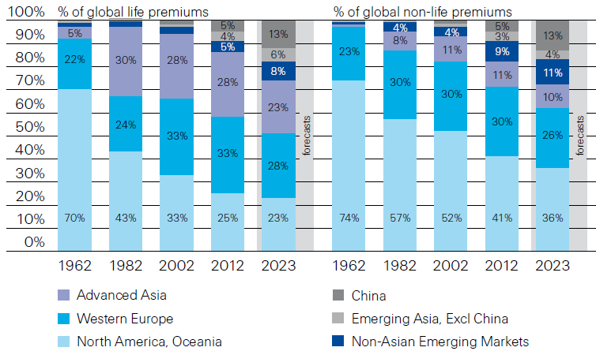
Premiums Written in Life and Non-Life, by Region: 1962-2012
Emerging market shares rose rapidly over the past 50 years
Source: Swiss Re, sigma, No. 3/2013.
68
12/01/09 - 9pm
eSlide – P6466 – The Financial Crisis and the Future of the P/C
Notes:
68

Slide 69
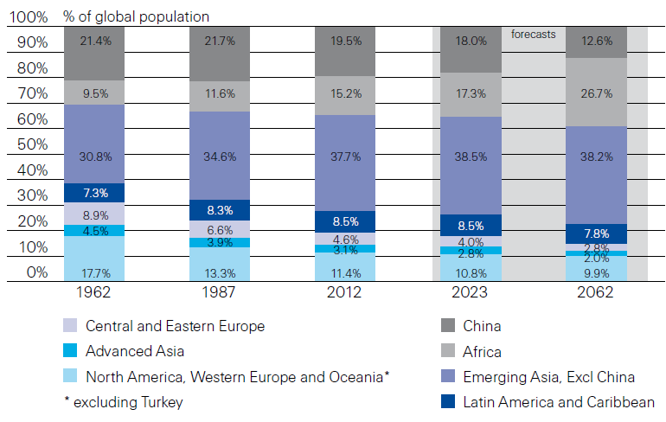
Population Distribution, by Region: 1962-2062F
Enormous population shifts will impact insurance demand over the next half century
Africa is expected to be the fastest population growth over the next 50 years, but no expectation now of Asia-like growth in economies or insurance demand
Source: Swiss Re, sigma, No. 3/2013 from United Nations Department of Economic and Sovial Affairs, Population Division.
69
12/01/09 - 9pm
eSlide – P6466 – The Financial Crisis and the Future of the P/C
Notes:
69

Slide 70
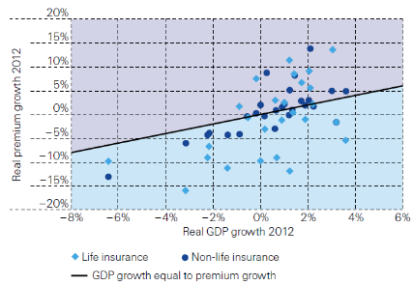
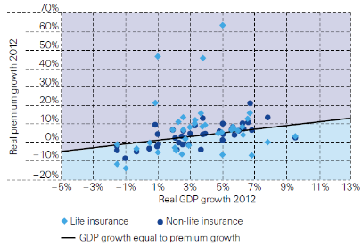
Relationship Between Real GDP and Real Life and Non-Life Premium Growth, 2012
Advanced Markets
Emerging Markets
The was a clear but highly relationship between real GDP growth and real premium growth in advance markets in 2012
The correlation between real GDP growth and real premium growth in emerging markets was much stronger than in advanced markets in 2012
Source: Swiss Re, sigma, No. 3/2013.
70
12/01/09 - 9pm
eSlide – P6466 – The Financial Crisis and the Future of the P/C
Notes:
70

Slide 71
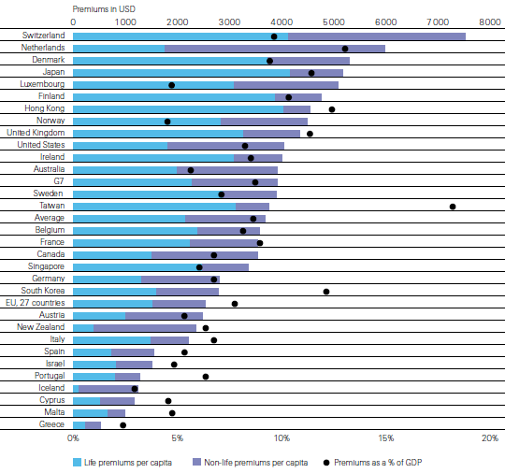
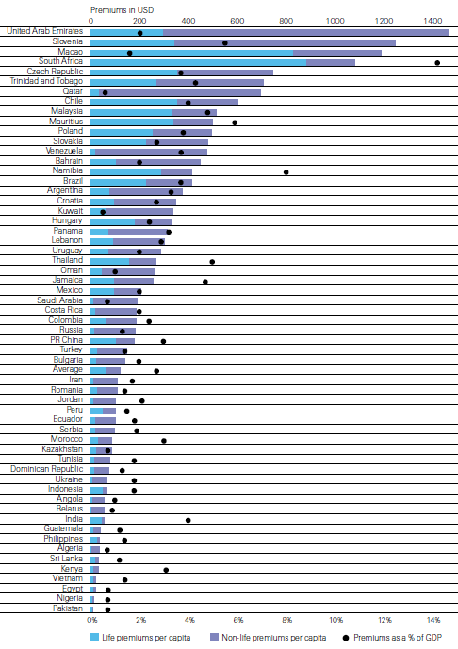
Insurance Density and Penetration for Advanced and Emerging Markets, 2012
Advanced Markets
Emerging Markets
Spending and penetration are generally much higher in advanced markets, though growth is fastest in emerging markets
Chinese spending on insurance is very similar to Russia, but Russian spending is mostly non-life and in China the majority is life
Source: Swiss Re, sigma, No. 3/2013.
71
12/01/09 - 9pm
eSlide – P6466 – The Financial Crisis and the Future of the P/C
Notes:
71

Slide 72
The Unfortunate Nexus: Opportunity, Risk & Instability
Most of the Global Economy’s Future Gains Will be Fraught with Much Greater Risk and Uncertainty than in the Past
72

Slide 73
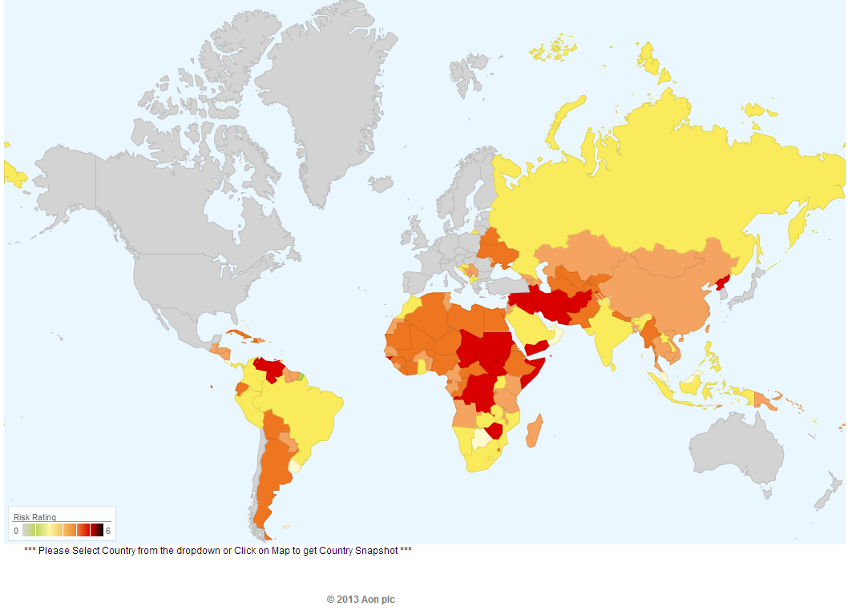
Political Risk in 2013: Greatest Business Opportunities Are Often in Risky Nations
Problems in the Ukraine will intensify political risk in several former Soviet republics
Latin and South America also present insurers with growth opportunities but political instability has increased markedly
The fastest growing markets are generally also among the politically riskiest, including East and South Asia and Africa
Source: Aon PLC; Insurance Information Institute.

Slide 74
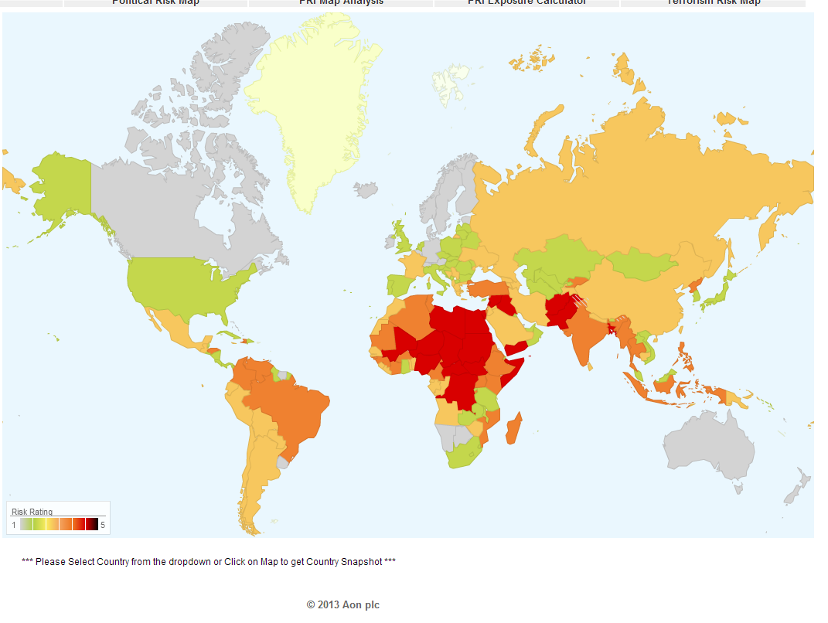
Terrorism Risk in 2013: Greatest Business Opportunities Are Often in Risky Nations
Latin and South America have modest terrorist threats though Brazil is elevated
Terrorism remains a greater concern in the Middle East, Africa and South Asia
Source: Aon PLC; Insurance Information Institute.

Slide 75
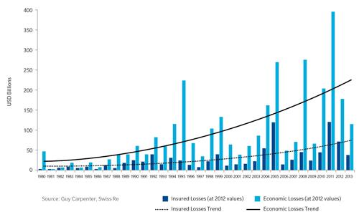
Gap Between Economic and Insured Losses: 1980—2013
The gap between economic and insured losses is growing—suggesting both a problem and an opportunity
Sources: Guy Carpenter, Swiss Re; Insurance Information Institute .
75
12/01/09 - 9pm
eSlide – P6466 – The Financial Crisis and the Future of the P/C
Notes:
75

Slide 76
Some Key Drivers in the US Economy
Economic Factors Driving Exposure Growth and Insurer Performance
76

Slide 77
US Real GDP Growth*
The Q4:2008 decline was the steepest since the Q1:1982 drop of 6.8%
Real GDP Growth (%)
Recession began in Dec. 2007. Economic toll of credit crunch, housing slump, labor market contraction was severe
2014/15 are expected to see a modest acceleration in growth
Demand for Insurance Should Increase in 2014/15 as GDP Growth Accelerates Modestly and Gradually Benefits the Economy Broadly
* Estimates/Forecasts from Blue Chip Economic Indicators.
Source: US Department of Commerce, Blue Economic Indicators 4/14; Insurance Information Institute.

Slide 78
Unemployment and Underemployment Rates: Still Too High, But Falling
January 2000 through March 2014, Seasonally Adjusted (%)
U-6 went from 8.0% in March 2007 to 17.5% in October 2009; Stood at 12.7% in Mar. 2014. 8% to 10% is “normal.”
As the unemployment rate approaches 6%, the Fed will begin signaling on short-term rates
“Headline” unemployment was 6.7% in March 2014. 4% to 6% is “normal.”
Stubbornly high unemployment and underemployment constrain overall economic growth, but the job market is now clearly improving.
Source: US Bureau of Labor Statistics; Insurance Information Institute.
78
12/01/09 - 9pm
eSlide – P6466 – The Financial Crisis and the Future of the P/C
Notes:
78

Slide 79
US Unemployment Rate Forecast
2007:Q1 to 2015:Q4F*
Rising unemployment eroded payrolls and WC’s exposure base.
Unemployment peaked at 10% in late 2009.
Jobless figures have been revised slightly downwards for 2014/15
Unemployment forecasts have been revised slightly downwards. Optimistic scenarios put the unemployment as low as 6.0% by Q4 of this year.
* = actual; = forecasts
Sources: US Bureau of Labor Statistics; Blue Chip Economic Indicators (4/14 edition); Insurance Information Institute.

Slide 80
Monthly Change in Private Employment
January 2007 through March 2014 (Thousands, Seasonally Adjusted)
192,000 private sector jobs were created in March. As of March 2014, all the jobs lost in the Great Recession have been recovered
Jobs Created
2013: 2.368 Mill
2012: 2.294 Mill
2011: 2.400 Mill
2010: 1.277 Mill
Monthly losses in Dec. 08–Mar. 09 were the largest in the post-WW II period
Private Employers Added 8.88 million Jobs Since Jan. 2010 After Having Shed 5.01 Million Jobs in 2009 and 3.76 Million in 2008 (State and Local Governments Have Shed Hundreds of Thousands of Jobs)
Source: US Bureau of Labor Statistics: http://www.bls.gov/ces/home.htm; Insurance Information Institute

Slide 81
New Private Housing Starts, 1990-2019F
Job growth, low inventories of existing homes, low mortgage rates and demographics should continue to stimulate new home construction for several more years
(Millions of Units)
New home starts plunged 72% from 2005-2009; A net annual decline of 1.49 million units, lowest since records began in 1959
Insurers Are Continue to See Meaningful Exposure Growth in the Wake of the “Great Recession” Associated with Home Construction: Construction Risk Exposure, Surety, Commercial Auto; Potent Driver of Workers Comp Exposure
Source: U.S. Department of Commerce; Blue Chip Economic Indicators (4/14 and 3/13); Insurance Information Institute.

Slide 82
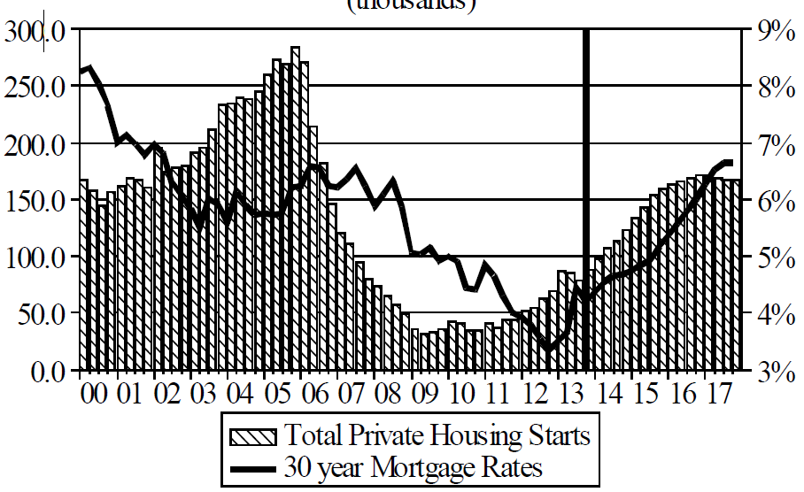
Florida Total Private Housing Starts, 2000 – 2017F
(Thousands of Units)
CRASH, CRATER, RECOVERY Homebuilding in FL continues to recover, adding substantially to coastal exposures.
The economic outlook for most of the US is positive for the first time in many years
Source: University of Central Florida Institute for Economic Competitiveness: http://iec.ucf.edu/post/2014/01/07/Florida-Metro-Forecast-December-2013.aspx

Slide 83
The combined ratios for both personal and commercial lines improved substantially in 2013:H1

Slide 85
Value of New Private Construction: Residential & Nonresidential, 2003-2013*
2013: Value of new pvt. construction hits $667.5B, up 33% from the 2010 trough but still 27% below 2006 peak
New Construction peaks at $911.8. in 2006
Billions of Dollars
Trough in 2010 at $500.6B, after plunging 55.1% ($411.2B)
$15.0
$613.7
$311.5
$298.1
$261.8
$238.8
$356.0
Private Construction Activity Is Moving in a Positive Direction though Remains Well Below Pre-Crisis Peak; Residential Dominates
*2013 figure is a seasonally adjusted annual rate as of December.
Sources: US Department of Commerce; Insurance Information Institute.
85
12/01/09 - 9pm
eSlide – P6466 – The Financial Crisis and the Future of the P/C
Notes:
85

Slide 86
Value of Private Construction Put in Place, by Segment, Jan. 2014 vs. Jan. 2013*
Growth (%)
Led by the Residential Construction, Lodging, Communication and Office segments, Private sector construction activity is rising after plunging during the “Great Recession.”
Private Construction Activity is Up in Most Segments, Including the Key Residential Construction Sector; Bodes Well for Early 2014
*seasonally adjusted Source: U.S. Census Bureau, http://www.census.gov/construction/c30/c30index.html ; Insurance Information Institute.

Slide 87
Private Construction by Segment/Project Type, Jan. 2014 vs. Jan. 2013*
Shopping malls/centers and warehouse construction are among the strongest nonresidential segments
Growth (%)
Private Construction Activity is Up in Many Segments, Including the Key Residential Construction Sector, But Down in a Few
*seasonally adjusted Source: U.S. Census Bureau, http://www.census.gov/construction/c30/c30index.html ; Insurance Information Institute.

Slide 88
Value of New Federal, State and Local Government Construction: 2003-2013*
Construction across all levels of government peaked at $314.9B in 2009
Austerity Reigns
Govt. construction is still shrinking, down $40.5B or 12.9% since 2009 peak
($ Billions)
Government Construction Spending Peaked in 2009, Helped by Stimulus Spending, but Continues to Contract As State/Local Governments Grapple with Deficits and Federal Sequestration Takes Hold
*2013 figure is a seasonally adjusted annual rate as of December.
Sources: US Department of Commerce; Insurance Information Institute.

Slide 89
Construction Employment, Jan. 2010—March 2014*
(Thousands)
Construction employment is +529,000 above Jan. 2011 (+9.7%) trough
Construction and manufacturing employment constitute 1/3 of all payroll exposure.
*Seasonally adjusted.
Sources: US Bureau of Labor Statistics at http://data.bls.gov; Insurance Information Institute.
89
12/01/09 - 9pm
eSlide – P6466 – The Financial Crisis and the Future of the P/C
Notes:
89

Slide 90
Dollar Value* of Manufacturers’ Shipments Monthly, Jan. 1992—Dec. 2013
$ Millions
The value of Manufacturing Shipments in Dec. 2013 was $492.7B—a near record high.
Monthly shipments in Dec. 2013 exceeded the pre-crisis (July 2008) peak. Manufacturing is energy-intensive and growth leads to gains in many commercial exposures: WC, Commercial Auto, Marine, Property, and various Liability Coverages.
*seasonally adjusted; Dec. 2013 is preliminary; data published February 4, 2014. Source: U.S. Census Bureau, Full Report on Manufacturers’ Shipments, Inventories, and Orders, http://www.census.gov/manufacturing/m3/
90
12/01/09 - 9pm
eSlide – P6466 – The Financial Crisis and the Future of the P/C
Notes:
90

Slide 91
Manufacturing Growth for Selected Sectors, 2013 vs. 2012*
Growth (%)
Durables: +3.4%
Non-Durables: +0.2%
Manufacturing of durable goods was especially strong in 2012 but weakened in 2013
Manufacturing Is Expanding—Albeit Slowly—Across a Number of Sectors that Will Contribute to Growth in Insurable Exposures Including: WC, Commercial Property, Commercial Auto and Many Liability Coverages
*Seasonally adjusted; Date are YTD comparing data through November 2013 to the same period in 2012. Source: U.S. Census Bureau, Full Report on Manufacturers’ Shipments, Inventories, and Orders, http://www.census.gov/manufacturing/m3/

Slide 92
Manufacturing Employment, Jan. 2010—March 2014*
(Thousands)
Since Jan 2010, manufacturing employment is up (+619,000 or +5.4%) and still growing.
Manufacturing employment is a surprising source of strength in the economy. Employment in the sector is at a multi-year high.
*Seasonally adjusted; Feb. and Mar. 2014 are preliminary
Sources: US Bureau of Labor Statistics at http://data.bls.gov; Insurance Information Institute.
92
12/01/09 - 9pm
eSlide – P6466 – The Financial Crisis and the Future of the P/C
Notes:
92

Slide 93
Nonfarm Payroll (Wages and Salaries): Quarterly, 2005–2013:Q4
Billions
Latest (2013:Q4) was $7.23 trillion, a new peak--$980B above 2009 trough
Prior Peak was 2008:Q1 at $6.60 trillion
Payrolls are 15.7% above their 2009 trough and up 2.0% over the past year
Recent trough (2009:Q3) was $6.25 trillion, down 5.3% from prior peak
Note: Recession indicated by gray shaded column. Data are seasonally adjusted annual rates.
Sources: http://research.stlouisfed.org/fred2/series/WASCUR; National Bureau of Economic Research (recession dates); Insurance Information Institute.
93
12/01/09 - 9pm
eSlide – P6466 – The Financial Crisis and the Future of the P/C
Notes:
93

Slide 94
Business Investment: Expected to Accelerate, Fueling Commercial Exposure Growth
Accelerating business investment will be a potent driver of commercial property and liability insurance exposures and should drive employment and WC payroll exposures as well (with a lag)
Source: IHS Global Insights as of Jan. 13, 2014; Insurance Information Institute.

Slide 95
ISM Non-Manufacturing Index
(Values > 50 Indicate Expansion)
January 2010 through February 2014
Optimism among non-manufacturers was hurt by the uncertainty in Washington, but remains resilient
Non-manufacturing industries have been expanding and adding jobs. This trend is likely to continue through 2014.
Source: Institute for Supply Management at http://www.ism.ws/ismreport/nonmfgrob.cfm; Insurance Information Institute.

Slide 96
Business Bankruptcy Filings, 1980-2013
% Change Surrounding Recessions
1980-82 58.6%
1980-87 88.7%
1990-91 10.3%
2000-01 13.0%
2006-09 208.9%
2013 bankruptcies totaled 33,212, down 17.1% from 2012—the fourth consecutive year of decline. Business bankruptcies more than tripled during the financial crisis.
Significant Exposure Implications for All Commercial Lines as Business Bankruptcies Begin to Decline
Sources: American Bankruptcy Institute (1980-2012) at http://www.abiworld.org/AM/AMTemplate.cfm?Section=Home&TEMPLATE=/CM/ContentDisplay.cfm&CONTENTID=61633; 2013 data from United States Courts at http://news.uscourts.gov; Insurance Information Institute.
96
12/01/09 - 9pm
eSlide – P6466 – The Financial Crisis and the Future of the P/C
Notes:
96

Slide 97
12 Industries for the Next 10 Years: Insurance Solutions Needed
Health Care
Health Sciences
Energy (Traditional)
Many industries are poised for growth, though insurers’ ability to capitalize on these industries varies widely
Alternative Energy
Petrochemical
Agriculture
Natural Resources
Technology (incl. Biotechnology)
Light Manufacturing
Insourced Manufacturing
Export-Oriented Industries
Shipping (Rail, Marine, Trucking, Pipelines)

Slide 98
U.S. Natural Has Imports and Exports, 1990 - 2040
Trillions of Cubic Feet
The US is now the largest gas producer in the world, though Russia is the largest exporter. The US needs to invest in its pipeline and LNG infrastructure and expedite regulatory approval to realize its full export potential
Sources: US Energy Information Administration, Annual Energy Outlook 2014 Early Release Overview; ;Insurance Information Institute.

Slide 99
U.S. Electricity Generation by Fuel,
1990 - 2040
Trillions of kilowatt Hours
Electricity consumption in the US will rise steadily along with the fuel shares of natural gas and renewables
Sources: US Energy Information Administration, Annual Energy Outlook 2014 Early Release Overview; ;Insurance Information Institute.

Slide 100
U.S. Primary Energy Consumption by Fuel, 1990 - 2040
Quadrillion BTUs
Energy consumption in the US will rise steadily with natural gas fueling most of the additional consumption
Sources: US Energy Information Administration, Annual Energy Outlook 2014 Early Release Overview; ;Insurance Information Institute.

Slide 101
U.S. Petroleum and Other Liquid Fuel Supplies by Source, 1990 - 2040
Millions of Barrels per Day
Liquid fuel consumption is expected to change little through 2040, though “tight” oil will account for a much larger share thereby reducing imports of petroleum products
Sources: US Energy Information Administration, Annual Energy Outlook 2014 Early Release Overview; ;Insurance Information Institute.

Slide 102

Oil & Gas Extraction Employment, Jan. 2010—March 2014*
Oil and gas extraction employment is up 33.1% since Jan. 2010 as the energy sector booms. Domestic energy production is essential to any robust economic recovery in the US.
Highest since Aug. 1986
(Thousands)
*Seasonally adjusted
Sources: US Bureau of Labor Statistics at http://data.bls.gov; Insurance Information Institute.
102
12/01/09 - 9pm
eSlide – P6466 – The Financial Crisis and the Future of the P/C
Notes:
102

Slide 103
The Future of Healthcare in America
Insurers Are Increasingly Along for the Ride in the American Health Care Saga
103

Slide 104
U.S. Health Care Expenditures, 1965–2022F
$ Billions
From 1965 through 2013, US health care expenditures had increased by 69 fold. Population growth over the same period increased by a factor of just 1.6. By 2022, health spending will have increased 119 fold.
U.S. health care expenditures have been on a relentless climb for most of the past half century, far outstripping population growth, inflation of GDP growth
Sources: Centers for Medicare & Medicaid Services, Office of the Actuary at http://www.cms.gov/Research-Statistics-Data-and-Systems/Statistics-Trends-and-Reports/NationalHealthExpendData/NationalHealthAccountsProjected.html accessed 3/14/14; Insurance Information Institute.

Slide 105
National Health Care Expenditures as a Share of GDP, 1965 – 2022F*
% of GDP
Health care expenditures as a share of GDP rose from 5.8% in 1965 to 18.0% in 2013 and are expected to reach 19.9% of GDP by 2022
2022 19.9%
2010: 17.9%
2000: 13.8%
1990: 12.5%
Since 2009, heath expenditures as a % of GDP have flattened out at about 18%--the question is why and will it last?
1980: 9.2%
1965 5.8%
Sources: Centers for Medicare & Medicaid Services, Office of the Actuary at http://www.cms.gov/Research-Statistics-Data-and-Systems/Statistics-Trends-and-Reports/NationalHealthExpendData/NationalHealthAccountsProjected.html accessed 3/14/14; Insurance Information Institute.

Slide 106
Rate of Health Care Expenditure Increase Compared to Population, CPI and GDP
Accelerating business investment will be a potent driver of commercial property and liability insurance exposures and should drive employment and WC payroll exposures as well (with a lag)
1965: $42.0 Bill
2013: $2,914.7 Bill
1965: $719.1 Bill
2013: $16,797.5 Bill
1965: 194.3 Mill
2013: 317.0 Mill
Source: Insurance Information Institute research.

Slide 107
Medical Cost Inflation vs. Overall CPI, 1995 - 2013
Though moderating, medical inflation will continue to exceed inflation in the overall economy
Average Annual Growth Average
Healthcare: 3.8%
Overall CPI: 2.4%
Sources: Med CPI from US Bureau of Labor Statistics, WC med severity from NCCI based on NCCI states.

Slide 108
WC Medical Severity Generally Outpaces the Medical CPI Rate
Average annual increase in WC medical severity form 1995 through 2011 was well above the medical CPI (6.8% vs. 3.8%), but the gap is narrowing.
Sources: Med CPI from US Bureau of Labor Statistics, WC med severity from NCCI based on NCCI states.

Slide 109
CYBER RISK
Cyber Risk is a Rapidly Emerging Exposure for Businesses Large and Small in Every Industry
NEW III White Paper: http://www.iii.org/assets/docs/pdf/paper_CyberRisk_2013.pdf
109

Slide 110





Data Breaches 2005-2013, by Number of Breaches and Records Exposed
# Data Breaches/Millions of Records Exposed
Millions
The Total Number of Data Breaches (+38%) and Number of Records Exposed (+408%) in 2013 Soared
* 2013 figures as of Jan. 1, 2014 from the ITRC updated to an additional 30 million records breached (Target) as disclosed in Jan. 2014.
Source: Identity Theft Resource Center.

Slide 111
Shifting Legal Liability & Tort Environment
Is the Tort Pendulum Swinging Against Insurers?
111

Slide 112
Over the Last Three Decades, Total Tort Costs as a % of GDP Appear Somewhat Cyclical, 1980-2013E
($ Billions)
2.21% of GDP in 2003 = pre-tort reform peak
Deepwater Horizon Spike in 2010
Tort costs in dollar terms have remained high but relatively stable since the mid-2000s., but are down substantially as a share of GDP
1.68% of GDP in 2013
Sources: Towers Watson, 2011 Update on US Tort Cost Trends, Appendix 1A

Slide 113
Commercial Lines Tort Costs: Insured vs. Self-(Un)Insured Shares, 1973-2010
2005: $143.5B 66.4% insured, 33.6% self-(un)insured
Billions of Dollars
$15.0
1995: $83.6B 69.5% insured, 30.5% self-(un)insured
1973: Commercial Tort Costs Totaled $6.49B, 94% was insured, 6% self-(un)insured
1985: $46.6B 74.5% insured, 25.5% self-(un)insured
$9.5
$6.0
2009: $126.5B 64.4% insured, 35.6% self-(un)insured
Tort Costs and the Share Retained by Risks Both Grew Rapidly from the mid-1970s to mid-2000s, When Tort Costs Began to Fall But Self-Insurance Shares Continued to Rise
Sources: Towers Watson, 2011 Update on US Tort Cost Trends, III Calculations based on data from Appendix 4.
113
12/01/09 - 9pm
eSlide – P6466 – The Financial Crisis and the Future of the P/C
Notes:
113

Slide 114
Commercial Lines Tort Costs: Insured vs. Self-(Un)Insured Shares, 1973-2010
Percent
2010: $138.1B 56.6% insured, 44.4% self-(un)insured (distorted by Deepwater Horizon event with most losses retained by BP)
1973: 94% was insured, 6% self-(un)insured
1985:74.5% insured, 25.5% self-(un)insured
1995: 69.5% insured, 30.5% self-(un)insured
2005: 66.4% insured, 33.6% self-(un)insured
The Share of Tort Costs Retained by Risks Has Been Steadily Increasing for Nearly 40 Years. This Trend Contributes Has Left Insurers With Less Control Over Pricing.
Sources: Towers Watson, 2011 Update on US Tort Cost Trends, III Calculations based on data from Appendix 4.
114
12/01/09 - 9pm
eSlide – P6466 – The Financial Crisis and the Future of the P/C
Notes:
114

Slide 115
Business Leaders Ranking of Liability Systems in 2012
Best States
Delaware
Nebraska
Wyoming
Minnesota
Kansas
Idaho
Virginia
North Dakota
Utah
Iowa
Worst States
Florida
Oklahoma
Alabama
New Mexico
Montana
Illinois
California
Mississippi
Louisiana
West Virginia
New in 2012
Wyoming
Minnesota
Kansas
Idaho
Newly Notorious
Oklahoma
Drop-offs
Rising Above
Indiana
Colorado
Massachusetts
South Dakota
Arkansas
Source: US Chamber of Commerce 2012 State Liability Systems Ranking Study; Insurance Info. Institute.

Slide 116
The Nation’s Judicial Hellholes: 2012/2013
Watch List
Illinois
Madison County
West Virginia
Maryland
Baltimore
Philadelphia, Pennsylvania
South Florida
Cook County, Illinois
New Jersey
Nevada
Louisiana
California
Dishonorable Mention
New York
Albany and NYC
MO Supreme Court
WA Supreme Court
Source: American Tort Reform Association; Insurance Information Institute

Slide 117
U.S. Insured Catastrophe Loss Update
2013 Was a Welcome Respite from the High Catastrophe Losses in Recent Years
117

Slide 118

U.S. Insured Catastrophe Losses
($ Billions, $ 2012)
2012 was the third most expensive year ever for insured CAT losses
2012 Was the 3rd Highest Year on Record for Insured Losses in U.S. History on an Inflation-Adj. Basis. 2011 Losses Were the 6th Highest. YTD 2013 Running Well Below 2011 and 2012 YTD Totals.
Record tornado losses caused 2011 CAT losses to surge
*Through 12/31/13.
Note: 2001 figure includes $20.3B for 9/11 losses reported through 12/31/01 ($25.9B 2011 dollars). Includes only business and personal property claims, business interruption and auto claims. Non-prop/BI losses = $12.2B ($15.6B in 2011 dollars.)
Sources: Property Claims Service/ISO; Insurance Information Institute.
118
12/01/09 - 9pm
eSlide – P6466 – The Financial Crisis and the Future of the P/C
Notes:
118

Slide 119
Combined Ratio Points Associated with Catastrophe Losses: 1960 – 2013*
Avg. CAT Loss Component of the Combined Ratio by Decade
1960s: 1.04 1970s: 0.85 1980s: 1.31 1990s: 3.39 2000s: 3.52 2010s: 6.1E*
Catastrophe losses as a share of all losses reached a record high in 2012
Combined Ratio Points
The Catastrophe Loss Component of Private Insurer Losses Has Increased Sharply in Recent Decades
*2010s represent 2010-2013.
Notes: Private carrier losses only. Excludes loss adjustment expenses and reinsurance reinstatement premiums. Figures are adjusted for losses ultimately paid by foreign insurers and reinsurers.
Source: ISO (1960-2011); A.M. Best (2012E) Insurance Information Institute.

Slide 120
Top 10 States for Insured Catastrophe Losses, 2013
$ Millions
Oklahoma let the country in insured CAT losses in 2013
Source: The Property Claim Services (PCS) unit of ISO, a Verisk Analytics company.

Slide 121
Top 5 States by Insured Catastrophe Losses in 2012*
(2012, $ Billions)
NY and NJ let the US in CAT losses in 2012 due Sandy
*Includes catastrophe losses of at least $25 million.
Sources: PCS unit of ISO; Insurance Information Institute.

Slide 122
Top States by Inflation-Adjusted Insured Catastrophe Losses, 1983–2012
Over the Past 30 Years Florida Has Accounted for the Largest Share of Catastrophe Losses in the U.S., Followed by Texas and Louisiana
FL is the most costly state for CATs, with nearly $67B in insured losses over the past 30 years
Louisiana
$42.0B
Texas
$48.8B
Rest of the U.S.
$309.9B
Florida
$66.7B
Total: $467.5 Billion, an average of $16.6B per year or $1.3B per month
Source: PCS unit of ISO, Verisk Company.; Insurance Information Institute.

Slide 123
Inflation Adjusted U.S. Catastrophe Losses by Cause of Loss, 1993–2012¹
Wind/Hail/Flood (3), $14.9
Fires (4), $6.5
Other (5), $0.2
Insured cat losses from 1993-2012 totaled $391.7B, an average of $19.6B per year or $1.6B per month
Geological Events, $18.4
Terrorism, $24.8
Winter Storms, $27.8
Hurricanes & Tropical Storms, $158.2
Tornado share of CAT losses is rising
Wind losses are by far cause the most catastrophe losses, even if hurricanes/TS are excluded.
Tornadoes (2), $140.9
Catastrophes are defined as events causing direct insured losses to property of $25 million or more in 2012 dollars.
Excludes snow.
Does not include NFIP flood losses
Includes wildland fires
Includes civil disorders, water damage, utility disruptions and non-property losses such as those covered by workers compensation.
Source: ISO’s Property Claim Services Unit.

Slide 124
Top 16 Most Costly Disasters in U.S. History
(Insured Losses, 2012 Dollars, $ Billions)
Hurricane Sandy became the 5th costliest event in US insurance history
Includes Tuscaloosa, AL, tornado
Includes Joplin, MO, tornado
Hurricane Irene became the 12th most expense hurricane in US history in 2011
12 of the 16 Most Expensive Events in US History Have Occurred Over the Past Decade
*PCS estimate as of 4/12/13.
Sources: PCS; Insurance Information Institute inflation adjustments to 2012 dollars using the CPI.

Slide 125
Top 16 Most Costly World Insurance Losses, 1970-2013*
(Insured Losses, 2012 Dollars, $ Billions)
5 of the top 14 most expensive catastrophes in world history have occurred within the past 3 years (2010-2012)
2012 insured CAT Losses totaled $60B; Economic losses totaled $140B, according to Swiss Re
Hurricane Sandy is now the 6th costliest event in global insurance history
*Figures do not include federally insured flood losses.
**Estimate based on PCS value of $18.75B as of 4/12/13.
Sources: Munich Re; Swiss Re; Insurance Information Institute research.

Slide 126
Top 12 Most Costly Hurricanes in U.S. History
(Insured Losses, 2012 Dollars, $ Billions)
10 of the 12 most costly hurricanes in insurance history occurred over the past 9 years (2004—2012)
Hurricane Sandy became the 3rd costliest hurricane in US insurance history
Hurricane Irene became the 12th most expensive hurricane in US history in 2011
*PCS estimate as of 4/12/13.
Sources: PCS; Insurance Information Institute inflation adjustments to 2012 dollars using the CPI.

Slide 127
Total Value of Insured Coastal Exposure in 2012
(2012, $ Billions)
NY and FL lead the US in the value of insured coastal exposure at $2.9 Trillion
In 2012, New York Ranked as the #1 Most Exposed State to Hurricane Loss, Overtaking Florida with $2.862 Trillion. Texas is very exposed too, and ranked #3 with $1.175 Trillion in insured coastal exposure
The Insured Value of All Coastal Property Was $10.6 Trillion in 2012 , Up 20% from $8.9 Trillion in 2007 and Up 48% from $7.2 Trillion in 2004
Source: AIR Worldwide

Slide 128
Total Value of Insured Coastal Exposure in 2007
(2007, $ Billions)
In 2007, Florida Still Ranked as the #1 Most Exposed State to Hurricane Loss, with $2.459 Trillion Exposure, but Texas is very exposed too, and ranked #3 with $895B in insured coastal exposure
The Insured Value of All Coastal Property Was $8.9 Trillion in 2007, Up 24% from $7.2 Trillion in 2004
Source: AIR Worldwide

Slide 129
Hurricane Sandy: Average Claim Payment by Type of Claim
Commercial (i.e., business claims) are more expensive because the value of property is often higher as well as the impact of insured business interruption losses
The average insured flood loss was nearly 9 times larger than the average non-flood insured loss (mostly wind)
Post-Sandy, the I.I.I. worked very hard to make help media, consumers and regulators understand the distinction between a flood claim and a standard homeowners claim. NFIP is $24B in debt.
*Includes rental and condo policies (excludes NFIP flood). **As of Oct. 31, 2013.
Sources: Catastrophe loss data is for Catastrophe Serial No. 90 (Oct. 28 – 31, 2012) from PCS as of March 2013; Insurance Information Institute.

Slide 130
Total Potential Home Value Exposure to Storm Surge Risk in 2013*
($ Billions)
Florida is by the state most vulnerable to storm surge.
The Value of Homes Exposed to Storm Surge was $1.147 Trillion in 2013.* Only a fraction of this is insured, hence the huge demand for federal aid following major coastal flooding events.
*Insured and uninsured property. Based on estimated property values as of April 2013.
Source: Storm Surge Report 2013, CoreLogic.

Slide 131
Top 10 Winter Storm and Winter Damage Events in the US and Canada, 1980-2013*
Ranked by Insured Loss, in Millions of $ 2013*
Period | Area | Economic Loss (in inflation-adjusted 2013 $US mill) | Insured Loss (in inflation-adjusted 2013 $US mill) | Fatalities
Mar. 11-14, 1993 | CAN, USA | 8,061 | 3,224 | 270
Dec. 17-30,1983 | USA | 2,339 | 2,058 | 500
Apr. 13-17, 2007 | CAN, USA | 2,247 | 1,775 | 23
Dec. 10-13, 1992 | USA | 4,981 | 1,660 | 19
Jan. 5-12, 1998 | CAN, USA | 4,145 | 1,644 | 45
Feb. 10-12, 1994 | USA | 4,716 | 1,258 | 9
Jan. 17-20, 1994 | USA | 1,572 | 1,258 | 70
Apr. 7-11, 2013 | USA | 1,600 | 1,200 | N/A
Jan. 1-4, 1999 | CAN, USA | 1,398 | 1,084 | 25
Jan. 31-Feb. 2, 2011 | USA | 1,346 | 1,010 | 36
*Top 10 events in original insured loss dollars were adjusted to and ranked by the Insurance Information Institute to 2013 inflation-adjusted values.
Sources: Munich Re NatCatSERVICE; Insurance Information Institute.

Slide 132
Winter Storm and Winter Damage Events in the US and Canada, 1980-2013 (2013 US$)
Three of the four most costly years ever for insured losses from winter storms and damage occurred in the 1990s, led by the “Storm of the Century” in 1993.
Insured Losses (Millions, $ 2013)
5-year running average
Insured losses from severe winter events totaled $2 billion in 2013.
Insured winter storm and damage losses in Jan. 2014 already totaled $1.5 billion. Continued severe weather since then makes it likely that 2014 will become one of the top 5 costliest winters since 1980.
Sources: Munich Re NatCatSERVICE; Insurance Information Institute.
132

Slide 133
Natural Disaster Losses in the United States, by Type, 2013
As of December 31, 2013 | Number of Events | Fatalities | Estimated Overall Losses (US $m) | Estimated Insured Losses (US $m)
Severe Thunderstorm | 69 | 110 | 16,341 | 10,274
Winter Storm | 11 | 43 | 2,935 | 1,895
Flood | 19 | 23 | 1,929 | 240
Earthquake & Geophysical | 6 | 1 | Minor | Minor
Tropical Cyclone | 1 | 1 | Minor | Minor
Wildfire, Heat, & Drought | 22 | 29 | 620 | 385
Totals | 128 | 207 | 21,825 | 12,794
Source: Munich Re NatCatSERVICE
133
133

Slide 134
Significant Natural Catastrophes, 2013 (Events with $1 billion economic loss and/or 50 fatalities)
Date | Event | Estimated Economic Losses (US $m) | Estimated Insured Losses (US $m)
February 24 – 25 | Winter Storm | 1,300 | 690
March 18 – 19 | Thunderstorms | 2,200 | 1,600
April 7 – 11 | Winter Storm | 1,600 | 1,200
April 16 – 18 | Thunderstorms | 1,100 | 560
May 18 – 20 | Thunderstorms | 3,100 | 1,800
May 28 – 31 | Thunderstorms | 2,800 | 1,400
August 6 – 7 | Thunderstorms | 1,300 | 740
September 9 – 16 | Flooding | 1,500 | 160
November 17 - 18 | Thunderstorms | 1,300 | 931
Source: Munich Re NatCatSERVICE
134

Slide 135
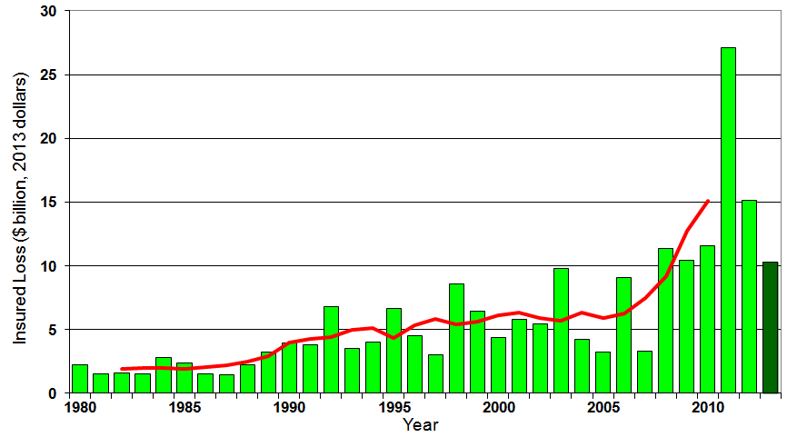
U.S. Thunderstorm Insured Loss Trends, 1980 – 2013
Hurricanes get all the headlines, but thunderstorms are consistent producers of large scale loss. 2008-2013 are the most expensive years on record.
Average thunderstorm losses are up 7 fold since the early 1980s. The 5-year running average loss is up sharply
Thunderstorm losses in 2013 totaled $10.3 billion, the 6th highest on record
Source: Property Claims Service, and MR NatCatSERVICE
135

Slide 136
Insured Homeowners Losses Due to Lightning, 2004-2012
$ Millions
Lightning claims cost insurers an estimated $969 million in 2012, 31.7% from $735.5 million in 2004
The Increased Number and Value of Expensive Electronic Devices in Homes is Pushing the Total Lightning Claim Costs Up Even as the Number of Lightning Claims Falls
Source: Insurance Information Institute.

Slide 137
Natural Disasters in the United States, 1980 – 2013 Number of Events (Annual Totals 1980 – 2013)
There were 128 natural disaster events in 2013
Number
22
19
81
6
Geophysical
(earthquake, tsunami,
volcanic activity)
Meteorological (storm)
Climatological
(temperature extremes,
drought, wildfire)
Hydrological
(flood, mass movement)
Source: MR NatCatSERVICE
137

Slide 138
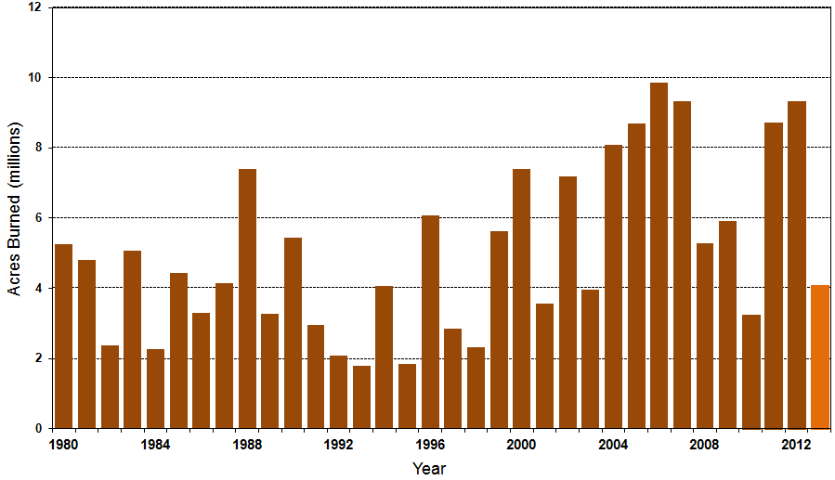
Number of Acres Burned in Wildfires, 1980 – 2013
TX experienced significant wildfire losses in 2011 (Bastrop fire insured losses ~$500 million)
Source: National Interagency Fire Center
138

Slide 139
Losses Due to Natural Disasters in the US, 1980–2013
(Overall and Insured Losses)
(2013 Dollars, $ Billions)
2013 CAT Losses
Overall : $21.8B
Insured: $12.8B
Indicates a great deal of losses are uninsured (~40%-50% in the US) = Growth Opportunity
2013 losses were far below 2011 and 2012 and were 44% lower than the average from 2000-2012
Overall losses (in 2012 values)
Insured losses (in 2013 values)
Source: MR NatCatSERVICE
139

Slide 140
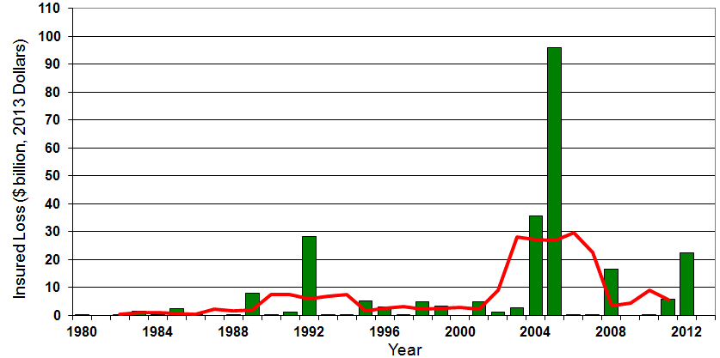

Insured US Tropical Cyclone Losses, 1980 - 2013
The current 5-year average (2008 - 2013) insured tropical cyclone loss is $5.6 billion per year.
Sources: Property Claims Service, Munich Re NatCatSERVICE, NFIP
140

Slide 141
The combined ratios for both personal and commercial lines improved substantially in 2013:H1

Slide 143
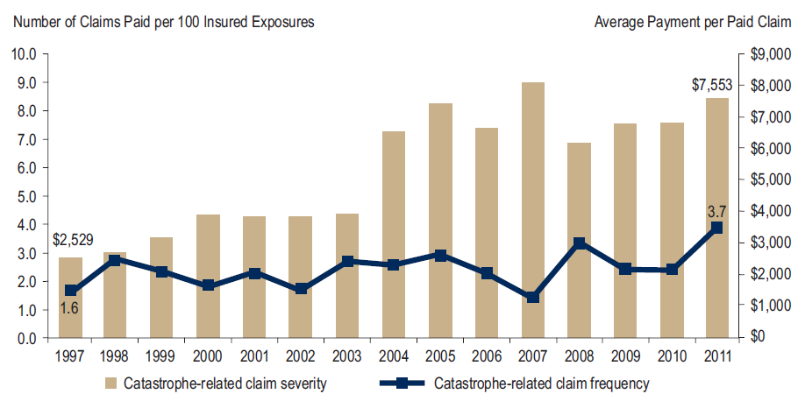
Homeowners Insurance Catastrophe-Related Claim Frequency and Severity, 1997—2012*
Avg. catastrophe claim cost rose approximately 200% from 1997-2011
Cat claim frequency in 2011 was at historic highs and more than double the rate in 1997
*All policy forms combined, countrywide.
Source: Insurance Research Council, Trends in Homeowners Insurance Claims, Sept. 2012 from ISO Fast Track data.
143

Slide 144
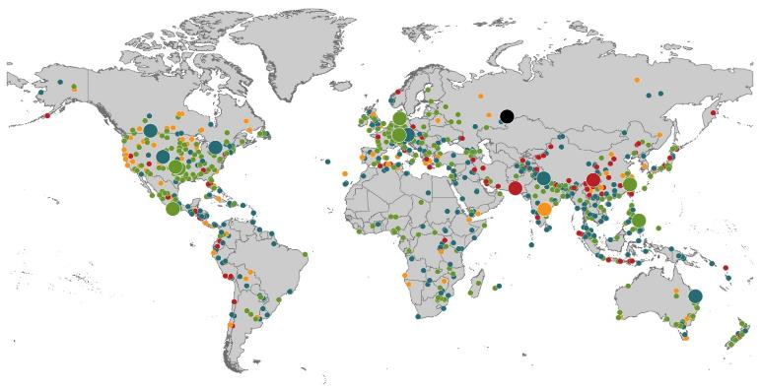
Natural Loss Events:
Full Year 2013 World Map
Winter Storm Christian (St. Jude)
Europe, 27–30 October
Floods
Europe,
30 May–19 June
Meteorite impact
Russian Federation, 15 February
Flash floods
Canada, 8–9 July
Floods
Canada, 19–24 June
Earthquake
China, 20 April
Hailstorms
Germany,
27–28 July
Floods
USA, 9–16 September
Typhoon Fitow
China, Japan,
5–9 October
Severe storms, tornadoes
USA, 18–22 May
Typhoon Haiyan
Philippines,
8–12 November
Severe storms, tornadoes
USA, 28–31 May
Floods
India, 14–30 June
Hurricanes Ingrid & Manuel
Mexico, 12–19 September
Floods
Australia,
21–31 January
880
Loss events
Earthquake (series)
Pakistan, 24–28 September
Heat wave
India, April–June
Geophysical events (earthquake, tsunami, volcanic activity)
Hydrological events (flood, mass movement)
Natural catastrophes
Geophysical events (earthquake, tsunami, volcanic activity)
Hydrological events (flood, mass movement)
Selection of significant
Natural catastrophes
Meteorological events (storm)
Climatological events (extreme temperature, drought, wildfire)
Meteorological events (storm)
Climatological events (extreme temperature, drought, wildfire)
Extraterrestrial events (Meteorite impact)
Source: Munich Re Geo Risks Research, NatCatSERVICE – as of January 2014.
144

Slide 145
Natural Disasters Worldwide, 1980 – 2013 (Number of Events)
There were 880 natural disaster events globally in 2013 compared to 905 in 2012
Number
Geophysical
(earthquake, tsunami,
volcanic activity)
Meteorological (storm)
Climatological
(temperature extremes,
drought, wildfire)
Hydrological
(flood, mass movement)
Source: MR NatCatSERVICE
145

Slide 146
Losses Due to Natural Disasters Worldwide, 1980–2013 (Overall & Insured Losses)
(Overall and Insured Losses)
(2013 Dollars, $ Billions)
10-Yr. Avg. Losses
Overall : $184B
Insured: $56B
2013 Losses
Overall : $125B
Insured: $34B
There is a clear upward trend in both insured and overall losses over the past 30+ years
Overall losses (in 2013 values)
Insured losses (in 2013 values)
Source: MR NatCatSERVICE
146

Slide 147
Flood Insurance
Biggert-Waters 2012 Created Opportunity for Private Insurers
2014 Backtracking on Those Reforms Reduces Opportunities
147

Slide 148
Hurricane Sandy: Average Claim Payment by Type of Claim
Commercial (i.e., business claims) are more expensive because the value of property is often higher as well as the impact of insured business interruption losses
The average insured flood loss was nearly 9 times larger than the average non-flood insured loss (mostly wind)
Post-Sandy, the I.I.I. worked very hard to make help media, consumers and regulators understand the distinction between a flood claim and a standard homeowners claim. NFIP is $24B in debt.
*Includes rental and condo policies (excludes NFIP flood). **As of Oct. 31, 2013.
Sources: Catastrophe loss data is for Catastrophe Serial No. 90 (Oct. 28 – 31, 2012) from PCS as of March 2013; Insurance Information Institute.

Slide 149
Total Potential Home Value Exposure to Storm Surge Risk in 2013*
($ Billions)
Florida is by the state most vulnerable to storm surge.
The Value of Homes Exposed to Storm Surge was $1.147 Trillion in 2013.* Only a fraction of this is insured, hence the huge demand for federal aid following major coastal flooding events.
*Insured and uninsured property. Based on estimated property values as of April 2013.
Source: Storm Surge Report 2013, CoreLogic.

Slide 150
I.I.I. Poll: Flood Insurance
Q. Do you think it is fair that flood insurance premium increases are higher if people who live in high flood risk areas and rebuild their homes do not elevate them?
Don’t know
No
Yes
Almost two-thirds of Americans think that it is fair that flood insurance premiums be raised for people who live in high flood risk areas and rebuild their homes after a flood but do not elevate them.
Source: Insurance Information Institute Annual Pulse Survey.

Slide 151
Terrorism Update
Down to the Wire? Boston Bombings Underscore the Need for Extension of the Terrorism Risk Insurance Program
Download III’s Terrorism Insurance Report at: http://www.iii.org/white_papers/terrorism-risk-a-constant-threat-2013.html
151
Notes:
151

Slide 152
Loss Distribution by Type of Insurance from Sept. 11 Terrorist Attack ($ 2011)
($ Billions)
Total Insured Losses Estimate: $40.0B**
*Loss total does not include March 2010 New York City settlement of up to $657.5 million to compensate approximately 10,000 Ground Zero workers or any subsequent settlements.
**$32.5 billion in 2001 dollars.
Source: Insurance Information Institute.

Slide 153
Terrorism Insurance Take-up Rates, By Year, 2003-2012
Take-up rates for smaller commercial risks are lower—potentially very low in some areas and industries
In 2003, the first year TRIA was in effect, the terrorism take-up rate was 27 percent. Since then, it has increased steadily, remaining in the low 60 percent range since 2009.
Source: Marsh Global Analytics, 2013 Terrorism Risk Insurance Report, May 2013.
153
Notes:
153

Slide 154
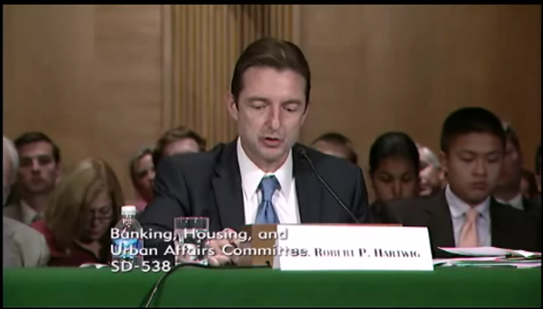

Terrorism Risk Insurance Program
Testified before Senate Banking Cmte. in Sept. 2013
Testified before House Financial Services Nov. 2013
Provided testimony at NYC hearing on June 2013
I.I.I. Accelerated Planned Study on Terrorism Risk and Insurance in the Wake of Boston and Hearings; Was Well Received and Widely Circulated
Working with Trades, Congressional Staff, GAO & Others
House Financial Services Subcommittee, 11/13/13
Senate Banking Committee, 9/25/13
154
12/01/09 - 9pm
eSlide – P6466 – The Financial Crisis and the Future of the P/C
Notes:
154

Slide 155
SURPLUS/CAPITAL/CAPACITY
2013 Recorded Yet Another Record High in the Primary and Reinsurance Sectors
155

Slide 156
Policyholder Surplus, 2006:Q4–2013:Q4
Drop due to near-record 2011 CAT losses
($ Billions)
2007:Q3 Pre-Crisis Peak
Surplus as of 12/31/13 stood at a record high $653.3B
The industry now has $1 of surplus for every $0.73 of NPW, close to the strongest claims-paying status in its history.
2010:Q1 data includes $22.5B of paid-in capital from a holding company parent for one insurer’s investment in a non-insurance business .
The P/C insurance industry entered 2014 in very strong financial condition.
Sources: ISO, A.M .Best.
156
12/01/09 - 9pm
eSlide – P6466 – The Financial Crisis and the Future of the P/C
Notes:
156

Slide 157
US Policyholder Surplus: 1975–2013*
($ Billions)
Surplus as of 9/30/13 was a record $624.4, up 6.4% from $586.9 of 12/31/12, and up 42.9% ($187.3B) from the crisis trough of $437.1B at 3/31/09. Pre-crisis peak was $521.8 as of 9/30/07. Surplus as of 9/30/13 was 19.7% above 2007 peak.
“Surplus” is a measure of underwriting capacity. It is analogous to “Owners Equity” or “Net Worth” in non-insurance organizations
The Premium-to-Surplus Ratio Stood at $0.78:$1 as of 9/30/13, a Near Record Low (at Least in Recent History)*
* As of 9/30/13.
Source: A.M. Best, ISO, Insurance Information Institute.

Slide 158
U.S. INSURANCE MERGERS AND ACQUISITIONS, 2002-2012 (1)
($ Millions)
M&A activity has returned to its pre-crisis levels.
(1) Includes transactions where a U.S. company was the acquirer and/or the target.
Source: Conning proprietary database.

Slide 159
U.S. INSURANCE MERGERS AND ACQUISITIONS, All Sectors, 1989-2012 (1)
M&A activity is close to its pre-crisis levels
($ Billions)
$165.4
(1) Includes transactions where a U.S. company was the acquirer and/or the target.
Source: Conning proprietary database.

Slide 160
U.S. INSURANCE MERGERS AND ACQUISITIONS, P/C SECTOR, 2002-2012 (1)
($ Millions)
M&A activity in the P/C sector remains below pre-crisis levels.
(1) Includes transactions where a U.S. company was the acquirer and/or the target.
Source: Conning proprietary database.

Slide 161
U.S. INSURANCE MERGERS AND ACQUISITIONS, LIFE/ANNUITY SECTOR, 2002-2012 (1)
($ Millions)
Life/Annuity sector M&A activity is highly volatile
(1) Includes transactions where a U.S. company was the acquirer and/or the target.
Source: Conning proprietary database.

Slide 162
REINSURANCE MARKET CONDITIONS
Ample Capacity as Alternative Capital is Transforming the Market—And Pushing Down Prices
162

Slide 163
Global Reinsurance Capital (Traditional and Alternative), 2007 - 2013
Total reinsurance capital reached a record $540B in 2013, up 58.8% from 2008. Of that, $50B (9.3%) is alternative capacity, up 163% from $19B since 2008
Source: Aon Benfield Reinsurance Market Outlook, April 1, 2014; Insurance Information Institute.

Slide 164
Global Reinsurer Capital, 2007-2013:H1*
($ Billions)
+11%
+1%
+18%
-3%
+18%
-17%
Global Reinsurance Capital Has Been Trending Generally Upward Since the Global Financial Crisis, a Trend that Seems Likely to Continue
*Includes both traditional and non-traditional forms of reinsurance capital.
Source: Aon Benfield Aggregate study for the 6 months ending June 2013; Insurance Information Institute.

Slide 165
Long-Term Evolution of Shareholders’ Funds for the Guy Carpenter Global Reinsurance Composite
Source: Guy Carpenter

Slide 166
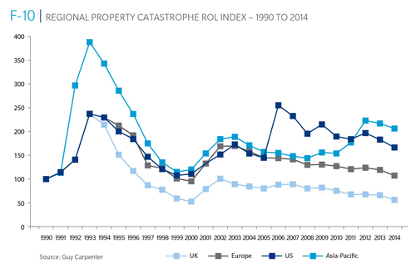
Reinsurance Pricing: Rate-on-Line Index by Region, 1990 – 2014*
Lower CATs and a flood of new capital has pushed reinsurance pricing down in most regions, including the US
*As of Jan. 1.
Source: Guy Carpenter

Slide 167
Reinsurer Combined Ratios (Aon Benfield Aggregate), 2007 - 2013
Reinsurers posted a combined under 90 in 2013, the best result since 2009
Source: Aon Benfield Reinsurance Market Outlook, April 1, 2014; Insurance Information Institute.

Slide 168
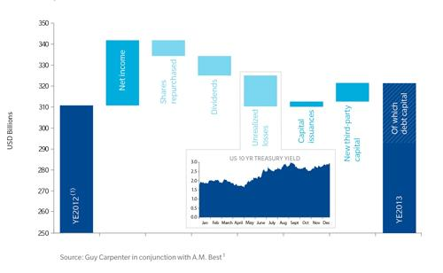
Sources of Reinsurance Capital Change: YE 2012 to YE 2013
Net income and new 3rd party capital were the leading source of reinsurance capital growth in 2013
Sources: Guy Carpenter and A.M. Best; Insurance Information Institute .
168
12/01/09 - 9pm
eSlide – P6466 – The Financial Crisis and the Future of the P/C
Notes:
168

Slide 169
Global Insurance Capital, 2007 - 2013
Insurance capital increased by 69.4% ($1.5 trillion) since the depths of the global financial crisis in 2008
Source: Aon Benfield Reinsurance Market Outlook, April 1, 2014; Insurance Information Institute.

Slide 170
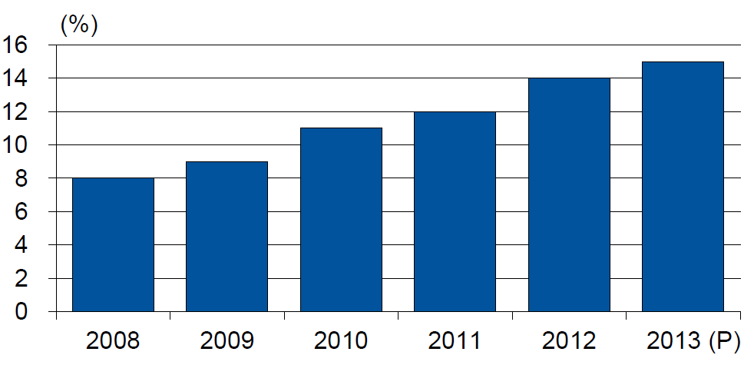
Alternative Capacity as a Percentage of Global Property Catastrophe Reinsurance Limit
(As of Year End)
Alternative Capacity accounted for approximately 14% or $45 billion of the $316 in global property catastrophe reinsurance capital as of mid-2013 (expected to rise to ~15% by year-end 2013)
Source: Guy Carpenter

Slide 171
Property Catastrophe Reinsurance Capacity by Source as of Mid-2013 ($ Bill)
Total = $316 Billion*
“Convergence Capital” accounted for an estimated $45B or 14% or total property catastrophe reinsurance capacity as of mid-2013, up $10B over the past 18 months (since 1/1/12). Penetration of this type of capacity is growing
Collateralized reinsurance (sidecars) is the fastest growing segment recently
Source: Guy Carpenter; Mid-Year Market Report, September 2013; Insurance Information Institute.

Slide 172
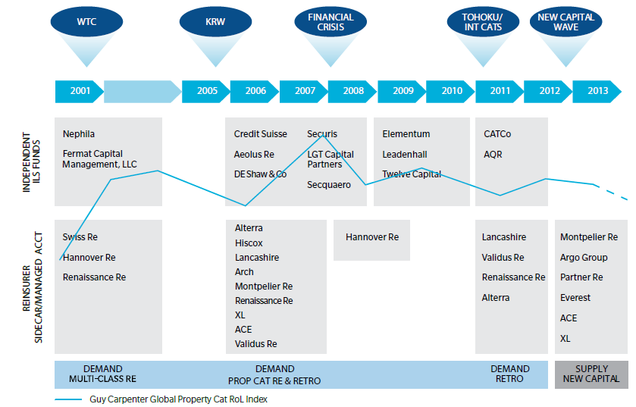
Alternative Capacity Development, 2001—2013:H1
Source: Guy Carpenter; Mid-Year Market Report, September 2013; Insurance Information Institute.

Slide 173
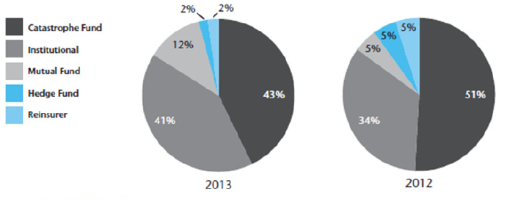
Investor by Category, 2013 vs. 2012*
Institutional Investors are accounting for a larger share of alternative reinsurance investors
*As of June 30 each year.
Source: Aon Benfield Securities; Insurance Information Institute.

Slide 174
Non-Traditional Property Catastrophe Limits by Type, YE 2012 vs. YE 2015E
Alternative capital is expected to rise by 30% by YE 2015 and will ultimately account for 20-30% of total reinsurance spend, according to Guy Carpenter
Source: Guy Carpenter; Reinsurance Association of America; Insurance Information Institute.

Slide 175
Catastrophe Bonds: Issuance and Outstanding, 1997- 2014:Q1*
Risk Capital Amount ($ Millions)
Risk capital outstanding reached a record high in 2013
Financial crisis depressed issuance
CAT bond issuance reached a record high in 2013
Catastrophe Bond Issuance Is Approaching Pre-Crisis Levels While Risk Capital Outstanding Stands at an All-Time Record
*Through Jan. 31, 2014.
Source: Guy Carpenter; Insurance Information Institute.

Slide 176
Questions Arising from Influence of Alternative Capital
Could Pension Fund Money Swamp Traditional Capacity?
US private pension funds hold ~$7 trillion in assets
2% allocation = $140 billion
Global property cat capital = ~$316 bill as of mid-2013
Do New Investors Have a Lower Cost of Capital?
New capacity expects 6-8% rate of return compared to 8-10% for traditional reinsurance, according to Dowling & Partners
Will Reinsurance Pricing Become More Closely Linked to Interest Rates?
What happens when interest rates rise?
Terms and Conditions Could Weaken
Multi-year deals

Slide 177
Questions Arising from Influence of Alternative Capital
What Will Happen When Investors Face Large-Scale Losses?
Does ILS Have a Higher Propensity to Litigate?
Short-term focus could contribute to disputes
Large share of triggered transactions ended up in dispute
How Low Will ROLs Be Pushed?
Does the New Interconnectedness with Capital Markets Lend Credence to the Suggestion that Reinsurance Is a Systemic Risky Business?
Will Alternative Capital Drive Consolidation Among Traditional Reinsurers?
Has the mating dance begun? → Endurance/Aspen

Slide 178
INVESTMENTS: THE NEW REALITY
Investment Performance is a Key Driver of Profitability
Depressed Yields Will Necessarily Influence Underwriting & Pricing
178

Slide 179
Property/Casualty Insurance Industry Investment Income: 2000–2013¹
($ Billions)
Investment earnings are running below their 2007 pre-crisis peak
Investment Income Fell in 2012 and 2013 Due to Persistently Low Interest Rates, Putting Additional Pressure on (Re) Insurance Pricing
¹ Investment gains consist primarily of interest and stock dividends...
Sources: ISO; Insurance Information Institute.

Slide 180
P/C Insurer Net Realized Capital Gains/Losses, 1990-2013
Realized capital gains were up sharply as equity markets rallied
($ Billions)
Insurers Posted Net Realized Capital Gains in 2010 - 2013 Following Two Years of Realized Losses During the Financial Crisis. Realized Capital Losses Were the Primary Cause of 2008/2009’s Large Drop in Profits and ROE
Sources: A.M. Best, ISO, Insurance Information Institute.
180
12/01/09 - 9pm
eSlide – P6466 – The Financial Crisis and the Future of the P/C
Notes:
180

Slide 181
Property/Casualty Insurance Industry Investment Gain: 1994–2013¹
($ Billions)
Investment gains in 2013 were their highest in the post-crisis era
Investment Income Continued to Fall in 2013 Due to Low Interest Rates but Realized Investment Gains Were Up Sharply; The Financial Crisis Caused Investment Gains to Fall by 50% in 2008
¹ Investment gains consist primarily of interest, stock dividends and realized capital gains and losses.
* 2005 figure includes special one-time dividend of $3.2B;
Sources: ISO; Insurance Information Institute.

Slide 182
Reduction in Combined Ratio Necessary to Offset 1% Decline in Investment Yield to Maintain Constant ROE, by Line*
Lower Investment Earnings Place a Greater Burden on Underwriting and Pricing Discipline
*Based on 2008 Invested Assets and Earned Premiums
**US domestic reinsurance only
Source: A.M. Best; Insurance Information Institute.
182
12/01/09 - 9pm
eSlide – P6466 – The Financial Crisis and the Future of the P/C
Notes:
182
This shows the drop in Combined Ratio for each line of business that would be needed to maintain a constant ROE, given a 1-percentage-point drop in investment yield

Slide 183
U.S. 10-Year Treasury Note Yields: A Long Downward Trend, 1990–2014*
Yields on 10-Year U.S. Treasury Notes recently plunged to record modern-era lows in early 2013 but have since risen as the Fed begins “tapering” its QE program in 2014
Yields on 10-Year U.S. Treasury Notes have been essentially below 5% for a full decade.
Since roughly 80% of P/C bond/cash investments are in 10-year or shorter durations, most P/C insurer portfolios will have low-yielding bonds for years to come.
*Monthly, through February 2014. Note: Recessions indicated by gray shaded columns.
Sources: Federal Reserve Bank at http://www.federalreserve.gov/releases/h15/data.htm. National Bureau of Economic Research (recession dates); Insurance Information Institutes.
183
12/01/09 - 9pm
eSlide – P6466 – The Financial Crisis and the Future of the P/C
Notes:
183

Slide 184
U.S. Treasury Security Yields: A Long Downward Trend, 1990–2014*
Yields on 10-Year U.S. Treasury Notes have been essentially below 5% for a full decade.
U.S. Treasury yields plunged to historic lows in 2013. Only longer-term yields have rebounded.
Since roughly 80% of P/C bond/cash investments are in 10-year or shorter durations, most P/C insurer portfolios will have low-yielding bonds for years to come.
*Monthly, constant maturity, nominal rates, through February 2014.
Sources: Federal Reserve Bank at http://www.federalreserve.gov/releases/h15/data.htm. National Bureau of Economic Research (recession dates); Insurance Information Institute.
184
12/01/09 - 9pm
eSlide – P6466 – The Financial Crisis and the Future of the P/C
Notes:
184

Slide 185
Treasury Yield Curves: Pre-Crisis (July 2007) vs. Feb. 2014
Treasury yield curve remains near its most depressed level in at least 45 years. Investment income is falling as a result. Even as the Fed “tapers” rates are unlikely to return to pre-crisis levels anytime soon
The Fed Is Actively Signaling that it Is Determined to Keep Rates Low Until Unemployment Drops Below 6.5% or Until Inflation Expectations Exceed 2.5%; Low Rates Add to Pricing Pressure for Insurers.
Source: Federal Reserve Board of Governors; Insurance Information Institute.

Slide 186
Treasury Yield Curves: Pre-Crisis (July 2007) vs. Feb. 2014
Longer term yields are expected to rise in 2014 and 2015 while short-term yields will not begin to normalize until 2015
Higher longer-term yields will help insurers but short term yields are expected to lag behind
Source: Federal Reserve Board of Governors (2006-2013), Swiss Re (2014-2015); Insurance Information Institute.

Slide 187
Outlook for U.S. Treasury Bond Yields Through 2015
Long-term yields should begin to normalize in 2014 but short-term yields will remain very low until 2015
% Yield
Longer-tail lines like MPL and workers comp will benefit the most from the normalization of yields
Source: Federal Reserve Board of Governors (2012-2013), Blue Economic Forecasts (2014-2015 3-month and 10-yr; 4/14) Swiss Re (2014-2015, 5-yr yield; 4/14); Insurance Information Institute.
187
12/01/09 - 9pm
eSlide – P6466 – The Financial Crisis and the Future of the P/C
Notes:
187

Slide 188
Average Maturity of Bonds Held by US P/C Insurers, 2006—2011*
Average Maturity (Years)
The average bond maturity is down by a full year between 2007 and 2011
Falling Average Maturity (and Duration) of the P/C Industry’s Bond Portfolio is Contributing to the Drop in Investment Income Along With Lower Yields
*Year-end figures. Latest available.
Sources: Insurance Information Institute calculations based on A.M. Best data.
188
12/01/09 - 9pm
eSlide – P6466 – The Financial Crisis and the Future of the P/C
Notes:
188

Slide 189
Distribution of Bond Maturities, P/C Insurance Industry, 2003-2012
The main shift over these years has been from bonds with longer maturities to bonds with shorter maturities. The industry first trimmed its holdings of over-10-year bonds (from 24.6% in 2003 to 15.5% in 2012) and then trimmed bonds in the 5-10-year category (from 31.3% in 2003 to 27.6% in 2012) . Falling average maturity of the P/C industry’s bond portfolio is contributing to a drop in investment income along with lower yields.
Sources: SNL Financial; Insurance Information Institute.

Slide 190
Bonds Rated NAIC Quality Category 3-6 as a Percent of Total Bonds, 2003–2012
From 2006-07 to year-end 2012, the percentage of lower-quality bonds in P/C industry portfolios more than doubled
There are many ways to capture higher yields on bond portfolios. One is to accept greater risk, as measured by NAIC bond ratings. The ratings range from 1 to 6, with the highest quality rated 1. Even in 2012, over 95% of the industry’s bonds were rated 1 or 2.
Sources: SNL Financial; Insurance Information Institute.

Slide 191
PRICING TRENDS
Modest Growth Continues
191

Slide 192
Net Premium Growth: Annual Change, 1971—2013
(Percent)
1975-78
1984-87
2000-03
Net Written Premiums Fell 0.7% in 2007 (First Decline Since 1943) by 2.0% in 2008, and 4.2% in 2009, the First 3-Year Decline Since 1930-33.
2013 = +4.6%
2012 = +4.3%
Shaded areas denote “hard market” periods
Sources: A.M. Best (historical and forecast), ISO, Insurance Information Institute.

Slide 193
Growth in Direct Written Premium by Line, 2013-2015F*
(Percent)
P/C growth is expected to remain fairly stable through 2015
Source: Conning.

Slide 194
Average Commercial Rate Change, All Lines, (1Q:2004–4Q:2013)
Pricing as of Q4:2013 was positive for the 10th consecutive quarter. Gains are likely to continue into 2014.
(Percent)
Q2 2011 marked the last of 30th consecutive quarter of price declines
KRW Effect
Note: CIAB data cited here are based on a survey. Rate changes earned by individual insurers can and do vary, potentially substantially.
Source: Council of Insurance Agents & Brokers; Insurance Information Institute

Slide 195
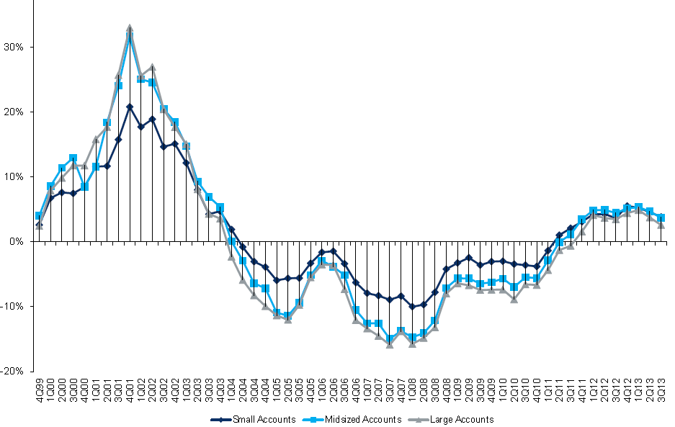
Change in Commercial Rate Renewals, by Account Size: 1999:Q4 to 2013:Q3
Percentage Change (%)
Peak = 2001:Q4 +28.5%
Pricing turned positive in Q3:2011, the first increase in nearly 8 years; Q3:2013 renewals were up 3.4%. Some insurers posted stronger numbers.
Pricing Turned Negative in Early 2004 and Remained that way for 7 ½ years
KRW : No Lasting Impact
Trough = 2007:Q3 -13.6%
Source: Council of Insurance Agents and Brokers; Barclay’s Capital; Insurance Information Institute.
Note: CIAB data cited here are based on a survey. Rate changes earned by individual insurers can and do vary, potentially substantially.

Slide 196
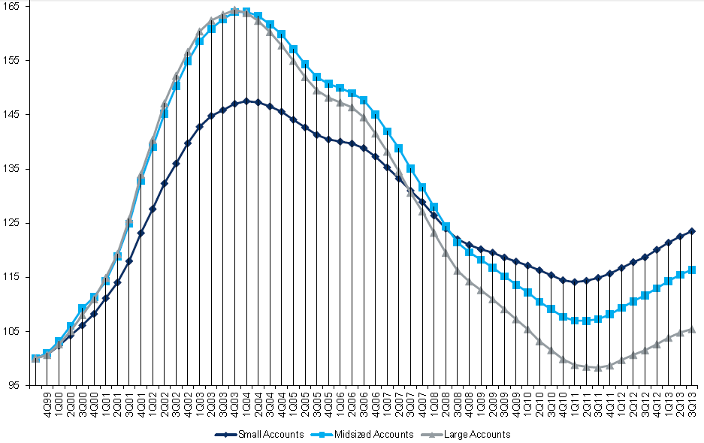
Cumulative Qtrly. Commercial Rate Changes, by Account Size: 1999:Q4 to 2013:Q3
1999:Q4 = 100
Despite 9 consecutive quarters of gains (Q3:2013 = 3.4%), pricing today is where is was in late 2001 (around 9/11), suggesting additional rate need going forward, esp. in light of record low interest rates
Note: CIAB data cited here are based on a survey. Rate changes earned by individual insurers can and do vary, potentially substantially.
Source: Council of Insurance Agents and Brokers; Barclay’s Capital; Insurance Information Institute.

Slide 197
Change in Commercial Rate Renewals, by Line: 2013:Q3
Workers Comp rate increases are large than any other line, followed by Property lines
Percentage Change (%)
Major Commercial Lines Renewed Uniformly Upward in Q3:2013 for the 9th Consecutive Quarter; Property Lines & Workers Comp Leading the Way; Cat Losses and Low Interest Rates Provide Momentum Going Forward
Note: CIAB data cited here are based on a survey. Rate changes earned by individual insurers can and do vary, potentially substantially.
Source: Council of Insurance Agents and Brokers; Insurance Information Institute.

Slide 198
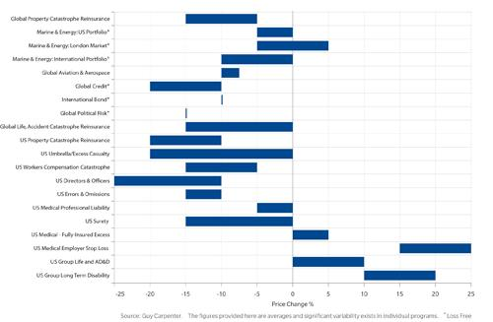
Rate Movements by Business Segment as of January 1, 2014
Many business segments renewed were under price pressure as of 1/1/14
Sources: Guy Carpenter; Insurance Information Institute .
198
12/01/09 - 9pm
eSlide – P6466 – The Financial Crisis and the Future of the P/C
Notes:
198

Slide 199
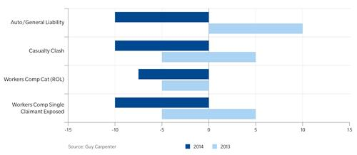
Casualty: Typical Excess of Loss Rate Changes as of Jan. 1, 2014
Casualty excess of loss renewals turned generally negative as of 1/1/14
Sources: Guy Carpenter; Insurance Information Institute .
199
12/01/09 - 9pm
eSlide – P6466 – The Financial Crisis and the Future of the P/C
Notes:
199

Slide 200
Regulation: The Ultimate External Factor
Regulation Has Shaped and Reshaped Insurance for Hundreds of Years— The Future Will Be No Different
200

Slide 201
New Waves of Regulations
2008 - Present
Global Crisis and Regulatory Response
201

Slide 202
The Global Financial Crisis: The Pendulum Swings Again: Dodd-Frank & Systemic Risk
Dodd-Frank Act of 2010: The implosion of the housing bubble and virtual collapse of the US banking system, the seizure of credit markets and massive government bailouts of US financial institutions led to calls for sweeping regulatory reforms of the financial industry
Limiting Systemic Risk is at the Core of Dodd-Frank
Designation as a Systemically Important Financial Institutional (SIFI) Will Result in Greater Regulatory Scrutiny and Heightened Capital Requirements
Dodd-Frank Established Several Entities Impacting Insurers
Federal Insurance Office
Financial Stability Oversight Council
Office of Financial Research
Consumer Financial Protection Bureau

Slide 203
The Global Financial Crisis: The Pendulum Swings Again: Dodd-Frank & Systemic Risk
Insurers—as Non-Bank Financial Institutions—Have Escaped Some, though Not All of the Most Draconian Provision of Dodd-Frank
In particular, small number of large insurers will (are) receiving a designations as Systemically Important Financial Institutions (SIFIs)
Insurers Generally Reject the Notion that Insurance Is Systemically Risky (or that any Individual Insurer is Systemically Important)
Such a Designation Makes the Fed the Penultimate Regulator
To Date: AIG, Prudential Have Been Designated as non-bank SIFIs by the FSOC
MetLife is still under evaluation
Fed Reserve Seems Open to Developing a Tailored Capital Requirement Approach for Insurers
Conflicting language in the DFA make this somewhat difficult
SIFIs may need Fed approval to repurchase shares on increase dividend

Slide 204
Global Financial Crises & Global Systemic Risk
The Global Financial Crisis Prompted the G-20 Leaders to Request that the Financial Stability Board (FSB) Assess the Systemic Risks Associated with SIFIs, Global-SIFIs in Particular
In July 2013, the FSB Endorsed the International Association of Insurance Supervisors Methodology for Identifying Globally Systemically Important Insurers (G-SIIs)
For Each G-SII, the Following Will Be Required:
(i) Recovery and resolution plans
(ii) Enhanced group-wide supervision
(iii) Higher loss absorbency (HLA) requirements
G-SIIs as Designated by the FSB as of July 2013:
Allianz SE AIG Assicurazioni Generali
Aviva Axa MetLife
Ping An Prudential Financial Prudential plc

Slide 205
Global Financial Crises & Global Systemic Risk: Key Dates
Implementation Date | Action
July 2013 | Designation of G-SIIs (annual updates thereafter beginning Nov. 2014)
July 2014 | FSB to make a decision on the G-SII status of, and appropriate risk mitigating measures for major reinsurers
By G-20 Summit 2014 | IAIS to develop backstop capital requirements to apply to all group activities, incl. non-ins. subs.
End 2015 | IAIS to develop HLA requirements that will apply to G-SIIs staring in 2019
January 2019 | G-SIIs to apply HLA requirements
Sources: Financial Stability Board, “Globally Systemically Important Insurers (G-SIIs) and the Policy Measures that Will Apply to Them,” July 18, 2013.

Slide 206
Global Financial Crises & Global Systemic Risk…There’s More…
IAIS Also Plans to Develop the First-Ever Risk-Based Global Insurance Capital Standards by 2016
Would be Tested in 2017-2018; Implemented in 2019
Would Be Included as Part of ComFrame and Apply to Internationally Active Insurance Groups (IAIGs): ~50 IAIGs Designations Likely
While Flexibility May Exist within the Standards, Doubts in the US Are Likely to Be Strong
Concern that the standards may be bank-centric
Questions as to whether such standards are even needed:
“Although US state insurance regulators continue to have doubts about the timing, necessity and complexity of developing a global capital standard given regulatory differences around the globe, we intend to remain fully engaged in the process to ensure that any development augments the strong legal entity capital requirements in the US that have provided proven and tested security for US policyholders and stable insurance markets for consumers and industry.” --NAIC President Ben Nelson (P/C 360, Oct. 16, 2013)

Slide 207
Financial Strength & Underwriting
Cyclical Pattern is P-C Impairment History is Directly Tied to Underwriting, Reserving & Pricing
207

Slide 208
P/C Insurer Impairments, 1969–2012
Impairments among P/C insurers remain infrequent
The Number of Impairments Varies Significantly Over the P/C Insurance Cycle, With Peaks Occurring Well into Hard Markets
Source: A.M. Best Special Report “Pace of P/C Impairments Slowed in 2012; Auto Writers, RRGs Continued to Struggle,” June 2013; Insurance Information Institute.

Slide 209
P/C Insurer Impairment Frequency vs. Combined Ratio, 1969-2012
2012 impairment rate was 0.69%, down from 1.11% in 2011; the rate is lower than the 0.82% average since 1969
Impairment Rates Are Highly Correlated With Underwriting Performance and Reached Record Lows in 2007; Recent Increase Was Associated Primarily With Mortgage and Financial Guaranty Insurers and Not Representative of the Industry Overall
Source: A.M. Best; Insurance Information Institute

Slide 210
Reasons for US P/C Insurer Impairments, 1969–2012
Historically, Deficient Loss Reserves and Inadequate Pricing Are By Far the Leading Cause of P-C Insurer Impairments. Investment and Catastrophe Losses Play a Much Smaller Role
Reinsurance Failure
Sig. Change in Business
Misc.
Investment Problems (Overstatement of Assets)
Deficient Loss Reserves/ Inadequate Pricing
Affiliate Impairment
Catastrophe Losses
Alleged Fraud
Rapid Growth
Source: A.M. Best Special Report “Pace of P/C Impairments Slowed in 2012; Auto Writers, RRGs Continued to Struggle,” June 2013; Insurance Information Institute.

Slide 211
Rapid Growth ‘A Leading Cause’ of Impairment’
“The leading causes of impairment are deficient loss reserves (inadequate pricing) and rapid growth, together comprising more than 50 percent of annual impairments.”
- A.M. Best, 2013
Source: SNL Financial, Insurance Information Institute.

Slide 212
Top 10 Lines of Business for US P/C Impaired Insurers, 2000–2012
Workers Comp and Pvt. Passenger Auto Account for More Than 40 Percent of the Impaired Insurers Since 2000
Other
Title
Surety
Workers Comp
Med Mal
Other Liability
Pvt. Passenger Auto
Commercial Auto Liability
Commercial Multiperil
Homeowners
Source: A.M. Best Special Report “Pace of P/C Impairments Slowed in 2012; Auto Writers, RRGs Continued to Struggle,” June 2013; Insurance Information Institute.
.

Slide 213
Insurance Information Institute Online:
www.iii.org
Thank you for your time and your attention!
Twitter: twitter.com/bob_hartwig

