Slide 1
Economic Perspectives on the Future of Reinsurance
Re Underwriting: Facing the Future –
Emerging, Issues, Risks, and Opportunities
New York, NY
September 13, 2016
Steven N. Weisbart, Ph.D., CLU, Senior Vice President & Chief Economist
Insurance Information Institute ♦ 110 William Street ♦ New York, NY 10038
Tel: 212.346.5540 ♦ Cell: 917.494.5945 ♦ stevenw@iii.org ♦ www.iii.org

Slide 2
The Growth of the Reinsurance Industry Depends on …
The Growth of the Global Exposure Base
  GDP growth
  Increased premium “penetration”
  New lines of business (e.g., flood, cyber?)
  Inflation => Claims, Rates
The Experience and Capital Position of the Primary Insurance Industry
The Experience and Capital Position of the Reinsurance Industry
  The Extent and Attractiveness of Alternate Sources of Capital

Slide 3
Global Economic Outlook: Regional and Major Economy Perspectives
Reinsurance is a Global Business
Strength of Economies and Pace of Recovery Varies Greatly
Important Consequences for Insurer and Reinsurer Growth Opportunities
3

Slide 4
Shares of Global Output, Advanced vs. Developing Economies, 2015
China is the world’s largest economy.* The EU will be third after the UK leaves.
Largest economies (% of world GDP)
China 17.1%
Euro Union 16.9%
U.S. 15.8%
India 7.0%
Japan 4.3%
Germany 3.4%
*Based on GDP adjusted for purchasing power parity
Sources: http://www.economywatch.com/economic-statistics/economic-indicators/GDP_Share_of_World_Total_PPP (citing the International Monetary Fund, as updated 30 June 2016); Ins. Info. Institute

Slide 5
Forecast Shares of Global Output,
5 Largest Economies, 2016-2020
  China and India are forecast to produce larger shares of global output, while the European Union (including the U.K.), the U.S., and Japan—though growing—will produce smaller shares of global output
Sources: http://www.economywatch.com/economic-statistics/economic-indicators/GDP_Share_of_World_Total_PPP (citing the International Monetary Fund, as updated 30 June 2016); Ins. Info. Institute

Slide 6
Past Global GDP Growth: Advanced vs. Emerging Economies, 1970-1994
GDP Growth (%)
From 1970 to 1982, emerging economies grew significantly faster than advanced economies.
From 1983 to 1994, advanced economies grew roughly as fast as emerging economies.
Sources: International Monetary Fund, World Economic Outlook, October 2012, Table 1.1; Ins. Info. Institute.

Slide 7
Recent & Forecast GDP Growth: Advanced vs. Emerging Economies, 1994-2017F
GDP Growth (%)
Emerging economies (led by China at 6.2% and India at 7.4%) are expected to grow by 4.6% in 2017.
Advanced economies are forecast to grow slowly (+1.8%) in 2017
Sources: International Monetary Fund, World Economic Outlook Update, July 2016 and July 2014, Table 1; Ins. Info. Institute.

Slide 8
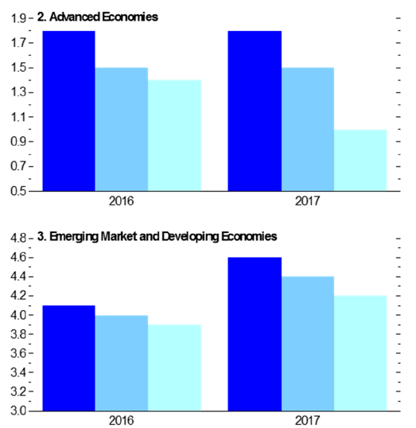
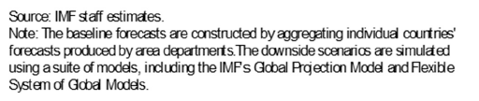
But on the heels of the Brexit vote, the Uncertainty About Growth is High
Whether the negative effect of Brexit is moderate or severe, the advanced economies are expected to be affected to a greater extent than the emerging/developing economies
1.8%
1.8%
1.5%
1.5%
1.4%
1.0%
The IMF said in mid-July that both scenarios are now less likely since the markets have settled down since the vote
4.6%
4.4%
4.2%
4.1%
4.0%
3.9%

Slide 9
Forecasts of 2016-17 GDP Growth of Selected Advanced Economies
The July 2016 IMF report forecasts growth in advanced economies in 2016-17 generally under 2% in Europe, around 2% in North America.
Except for North America, slight deterioration generally forecast for 2017.
Sources: International Monetary Fund, World Economic Outlook Update, July 2016, Table 1; Ins. Info. Institute.
9
Notes:
9

Slide 10
Forecasts of 2016-17 GDP Growth of Selected Developing Economies
IMF forecasts that 2016-17 growth in emerging/developing economies will continue to outpace advanced economies’ growth. Brazil and Russia will recover from their slump, posting weak but positive growth.
*Indonesia, Malaysia, the Phillipines, Thailand, and Vietnam
Sources: International Monetary Fund, World Economic Outlook Update, July 2016, Table 1; Ins. Info. Institute.
10
Notes:
10

Slide 11
World Trade Volume:
2010—2017F
Percentage Change
After a slowdown in growth in 2015 and 2016, global trade volume is expected to be stronger in 2017
The spurt of trade growth in 2010 was a rebound from the global recession. Growth in world trade volume (Imports + Exports)
has slowed but the volume is still rising.
Sources: IMF World Economic Outlook Update, July 2016, Table 1; Insurance Information Institute.

Slide 12
World Trade Volume: EXPORTS
2010 – 2017F
Advanced Economies
Emerging Economies
Growth (%)
Export growth in advanced economies should hold steady in 2017
Export growth in emerging economies matches advanced economies
Sources: IMF World Economic Outlook (April 2016); Insurance Information Institute.

Slide 13
World Trade Volume: IMPORTS
2010 – 2017F
Advanced Economies
Emerging Economies
Growth (%)
Import growth in Advanced Economies is expected to hold steady in 2016-17
Import growth in emerging economies is rebounding from a very weak 2015
Sources: IMF World Economic Outlook (April 2016); Insurance Information Institute.

Slide 14
Global P/C Insurance Snapshot
Developing Economies
are Severely Under-insured;
Will Faster GDP Growth Translate into Significant Premium Growth?
14

Slide 15
Nonlife Premium: Advanced vs. Emerging Economies, 2015
2015, US$ Billions
Nonlife premiums in the emerging economies grew 7.8% in 2015, after inflation adjustment.
In the advanced economies, nonlife premiums grew by 2.6% in 2015.
Premium Growth Facts
Industrialized Economies
$1, 614.3
Emerging Markets
$405.7
Developing economies now produce over half of global GDP but just 20% of nonlife premiums
Sources: Swiss Re Sigma No 3/2016 “World Insurance in 2015: steady growth amid regional disparities”; Insurance Information Institute research.

Slide 16
Non-life Premium/GDP* (Penetration) for Advanced Economies, 2001-2015
  Year-to-year comparisons of the penetration percentage indicates the degree to which premium growth is keeping up with exposure growth (as proxied by GDP).
*both measured in U.S. dollars; premiums exclude cross-border business Source: Swiss Re Sigma, various volumes

Slide 17
Non-life Premium/GDP* (Penetration) for the BRIC Economies, 2001-2015
Non-life premium growth faster than GDP growth. This is remarkable considering how fast China’s and India’s economies were growing.
Although the Penetration ratio in Brazil was essentially flat, that means premium growth basically kept pace with exposure growth. In Russia, the economy has struggled, and non-life premium growth struggled even more.
*both measured in U.S. dollars; premiums exclude cross-border business Source: Swiss Re Sigma, various volumes

Slide 18
2013 Non-life Premium if Penetration in BRIC Economies Equaled Advanced Economies
$US, billions
Sources: Swiss Re Sigma, various volumes; I.I.I. calculations

Slide 19
As Economies Grow Wealthier,
Insurance Market Penetration Grows Also
Some wealthy countries have penetration rates of 10% and over
U.S.?
Source: A.M. Best.

Slide 20
Greater Insurance Market Penetration Possibilities in Higher-Risk Countries
Low risk countries have high insurance penetration rates and afford fewer growth opportunities
Higher risk countries have low insurance penetration rates and often offer more growth opportunities
Low Risk High Risk
Source: A.M. Best.

Slide 21
Catastrophe Update
21

Slide 22
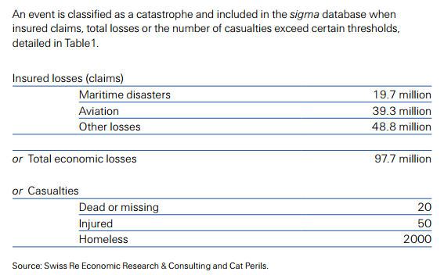
Swiss Re: Definition of a Catastrophe
Source: Swiss Re Sigma No. 1/2016 «Natural catastrophes and man-made disasters in 2015: Asia suffers substantial losses».

Slide 23
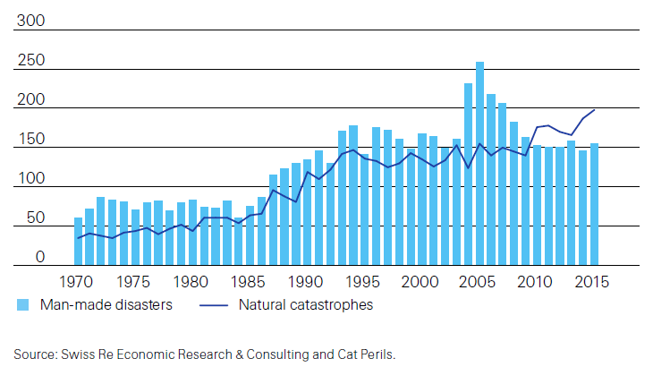
The number of natural catastrophe
events continues to trend up
Number of catastrophe events, 1970 – 2015
Record high number of natural cats in 2015, continuing upward trend
1993 was the first year that the number of man-made nat-cat events passed 150. It has happened virtually every year since then
Source: Swiss Re Sigma No. 1/2016 «Natural catastrophes and man-made disasters in 2015: Asia suffers substantial losses».

Slide 24
Swiss Re:
Man-Made Catastrophes in 2015
Catastrophe | # of Deaths
Boat sinking off Libyan coast | 800
Stampede at pilgrimage in Saudi Arabia | 769
Germanwings airplane crash | 150
Egyptair airplane crash | 224
Other aviation disasters | 311
Major fires, explosions, other | 1,123
Total | 7,000
Source: Swiss Re Sigma No. 1/2016 «Natural catastrophes and man-made disasters in 2015: Asia suffers substantial losses».

Slide 25
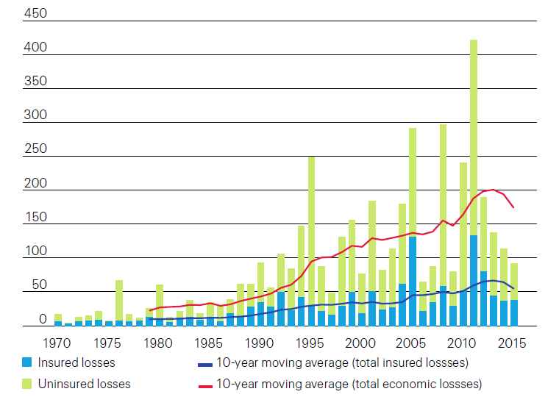
Total losses outpaced insured losses
Source: Swiss Re Sigma No. 1/2016 «Natural catastrophes and man-made disasters in 2015: Asia suffers substantial losses».

Slide 26
U.S. Insured Catastrophe Losses
($ Billions, $ 2015)
2012 was the 3rd most expensive year ever for insured CAT losses
2013/14/15 Were Welcome Respites from 2011/12, among the Costliest Years for Insured Disaster Losses in US History. 2016 Is Off to a Costlier Start.
$11.0B in insured CAT losses though 6/30/16
*Through 6/30/16. 2016 figure stated in 2016 dollars.
Note: 2001 figure includes $20.3B for 9/11 losses reported through 12/31/01 ($25.9B 2011 dollars). Includes only business and personal property claims, business interruption and auto claims. Non-prop/BI losses = $12.2B ($15.6B in 2011 dollars.)
Sources: Property Claims Service/ISO; Insurance Information Institute.
26
12/01/09 - 9pm
eSlide – P6466 – The Financial Crisis and the Future of the P/C
Notes:
26

Slide 27
Combined Ratio Points Associated with Catastrophe Losses: 1960 – 2015E*
Avg. CAT Loss Component of the Combined Ratio by Decade
1960s: 1.04 1970s: 0.85 1980s: 1.31 1990s: 3.39 2000s: 3.52 2010s: 5.46*
Catastrophe losses as a share of all losses reached a record high in 2011
Combined Ratio Points
The Catastrophe Loss Component of Private Insurer Losses Has Increased Sharply in Recent Decades
*2010s represent 2010-2015E.
Notes: Private carrier losses only. Excludes loss adjustment expenses and reinsurance reinstatement premiums. Figures are adjusted for losses ultimately paid by foreign insurers and reinsurers.
Source: ISO (1960-2009); A.M. Best (2010-15E) Insurance Information Institute.

Slide 28
Inflation-Adjusted U.S. Catastrophe Losses by Cause of Loss, 1995–2014¹
Wind/Hail/Flood (3), $21.4
Fires (4), $6.0
Winter storm losses were much above average in 2014/15 and will push this share up
Other (5), $0.2
Insured cat losses from 1995-2014 totaled $395.6B, an average of $19.8B per year
Geological Events, $0.5
Terrorism, $24.5
Winter Storms, $26.9
Hurricanes & Tropical Storms, $161.2
Tornado share of CAT losses is rising
Wind causes the most catastrophe losses by far, even if hurricanes/TS are excluded.
Events Involving Tornadoes (2), $154.9
Catastrophes are defined as events causing direct insured losses to property of $25 million or more in 2014 dollars.
Excludes snow.
Does not include NFIP flood losses
Includes wildland fires
Includes civil disorders, water damage, utility disruptions and non-property losses such as those covered by workers compensation.
Source: ISO’s Property Claim Services Unit.

Slide 29
Global CATs in the First Half of 2016 vs. 2015:1H and 10-year average
$Billion
Thunderstorms were the costliest type of insured event in both years
$110B
$71B
$52B
In 2016:1H, insured losses were 44% of total CAT losses, compared to 40% in 2015:1H. The insured losses were a higher percent of total losses in these years than the 10-year average.
Sources: Swiss Re Sigma; Insurance Information Institute.

Slide 30
Investments:
A Key Driver of Profitability
Depressed Yields Will Necessarily Influence Underwriting & Pricing
30

Slide 31
U.S. P/C Insurer Portfolio Yields,
2002-2015
P/C carrier yields have been falling for over a decade, reflecting the long downtrend in prevailing interest rates. Even as prevailing rates rise in the next few years, portfolio yields are unlikely to rise quickly,
since low yields of recent years are “baked in” to future returns.
Sources: NAIC, via SNL Financial; Insurance Information Institute.

Slide 32
US Treasury Note 10-Year Yields:
A Long Downward Trend, 2000–2016*
Yields on 10-Year US Treasury Notes have been below 3% for 5 years: bonds bought in 2006 at 5% will be reinvested at 1.50% for 10 more years
US Treasury yields plunged to historic lows in 2013, then rebounded but are sinking again
Since roughly 80% of P/C bond/cash investments are in 5-to-10-year durations, most P/C insurer portfolios will have low-yielding bonds for years to come.
*Monthly, constant maturity, nominal rates, through July 2016.
Sources: Federal Reserve Bank at http://www.federalreserve.gov/releases/h15/data.htm; National Bureau of Economic Research (recession dates); Insurance Information Institute.
32
12/01/09 - 9pm
eSlide – P6466 – The Financial Crisis and the Future of the P/C
Notes:
32

Slide 33
Distribution of Bond Maturities,
P/C Insurance Industry, 2006-2015
Two main shifts over these years. From 2008 to 2011-12, from bonds with longer maturities to bonds with shorter maturities. But beginning in 2013, the reverse. Note, however, that the percentages in bonds with maturities over 10 years continues to drop.
Sources: SNL Financial; Insurance Information Institute.

Slide 34
P/C Insurers: Below-Investment-Grade (BIG)
Bonds as a Percent of Total Bonds, 2001-2015
Chasing Yield? As a Group, P/C Carriers Have Increased
the Percentage of Bond Investments in Riskier Instruments.
Since 2006, That Percentage Has Risen About 250 Basis Points.
As Interest Rates Rise, Will This Percentage Return to Pre-recession Levels?
Sources: NAIC data, sourced from S&P Global Market Intelligence; Insurance Information Institute.

Slide 35
P/C Insurer Groups Holdings of BIG**
Bonds as a Percent of Total Bonds, 2014
Number of Groups
The 67 groups graphed are those with over $3 billion in cash & admitted assets as of year-end
P/C industry average
There is a wide disparity among insurance groups regarding holdings of below-investment-grade bonds. Some hold none (or almost none); a few have over 10% of their bond portfolio in BIGs.
*Below Investment Grade Sources: NAIC, via SNL Financial; Insurance Information Institute.

Slide 36
Forecasts for 10-Year Government Bond Yields, Quarterly, 2016:Q3 - 2017:Q3
Forecast as of June 8, 2016 (before the Brexit vote)
As noted, inflation in these nations is forecast to remain at 2% or lower through 2017. With real growth also low, bond yields aren’t likely to rise much more than 1/3 of a percentage point by 2017:Q3.
Sources: Wells Fargo Economics Group, Global Chartbook, June 2016, p. 26; I.I.I.

Slide 37
Other Things That Could
Affect the Course of Interest Rates
Prices of world currencies (the value of the US Dollar vs. the Euro, the Yen, the Yuan and other major world currencies)
Prices of a number of commodities (especially oil)
Prevailing interest rates in other countries (determined, in part, by those countries’ central banks)
The demand for, and the supply of, loanable funds
37
12/01/09 - 9pm
eSlide – P6466 – The Financial Crisis and the Future of the P/C
Notes:
37

Slide 38
The Growth, Profitability,
and Capital Position
of the Primary
P/C Insurance Industry
38

Slide 39
Net Premium Growth: Annual Change,
1971—2016F
16 Years
16 Years?
1975-78
1984-87
2000-03
2016-19
Net Written Premiums Fell 0.7% in 2007 (First Decline Since 1943) by 2.0% in 2008, and 4.2% in 2009, the First 3-Year Decline Since 1930-33.
2016F: 4.5%
2015: 3.4%
2014: 4.2%
2013: 4.6%
2012: 4.3%
Shaded areas denote “hard market” periods
Sources: A.M. Best (historical and forecast), ISO, Insurance Information Institute.

Slide 40
P/C Insurance Industry
Combined Ratio, 2001–2015*
Insurers Paid Nearly $1.16 for Every $1 in Earned Premiums
Higher CAT Losses, Shrinking Reserve Releases, Toll of Soft Market
Best Combined Ratio Since 1949 (87.6)
Heavy Use of Reinsurance Lowered Net Losses
* Excludes Mortgage & Financial Guaranty insurers 2008--2014. Including M&FG, 2008=105.1, 2009=100.7, 2010=102.4, 2011=108.1; 2012:=103.2; 2013: = 96.1; 2014: = 97.0.
Sources: A.M. Best, ISO.

Slide 41
Property/Casualty Insurance Industry Investment Income: 2000–2015¹
($ Billions)
Investment income is still below its 2007 pre-crisis peak
Due to persistently low interest rates, investment income fell in 2012, 2013 and 2014 but showed a small (1.9%) increase in 2015—a trend that may continue.
¹ Investment gains consist primarily of interest and stock dividends. Sources: ISO; Insurance Information Institute.

Slide 42
P/C Industry Net Income After Taxes
1991–2015
$ Millions
2006 ROE = 12.7%
2007 ROE = 10.9%
2008 ROE = 0.1%
2009 ROE = 5.0%
2010 ROE = 6.6%
2011 ROAS¹ = 3.5%
2012 ROAS¹ = 5.9%
2013 ROAS¹ = 10.2%
2014 ROAS¹ = 8.4%
2015:ROAS = 8.4%
ROE figures are GAAP; ¹Return on avg. surplus. Excluding Mortgage & Financial Guaranty insurers yields a 8.2% ROAS in 2014, 9.8% ROAS in 2013, 6.2% ROAS in 2012, 4.7% ROAS for 2011, 7.6% for 2010 and 7.4% for 2009.
Sources: A.M. Best, ISO; Insurance Information Institute.

Slide 43
Profitability Peaks & Troughs in the P/C Insurance Industry, 1975 – 2016F
ROE
1977:19.0%
History suggests next ROE peak will be in 2016-2017, but that seems unlikely
1987:17.3%
10 Years
2006:12.7%
1997:11.6%
10 Years
2013 9.8%
2015=8.4%
2016F=6.3%
9 Years
2014 8.4%
1975: 2.4%
1984: 1.8%
1992: 4.5%
2001: -1.2%
*Profitability = P/C insurer ROEs. 2011-14 figures are estimates based on ROAS data. Note: Data for 2008-2014 exclude mortgage and financial guaranty insurers.
Source: Insurance Information Institute; NAIC, ISO, A.M. Best, Conning

Slide 44
Return on Net Worth (RNW)
Largest Lines: 2005-2014 Average
Percent
Commercial lines have tended to be more profitable than personal lines over the past decade
Source: NAIC; Insurance Information Institute.

Slide 45
Policyholder Surplus,
2006:Q4–2016:Q1
($ Billions)
2007:Q3
Pre-Crisis Peak
Drop due to near-record 2011 CAT losses
Surplus as of 3/31/16 stood at $676.3B
The industry now has $1 of surplus for every $0.77 of NPW,
close to the strongest claims-paying status in its history.
2010:Q1 data includes $22.5B of paid-in capital from a holding company parent for one insurer’s investment in a non-insurance business.
The P/C insurance industry entered 2016
in very strong financial condition.
Sources: ISO, A.M .Best.
45
12/01/09 - 9pm
eSlide – P6466 – The Financial Crisis and the Future of the P/C
Notes:
45

Slide 46
Alternative Capital
New Investors
Are Changing the Reinsurance Landscape
46

Slide 47
Global Reinsurance Capital (Traditional and Alternative), 2006-2016
Total reinsurance capital is at a new high, just above the 2014 level.
Alternative capacity has grown 284% since 2008.
In just the past four years it more than doubled.
Aon projection: $180 Billion by 2018.
Source: Aon Benfield Analytics; Insurance Information Institute.

Slide 48
Growth of Alternative Capital Structures, 2002–2016
Collateralized Re’s Growth Has Accelerated in the Past Seven Years.
Collateralized Reinsurance and Catastrophe Bonds Currently Dominate the Alternative Capital Market.
Source: Aon Benfield Analytics; Insurance Information Institute.

Slide 49
Growth of Alternative Capital Structures, 2002–2016
Collateralized Re’s Growth Has Accelerated in the Past Seven Years.
Collateralized Reinsurance and Catastrophe Bonds Currently Dominate the Alternative Capital Market.
Source: Aon Benfield Analytics; Insurance Information Institute.

Slide 50
Catastrophe Bonds Issued,
2004-2015
Risk Capital ($ Millions)
Volume grew slowly from 2007-2011.
Volume doubled from 2011-2015.
Volume soared from 2004-2007.
* Trailing 12-month average
Sources: Willis Capital Markets, Insurance Information Institute.

Slide 51
Catastrophe Bonds Outstanding,
2004-2015
Risk Capital ($ Millions)
Volume unchanged from 2007-2011.
Volume doubled from 2011-2015.
Volume tripled from 2004-2007.
* Trailing 12-month average
Sources: Willis Capital Markets, Insurance Information Institute.

Slide 52
Conclusion
Economic Issues Facing
the Reinsurance Industry
52

Slide 53
Near-Term Issues
Effects of the near-stagnation of the major European economies
  Tight monetary/fiscal policy => Slow/No Growth
  Other headwinds affecting European growth:
    Population aging
A Return to Tariffs/Trade Wars?
Inflation is not a concern currently, but it could become one quickly
  Helpful and Harmful: Inflation affects claims (bad) and investment income (good)

Slide 54
IMF Inflation Forecast for Selected Advanced Economies, 2016-2017
The July 2016 IMF report forecasts 1% inflation in advanced economies in 2016 and a little higher growth in prices in 2017.
Sources: International Monetary Fund, World Economic Outlook Update, July 2016, Table 1; Ins. Info. Institute.
54
Notes:
54

Slide 55
IMF Inflation Rate Forecast for 2016-17 for Selected Emerging Economies
Inflation is forecast to be 6% or more in 2016-17 in some major emerging economies. Inflation there can spread to advanced economies through imports. The IMF forecasts a slight decrease in inflation in 2017.
Sources: International Monetary Fund, World Economic Outlook, April 2016; Ins. Info. Institute.

Slide 56
Longer-Term Issues (a partial list)
Persistently Low Interest Rates
Currency Market Instability
Strong Capital Flows to Emerging/Developing Economies => Asset Price Bubbles?
Regulatory Backlash/Developments
Terrorism

Slide 57
Insurance Information Institute Online:
www.iii.org
Thank you for your time
and your attention!

