Slide 1
An Actuary Looks at Social Inflation
Insurance Information Institute

Slide 2
Social Inflation
Coming to terms
A good definition
  “A fancy term to describe rising litigation costs and their impact on insurers’ claim payouts, loss ratios, and ultimately, how much policyholders pay for coverage.”
Actuarial interpretation
  “Excessive inflation in claims.”
    Occurs when development defies key assumption: Loss Development is RV about stable mean

Slide 3
Upward Trend in Incurred Losses
Incurred Losses, Commercial Auto Liability
Billions
11% Annual Growth for a Decade
Sources: NAIC data sourced from S&P Market Intelligence; Insurance Information Institute.
Notes:
Why is this growing?
More accidents
Bigger claims
Can’t tell by looking at this

Slide 4
What Actuaries Do
How much will insurers pay for claims that occurred in 2010?
Industry Losses for AY 2010 Commercial Auto Liability
Reported losses change over time. Actuaries estimate
how much will ultimately be paid on a bloc of claims.
Source: NAIC data, sourced through S&P Global Market Intelligence.
Notes:
Actuaries estimate how much will be paid out on a bloc of claims.
The change in reported losses generally follows a predictable pattern. Actuaries discern that pattern, then help management know how much they must set aside to make sure there’s enough to pay all claims that occurred in a period.
This is a chart of losses for claims arising in 2010.
Blue line is how much is reported in losses. What claims professionals estimate will ultimately be paid on all the claims they know about that occurred in 2010. This changes from year to year as they learn more about each claim. Like it might take more than a year to learn the extent of a plaintiff’s injuries. So the claims estimates generally grow over time, as they do here.
Orange line is how much companies estimated would ultimately be paid on that set of claims. That gets reestimated every year, but in a line like commercial auto liability, that estimate doesn’t change much. And it doesn’t here.

Slide 5
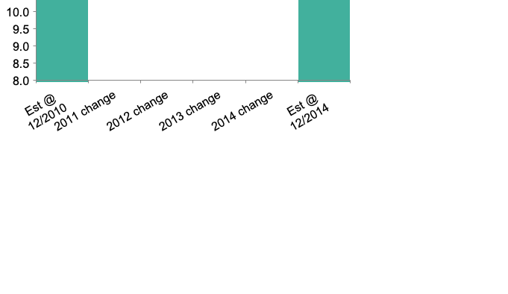
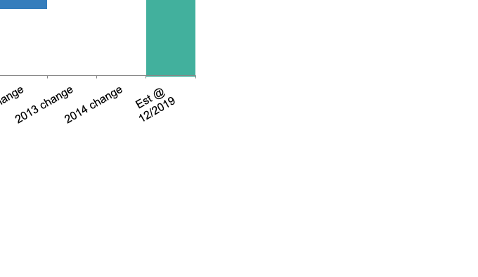
What Actuaries Do
The old rules don’t apply anymore
Ultimate Losses for 2010 Claims
Across Time
Ultimate Losses for 2015 Claims
Across Time
Starting around 2015, something made the old process yield a weak estimate.
Source: NAIC data, sourced through S&P Global Market Intelligence.

Slide 6
Social Inflation: The Toll
Reserve development, commercial auto liability
Millions
Additions to Claim Reserves
Reductions from Claim Reserves
Sources: NAIC data sourced from S&P Market Intelligence; Insurance Information Institute.

Slide 7
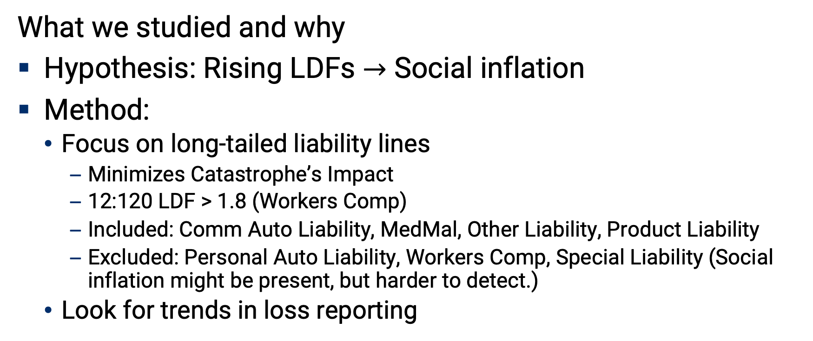
Triple-I Analysis
What we studied and why
Hypothesis: Rising LDFs $→$ Social inflation
Method:
  Focus on long-tailed liability lines
    Minimizes Catastrophe’s Impact
    12:120 LDF > 1.8 (Workers Comp)
    Included: Comm Auto Liability, MedMal, Other Liability, Product Liability
    Excluded: Personal Auto Liability, Workers Comp, Special Liability (Social inflation might be present, but harder to detect.)
  Look for trends in loss reporting

Slide 8
Upward Creep in Loss Development
Key assumption: LDF is RV about mean + inflation
Comm Auto LDFs
2-Year Expected vs. Actual
 | 12 | 24 | 36 | 48
2009 | 1.34 | 1.14 | 1.08 | 1.03
2010 | 1.36 | 1.16 | 1.08 | 1.04
2011 | 1.40 | 1.16 | 1.08 | 1.04
2012 | 1.40 | 1.16 | 1.09 | 1.04
2013 | 1.41 | 1.18 | 1.10 | 1.04
2014 | 1.42 | 1.19 | 1.10 | 1.05
2015 | 1.45 | 1.18 | 1.11
2016 | 1.43 | 1.20
2017 | 1.44
12-36 Development ($ Millions)
Source: NAIC data, sourced from S&P Global Intelligence; Insurance Information Institute. Expected: 3-yr Straight Average.
Notes:
Actuaries look at the pattern of reported losses – the sum of claims experts’ estimates of every known loss.
Even if the ultimate amount of claims rises or falls from year to year, the pattern of emergence should stay the same. That hypothesis is at the core of standard actuarial practices.
Actuaries call that pattern of emergence loss development and measure it with loss development factors.
In normal times, the loss development factors should stay the same over time. Here it is increasing.
One interesting offshoot of this work is that you can also predict how much will be reported in any 12 month period. The chart on the right shows how actuaries have not been able to do this in commercial auto.

Slide 9
It’s Not Just Auto
12:36 loss development factors by year, long-tailed lines
Commercial Auto
MedMal Claims-Made
Other Liability Occurrence
Other Long-Tailed Lines*
*Medical Malpractice Occurrence, Other Liability Claims-Made, Products Liability Occurrence, Products Liability Claims-Made.
Estimate assumes 24:36 Factor is straight average of previous three years.
Source: NAIC data, sourced from S&P Global Market Intelligence; Insurance Information Institute.

Slide 10
Why Is It Happening? …And What Makes It Social Inflation
Overall Inflation Remains Steady
Who Solves Problems?
CPI Change vs Year Earlier
Confidence in Institutions
Sources: Bureau of Labor Statistics (via FRED), Gallup.

Slide 11
Why Is It Happening? The Changing Legal Environment
Anchoring: “Jackpot Justice”
Litigation Financing
Median, 50 Largest Jury Verdicts
Percent of US Law Firms Using Litigation Financing
Litigation is a financeable asset.
- 68% of US Law Firms
Sources: Swiss Re Economic Insights, Burford Capital.

Slide 12
Why Is It Happening? Social Trends Set the Stage
Big Payout Expectations
Dystopian Days
No. of $300M Lottery Jackpots
% Chg, Real Income Since 79
Life Expectancy at Birth
Search Topic: Utopia vs Dystopia
Interest Over Time (12-Mo Mov. Avg)
Sources: Wikipedia, Economic Policy Institute, Centers for Disease Control, Google Trends.

