Slide 1
The Great Tradeoff: Regulation, Strength & Solvency vs. Profitability & Growth Can They Co-Exist?
St. John’s University
School of Risk Management, Insurance & Actuarial Science
New York, NY
October 15, 2014
Robert P. Hartwig, Ph.D., CPCU, President & Economist
Insurance Information Institute ♦ 110 William Street ♦ New York, NY 10038
Tel: 212.346.5520 ♦ Cell: 917.453.1885 ♦ bobh@iii.org ♦ www.iii.org

Slide 2
Presentation Outline
PART I: PROFITABILITY
A History of Insurance Industry Profitability
Can financial strength and robust profitability co-exist?
Supply, Demand and Alternative “Capital”
When Profits Suffer, Who Is to Blame?
7 Leading Contenders: The “Fall Guys”
Is the Insurance Industry Becoming Less Risky?
Since when? Why?
Comparison with Banks
PART II: GROWTH
A Global History & Overview of Growth
Pockets and Waves of Growth
Narrowing the “Underinsurance Gap”
Growth through Consolidation?
Q&A

Slide 3
PART I: PROFITABILITY Has Strength Come at the Expense of Performance?
What Can History Tell Us?
3

Slide 4
What Is Happening to Insurer Profitability?
What Can We Learn from History?
Déjà Vu: Cycles or Super-Cycles?
4

Slide 5
P/C Industry Net Income After Taxes 1991–2014*
2005 ROE*= 9.6%
2006 ROE = 12.7%
2007 ROE = 10.9%
2008 ROE = 0.1%
2009 ROE = 5.0%
2010 ROE = 6.6%
2011 ROAS¹ = 3.5%
2012 ROAS¹ = 5.9%
2013 ROAS¹ = 10.3%
2014 ROAS¹ = 7.8%*
Net income rose strongly (+81.9%) in 2013 vs. 2012 on lower cats, capital gains
$ Millions
2014 is off to a slower start
ROE figures are GAAP; ¹Return on avg. surplus. Excluding Mortgage & Financial Guaranty insurers yields a 7.7% ROAS through 2014:Q2, 9.8% ROAS in 2013, 6.2% ROAS in 2012, 4.7% ROAS for 2011, 7.6% for 2010 and 7.4% for 2009. 2014 is annualized H1 data.
Sources: A.M. Best, ISO; Insurance Information Institute

Slide 6
RNW All Lines by State, 2003-2012 Average: Highest 25 States
The most profitable states over the past decade are widely distributed geographically, though none are in the Gulf region
Source: NAIC; Insurance Information Institute.

Slide 7
RNW All Lines by State, 2003-2012 Average:
Lowest 25 States
Some of the least profitable states over the past decade were hit hard by catastrophes
Source: NAIC; Insurance Information Institute.

Slide 8
P/C Insurance Industry Combined Ratio, 2001–2014:H1*
Relatively Low CAT Losses, Reserve Releases
Higher CAT Losses, Shrinking Reserve Releases, Toll of Soft Market
As Recently as 2001, Insurers Paid Out Nearly $1.16 for Every $1 in Earned Premiums
Heavy Use of Reinsurance Lowered Net Losses
Relatively Low CAT Losses, Reserve Releases
Avg. CAT Losses, More Reserve Releases
Sandy Impacts
Best Combined Ratio Since 1949 (87.6)
Cyclical Deterioration
Lower CAT Losses
* Excludes Mortgage & Financial Guaranty insurers 2008--2014. Including M&FG, 2008=105.1, 2009=100.7, 2010=102.4, 2011=108.1; 2012:=103.2; 2013: = 96.1; 2014:H1 = 98.9.
Sources: A.M. Best, ISO.

Slide 9
ROE: Property/Casualty Insurance by Major Event, 1987–2014:H1
(Percent)
P/C Profitability Is Both by Cyclicality and Ordinary Volatility
Katrina, Rita, Wilma
Low CATs
Sept. 11
Hugo
Lowest CAT Losses in 15 Years
4 Hurricanes
Sandy
Andrew
Record Tornado Losses
Northridge
Financial Crisis*
* Excludes Mortgage & Financial Guarantee in 2008 – 2014. 2014 figure is through H1:2014.
Sources: ISO, Fortune; Insurance Information Institute.

Slide 10
Profitability Peaks & Troughs in the P/C Insurance Industry, 1975 – 2014:H1*
ROE
1977:19.0%
History suggests next ROE peak will be in 2015-2016
1987:17.3%
10 Years
2006:12.7%
1997:11.6%
10 Years
2013 10.4%
9 Years
2014:H1 7.7%
1975: 2.4%
1984: 1.8%
1992: 4.5%
2001: -1.2%
*Profitability = P/C insurer ROEs. 2011-14 figures are estimates based on ROAS data. Note: Data for 2008-2014 exclude mortgage and financial guaranty insurers.
Source: Insurance Information Institute; NAIC, ISO, A.M. Best.

Slide 11
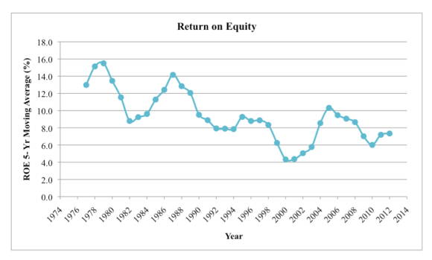
P/C Insurance ROE as 5-Year Moving Average
After smoothing, there is a more evident trend toward lower profitability
The Tradeoff:
Industry impairment rates have plunged
Source: Jessica Weinkle, Insurance Journal, “An Average Perspective Based Insurance Profitability Cycles,” October 6, 2014, based om I.I.I. data, http://www.insurancejournal.com/magazines/closingquote/2014/10/06/342096.htm.

Slide 12
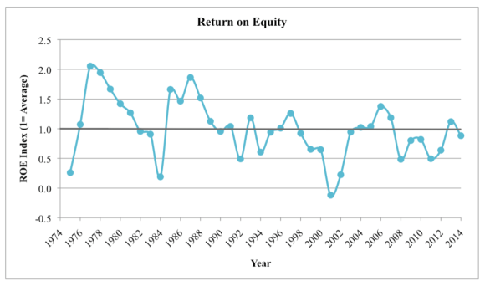
P/C Insurance ROE Index (1974-2014:Q1 = 100)
Lower profitability seems to be the norm after 1994. Is RBC a cause? Greater use of modeling?
The Tradeoff:
Industry impairment rates have plunged
Source: Jessica Weinkle, Insurance Journal, “An Average Perspective Based Insurance Profitability Cycles,” October 6, 2014, based om I.I.I. data, http://www.insurancejournal.com/magazines/closingquote/2014/10/06/342096.htm.

Slide 13
Back to the Future: Profitability Peaks & Troughs in the P/C Insurance Industry, 1950 – 2014*
ROE
1970-90: Peak ROEs were much higher in this period while troughs were comparable. High interest rates, rapid inflation, economic volatility all played roles
1950-70: ROEs were lower in this period. Low interest rates, low inflation, “Bureau” rate regulation all played a role
1990-2010s: Déjà vu. Excluding mega-CATs, this period is very similar to the 1950-1970 period
1977:19.0%
1987:17.3%
2006:12.7%
1972:13.7%
1997:11.6%
2013 10.4%
1950:8.0%
1966-67: 5.5%
1959:6.8%
2014:H1 7.7%
1969: 3.9%
1957: 1.8%
1965: 2.2%
1975: 2.4%
1984: 1.8%
1992: 4.5%
2001: -1.2%
*Profitability = P/C insurer ROEs. 2011-14 figures are estimates based on ROAS data. Note: Data for 2008-2014 exclude mortgage and financial guaranty insurers. 2014 figure is through Q2.
Source: Insurance Information Institute; NAIC, ISO, A.M. Best.

Slide 14
Average ROE for the P/C Insurance Industry by Decade, 1950s – 2010s
Profitability peaked in the 1970s and 1980s but has tapered off since then
Average Annual Percent Change (%)
P/C profitability was much lower in the 1960s and 1970s
Profitability Has Declined since the highs of the 1970s and 1980s, but is above that of the 1950s and 1960s
Sources: Insurance Information Institute research.
14
12/01/09 - 9pm
eSlide – P6466 – The Financial Crisis and the Future of the P/C
Notes:
14

Slide 15
A 100 Combined Ratio Isn’t What It Once Was: Investment Impact on ROEs
A combined ratio of about 100 generates an ROE of ~7.0% in 2012/13, ~7.5% ROE in 2009/10, 10% in 2005 and 16% in 1979
Combined Ratio / ROE
Lower CATs helped ROEs in 2013
Combined Ratios Must Be Lower in Today’s Depressed Investment Environment to Generate Risk Appropriate ROEs
* 2008 -2014 figures are return on average surplus and exclude mortgage and financial guaranty insurers. 2014:H1 combined ratio including M&FG insurers is 98.9; 2013 = 96.1; 2012 =103.2, 2011 = 108.1, ROAS = 3.5%.
Source: Insurance Information Institute from A.M. Best and ISO Verisk Analytics data.

Slide 16
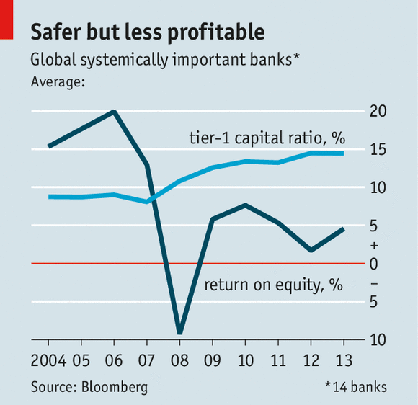
BANK LESSON: Profitability, Capital and Systemically Important Banks
Global Systemically Important bank Tier-1 capital ratios are up since the global financial crisis, but ROEs are lower
The Message from Regulators:
Get used to it!
Source: The Economist, “No Respite,” September 27, 2014.

Slide 17
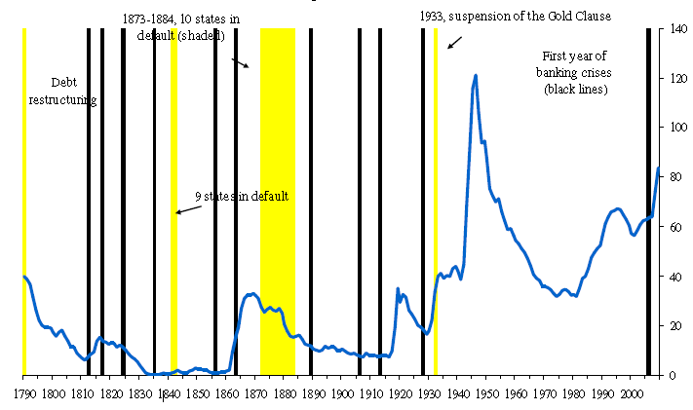
Banks Regularly Get Themselves Into Trouble, Crashing the Economy
Global Systemically Important bank Tier-1 capital ratios are up since the global financial crisis, but ROEs are lower
The Message from Regulators:
Get used to it!
Source: Carmen Reinhardt, Chartbook for “This Time is Different,” https://www.princeton.edu/economics/seminar-schedule-by-prog/macro-s10/papers/Reinhardt-Chartbook.pdf

Slide 18
Who’s to Blame for the Decline in Peak P/C Profitability?
The 7 “Fall Guys”
18

Slide 19
#1 Mother Nature
Profits in the Age of Mega CATs
19

Slide 20
Number of Federal Major Disaster Declarations, 1953-2014*
There have been 2,176 federal disaster declarations since 1953. The average number of declarations per year is 35 from 1953-2013, though there few haven’t been recorded since 1995.
The number of federal disaster declarations set a new record in 2011, with 99, shattering 2010’s record 81 declarations.
40 federal disasters were declared so far in 2014*
The Number of Federal Disaster Declarations Is Rising and Set New Records in 2010 and 2011 Before Dropping in 2012/13
*Through September 2, 2014.
Source: Federal Emergency Management Administration; http://www.fema.gov/disasters; Insurance Information Institute.

Slide 21
Natural Disasters in the United States, 1980 – 2013 Number of Events (Annual Totals 1980 – 2013)
There were 128 natural disaster events in 2013
Number
22
19
81
6
Geophysical
(earthquake, tsunami,
volcanic activity)
Meteorological (storm)
Climatological
(temperature extremes,
drought, wildfire)
Hydrological
(flood, mass movement)
Source: MR NatCatSERVICE
21

Slide 22
Combined Ratio Points Associated with Catastrophe Losses: 1960 – 2013*
Avg. CAT Loss Component of the Combined Ratio by Decade
1960s: 1.04 1970s: 0.85 1980s: 1.31 1990s: 3.39 2000s: 3.52 2010s: 6.1E*
Catastrophe losses as a share of all losses reached a record high in 2012
Combined Ratio Points
The Catastrophe Loss Component of Private Insurer Losses Has Increased Sharply in Recent Decades
*2010s represent 2010-2013.
Notes: Private carrier losses only. Excludes loss adjustment expenses and reinsurance reinstatement premiums. Figures are adjusted for losses ultimately paid by foreign insurers and reinsurers.
Source: ISO (1960-2011); A.M. Best (2012E) Insurance Information Institute.

Slide 23
Top 16 Most Costly Disasters in U.S. History
(Insured Losses, 2013 Dollars, $ Billions)
Superstorm Sandy in 2012 was the last mega-CAT to hit the US
Includes Tuscaloosa, AL, tornado
Includes Joplin, MO, tornado
12 of the 16 Most Expensive Events in US History Have Occurred Over the Past Decade (2004-2013)
Sources: PCS; Insurance Information Institute inflation adjustments to 2013 dollars using the CPI.

Slide 24
#2 Wall Street
Crashes, Interest Rates & General Volatility
24

Slide 25
S&P 500 Index Returns, 1950 – 2014*
ROE
Volatility is endemic to stock markets—and may be increasing—but there is no persistent downward trend over long periods of time
Fed Raises Rate
2014:H1 7.7%
Tech Bubble Implosion
Energy Crisis
Financial Crisis
*Through Oct. 12, 2014.
Source: NYU Stern School of Business: http://pages.stern.nyu.edu/~adamodar/New_Home_Page/datafile/histretSP.html Ins. Info. Inst.

Slide 26
P/C Insurer Net Realized Capital Gains/Losses, 1990-2013
Realized capital gains rose sharply as equity markets rallied
($ Billions)
Insurers Posted Net Realized Capital Gains in 2010 - 2013 Following Two Years of Realized Losses During the Financial Crisis. Realized Capital Losses Were a Primary Cause of 2008/2009’s Large Drop in Profits and ROE
Sources: A.M. Best, ISO, Insurance Information Institute.
26
12/01/09 - 9pm
eSlide – P6466 – The Financial Crisis and the Future of the P/C
Notes:
26

Slide 27
Property/Casualty Insurance Industry Investment Income: 2000–2014¹
Investment earnings are still below their 2007 pre-crisis peak
($ Billions)
Due to persistently low interest rates, investment income fell in 2012 and in 2013 and is falling again in 2014.
¹ Investment gains consist primarily of interest and stock dividends. *2014 figure is estimated based on annualized H1 data.
Sources: ISO; Insurance Information Institute.

Slide 28
Property/Casualty Insurance Industry Investment Gain: 1994–2013¹
($ Billions)
Investment gains in 2013 were their highest in the post-crisis era
Investment Income Continued to Fall in 2013 Due to Low Interest Rates but Realized Investment Gains Were Up Sharply; The Financial Crisis Caused Investment Gains to Fall by 50% in 2008
¹ Investment gains consist primarily of interest, stock dividends and realized capital gains and losses.
* 2005 figure includes special one-time dividend of $3.2B;
Sources: ISO; Insurance Information Institute.

Slide 29
#3 The Federal Reserve
Do Fed Rates Actions Help or Hurt P/C Insurers?
29

Slide 30
U.S. Treasury Security Yields: A Long Downward Trend, 1990–2014*
Yields on 10-Year U.S. Treasury Notes have been essentially below 5% for a full decade.
U.S. Treasury yields plunged to historic lows in 2013. Longer-term yields have rebounded a bit.
Since roughly 80% of P/C bond/cash investments are in 10-year or shorter durations, most P/C insurer portfolios will have low-yielding bonds for years to come.
*Monthly, constant maturity, nominal rates, through July 2014.
Sources: Federal Reserve Bank at http://www.federalreserve.gov/releases/h15/data.htm. National Bureau of Economic Research (recession dates); Insurance Information Institute.
30
12/01/09 - 9pm
eSlide – P6466 – The Financial Crisis and the Future of the P/C
Notes:
30

Slide 31
Reduction in Combined Ratio Necessary to Offset 1% Decline in Investment Yield to Maintain Constant ROE, by Line*
Lower Investment Earnings Place a Greater Burden on Underwriting and Pricing Discipline
*Based on 2008 Invested Assets and Earned Premiums
**US domestic reinsurance only
Source: A.M. Best; Insurance Information Institute.
31
12/01/09 - 9pm
eSlide – P6466 – The Financial Crisis and the Future of the P/C
Notes:
31
This shows the drop in Combined Ratio for each line of business that would be needed to maintain a constant ROE, given a 1-percentage-point drop in investment yield

Slide 32
#4 The Economy
Do Variability and Volatility in the Economy Make Earning Reasonable ROEs More Difficult?
32

Slide 33
US Real GDP Growth*
The Q4:2008 decline was the steepest since the Q1:1982 drop of 6.8%
Real GDP Growth (%)
Recession began in Dec. 2007. Economic toll of credit crunch, housing slump, labor market contraction was severe
Q1 2014 GDP data were hit hard by this year’s “Polar Vortex” and harsh winter
Demand for Insurance Should Increase in 2014/15 as GDP Growth Accelerates Modestly and Gradually Benefits the Economy Broadly
* Estimates/Forecasts from Blue Chip Economic Indicators.
Source: US Department of Commerce, Blue Economic Indicators 9/14; Insurance Information Institute.

Slide 34
Impairments vs. Real GDP Growth, P/C & L/H, 1978-2013
Insurers are more resilient to economic volatility than in the past. That improvement began well before Dodd-Frank
No. of Impairments
Real GDP Growth
Today, impairment rates seem less sensitive to economic downturns
Historically, there has been a lagged, inverse relationship between GDP growth and impairments
Very few impairments
*US P/C and L/H companies, 1977-2013.
Sources: A.M. Best: Best’s Impairment Rate and Rating Transition Study—1977-2013, March 31, 2014; Insurance Information Institute.

Slide 35
Downgrade/Upgrade Ratio vs. Real GDP Growth, P/C & L/H, 1978-2013
Downgrades tend to fall relative to upgrades as the economy improves
Ratio of Downgrades to Upgrades
Increase in downgrade/upgrade ratio was smaller in Great Recession than past recessions, suggesting greater resilience
Real GDP Growth
Historically, there has been a lagged, inverse relationship between GDP growth and impairments
*US P/C and L/H companies, 1977-2013.
Sources: A.M. Best: Best’s Impairment Rate and Rating Transition Study—1977-2013, March 31, 2014; Insurance Information Institute.

Slide 36
Number of Recessions Endured by P/C Insurers, by Number of Years in Operation
Number of Recessions Since 1860
Insurers are true survivors—not just of natural catastrophes but also economic ones
Number of Years in Operation
Many US Insurers Are Close to a Century Old or Older
Sources: Insurance Information Institute research from National Bureau of Economic Research data.
36
12/01/09 - 9pm
eSlide – P6466 – The Financial Crisis and the Future of the P/C
Notes:
36

Slide 37
#5 The President (of the United States)
How Is Profitability Affected by the President’s Political Party?
37

Slide 38
P/C Insurance Industry ROE by Presidential Administration, 1950-2014*
OVERALL RECORD: 1950-2014*
Democrats 7.72%
Republicans 7.85%
Party of President has marginal bearing on profitability of P/C insurance industry
*Truman administration ROE of 6.97% based on 3 years only, 1950-52; Estimated ROE for 2014 = 7.8% based on data through 2014:Q2.
Source: Insurance Information Institute

Slide 39
P/C insurance Industry ROE by Presidential Party Affiliation, 1950- 2014*
BLUE = Democratic President RED = Republican President
Nixon/Ford
Carter
Reagan/Bush I
Clinton
Bush II
Obama
Truman
Eisenhower
Kennedy/ Johnson
Estimated ROE for 2014 = 7.8% based on data through 2014:Q2.
Source: Insurance Information Institute

Slide 40
#6 Ratings Agencies
Quasi-Regulators Must Have Some Impact
40

Slide 41
P/C Insurer Impairments, 1969–2013
Impairments among P/C insurers remain infrequent
The Number of Impairments Varies Significantly Over the P/C Insurance Cycle, With Peaks Occurring Well into Hard Markets
Source: A.M. Best Special Report “U.S. P/C Impairments Down Sharply in 2013; Alternative Risk Players Faltered,” June 23, 2014; Insurance Information Institute.

Slide 42
P/C Insurer Impairment Frequency vs. Combined Ratio, 1969-2013
2013 impairment rate was 0.43%, down from 0.76% in 2012; the rate is lower than the 0.81% average since 1969
Impairment Rates Are Highly Correlated With Underwriting Performance and Reached Record Lows in 2007; Recent Increase Was Associated Primarily With Mortgage and Financial Guaranty Insurers and Not Representative of the Industry Overall
Source: A.M. Best; Insurance Information Institute

Slide 43
Reasons for US P/C Insurer Impairments, 1969–2013
Historically, Deficient Loss Reserves and Inadequate Pricing Are By Far the Leading Cause of P-C Insurer Impairments. Investment and Catastrophe Losses Play a Much Smaller Role
Reinsurance Failure
Sig. Change in Business
Misc.
Investment Problems (Overstatement of Assets)
Deficient Loss Reserves/ Inadequate Pricing
Affiliate Impairment
Leading causes of death (reserves and growth) are generally under the control of insurers
Catastrophe Losses
Alleged Fraud
Rapid Growth
Source: A.M. Best Special Report “U.S. P/C Impairments Down Sharply in 2013; Alternative Risk Players Faltered,” June 23, 2014; Insurance Information Institute.

Slide 44
P/C Reserve Development, 1992–2015E
P/C reserve development is clearly cyclical
Note: 2005 reserve development excludes a $6 billion loss portfolio transfer between American Re and Munich Re. Including this transaction, total prior year adverse development in 2005 was $7 billion. The data from 2000 and subsequent years excludes development from financial guaranty and mortgage insurance.
Sources: A.M. Best, ISO, Barclays Research (estimates for 2013-2015).

Slide 45
Rapid Growth ‘A Leading Cause’ of Impairment’
“The leading causes of impairment are deficient loss reserves (inadequate pricing) and rapid growth, together comprising more than 50 percent of annual impairments.”
- A.M. Best, 2013
Source: SNL Financial, Insurance Information Institute.

Slide 46
Top 10 Lines of Business for US P/C Impaired Insurers, 1969–2013
Workers Comp and Pvt. Passenger Auto Account for Nearly 45 Percent of the Impaired Insurers Since 1969
Other
Mortgage & Financial Guaranty
Title
Workers Comp
WC accounts for only about 9% of all premiums written but 17% of premium of impaired insurers, whereas PPA accounts for 37% of all premiums but only 26% of impaired insurer premiums
Surety
Medical Prof. Liability
Other Liability
Pvt. Passenger Auto
Commercial Auto Liability
Commercial Multiperil
Homeowners
Source: A.M. Best Special Report “U.S. P/C Impairments Down Sharply in 2013; Alternative Risk Players Faltered,” June 23, 2014; Insurance Information Institute.

Slide 47
Cumulative Average Impairment Rates by A.M. Best Financial Strength Rating*
Insurers with strong ratings are far less likely to become impaired (fail) over long periods of time. Note: The cumulative likelihood of impairment has been falling uniformly across the 15-year time horizon for all but the riskiest (lowest rated) riskiest insurers. This suggests that insurers have become less risky over the past several years.
*US P/C and L/H companies, 1977-2013.
Sources: A.M. Best: Best’s Impairment Rate and Rating Transition Study—1977-2013, March 31, 2014; Insurance Information Institute.

Slide 48
Cumulative Average Impairment Rates by A.M. Best Financial Strength Rating*
“Vulnerable” (rating of B or lower) are far more likely to become impaired than “Secure” (rating of B+ or better
*US P/C and L/H companies, 1977-2013.
Sources: A.M. Best: Best’s Impairment Rate and Rating Transition Study—1977-2013, March 31, 2014; Insurance Information Institute.

Slide 49
#7 Regulators
Is an Increased Regulatory Burden Reducing ROEs?
49

Slide 50
Is There Evidence that the (Re) Insurance Industry Is Becoming Less Risky
Is Boring Better?
50

Slide 51
Policyholder Surplus, 2006:Q4–2014:H1
Drop due to near-record 2011 CAT losses
($ Billions)
2007:Q3 Pre-Crisis Peak
Surplus as of 6/30/14 stood at a record high $671.6B
The industry now has $1 of surplus for every $0.73 of NPW, close to the strongest claims-paying status in its history.
2010:Q1 data includes $22.5B of paid-in capital from a holding company parent for one insurer’s investment in a non-insurance business .
The P/C insurance industry entered 2014 in very strong financial condition.
Sources: ISO, A.M .Best.
51
12/01/09 - 9pm
eSlide – P6466 – The Financial Crisis and the Future of the P/C
Notes:
51

Slide 52
US Policyholder Surplus: 1975–2014*
($ Billions)
Surplus as of 6/30/14 was a record $671.6, up 2.8% from $653.3 of 12/31/13, and up 53.6% ($234.5B) from the crisis trough of $437.1B at 3/31/09
“Surplus” is a measure of underwriting capacity. It is analogous to “Owners Equity” or “Net Worth” in non-insurance organizations
The Premium-to-Surplus Ratio Stood at $0.73:$1 as of 6/30/14, a Near Record Low (at Least in Recent History)
* As of 6/30/14.
Source: A.M. Best, ISO, Insurance Information Institute.

Slide 53
Premium-to-Surplus Ratio: 1985–2014*
(Ratio of NWP to PHS)
The larger surplus is in relation to premiums—the lower the P:S ratio—and the great the industry’s capacity to handle the risk it has accepted
Surplus as of 6/30/14 was $0.73:$1, a record low (at least in modern history)
9/11, Recession & Hard Market
The Premium-to-Surplus Ratio Stood at $0.73:$1 as of 6/30/14, a Record Low (at Least in Recent History)
* As of 6/30/14.
Source: A.M. Best, ISO, Insurance Information Institute.

Slide 54
P/C Industry: Loss Reserve-to-Surplus Ratio
Inflation, Liability Crisis Increased Reserves, Plunging Stock Prices Depleted Surplus
The Property/Casualty Industry Adjusted Its Risk Portfolio in Response to Risk-Based Capital Requirements Implemented in 1994.
Source: Calculations from A.M. Best data by Insurance Information Institute.

Slide 55
P/C Industry: Capital Adequacy Is on the Rise
Median Adjusted Capital/Authorized Control Level (ACL) Capital
For Every $1 of Capital Needed to Prevent Regulatory Capital, the Average Insurer Has More Than $10 – And the Cushion is Getting Larger.
Source: Calculations from SNL Financial data by Insurance Information Institute.

Slide 56
Is There Any Parallel with the Banking World?
Have Banks Gotten Safer?
56

Slide 57
Commercial Banking: Loan/Deposit Ratio, 1973 – 2014
Gramm-Leach-Bliley Act became effective November 1999.
Lending Has Become a Smaller Part of Commercial Banking Activity Since the Financial Crisis.
Source: Insurance Information Institute calculation from Board of Governors of the Federal Reserve System (FRED) data.

Slide 58
Commercial Banking: Leverage Ratio, 1991 – 2014
Adjusted Average Assets/Tier 1 Capital
Financial Crisis
Investments in Risk-Free Treasuries Have Helped Strengthened Banks’ Financial Status.
Source: SNL Financial LC, Insurance Information Institute.

Slide 59
Is Boring Better for Insurers?
Peak P/C ROEs Are Down, But Impairment Rates Appear to Be Lower As Well
59

Slide 60
P/C Insurer Impairments, 1969–2013
Impairments among P/C insurers remain infrequent
The Number of Impairments Varies Significantly Over the P/C Insurance Cycle, With Peaks Occurring Well into Hard Markets
Source: A.M. Best Special Report “U.S. P/C Impairments Down Sharply in 2013; Alternative Risk Players Faltered,” June 23, 2014; Insurance Information Institute.

Slide 61
P/C Insurer Impairment Frequency vs. Combined Ratio, 1969-2013
2013 impairment rate was 0.43%, down from 0.76% in 2012; the rate is lower than the 0.81% average since 1969
Impairment Rates Are Highly Correlated With Underwriting Performance and Reached Record Lows in 2007; Recent Increase Was Associated Primarily With Mortgage and Financial Guaranty Insurers and Not Representative of the Industry Overall
Source: A.M. Best; Insurance Information Institute

Slide 62
Secrets of the Ancients The Centenarians: Who Lives to Be 100+ in the P/C Insurance World?
SIDEBAR
The Ultimate Test of Time
62

Slide 63
100+ Year Old Insurers as a Share of All P/C Insurers
About 12% of P/C insurance companies (fewer than 1-in-8) today (2013) are 100+ years old. This is a surprisingly high percentage.
Insurers at Least 100 Years Old, 12.3%
(287)
Insurers Less than 100 Years Old, 87.7%
(1,979)
Odds of a Human Living to 100
Born 1900: ~0.25% (1-in-400)
Born Today: ~2% (1-in-50)
Source: National Association of Insurance Commissioners (NAIC) Annual Statement Database, via Highline Data LLC; CDC

Slide 64
Decade of Formation for P/C Insurers at Least 100 Years Old in 2014
Of the Centenarian p/c insurers in existence today, 64% were formed since 1870. There was a post-Civil war spike in formations in the 1870s and another in the 1890s. Another spike occurred in the 1910s after the financial crises of the 1900-1909 era and as workers compensation systems were adopted.
77 insurers formed in the decade 1910-1919 are still in existence; 32 were formed between 1910 and 1914
As of Jan. 1, 2014 there were 296 P/C that were at least 100 years old.
Source: insurance Information Institute analysis of National Association of Insurance Commissioners (NAIC) Annual Statement Database, via Highline Data LLC.

Slide 65
100-Year-Old Insurers: Independent vs. Part of Group/Holding Company*
The number of 100-year-old insurers that are independent vs. part of a more diversified group structure is split almost evenly.
Independent, 48.8%
(140)
Part of Holding Company, 51.2%
(147)
*As of 2010.
Source: National Association of Insurance Commissioners (NAIC) Annual Statement Database, via Highline Data LLC.

Slide 66
100-year-old Insurers: Mutual vs. Stock vs. Reciprocal
The vast majority (62.4%) of 100-year-old insurers are mutual insurers, while stock insurers account for 35.9% of the total.
Reciprocal, 1.4%,
(4)
Other, 0.3%,
(1)
Mutual, 62.4%,
(179)
Stock, 35.9%,
(103)
*As of 2010.
Source: National Association of Insurance Commissioners (NAIC) Annual Statement Database, via Highline Data LLC.

Slide 67
Premium to Surplus Ratios, “Centenarians” vs. Overall P-C Industry, 1998, 2008 and 2013
NWP/Surplus
Insurers that are 100+ years old hold nearly $2 in surplus for every $1 dollar in premium they write
Premiums are a rough measure of risk accepted; surplus is funds beyond reserves to pay unexpected losses. The larger surplus is in relation to premiums—the lower the ratio of premiums to surplus—the greater the capacity to handle the risk it has accepted.
“Centenarians” are companies at least 100 years old with positive NWP in 2013.
Sources: National Association of Insurance Commissioners’ Annual Statements, via Highline; I.I.I. calculations

Slide 68
Is There Evidence that the (Re) Insurance Industry Is Becoming More Risky
Is Boring Better?
68

Slide 69
Mentions of the Term “Alternative Capital” with “Insurance” or “Reinsurance”
Should the Increased Use of Terms Such as “Alternative Capital,” “Hedge Fund” and “Pension Fund” in Conjunction with a (Re)Insurance Be a Concern
* Estimate is annualized figure based on actual data through September 30, 2014.
Source: Insurance Information Institute search of Factiva database.

Slide 70
Mentions of the Term “Private Equity” with “Insurance” or “Reinsurance”
Should the Increased Use of Terms Such as “Alternative Capital,” “Hedge Fund” and “Pension Fund” in Conjunction with a (Re)Insurance Be a Concern
* Estimate is annualized figure based on actual data through September 30, 2014.
Source: Insurance Information Institute search of Factiva database.

Slide 71
Mentions of the Term “Hedge Fund(s)” with “Insurance” or “Reinsurance”
Should the Increased Use of Terms Such as “Alternative Capital,” “Hedge Fund” and “Pension Fund” in Conjunction with a (Re)Insurance Be a Concern
* Estimate is annualized figure based on actual data through September 30, 2014.
Source: Insurance Information Institute search of Factiva database.

Slide 72
Does Deluge of “Alternative” Capital Suggest the Industry is Riskier?
Or Has Capital Always Flowed in and Out of this Business?
72

Slide 73
Global Reinsurance Capital (Traditional and Alternative), 2007 - 2013
Total reinsurance capital reached a record $540B in 2013, up 58.8% from 2008.
But alternative capacity has grown 163% since 2008, to $50B. It has grown 79% in the past two years.
Source: Aon Benfield Reinsurance Market Outlook, April 1, 2014; Insurance Information Institute.

Slide 74
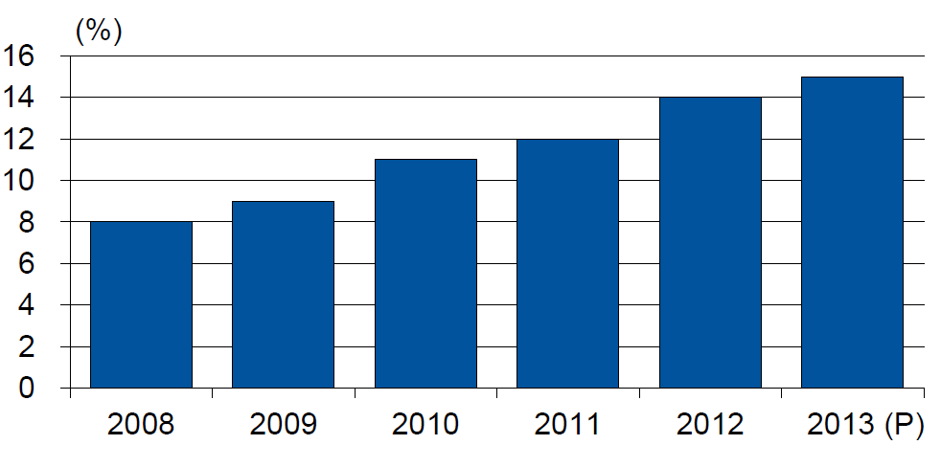
Alternative Capacity as a Percentage of Global Property Catastrophe Reinsurance Limit
(As of Year End)
Alternative Capacity accounted for approximately 14% or $45 billion of the $316 in global property catastrophe reinsurance capital as of mid-2013 (expected to rise to ~15% by year-end 2013)
Source: Guy Carpenter

Slide 75
Investor by Category
Institutional investors are accounting for a larger share of alternative reinsurance investors
Years ended June 30.
Source: Aon Benfield Securities; Insurance Information Institute.

Slide 76
Alternative Risk Transfer: Market Growth
Since 2009, market share of collateralized reinsurance has grown faster than cat bonds or other forms of risk transfer
Source: Aon Benfield Insurance-Linked Securities: Capital Revolution, August 30, 2013; Insurance Information Institute.

Slide 77
Catastrophe Bonds: Issuance and Outstanding, 1997- 2014:Q2
Risk Capital Amount ($ Millions)
Risk capital outstanding reached a record high in 2014
Financial crisis depressed issuance
CAT bond issuance reached a record high in 2013.
2014 Issuance Slowed Down Substantially; May Not Surpass 2013 Record
Sources: Guy Carpenter; Insurance Information Institute.

Slide 78
U.S. Wind-Exposed Risk Premium* 2010:Q1 to 2014: Q1
Risk spreads dropped – equivalent to lower rates – low cat losses, capital entering market.
* Trailing 12-month average
SOURCE: Willis Capital Markets, Insurance Information Institute.

Slide 79
Non-U.S. Wind-Exposed Risk Premium* 2010:Q1-2014: Q1
Spreads are also falling in non-U.S. wind exposures, but less sharply and in line with expected losses
* Trailing 12-month average.
SOURCE: Willis Capital Markets, Insurance Information Institute.

Slide 80
Catastrophe Bonds Outstanding, Q1 2014
Catastrophe bonds are heavily concentrated in U.S. hurricane exposures. Two-thirds of catastrophe risks outstanding cover U.S. wind risks.
Source: Willis Capital Markets.

Slide 81
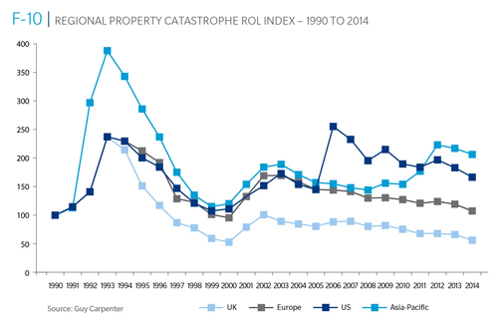
Reinsurance Pricing: Rate-on-Line Index by Region, 1990 – 2014*
Lower CATs and a flood of new capital has pushed reinsurance pricing down in most regions, including the U.S.
*As of Jan. 1.
Source: Guy Carpenter

Slide 82
Notable Cat Bond Events
Bond | Sponsor | Event(s) | Loss to Investors
Kelvin Ltd. | Koch Energy | U.S. Winter 2000-01 | $5 million
George Town Re | St. Paul Re | 9/11, Hurricane Floyd, European wind | $1 million
KAMP Re | Zurich | Hurricane Katrina (2005) | $144 million
Avalon Re | Oil Casualty | Katrina, 2005 fuel depot explosion, NYC street collapse | $13 million
Ajax | Aspen Re | 2008 Lehman bankruptcy | $72 million
Carillon | Munich Re | 2008 Lehman bankruptcy | $31 million
Newton Re | Catlin | 2008 Lehman bankruptcy | $4 million
Willow | Allstate | 2008 Lehman bankruptcy | $10 million
Muteki Ltd. | Munich Re for Zenkyoren | 2011 Tohuku earthquake | $300 million
Vega Capital | Swiss Re | 2011 Tohuku earthquake | $16 million
Mariah Re | American Family | 2011 tornadoes | $200 million¹
Vega Capital | Swiss Re | Superstorm Sandy (2012) | $7 million
Successor X | Swiss Re | Superstorm Sandy (2012) | $15 million²
Most events have been relatively small. Four were counterparty risks related to the Lehman Brothers bankruptcy in 2008.
1 (In litigation) 2 Estimated
Source: Munich Re

Slide 83
Questions Arising from Influence of Alternative Capital
What Will Happen When Investors Face Large-Scale Losses?
What Happens When Interest Rates Rise?
Does ILS Have a Higher Propensity to Litigate?
How Much Lower Will Risk Premiums Shrink/ROLs Fall?
Will There Be Spillover Into Casualty Reinsurance?
Does the New Interconnectedness with Capital Markets Lend Credence to the Suggestion that Reinsurance Is a Systemic Risky Business?
Will Alternative Capital Drive Consolidation?

Slide 84
PART II: GROWTH Has Strength Come at the Expense of Growth?
Obstacles and Opportunities
84

Slide 85
Will We Ever See Vigorous Growth Again?
Who and What Are to Blame?
Soft Markets?
“Great Recession”?
Regulation?
85

Slide 86
Net Premium Growth: Annual Change, 1971—2014F
(Percent)
1975-78
1984-87
2000-03
Net Written Premiums Fell 0.7% in 2007 (First Decline Since 1943) by 2.0% in 2008, and 4.2% in 2009, the First 3-Year Decline Since 1930-33.
2014F: 4.0%
2013: 4.6%
2012: +4.3%
Shaded areas denote “hard market” periods
Sources: A.M. Best (historical and forecast), ISO, Insurance Information Institute.

Slide 87
Real GDP Growth vs. Real P/C Premium Growth: Modest Association
Inflation-adjusted premium growth was negative for 6 years in a row before and during the Great Recession
Real GDP Growth vs. Real P/C (%)
P/C Insurance Industry’s Growth is Influenced Modestly by Growth in the Overall Economy
*Through Q2 2014.
Sources: A.M. Best, US Bureau of Economic Analysis, Blue Chip Economic Indicators, 10/14; Insurance Information Institute

Slide 88
Direct Premiums Written: Total P/C Percent Change by State, 2007-2013
Top 25 States
North Dakota was the country’s growth leader over the past 6 years with premiums written expanding by 74.6%
Sources: SNL Financial LC.; Insurance Information Institute.

Slide 89
Direct Premiums Written: Total P/C Percent Change by State, 2007-2013
Bottom 25 States
Growth was negative in 7 states and DC between 2007 and 2013
Sources: SNL Financial LC.; Insurance Information Institute.

Slide 90
Direct Premiums Written: Comm. Lines Percent Change by State, 2007-2013
Top 25 States
Only 30 states showed any commercial lines growth from 2007 through 2013
Sources: SNL Financial LLC.; Insurance Information Institute.

Slide 91
Direct Premiums Written: Comm. Lines Percent Change by State, 2007-2013
Bottom 25 States
Nearly half the states have yet to see commercial lines premium volume return to pre-crisis levels
States with the poorest performing economies also produced the most negative net change in premiums of the past 6 years
Sources: SNL Financial LLC.; Insurance Information Institute.

Slide 92
Direct Premiums Written: Workers’ Comp Percent Change by State, 2007-2013*
Top 25 States
Only 13 states have seen works comp premium volume return to pre-crisis levels
*Excludes monopolistic fund states: ND, OH, WA, WY as well as WV, which transitioned to a competitive structure during this period.
Sources: SNL Financial LC.; Insurance Information Institute.

Slide 93
Direct Premiums Written: Worker’s Comp Percent Change by State, 2007-2013*
Bottom 25 States
States with the poorest performing economies also produced some of the most negative net change in premiums of the past 6 years
*Excludes monopolistic fund states: ND, OH, WA, WY as well as WV, which transitioned to a competitive structure during this period.
Sources: SNL Financial LC.; Insurance Information Institute.

Slide 94
Payroll vs. Workers Comp Net Written Premiums, 1990-2013P
Payroll Base* WC NWP
$Billions $Billions
7/90-3/91
3/01-11/01
12/07-6/09
WC premium volume dropped two years before the recession began
WC net premiums written were down $14B or 29.3% to $33.8B in 2010 after peaking at $47.8B in 2005
Continued Payroll Growth and Rate Gains Suggest WC NWP Will Grow Again in 2014; +8.6% Growth Estimated for 2013
*Private employment; Shaded areas indicate recessions. WC premiums for 2012 are I.I.I. estimate based YTD 2013 actuals.
Sources: NBER (recessions); Federal Reserve Bank of St. Louis at http://research.stlouisfed.org/fred2/series/WASCUR ; NCCI; I.I.I.

Slide 95
Average Commercial Rate Change, All Lines, (1Q:2004–2Q:2014)
Pricing as of Q2:2014 had turned (slightly) negative for the first time in 3 years
(Percent)
Q2 2011 marked the last of 30th consecutive quarter of price declines
KRW Effect
Note: CIAB data cited here are based on a survey. Rate changes earned by individual insurers can and do vary, potentially substantially.
Source: Council of Insurance Agents & Brokers; Insurance Information Institute

Slide 96
Change in Commercial Rate Renewals, by Account Size: 1999:Q4 to 2014:Q1
Percentage Change (%)
Peak = 2001:Q4 +28.5%
Pricing turned positive in Q3:2011, the first increase in nearly 8 years; Q1:2014 renewals were up 1.5%; Some insurers posted stronger numbers.
Pricing Turned Negative in Early 2004 and Remained that way for 7 ½ years
KRW : No Lasting Impact
Trough = 2007:Q3 -13.6%
Source: Council of Insurance Agents and Brokers; Barclay’s Capital; Insurance Information Institute.
Note: CIAB data cited here are based on a survey. Rate changes earned by individual insurers can and do vary, potentially substantially.

Slide 97
SIDEBAR Advertising in P/C Insurance
Growth in Capacity Spurs Competition
97

Slide 98
Advertising Expenditures by P/C Insurance Industry, 1999-2013
$ Billions
P/C ad spend hit an all time record high of $6.175 billion in 2013, up 1.5% over 2012. The pace of growth has slowed from 15.8% in 2011 and 23.8% in 2010
P/C ad spending has more than tripled since 2002 (up 256% from 2002-2013)
Over the same period Net Premiums Written rose ~45%
Source: Insurance Information Institute from consolidated P/C Annual Statement data, Insurance Expense Exhibit (Part I).

Slide 99
Growth in Premiums & Surplus vs. Growth in Advertising Expenditures, 2000 – 2013
Since 2000, Ad Spending has been increasing at nearly twice the pace of NWP and nearly double the of PHS
Average Annual Growth Rates 2000 – 2013
Ad Spending: 10.1%
Policyholder Surplus: 5.3%
Net Written Premiums: 3.7%
Sources: Insurance Information Institute analysis from A.M. Best data.

Slide 100
Growth in Premiums, Capacity vs. Growth in Advertising Expenditures, 2000 – 2013
Growth in the “Supply” of insurance has exceeded “Demand” → Efforts to sell have intensified
Average Annual Percent Change (%)
Overall Growth in Ad Spending has greatly exceeded growth in capacity (policyholder surplus) or premium growth. This suggests that there are diminishing returns to advertising.
Sources: Insurance Information Institute analysis from A.M. Best data.
100
12/01/09 - 9pm
eSlide – P6466 – The Financial Crisis and the Future of the P/C
Notes:
100

Slide 101
I.I.I. Poll: Ads Are Everywhere
Q. How long has it been since you have seen or heard an advertisement for auto insurance?
More Than 6 Months
Never Seen Or Heard Ad
1 to 6 months
1 week to 1 month
Less Than a Week
Four Out of Five Respondents Have Seen An Auto Insurance Ad in the Past Week.
Source: Insurance Information Institute Annual Pulse Survey, May 2014.

Slide 102
Global Insurance Premium Growth Trends
Growth Is Uneven Across Regions and Market Segments
102

Slide 103
Distribution of Global Insurance Premiums, 2013 ($ Trillions)
Total Premium Volume = $4.641 Trillion*
Life insurance accounted for 56.2% of global premium volume in 2013 vs. 43.8% for Non-Life
Source: Swiss Re, sigma, No. 3/2014; Insurance Information Institute.

Slide 104
Distribution of Nonlife Premium: Industrialized vs. Emerging Markets, 2013
Emerging market’s share of nonlife premiums increased to 19.5% in 2013, up from 17.3% in 2012 and 14.3% in 2009. The share of premiums written in the $2 trillion global nonlife market remains much larger (80.5%) but continues to shrink.
The financial crisis and sluggish recovery in the major insurance markets will accelerate the expansion of the emerging market sector
Premium Growth Facts
2013, $Billions
Industrialized Economies
$1, 653.0
Emerging Markets
$399.8
Developing markets now account for about 40% of global GDP but just under 20% of nonlife premiums
Sources: Swiss Re sigma No.4/2013; Insurance Information Institute research.

Slide 105
Premium Growth by Region, 2013
Latin America growth was the strongest in 2013
Growth in Advanced Asia (incl. China) markets decelerated in 2013
Strength in Africa,
Global Premium Volume Totaled $4.641 Trillion in 2013, up 1.4% from $4.599 Trillion in 2012. Global Growth Was Weighed Down by Slow Growth in N. America and W. Europe and Partially Offset by Emerging Markets
Source: Swiss Re, sigma, No. 3/2013.
105
Notes:
105

Slide 106
Premium Growth by Region, 2012
Latin America growth was the strongest in 2012
Growth in Advanced Asia (incl. China) markets was third highest in 2012
Global Premium Volume Totaled $4.613 Trillion in 2012, up 2.4% from $4.566 Trillion in 2011. Global Growth Was Weighed Down by Slow Growth in N. America and W. Europe and Partially Offset by Emerging Markets
Source: Swiss Re, sigma, No. 3/2013.
106
Notes:
106

Slide 107
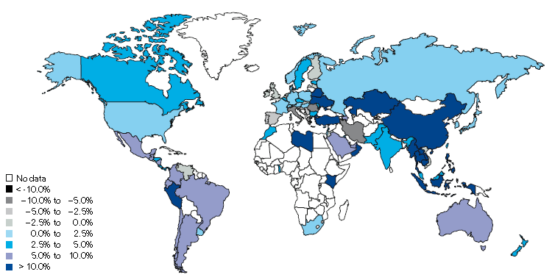
Non-Life Insurance: Global Real (Inflation Adjusted) Premium Growth, 2013
Real growth in non-life insurance premiums was faster in China and most of SE Asia than the US
Market | Life | Non-Life | Total
Advanced | -0.2 | 1.1 | 0.3
Emerging | 6.4 | 8.3 | 7.4
World | 0.7 | 2.3 | 1.4
Source: Swiss Re, sigma, No. 3/2014.
107
12/01/09 - 9pm
eSlide – P6466 – The Financial Crisis and the Future of the P/C
Notes:
107

Slide 108
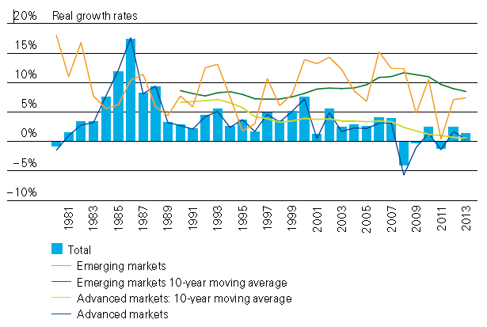
Global Real (Inflation Adjusted) Premium Growth: 1980-2013
Premium growth is very erratic in part to inflation volatility in emerging markets as well as a lack of consistent cyclicality
Emerging market growth has exceeded that of industrialized countries in 30 of the past 34 years, including the entirety of the global financial crisis and subsequent recovery
Source: Swiss Re, sigma, No. 3/2014.
108
12/01/09 - 9pm
eSlide – P6466 – The Financial Crisis and the Future of the P/C
Notes:
108

Slide 109
Globalization: The Global Economy Creates and Transmits Cycles & Risks
Globalization Is a Double Edged Sword—Creating Opportunity and Wealth But Potentially Creating and Amplifying Risk
Emerging vs. “Advanced” Economies
109

Slide 110
GDP Growth: Advanced & Emerging Economies vs. World, 1970-2015F
Emerging economy growth rates are expected to ease to 4.4% in 2014 and 5.0% in 2015
GDP Growth (%)
World output is forecast to grow by 3.3% in 2014 and 3.8% in 2015. The world economy shrank by 0.6% in 2009 amid the global financial crisis
Advanced economies are expected to grow at a modest pace of 1.8% in 2014 and to 2.3% in 2015.
Source: International Monetary Fund, World Economic Outlook , October 2014; Insurance Information Institute.

Slide 111
Real GDP Growth Forecasts: Major Economies: 2011 – 2015F
US growth should acceleratein 2015
Growth in China has slowed but outpaces the US and Europe
The Eurozone remains weak
Political turmoil in Latin America is hurting growth
Growth Prospects Vary Widely by Region but the Outlook for 2015 Has Dimmed Except in the US and UK
Sources: Blue Chip Economic Indicators (10/2014 issue); IMF (10/2014); Insurance Information Institute.
111
Notes:
111

Slide 112
Real GDP Growth Forecasts: Selected Economies: 2011 – 2015F
Strong economies in smaller industrialized nations will bolster demand for products, services, international trade and insure
Growth in Russia is being hit hard by sanctions
Growth Is Expected Accelerate Modestly in Most of the World in 2014 and 2015
Sources: Blue Chip Economic Indicators (10/2014 issue); IMF (10/2104); Insurance Information Institute.
112
Notes:
112

Slide 113
World GDP and Industrial Production (2005-Feb. 2015F)
Global industrial production should continue to rise as should exports and imports of manufactured goods
Source: IMF, World Economic Outlook, April 2014; Insurance Information Institute.
113
12/01/09 - 9pm
eSlide – P6466 – The Financial Crisis and the Future of the P/C
Notes:
113

Slide 114
World Trade Volume: 1948—2015F
Global trade volume will exceed $19 trillion in 2014, an increase of nearly 160% over the past decade
$ Billions
Insurance Regulation Will Necessarily Become More Transnational, Following Patterns of Global Economic Growth, the Creation of New Insurable Exposures and International Capital Flows
Sources: World Trade Organization data through 2012 from International Trade Statistics 2013; Insurance Information Institute estimates and forecasts for 2013-2015 based on IMF World Economic Outlook forecasts as of October 2014.
114
12/01/09 - 9pm
eSlide – P6466 – The Financial Crisis and the Future of the P/C
Notes:
114

Slide 115
World Trade Volume Growth*, 2012 – 2015F
World trade volume growth is expected to accelerate modestly through 2015—translating into about $2.1 trillion in net trade growth
*Goods and services.
Source: International Monetary Fund, World Economic Outlook, October 2014; Insurance Information Institute.

Slide 116
World Trade Volume: IMPORTS 2010 – 2015F
Growth (%)
Advanced Economies
Emerging Economies
Import growth in Advanced Economies is expected to accelerate in 2014
Import growth in emerging economies outpaces Advanced Economies by a wide margin but will slow in 2014
Sources: IMF World Economic Outlook (October 2014 ); Insurance Information Institute.

Slide 117
World Trade Volume: EXPORTS 2010 – 2015F
Growth (%)
Advanced Economies
Emerging Economies
Export growth in emerging economies has decelerated sharply
Export growth in advanced economies should accelerate in 2014
Sources: IMF World Economic Outlook (October 2014); Insurance Information Institute.

Slide 118
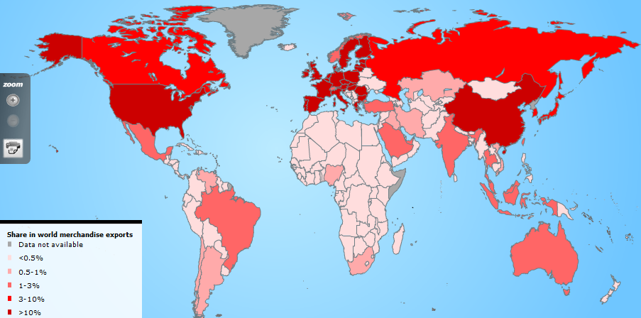
Country Shares of World Merchandise Exports
The US, China, Japan and Western Europe lead the world in merchandise exports
Source: World Trade Organization accessed 4/30/14 at: http://www.wto.org/english/res_e/statis_e/statis_e.htm ; Insurance Information Institute.
118
12/01/09 - 9pm
eSlide – P6466 – The Financial Crisis and the Future of the P/C
Notes:
118

Slide 119
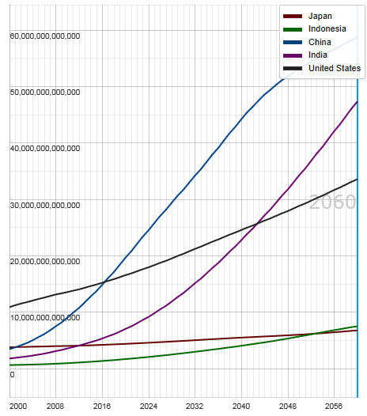
Potential Output of Total Economy: US, China, India, Indonesia and Japan, 2000-2060F
$ 2005 PPP
Growth in economic output will be concentrated in certain developing economies such as China and India
China will likely become the world’s largest economy between 2025 and 2030
Source: OECD; Insurance Information Institute .
119
12/01/09 - 9pm
eSlide – P6466 – The Financial Crisis and the Future of the P/C
Notes:
119

Slide 120
The “Underinsurance” Gap
Why is So Much Loss Uninsured and How to Close the Gap
120

Slide 121
Losses Due to Natural Disasters in the US, 1980–2013
(Overall and Insured Losses)
(2013 Dollars, $ Billions)
2013 CAT Losses
Overall : $21.8B
Insured: $12.8B
Indicates a great deal of losses are uninsured (~40%-50% in the US) = Growth Opportunity
2013 losses were far below 2011 and 2012 and were 44% lower than the average from 2000-2012
Overall losses (in 2012 values)
Insured losses (in 2013 values)
Source: MR NatCatSERVICE
121

Slide 122
Losses Due to Natural Disasters Worldwide, 1980–2013 (Overall & Insured Losses)
(Overall and Insured Losses)
(2013 Dollars, $ Billions)
10-Yr. Avg. Losses
Overall : $184B
Insured: $56B
2013 Losses
Overall : $125B
Insured: $34B
There is a clear upward trend in both insured and overall losses over the past 30+ years
Overall losses (in 2013 values)
Insured losses (in 2013 values)
Source: MR NatCatSERVICE
122

Slide 123
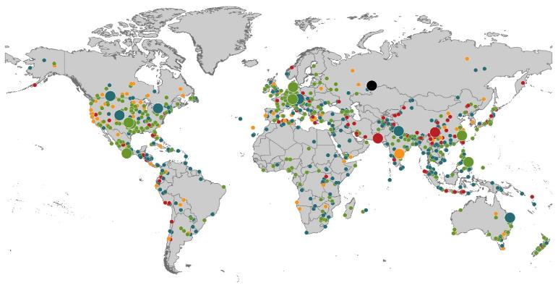
Natural Loss Events:
Full Year 2013 World Map
Winter Storm Christian (St. Jude)
Europe, 27–30 October
Floods
Europe,
30 May–19 June
Meteorite impact
Russian Federation, 15 February
Flash floods
Canada, 8–9 July
Floods
Canada, 19–24 June
Earthquake
China, 20 April
Hailstorms
Germany,
27–28 July
Floods
USA, 9–16 September
Typhoon Fitow
China, Japan,
5–9 October
Severe storms, tornadoes
USA, 18–22 May
Typhoon Haiyan
Philippines,
8–12 November
Severe storms, tornadoes
USA, 28–31 May
Floods
India, 14–30 June
Hurricanes Ingrid & Manuel
Mexico, 12–19 September
Floods
Australia,
21–31 January
880
Loss events
Earthquake (series)
Pakistan, 24–28 September
Heat wave
India, April–June
Geophysical events (earthquake, tsunami, volcanic activity)
Hydrological events (flood, mass movement)
Natural catastrophes
Geophysical events (earthquake, tsunami, volcanic activity)
Hydrological events (flood, mass movement)
Selection of significant
Natural catastrophes
Meteorological events (storm)
Climatological events (extreme temperature, drought, wildfire)
Meteorological events (storm)
Climatological events (extreme temperature, drought, wildfire)
Extraterrestrial events (Meteorite impact)
Source: Munich Re Geo Risks Research, NatCatSERVICE – as of January 2014.
123

Slide 124
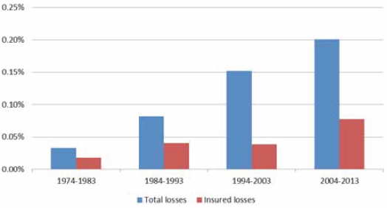
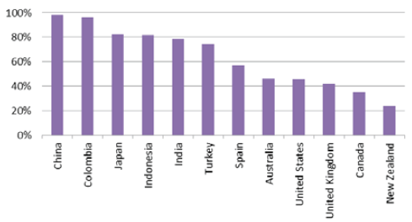
Even as Insurance Coverage Expands, the Insured Share of Losses Is Falling
Total Global vs. Insured Losses as % GDP (1974 – 2013)
Total and insured losses as a share of global GDP have both increased over the past 40 years, but insured losses as a share of total losses has shrunk
Natural Catastrophe Protection Gap (1974 – 2013)
Many emerging market nations have very large insurance gaps. In the US, the gap is about 50%.
Source: Swiss Re Economic Research & Consulting; Geneva Association; Insurance Information Institute.
124

Slide 125
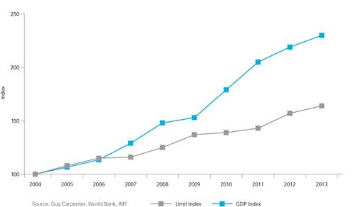
Gap Between GDP Growth and Reinsurance Limit in Asia-Pacific Region: 2004—2013
The gap between GDP and reinsurance limit in Asia is growing—suggesting the region is “under-reinsured”
Sources: Guy Carpenter, World Bank, IMF; Insurance Information Institute.
125
12/01/09 - 9pm
eSlide – P6466 – The Financial Crisis and the Future of the P/C
Notes:
125

Slide 126
I.I.I. Poll: Homes Near Hazards
Q. If you were to purchase a home today, which of the following summarizes your views on that home’s risk of damage from natural disasters . . . and your decision to purchase that home?
Don’t Know
Willing to Accept Risk
Risk Not a Major Consideration
Risk a Significant Influence on Purchase
More Than Half of the Public Would Be Significantly Influenced by Risk of Damage from Natural Disasters. Close to a Third Do Not Regard Such a Risk To Be a Major Consideration.
Source: Insurance Information Institute Annual Pulse Survey.

Slide 127
I.I.I. Poll: Flood Insurance Rates
Q. Congress recently passed a law that will roll back some of the rate increases it put in place for homeowers who purchase subsidized flood insurance from the government . . . . Do you think the recent rate rollback and subsidies should remain in place for most homeowners who purchase flood insurance; or the rollbacks and subsidies should be eliminated; or don’t know?
Don’t Know
Eliminated
Remain in Place
Most Americans Support the Flood Insurance Rate Rollback.
Source: Insurance Information Institute Annual Pulse Survey.

Slide 128
Causes of the Underinsurance Gap and Ways to Narrow/Close It
Contributing Factors to the
Underinsurance Gap
Solutions that Will Help Close the Underinsurance Gap
Compulsory Insurance
Create a Conducive Regulatory, Legal and Tax Environment
Build Public-Private Partnerships
Develop New Products
Microinsurance
Enhance Data Collection/Sharing
Foster a More Strategic Approach to Risk Among Businesses
Affordability
Lack of Awareness
Limits to Insurability
Regulatory Deficiencies
Source: Geneva Association; Insurance Information Institute.

Slide 129
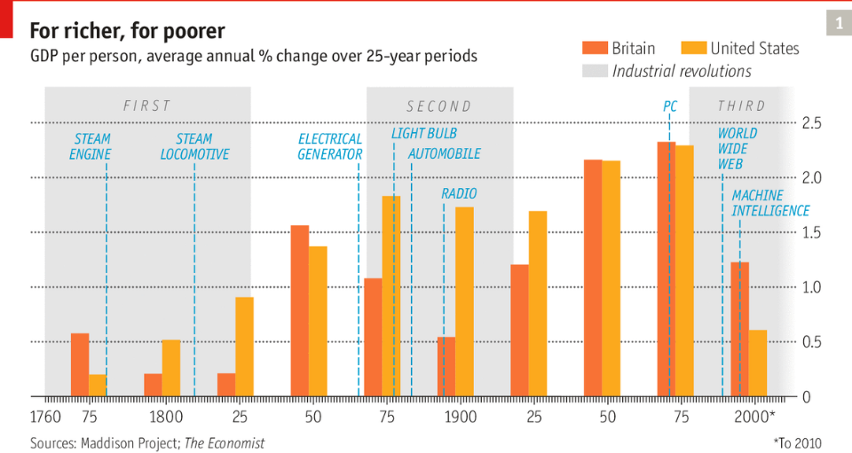
Industrial Revolutions: Benefits Do Not Always Resul Are Everywhere
Source: The Economist, “The Third Great Wave,” October 4, 2014.

Slide 130
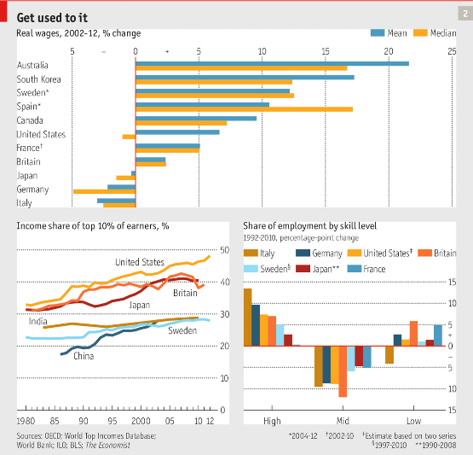
Are Simply Too Few Buyers of Insurance Products Being Created?
Source: The Economist, “Technology Isn’t Working,” October 4, 2014.

Slide 131
Growth Through M&A Merger and Acquisition Activity
Will Slow Growth, Excess Capacity Lead to Consolidation?
Hasn’t Happened—YET
131

Slide 132
U.S. INSURANCE MERGERS AND ACQUISITIONS, All Sectors, 1989-2013 (1)
M&A activity recovered to pre-crisis levels but deal values dropped sharply in 2013
($ Billions)
$165.4
(1) Includes transactions where a U.S. company was the acquirer and/or the target.
Source: Conning proprietary database.

Slide 133
U.S. INSURANCE MERGERS AND ACQUISITIONS, P/C SECTOR, 2002-2013 (1)
M&A activity in the P/C sector remains below pre-crisis levels.
($ Millions)
(1) Includes transactions where a U.S. company was the acquirer and/or the target.
Source: Conning proprietary database.

Slide 134
U.S. INSURANCE MERGERS AND ACQUISITIONS, LIFE/ANNUITY SECTOR, 2002-2013 (1)
Life/Annuity sector M&A activity is highly volatile
($ Millions)
(1) Includes transactions where a U.S. company was the acquirer and/or the target.
Source: Conning proprietary database.

Slide 135
Agent/Broker M&A Deals, 2000-2014:6M
Number of Deals
Agent/Broker activity is running at a record pace in 2014 with 314 deals announced through June 30.
Source: Optis Partners, “Agent-Broker Merger & Acquisition Statistics: The New Normal?”, August 2014; Insurance Information Institute.

Slide 136
Agent/Broker Consolidators by Type, 2011 – 2014:6M
Private Equity and Privately Owned agencies/brokers accounted for 68% of the 1,042 transactions from 2011 through mid-2014
Private Equity money flows in to finance deals, but also exits as ownership stakes are sold
Source: Optis Partners, “Agent-Broker Merger & Acquisition Statistics: The New Normal?”, August 2014, Insurance Information Institute.

Slide 137
Shifting Legal Liability & Tort Environment
(Temporary) “Taming” of the Tort System and Better Risk Management
Lack of Recent Liability Crises Removes Hard Market Catalyst
137

Slide 138
Over the Last Three Decades, Total Tort Costs as a % of GDP Appear Somewhat Cyclical, 1980-2013E
($ Billions)
2.21% of GDP in 2003 = pre-tort reform peak
Deepwater Horizon Spike in 2010
Tort costs in dollar terms have remained high but relatively stable since the mid-2000s., but are down substantially as a share of GDP
1.68% of GDP in 2013
Sources: Towers Watson, 2011 Update on US Tort Cost Trends, Appendix 1A

Slide 139
Commercial Lines Tort Costs: Insured vs. Self-(Un)Insured Shares, 1973-2010
2005: $143.5B 66.4% insured, 33.6% self-(un)insured
Billions of Dollars
$15.0
1995: $83.6B 69.5% insured, 30.5% self-(un)insured
1973: Commercial Tort Costs Totaled $6.49B, 94% was insured, 6% self-(un)insured
1985: $46.6B 74.5% insured, 25.5% self-(un)insured
$9.5
$6.0
2009: $126.5B 64.4% insured, 35.6% self-(un)insured
Tort Costs and the Share Retained by Risks Both Grew Rapidly from the mid-1970s to mid-2000s, When Tort Costs Began to Fall But Self-Insurance Shares Continued to Rise
Sources: Towers Watson, 2011 Update on US Tort Cost Trends, III Calculations based on data from Appendix 4.
139
12/01/09 - 9pm
eSlide – P6466 – The Financial Crisis and the Future of the P/C
Notes:
139

Slide 140
Commercial Lines Tort Costs: Insured vs. Self-(Un)Insured Shares, 1973-2010
Percent
2010: $138.1B 56.6% insured, 44.4% self-(un)insured (distorted by Deepwater Horizon event with most losses retained by BP)
1973: 94% was insured, 6% self-(un)insured
1985:74.5% insured, 25.5% self-(un)insured
1995: 69.5% insured, 30.5% self-(un)insured
2005: 66.4% insured, 33.6% self-(un)insured
The Share of Tort Costs Retained by Risks Has Been Steadily Increasing for Nearly 40 Years. This Trend Contributes Has Left Insurers With Less Control Over Pricing.
Sources: Towers Watson, 2011 Update on US Tort Cost Trends, III Calculations based on data from Appendix 4.
140
12/01/09 - 9pm
eSlide – P6466 – The Financial Crisis and the Future of the P/C
Notes:
140

Slide 141
Where the Growth Is
Growth Is Uneven Across Geographies, Industries
141

Slide 142
12 Industries for the Next 10 Years: Insurance Solutions Needed
Health Care
Health Sciences
Energy (Traditional)
Many industries are poised for growth, though insurers’ ability to capitalize on these industries varies widely
Alternative Energy
Petrochemical
Agriculture
Natural Resources
Technology (incl. Biotechnology)
Light Manufacturing
Insourced Manufacturing
Export-Oriented Industries
Shipping (Rail, Marine, Trucking, Pipelines)

Slide 143
ENERGY SECTOR: OIL & GAS INDUSTRY FUTURE IS BRIGHT
US Is Becoming an Energy Powerhouse; Domestic Demand and Exports Are Key
Need Infrastructure Investment
143

Slide 144
U.S. Natural Gas Production, 2000-2013
Trillions of Cubic Ft. per Year
The U.S. is already the world’s largest natural gas producer—recently overtaking Russia. This is a potent driver of commercial insurance exposures
Source: Energy Information Administration, Short-Term Energy Outlook (April 8, 2014) , Insurance Information Institute.

Slide 145
U.S. Crude Oil Production, 2005-2015P
Millions of Barrels per Day
Crude oil production in the U.S. is expected to increase by 82.6% from 2008 through 2015—and could overtake Saudi Arabia as the world’s largest oil producer
Source: Energy Information Administration, Short-Term Energy Outlook (April 8, 2014) , Insurance Information Institute.

Slide 146

Oil & Gas Extraction Employment, Jan. 2010—August 2014*
Oil and gas extraction employment is up 35.4% since Jan. 2010 as the energy sector booms. Domestic energy production is essential to any robust economic recovery in the US.
Highest since mid-1986
(Thousands)
*Seasonally adjusted
Sources: US Bureau of Labor Statistics at http://data.bls.gov; Insurance Information Institute.
146
12/01/09 - 9pm
eSlide – P6466 – The Financial Crisis and the Future of the P/C
Notes:
146

Slide 147
World Primary Energy Consumption, 1990-2040P
Quadrillion BTUs
Growth in worldwide energy consumption will create more risk and vulnerabilities (natural and manmade); Innovations in risk management and insurance are needed.
Between 2010 and 2040, energy consumption in projected to increase by 56.4% worldwide
Source: Energy Information Administration, 2013 International Energy Outlook, Insurance Information Institute.

Slide 148
Cumulative Projected Investment in Global Energy Infrastructure, 2011-2035 ($ Trill.)
Projected energy infrastructure investment through 2035 total $38 trillion; Implies substantial incurrence of risk.
Source: International Energy Agency, World Energy Outlook 2011.

Slide 149
CONSTRUCTION INDUSTRY OVERVIEW & OUTLOOK
The Construction Sector Is Critical to the Economy and the P/C Insurance Industry
149

Slide 150
Value of New Private Construction: Residential & Nonresidential, 2003-2014*
2014: Value of new pvt. construction hits $685.5B as of June 2014, up 37% from the 2010 trough but still 25% below 2006 peak
New Construction peaks at $911.8. in 2006
Billions of Dollars
Trough in 2010 at $500.6B, after plunging 55.1% ($411.2B)
$15.0
$613.7
$329.5
$298.1
$261.8
$355.9
$238.8
Private Construction Activity Is Moving in a Positive Direction though Remains Well Below Pre-Crisis Peak; Residential Dominates
*2014 figure is a seasonally adjusted annual rate as of June.
Sources: US Department of Commerce; Insurance Information Institute.
150
12/01/09 - 9pm
eSlide – P6466 – The Financial Crisis and the Future of the P/C
Notes:
150

Slide 151
Value of Construction Put in Place, June 2014 vs. June 2013*
Growth (%)
Private: +9.2%
Public: -2.9%
Public sector construction activity remains depressed
Private sector construction activity is up in the residential and nonresidential segments
Overall Construction Activity is Up, But Growth Is Almost Entirely in the Private Sector as State/Local Government Budget Woes Continue
*seasonally adjusted Source: U.S. Census Bureau, http://www.census.gov/construction/c30/c30index.html ; Insurance Information Institute.

Slide 152
MANUFACTURING SECTOR OVERVIEW & OUTLOOK
The U.S. Is Experiencing a Mini Manufacturing Renaissance That Is Benefitting the US Economy and the P/C Insurance Industry
152

Slide 153
Manufacturing Growth for Selected Sectors, 2014 vs. 2013*
Growth (%)
Durables: +4.8%
Non-Durables: +0.9%
Manufacturing of durable goods is stronger than nondurables in 2014
Manufacturing Is Expanding—Albeit Slowly—Across a Number of Sectors that Will Contribute to Growth in Insurable Exposures Including: WC, Commercial Property, Commercial Auto and Many Liability Coverages
*Seasonally adjusted; Date are YTD comparing data through July 2014 to the same period in 2013. Source: U.S. Census Bureau, Full Report on Manufacturers’ Shipments, Inventories, and Orders, http://www.census.gov/manufacturing/m3/

Slide 154
Dollar Value* of Manufacturers’ Shipments Monthly, Jan. 1992—July 2014
$ Millions
The value of Manufacturing Shipments in July 2014 was $507.4.B—a new record high.
Monthly shipments in July 2014 exceeded the pre-crisis (July 2008) peak. Manufacturing is energy-intensive and growth leads to gains in many commercial exposures: WC, Commercial Auto, Marine, Property, and various Liability Coverages.
* Seasonally adjusted; Data published Sept. 4, 2014. Source: U.S. Census Bureau, Full Report on Manufacturers’ Shipments, Inventories, and Orders, http://www.census.gov/manufacturing/m3/
154
12/01/09 - 9pm
eSlide – P6466 – The Financial Crisis and the Future of the P/C
Notes:
154

Slide 155
Manufacturing Employment, Jan. 2010—August 2014*
(Thousands)
Since Jan 2010, manufacturing employment is up (+698,000 or +6.1%) and still growing.
Manufacturing employment is a surprising source of strength in the economy. Employment in the sector is at a multi-year high.
*Seasonally adjusted.
Sources: US Bureau of Labor Statistics at http://data.bls.gov; Insurance Information Institute.
155
12/01/09 - 9pm
eSlide – P6466 – The Financial Crisis and the Future of the P/C
Notes:
155

Slide 156
HEALTHCARE
Healthcare Will Consume Ever More of US GDP & Demand More Insurance Solutions
156

Slide 157
U.S. Health Care Expenditures, 1965–2022F
$ Billions
From 1965 through 2013, US health care expenditures had increased by 69 fold. Population growth over the same period increased by a factor of just 1.6. By 2022, health spending will have increased 119 fold.
U.S. health care expenditures have been on a relentless climb for most of the past half century, far outstripping population growth, inflation of GDP growth
Sources: Centers for Medicare & Medicaid Services, Office of the Actuary at http://www.cms.gov/Research-Statistics-Data-and-Systems/Statistics-Trends-and-Reports/NationalHealthExpendData/NationalHealthAccountsProjected.html accessed 3/14/14; Insurance Information Institute.

Slide 158
National Health Care Expenditures as a Share of GDP, 1965 – 2022F*
% of GDP
Health care expenditures as a share of GDP rose from 5.8% in 1965 to 18.0% in 2013 and are expected to reach 19.9% of GDP by 2022
2022 19.9%
2010: 17.9%
2000: 13.8%
1990: 12.5%
Since 2009, heath expenditures as a % of GDP have flattened out at about 18%--the question is why and will it last?
1980: 9.2%
1965 5.8%
Sources: Centers for Medicare & Medicaid Services, Office of the Actuary at http://www.cms.gov/Research-Statistics-Data-and-Systems/Statistics-Trends-and-Reports/NationalHealthExpendData/NationalHealthAccountsProjected.html accessed 3/14/14; Insurance Information Institute.

Slide 159
CAT OF THE FUTURE? CYBER RISK
Cyber Risk is a Rapidly Emerging Exposure for Businesses Large and Small in Every Industry
NEW III White Paper: http://www.iii.org/assets/docs/pdf/paper_CyberRisk_2014.pdf
159

Slide 160





Data Breaches 2005-2013, by Number of Breaches and Records Exposed
# Data Breaches/Millions of Records Exposed
Millions
The Total Number of Data Breaches (+38%) and Number of Records Exposed (+408%) in 2013 Soared
* 2013 figures as of Jan. 1, 2014 from the ITRC updated to an additional 30 million records breached (Target) as disclosed in Jan. 2014.
Source: Identity Theft Resource Center.

Slide 161
2013 Data Breaches By Business Category, By Number of Breaches
The majority of the 614 data breaches in 2013 affected business and medical/healthcare organizations, according to the Identity Theft Resource Center.
Banking/Credit/Financial, 23 (3.7%)
Govt/Military, 56 (9.1%)
Business, 211 (34.4%)
Educational, 55 (9.0%)
Medical/Healthcare, 269 (43.8%)
Source: Identity Theft Resource Center, http://www.idtheftcenter.org/images/breach/2013/UpdatedITRCBreachStatsReport.pdf

Slide 162
External Cyber Crime Costs: Fiscal Year 2013
Information loss (43%) and business disruption or lost productivity (36%) account for the majority of external costs due to cyber crime.
Equipment damages
Information loss
Revenue loss
Business disruption
Other costs* 0%
* Other costs include direct and indirect costs that could not be allocated to a main external cost category
Source: 2013 Cost of Cyber Crime: United States, Ponemon Institute.

Slide 163
Terrorism Risk Insurance
Risk Is Rising
TRIA’s Future Is Uncertain
163
Notes:
163

Slide 164
Terrorism Insurance Take-up Rates, By Year, 2003-2013
TRIA’s high take-up rates, availability and affordability have benefitted businesses, workers and the entire US economy since the program’s enactment
In 2003, the first year TRIA was in effect, the terrorism take-up rate was 27 percent. Since then, it has increased steadily, remaining in the low 60 percent range since 2009.
Source: Marsh Global Analytics, 2014 Terrorism Risk Insurance Report, April 2014 and earlier editions.
164
Notes:
164

Slide 165
Summary
P/C Insurance Markets Remain Profitable
Peak profitability has declined over the past several cycles
Lower bound profitability has remained virtually unchanged
Many factors: economic, market & institutional at work
Quantum Shift or Evidence of a Super-Cycle?
Profitability patterns today more reminiscent of the pre-1970 era (and back to WW II and even pre-war)
Growth Concerns Are Valid
Apart from international trade barriers, sound regulation is not a leading driver or impediment to growth
Economics are a major driver
Innovative insurance solutions needed for old & new risks

Slide 166
Insurance Information Institute Online:
www.iii.org
Thank you for your time and your attention!
Twitter: twitter.com/bob_hartwig
Download at www.iii.org/presentations

