Slide 1
Inflation From All Angles
Southwest Actuarial Forum
San Antonio, TX
December 4, 2015
Download at www.iii.org/presentations
James Lynch, FCAS MAAA, chief actuary
Insurance Information Institute ♦ 110 William Street ♦ New York, NY 10038
Tel: 212.346.5533 ♦ Cell: 917.359.3908 ♦ jamesl@iii.org ♦ www.iii.org

Slide 2
Summary
Inflation is Low and Likely to Stay That Way
Low Yields Are Built Into P/C Investment, Pricing Strategy
Severity Inevitably Outstrips Inflation
Severity Has Been Abnormally Low But Is Returning to Long-Term Tendency
Frequency Is Rising, Breaking Decadeslong Tendency
Important Pricing/Reserving Implications

Slide 3
Inflation? What Inflation?
3

Slide 4
Change* in the Consumer Price Index, 2004-2015
For two months in 2008, led by gasoline, the general price level was rising at a 5.5% pace
Lately, core CPI is rising at a 1.9%
y-o-y pace
Impact of Falling Energy Prices
When gas prices dropped, the general price level was briefly lower than a year prior
Over the last decade, prices generally rose about 2% per year.
*Monthly, year-over-year, through October 2015. Not seasonally adjusted.
Sources: U.S. Bureau of Labor Statistics; National Bureau of Economic Research (recession dates); Insurance Information Institute.
4
12/01/09 - 9pm
eSlide – P6466 – The Financial Crisis and the Future of the P/C
Notes:
4

Slide 5
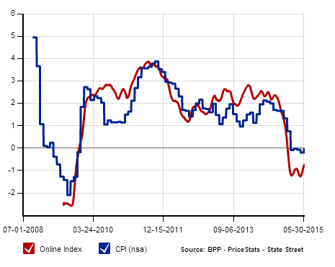
The “Billion Prices” Project Tracks Daily Price Changes for Internet Purchases
Independent Data Series Tracks CPI Closely
Data Collected Daily from Online Retailers
Includes Product Descriptions, Package Sizes, Brands
Tracks Whether Item is On Sale
(Publicly Available Data Lagged Several Months)
Annual Inflation Rate, Measured Daily
Source: Billion Prices Project: http://bpp.mit.edu/usa/

Slide 6
Should We Focus on Price Changes in a More Granular Way?
6

Slide 7
Prices for Hospital Services:
12-Month Change,* 1998–2015
October 2015
Inpatient services +5.2% Outpatient services +4.4%
Prices for Hospital Services have risen at an annual rate of 4% or more for the last 15 years, while the general price level rose by 2%/year.
*Percentage change from same month in prior year; through October 2015; seasonally adjusted
Sources: US Bureau of Labor Statistics; National Bureau of Economic Research (recession dates); Insurance Information Institute.
7
12/01/09 - 9pm
eSlide – P6466 – The Financial Crisis and the Future of the P/C
Notes:
7

Slide 8
Constant Quality Price Index for Single Family Houses Under Construction, Monthly, 2006-2015
Price Index,
Jan. 2005 = 100
Approx. 3.0% Rise Thru Oct.
Prices began dropping in April 2007—
9 months before the Great Recession started
Annual Price Changes
2006: +6.0%
2007: +0.9%
2008: -3.5%
2009: -5.0%
2010: -1.7%
2011: +1.0%
2012: +1.0%
2013: +6.5%
2014: +6.7%
The current rise began in Feb.
2012
Index Addresses: "How much is the sales price today for the same quality house as in the base year?”
Note: Recession indicated by gray shaded column. Price changes in 2015 are preliminary
Sources: Census Bureau at https://www.census.gov/construction/cpi/ ; NBER (recession dates); I.I.I.
8
12/01/09 - 9pm
eSlide – P6466 – The Financial Crisis and the Future of the P/C
Notes:
8

Slide 9
Auto Insurance Inflation vs.
Core CPI, 1995-2014
So Far This Year ≈ 5.3%
Hard Market After Stock Bubble
Since 1/1995:
CPI: +58%
CPI-Auto: +102%
Avg Expenditure: +22%*
Reasons for the Inflation-Expenditure Gap: Higher Deductibles, Lower Limits, Fewer Buying Optional Coverages? More Shopping?
* Through 2012.
Sources: Bureau of Labor Statistics, National Association of Insurance Commissioners,
Actuarial Review: http://www.actuarialreview-digital.org/actuarialreview/september_october_2014#pg27.

Slide 10
What Does the Future Hold?
10

Slide 11
The Bond Market’s Recent* Expectation of U.S. Inflation in the Next Five Years
At the start of 2012 the bond market thought inflation was likely to rise at a 2.4% clip.
Current expectations are for inflation over the next 5 years are near 1.31% per year.
The chart was derived by subtracting the TIPS 5-year yield (which has no inflation component) from the yield for the 5-year U.S. Treasury note (which, at least in theory, includes anticipated inflation).
* As of November 27.
Source: St. Louis Fed (FRED) https://research.stlouisfed.org/fred2/series/T5YIE# ; Insurance Information Institute.

Slide 12
Since We Are in Texas . . .
Since January 2014, Inflation Expectations Have Closely Followed the Price of Oil (or Vice Versa).
Data as of November 23.
Source: St. Louis Fed (FRED) https://research.stlouisfed.org/fred2/graph/?g=1433#, Insurance Information Institute.

Slide 13
Since We Are ACTUARIES in Texas . . .
Since January 2014, Natural Log of Inflation Expectations Has Closely Followed the Natural Log of Price of Oil (or Vice Versa).
Data as of November 23.
Source: St. Louis Fed (FRED) https://research.stlouisfed.org/fred2/graph/?g=1433#, Insurance Information Institute.

Slide 14
Inflation and P/C Insurer Investments
If Expected Inflation Remains Low,
Will Bond Yields Be Mired at Levels
Last Seen in the 1950s?
14

Slide 15
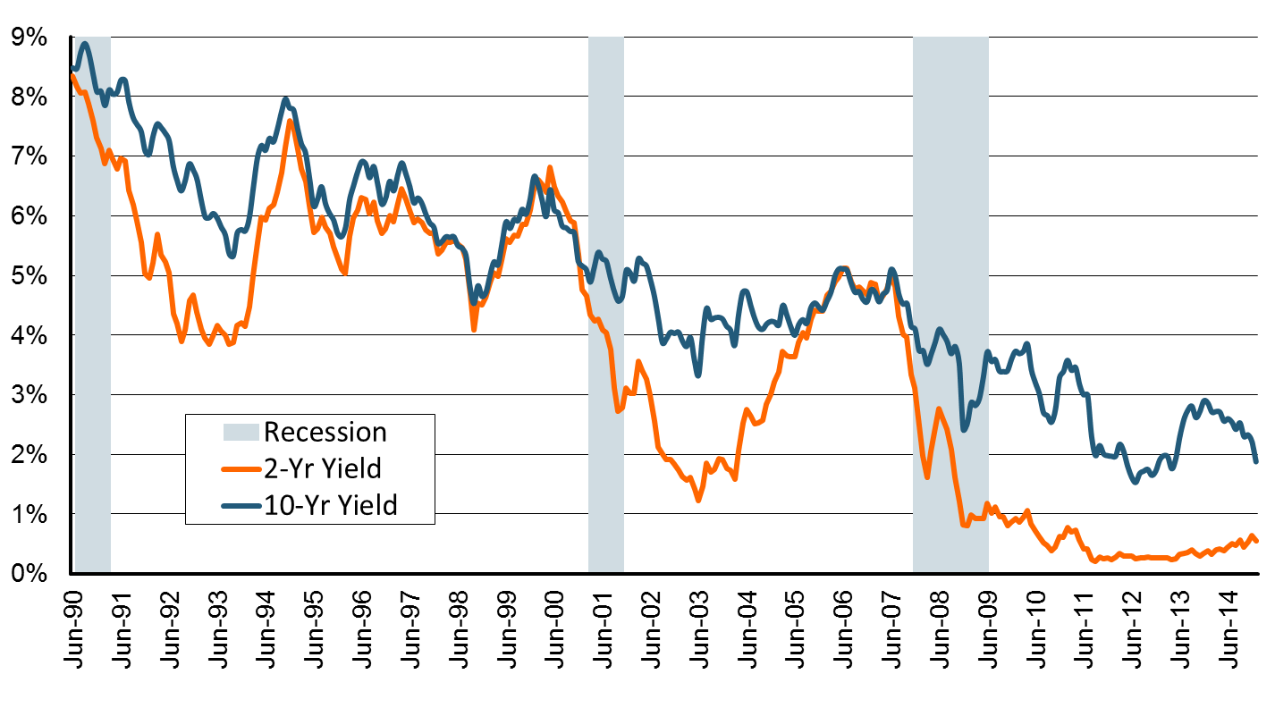
U.S. Treasury 2- and 10-Year Note Yields*: Monthly, 1990–2015
Yields on 10-Year U.S. Treasury Notes have been essentially below 5% for over a decade.
U.S. Treasury 10-year note yields “spiked”
Since roughly 80% of P/C bond/cash investments are in 10-year or shorter durations, most P/C insurer portfolios will have low-yielding bonds for years to come.
*Monthly, constant maturity, nominal rates, through January 2015.
Sources: Federal Reserve Bank at http://www.federalreserve.gov/releases/h15/data.htm.
National Bureau of Economic Research (recession dates); Insurance Information Institutes.
15
12/01/09 - 9pm
eSlide – P6466 – The Financial Crisis and the Future of the P/C
Notes:
15

Slide 16
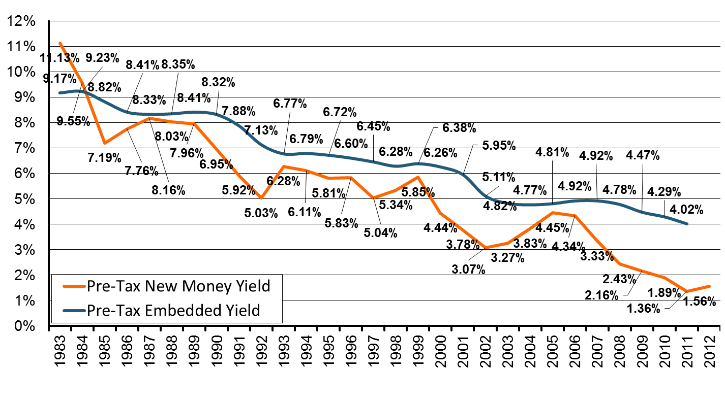
New Money vs. Embedded Yields,
U.S. Insurers, 1983-2012
Falling yields means less investment income, putting upward pressure on rates.
As long as new money rates are below the rates of maturing bonds,
the portfolio yield will continue to sink.
Sources: NCCI, Insurance Information Institute.
16
12/01/09 - 9pm
eSlide – P6466 – The Financial Crisis and the Future of the P/C
Notes:
16

Slide 17
U.S. P/C Insurers, New Money Rate vs. CPI, 1983-2012
Float? What Float?
If New Money Yields ≤ Inflation, Where Is the Insurance Float?
Sources: NCCI, Bureau of Labor Statistics, Insurance Information Institute.
17
12/01/09 - 9pm
eSlide – P6466 – The Financial Crisis and the Future of the P/C
Notes:
17

Slide 18
Net Yield on Property/Casualty Insurance Invested Assets, 2007–2015*
(Percent)
Book yield in 2015 is down 77 BP from pre-crisis levels
The yield on invested assets remains low relative to pre-crisis yields. The Fed’s plan to raise interest rates in late 2015 has already pushed up some yields, albeit quite modestly.
*2015 figure is the average of the four quarters ending in 2015:Q2.
Sources: SNL Financial; Insurance Information Institute

Slide 19
Interest Rate Forecasts: 2015 – 2021
Yield (%)
3-Month Treasury
10-Year Treasury
The end of the Fed’s QE program in 2014 and a stronger economy have yet to push longer-term yields much higher
A full normalization of interest rates is unlikely until the 2020s, more than a decade after the onset of the financial crisis.
Sources: Blue Chip Economic Indicators (11/15 for 2015 and 2016; for 2017-2021 10/15 issue); Insurance Info. Institute.

Slide 20
Distribution of Bond Maturities,
P/C Insurance Industry, 2005-2014
The main shift over these years has been from longer maturities to shorter maturities, but the 2013-14 data suggest a shift back has begun. The 2014 distribution resembles that at year-end 2009.
Sources: SNL Financial; Insurance Information Institute.

Slide 21
Bonds Rated NAIC Quality Category 3-6 as a Percent of Total Bonds, 2003–2014
From 2006-07 to year-end 2012, the percentage of lower-quality bonds in P/C industry portfolios doubled
There are many ways to capture higher yields on bond portfolios.
One is to accept greater risk, as measured by NAIC bond ratings.
The ratings range from 1 to 6, with the highest quality rated 1.
Even in 2014, over 95% of the industry’s bonds were rated 1 or 2.
Sources: SNL Financial; Insurance Information Institute.

Slide 22
What Inflation Doesn’t Measure
The Idea:
Trend ≥ Inflation
(And Always Will Be)
22

Slide 23
Case Study: Inflation in Auto Prices
CPI-U: New Cars
1997 to Present: No Inflation
1984 to 1997: 2.6% Annual Inflation
According to Government, Auto Prices Have Been ‘Flat’ for Nearly Two Decades.
Not Seasonally Adjusted. 1982-84 = 100.
Sources: Bureau of Labor Statistics, Insurance Information Institute.

Slide 24
Inflation in Auto Prices
CPI-U: New Cars vs. New Car Expenditures
Which Is Better Trend Index?
Great Recession
Basis of Settlement When Car Is Totaled
According to Government, Auto Prices Have Been ‘Flat’ for Nearly Two Decades. But New Car Expenditues Are Up 35%.
Expenditure Indexed to CPI-New Autos as of January 1997. Not Seasonally Adjusted. For CPI, 1982-84 = 100.
Sources: Bureau of Economic Analysis, Insurance Information Institute.

Slide 25
Auto Prices vs. Auto Inflation
% Increase, 1990-2013
From 1990 to 2013, Actual New Car Prices Rose Three Times Faster Than New Car Inflation Rate.
Not Seasonally Adjusted. 1982-84 = 100.
Sources: Bureau of Economic Analysis; Bureau of Labor Statistics; Calculations by Insurance Information Institute.

Slide 26
Auto Prices vs. Auto Inflation
% Increase
Auto Price Increases Regularly Outstrip Inflation.
The Difference: Safety Improvements, Conveniences.
Not Seasonally Adjusted.
Sources: The People History; Bureau of Labor Statistics; Calculations by Insurance Information Institute.

Slide 27
BLS Quality Adjustments
Safety Improvements
  Airbags
  Seatbelts
Mechanical/electrical
  Braking Improvements
  Battery Life
Durability
  Stronger Bumpers
  Flexible Body Panels
Comfort/convenience Changes
  Remote Door Locks
  GPS Systems

Slide 28
Typical Adjustments
(2013-14 Model Years)
These All Affect Price of Car, But Not Auto CPI.
$540 in Safety Changes.
Changes Above Would Increase Car Price By $1,220. CPI Impact – 0%.
Sources: Bureau of Labor Statistics, Insurance Information Institute.

Slide 29
Auto Price Change: Quality vs. Inflation
Value of Improvements > Change in Price, so Inflation is Negative.
Sales Year Is Similar to Calendar Year. Model Year Is Similar to Policy Year.
Sources: Bureau of Labor Statistics, Insurance Information Institute.

Slide 30
Other Adjustments (A Quiz)
It Doesn’t Change PV(Car)!
Adjustment | Counted As Inflation | Not Counted As Inflation
Mix of Model Years Within Sales Year
Environmental (Clean Air Regs.)
Rebates
Concessions (Negotiation)
Low Interest Financing
It’s an Apples-to-Apples Comparison!
It’s A Pigovian Tax!
Of Course It Is!
Of Course It Is!

Slide 31
Inflation vs. Trend (The Sequel)
The Idea:
Trend ≥ Inflation
(Except When It Isn’t)
31

Slide 32
An Example: Homeowners Non-cat Severity
Since 2009: 0.3 Points/Yr Above CPI.
Paid Severity in 2013 dollars
1997-2009: 6.8 Points/Year Above CPI.
There Can Be Periods Where CPI > Severity Change.
Sources: Insurance Research Council, “Trends in Homeowners Insurance Claims,” 2015 edition, p. 41; BLS inflation calculator,
with Insurance Information Institute calculations

Slide 33
Another Example: WC Medical
Average Annual Growth, 2002-09
WC Medical Severity: 6%
Medical CPI: 4%
…But Since 2010 WC Medical Severity has Closely Tracked the Medical CPI
Sources: CPI and Med CPI from US Bureau of Labor Statistics, WC med severity from NCCI based on NCCI states.

Slide 34
WC Indemnity Severity vs. Wage Inflation, 1995-2014p
Here Inflation Gauge > Trend for Now
Annual Change 1994–2014
Indemnity Claim Sev.: +4.6
US Avg. Weekly Wage: +3.4%
WC indemnity severity turned positive again in 2011
2014p: Preliminary based on data valued as of 12/31/2014; 1991-2010: Based on data through 12/31/2010, developed to ultimate. Based on the states where NCCI provides ratemaking services. Excludes the effects of deductible policies. CPS = Current Population Survey.
Source: NCCI

Slide 35
Auto PD Liability
Annual Change, 2005 through 2015*
Severity Converged in 2009 . . .
. . . And Diverged in 2013
Aftermath of Great Recession
*Through Second Quarter.
Sources: ISO/PCI Fast Track data, Bureau of Labor Statistics, Insurance Information Institute.

Slide 36
Auto Severity: Loss Trend vs. Inflation
Annual Change, 2001 through 2014
Trend, CPI Converged Around 2011. . .
Normally Trend > CPI
. . . And Starting to Diverge Again
If Loss Trends Return to the Norm, Upward Pressure Will Be Applied to Loss Costs.
Source: Towers Watson Claim Cost Index, Insurance Information Institute.

Slide 37
Other Liability (BI) Severity:
Loss Trend vs. Inflation
Annual Change, 2001 through 2014
Trend, CPI Converged Around 2011. . .
Normally Trend > CPI
. . . And Starting to Diverge Again
If Loss Trends Return to the Norm, Upward Pressure Will Be Applied to Loss Costs.
Source: Towers Watson Claim Cost Index, Insurance Information Institute.

Slide 38
Other Liability (PD) Severity:
Loss Trend vs. Inflation
Annual Change, 2001 through 2014
Trend, CPI Converged Around 2011. . .
Normally Trend > CPI
. . . And Starting to Diverge Again
If Loss Trends Return to the Norm, Upward Pressure Will Be Applied to Loss Costs.
Source: Towers Watson Claim Cost Index, Insurance Information Institute.

Slide 39
Claim Inflation vs. CPI: Not Just Auto
In Recent Years, Claim Costs Have Risen at About the Inflation Rate. If We Return to the Norm, Claim Costs Will Rise.
Source: Insurance Information Institute calculation from Towers Watson data.

Slide 40
How Could Inflation > Trend?
Δ Severity = Δ Quality + Δ Inflation
  Base Case: Δ Severity > Δ Inflation
  Δ Severity < Δ Inflation Implies . . .
  . . . Δ Quality < 0.0
  Are Cars Getting Worse?
  NAH!!!!
Better Insurance Claims Control?
Safer Cars Eliminate Expensive Claims?
We Do Need to Think About Impact When
Δ Severity → Δ Inflation – Will It Diverge Again?

Slide 41
The Bad News
Severity is Only Half the Problem
41

Slide 42
If Frequency Is Falling, Why Does Auto Insurance Keep Costing More?
Safer Cars . . . .
. . . That Cost More to Repair.
Down 55%!
Sources: Insurance Institute for Highway Safety, Insurance Services Office, Insurance Information Institute.

Slide 43
Claim Severity Has Grown Faster Than Inflation for 50 Years
Percentage Change, 1963-2013
Sources: Insurance Services Office, Bureau of Labor Statistics, calculations by Insurance Information Institute.

Slide 44
Frequency: The Chart of the Year
Billions of Miles
In Past 18 Months, Miles Driven Have Soared – More Accidents, More Exposures
*Moving 12-month total. Data through September 2015.
Note: Recessions indicated by gray shaded columns.
Sources: Federal Highway Administration (http://www.fhwa.dot.gov/policyinformation/travel_monitoring/tvt.cfm);
National Bureau of Economic Research (recession dates); Insurance Information Institute.
44
12/01/09 - 9pm
eSlide – P6466 – The Financial Crisis and the Future of the P/C
Notes:
44

Slide 45
Frequency: Rural Interstate Driving
Is Rising Fastest
Miles Driven, Percentage Change YTD*
* Through September.
Sources: Insurance Services Office, Bureau of Labor Statistics, calculations by Insurance Information Institute.

Slide 46
Severity: Driving Fatalities Are Rising
Driving Has Been Getting Safer For Decades, But Recent Trend Is Discouraging.
* Through June 2015.
Sources: National Safety Council, Insurance Information Institute.

Slide 47
Severity: Driving Fatalities Are Rising
On Track for Most Auto Fatalities Since 2007.
Sources: National Safety Council, Insurance Information Institute.

Slide 48
Bodily Injury:
Severity, Frequency Trend Are Rising
Annual Change, 2005 through 2015*
Cost Pressures Will Increase if BI Severity Increases Continue or Frequency Ticks Up
*Through midyear.
Source: ISO/PCI Fast Track data; Insurance Information Institute.

Slide 49
No-Fault (PIP) Liability: Frequency, Severity Are Rising*
Annual Change, 2005 through 2015♦
In Late ’00s Multiple States Experienced Fraud/Abuse Problems in their No-Fault Systems, Especially FL, MI, NY and NJ
*No-fault states included are: FL, HI, KS, KY, MA, MI, MN, NY, ND and UT. **2013 figure is for the 4 quarters ending in 2013:Q3. ♦Through midyear.
Source: ISO/PCI Fast Track data; Insurance Information Institute

Slide 50
Collision Coverage: Severity & Frequency Trends Are Both Rising
Annual Change, 2005 through 2015*
The Recession, High Fuel Prices Helped Temper Frequency and Severity, But this Trend Will Likely Be Reversed Based on Evidence from Past Recoveries
* Through midyear.
Source: ISO/PCI Fast Track data; Insurance Information Institute

Slide 51
Comprehensive Coverage:
Severity Trends Are Unfavorable
Annual Change, 2005 through 2015*
Weather Creates Volatility for Comprehensive Coverage. Long-term Trend in Auto Theft is Favorable.
* Through midyear.
Source: ISO/PCI Fast Track data; Insurance Information Institute

Slide 52
What About Loss Reserves?
The Idea:
Inflation Lags Long-Term Average,
And So Does Loss Trend
52

Slide 53
Loss Development Factors
Age to Age Reported Loss Development Factors - P&C Industry
Accident Year | 12 - 24 Months | 24 - 36 Months | 36 - 48 Months | 48 - 60 Months | 60 - 72 Months | 72 - 84 Months | 84 - 96 Months | 96 - 108 Months | 108 - 120 Months
2001 | 2.0677 | 1.4502 | 1.3170 | 1.1979 | 1.0866 | 1.0839 | 1.0762 | 1.0756 | 1.0517
2002 | 1.8992 | 1.5481 | 1.2450 | 1.1726 | 1.1063 | 1.0549 | 1.0730 | 1.0529 | 1.0307
2003 | 1.8481 | 1.5093 | 1.2143 | 1.1685 | 1.1060 | 1.0649 | 1.0781 | 1.0525 | 1.0516
2004 | 1.8071 | 1.3148 | 1.3307 | 1.1333 | 1.1198 | 1.1036 | 1.0531 | 1.0552 | 1.0406
2005 | 1.6358 | 1.5082 | 1.3227 | 1.2186 | 1.1718 | 1.0813 | 1.0572 | 1.0675 | 1.0535
2006 | 1.6401 | 1.4941 | 1.3249 | 1.1397 | 1.0859 | 1.0767 | 1.0803 | 1.0672
2007 | 1.8650 | 1.4456 | 1.3850 | 1.1379 | 1.1152 | 1.0426 | 1.0425
2008 | 1.8177 | 1.4458 | 1.1900 | 1.1542 | 1.0903 | 1.0720
2009 | 1.7207 | 1.3274 | 1.2050 | 1.1175 | 1.0926
2010 | 2.0081 | 1.2872 | 1.2918 | 1.1531
2011 | 1.7579 | 1.4266 | 1.2254
2012 | 1.8335 | 1.4336
2013 | 1.7573
Averages | 12 - 24 Months | 24 - 36 Months | 36 - 48 Months | 48 - 60 Months | 60 - 72 Months | 72 - 84 Months | 84 - 96 Months | 96 - 108 Months | 108 - 120 Months
Industry - All Years Wtd | 1.8186 | 1.4290 | 1.2763 | 1.1586 | 1.1073 | 1.0716 | 1.0656 | 1.0620 | 1.0458
Industry - 5 Years | 1.8155 | 1.3841 | 1.2594 | 1.1405 | 1.1112 | 1.0752 | 1.0623 | 1.0591 | 1.0456
Industry - 3 Years Wtd | 1.7811 | 1.3782 | 1.2405 | 1.1423 | 1.1005 | 1.0624 | 1.0591 | 1.0633 | 1.0485
Weighted | 1.8051 | 1.3971 | 1.2587 | 1.1471 | 1.1063 | 1.0697 | 1.0623 | 1.0615 | 1.0466
Manual Selected | 1.8051 | 1.3971 | 1.2587 | 1.1471 | 1.1063 | 1.0697 | 1.0623 | 1.0615 | 1.0466
Low Inflation
Low Inflation & Trend
Note Downward Trend
All Factors Have Low Inflation. Past Three Years Have Low Trend.
Source: Other Liability-Occurrence Factors From SNL Financial, Insurance Information Institute

Slide 54
What If Inflation, Trend Return?
15.2% of Stated Reserves
Some Economists Advocate Targeting A 2-Point Higher Inflation Rate
10.9% of Stated Reserves
7.2% of Stated Reserves
5.3% of Stated Reserves
3.4% of Stated Reserves
Source: Calculations by Insurance Information Institute using 2014 Industry Data from SNL Financial.

Slide 55
Which Lines Are Most Vulnerable to 2% Spike in Inflation/Trend?
Distribution of Reserve Increase By Line of Business

Slide 56
Which Lines Are Most Vulnerable to 2% Spike in Inflation/Trend?
Increase By % of Stated Reserve
Some of These Lines Are Already Redundant Industrywide.
Source: Calculations by Insurance Information Institute using 2014 Industry Data from SNL Financial.

Slide 57
Summary
Inflation is Low and Likely to Stay That Way
Low Yields Are Built Into P/C Investment, Pricing Strategy
Severity Inevitably Outstrips Inflation
Severity Has Been Abnormally Low But Is Returning to Long-Term Tendency
Frequency Is Rising, Breaking Decadeslong Tendency
Important Pricing/Reserving Implications

Slide 58
Insurance Information Institute Online:
www.iii.org
Thank you for your time
and your attention!
Twitter: twitter.com/@III_Research

