Slide 1

Natural and Man-made Catastrophes in 2015
Calm Before the Storm?

Slide 2
Natural and Man-made Catastrophes in 2015 – Calm Before the Storm?
Visit www.advisenltd.com at the end of this webinar to download:
  Copy of these slides
  Recording of today’s webinar

Slide 3

Many Thanks to our Sponsor!

Slide 4
About Advisen
Advisen delivers:
the right information into
the right hands at
the right time
to power performance
www.advisenltd.com

Slide 5
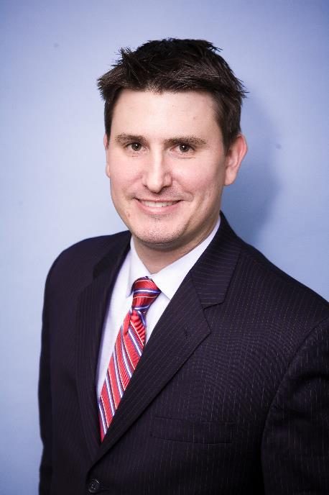
Today’s Moderator
Josh Bradford
Senior Editor, Specialty Editorial
Advisen

Slide 6


Today’s Panelists
Robert Hartwig
President,
Insurance Information Institute
.
Thomas Holzheu
Chief Economist Americas,
Swiss Re

Slide 7
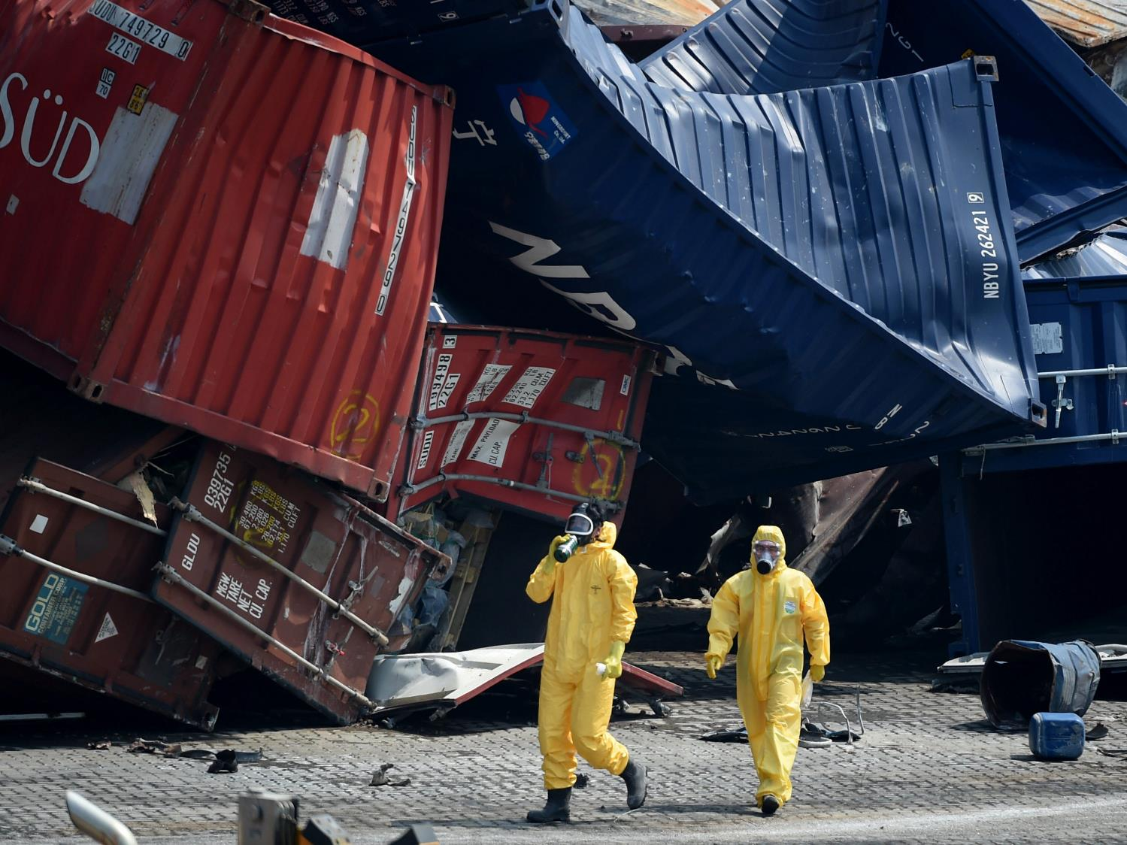
sigma
Natural catastrophes and man-made disasters in 2015
Swiss Re Economic Research & Consulting

Slide 8
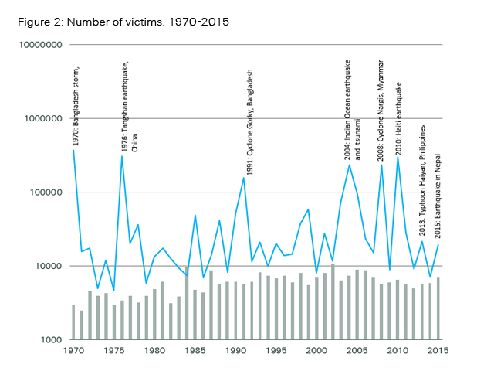

More than 26 000 casualties in 2015
  More than 19 000 people were killed or went missing in natural catastrophes,
  the majority in the devastating earthquake that struck Nepal in April

Slide 9
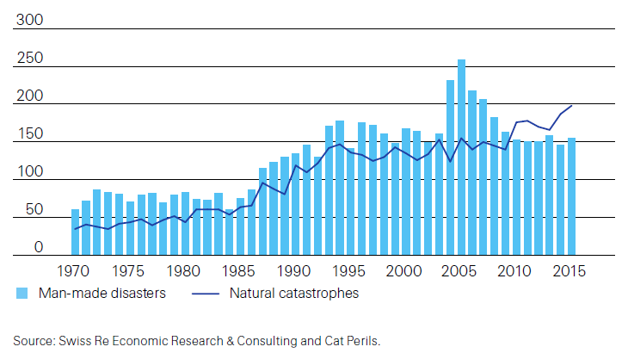
The number of natural catastrophe events
continues to trend up
Number of natural and man-made catastrophe events, 1970 – 2015
Record high number of nat cat events in 2015
Source: Swiss Re Economic Research & Consulting and Cat Perils.

Slide 10
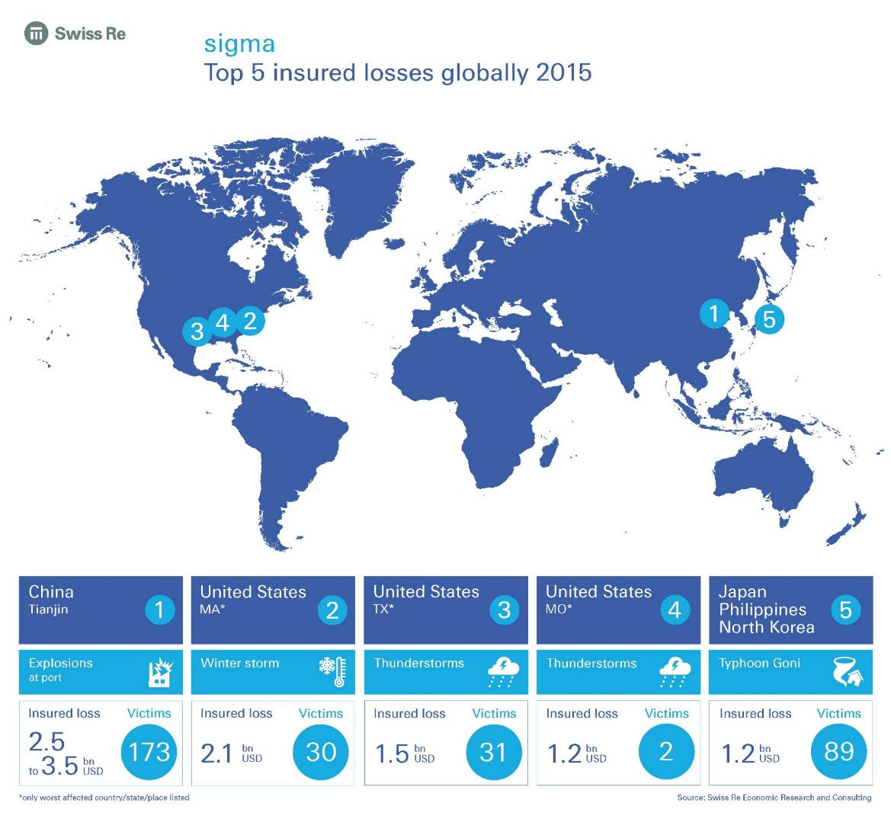
Top five insured losses in 2015
Notes:
Number 5 was Typhoon Goni in Japan, which resulted in insured losses of up to USD 1.2 billion

Slide 11
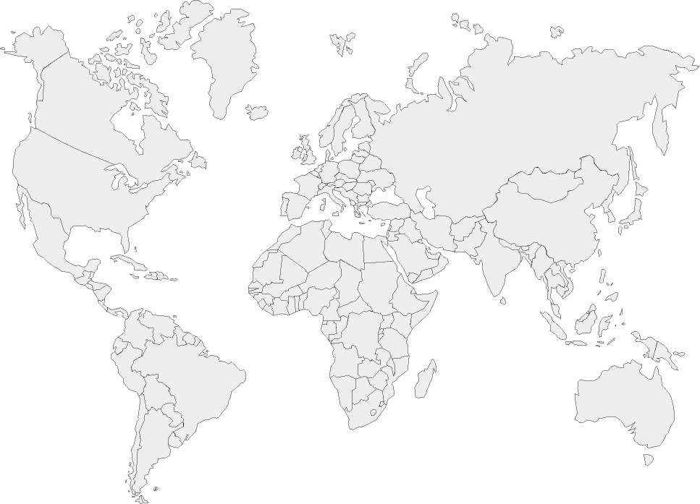



Global losses totalled 92 billion in 2015
with nearly 60% uninsured
Insured Losses
USD 37bn
Uninsured Losses
USD 55bn
Source: Swiss Re Economic Research & Consulting and Cat Perils.

Slide 12
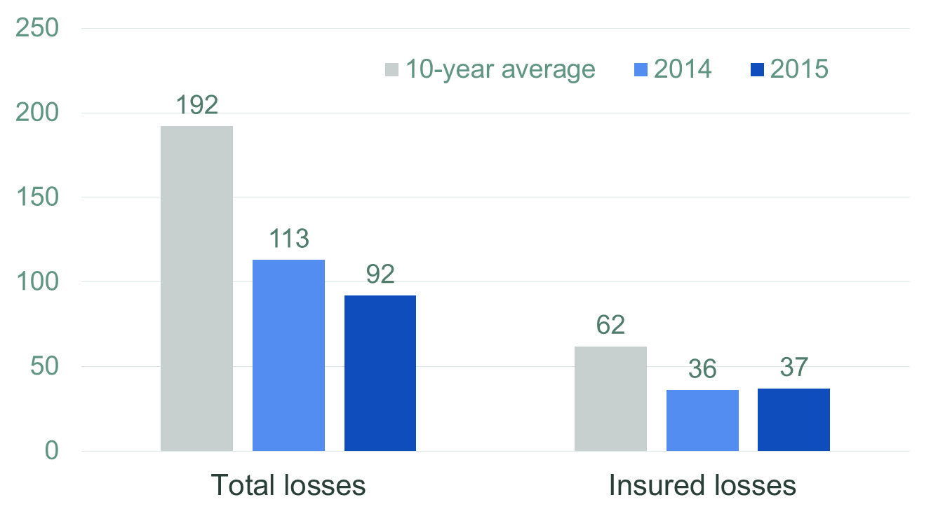
Below-average losses in 2015 – no room for complacency
Total and insured losses in USD billion
Source: Swiss Re Economic Research & Consulting and Cat Perils.

Slide 13
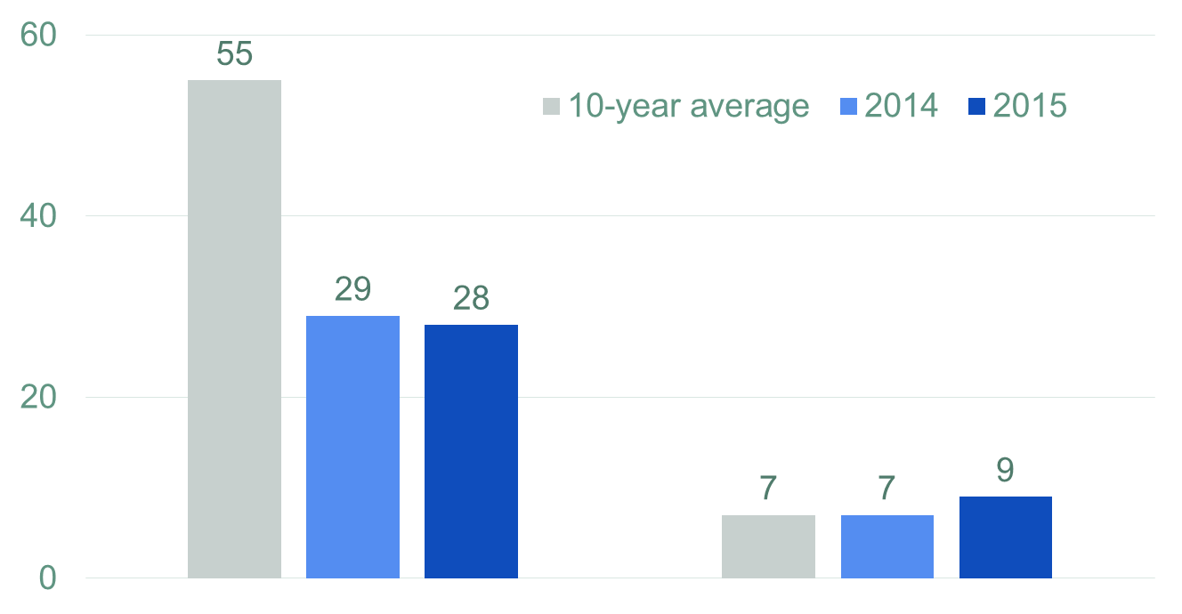
Man-made losses were up
Insured losses in USD billion
Nat Cat
Man-made
Source: Swiss Re Economic Research & Consulting and Cat Perils.

Slide 14






North America faced highest insured losses
49%
60%
46%
16%
15%
21%
18%
15%
15%
8%
3%
6%
7%
6%
1%
  2015 was the 10th year in succession that no major hurricane made US landfall, the longest stretch since the 1860s
Source: Swiss Re Economic Research & Consulting and Cat Perils.

Slide 15
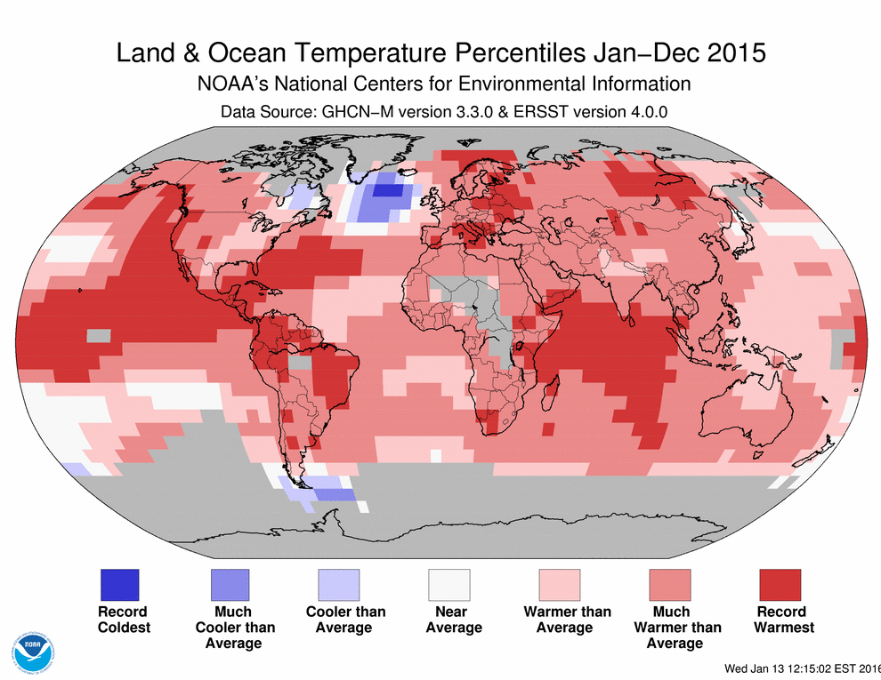
Global weather patterns deviated from climate norms
Land and Ocean Temperature deviations Jan through Dec 2015
  Despite a harsh winter season in the US, 2015 was the hottest year since 1850
Source: NOAA’s National Centers for Environmental Information
Notes:
Despite a harsh winter season in the US, overall 2015 was the hottest year since
1850.1 Exceptionally high temperatures and lack of rainfall caused drought and
wildfires in many regions. In Europe, summer temperatures remained above 30°C for
long stretches. Countries in Eastern Europe were particularly hard hit with drought
conditions lingering through to the end of the year. The US experienced its worst
year for wildfires since 1960 because of the heat and dry conditions. Heatwaves
claimed a number of lives all over the world.

Slide 16
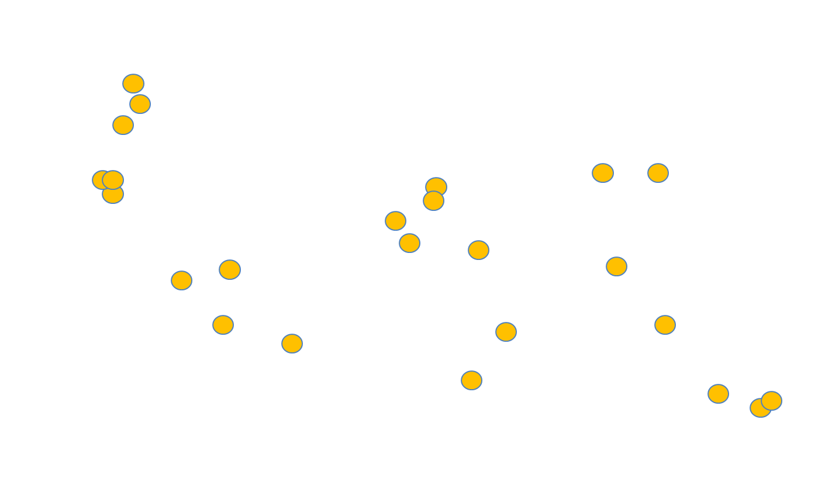
Several heat waves, wildfires and droughts
Source: Swiss Re Economic Research & Consulting and Cat Perils.

Slide 17
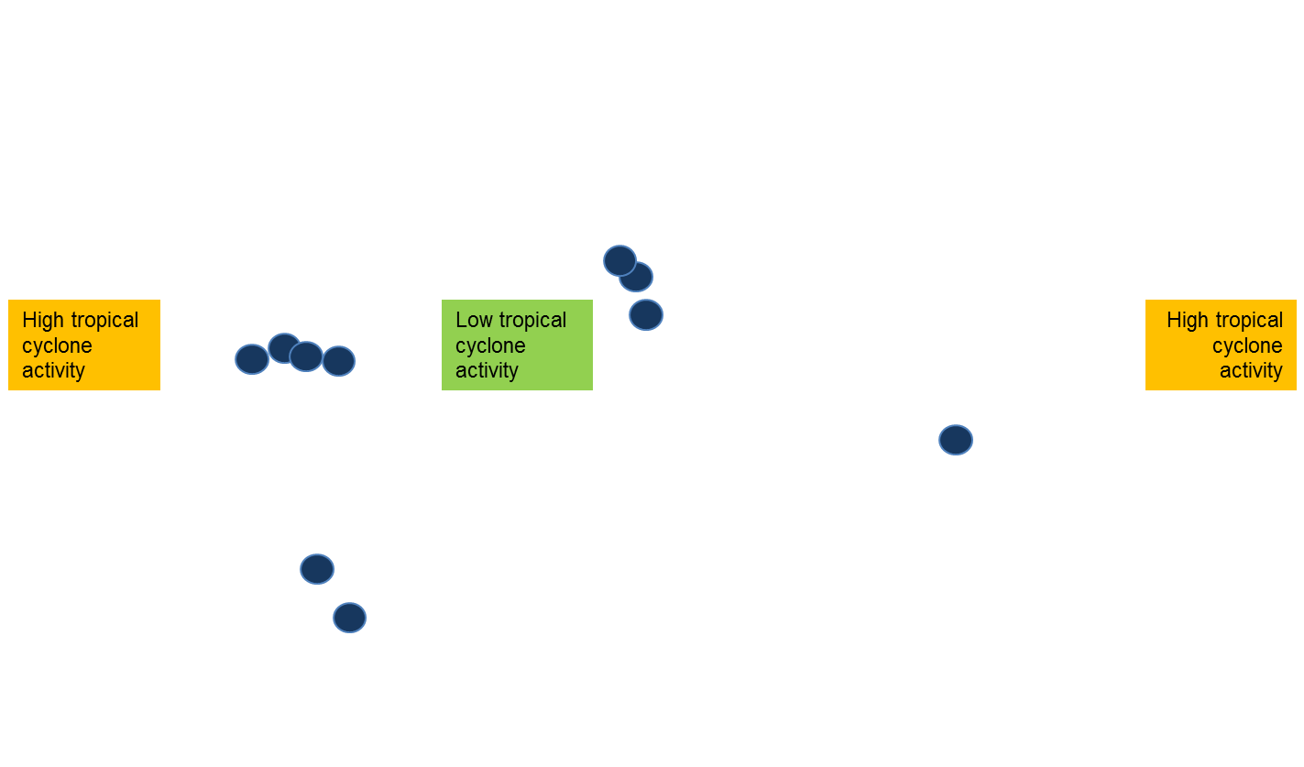
El Niño contributed to low North Atlantic hurricane activity
Hurricane Patricia
Chennai flash floods
Chile flash floods
  Tropical storm activity in the North Atlantic was suppressed, while it was a very active season in the Pacific
Source: Swiss Re Economic Research & Consulting and Cat Perils.

Slide 18
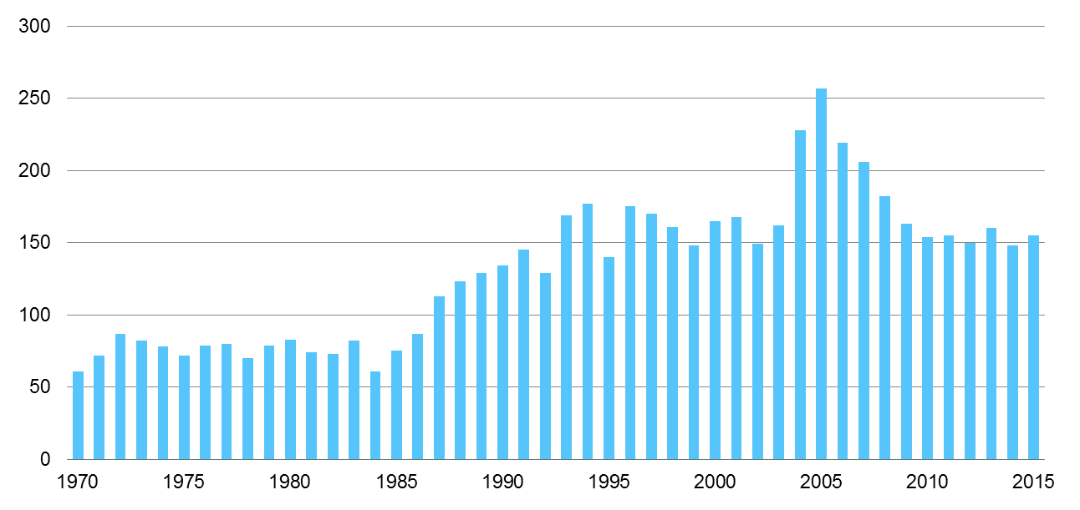
Frequency of man-made catastrophes was flat since 2010 but severity was above-average in 2015
Number of man-made catastrophe events, 1970 – 2015
  The frequency of man-made catastrophe events is stagnating with a weak
  global economy
Source: Swiss Re Economic Research & Consulting and Cat Perils.

Slide 19

The largest man-made losses of the last three years occurred in emerging economies... …
❷
❷
❸
❶
❶
❸
  … putting a spotlight on the global spread of commercial risks
Source: Swiss Re Economic Research & Consulting and Cat Perils.
Notes:
The chart on the right hand side exhibits the development of natural catastrophe losses, split into insured and non-insured losses.
Over the last decade, there were total or economic losses of USD 1.8 trillion, of which 1.3 trillion were not insured.
Here, I have to add a disclaimer on the accuracy of the data.
Insurance loss data is quite reliable, it is based on insurance claims which are sometimes estimated, but generally with a high degree of confidence.
For overall economic losses, there is no standard method in place how to calculate such amounts. Hence, there is higher level of uncertainty.
Often the source for the numbers are local government agencies which sometimes tend to blow up figures in order to get more support from the central government, sometimes they may even play down the numbers for other reasons.
However, we found that the share of insured losses has been quite stable at around 30% of the overall losses.

Slide 20

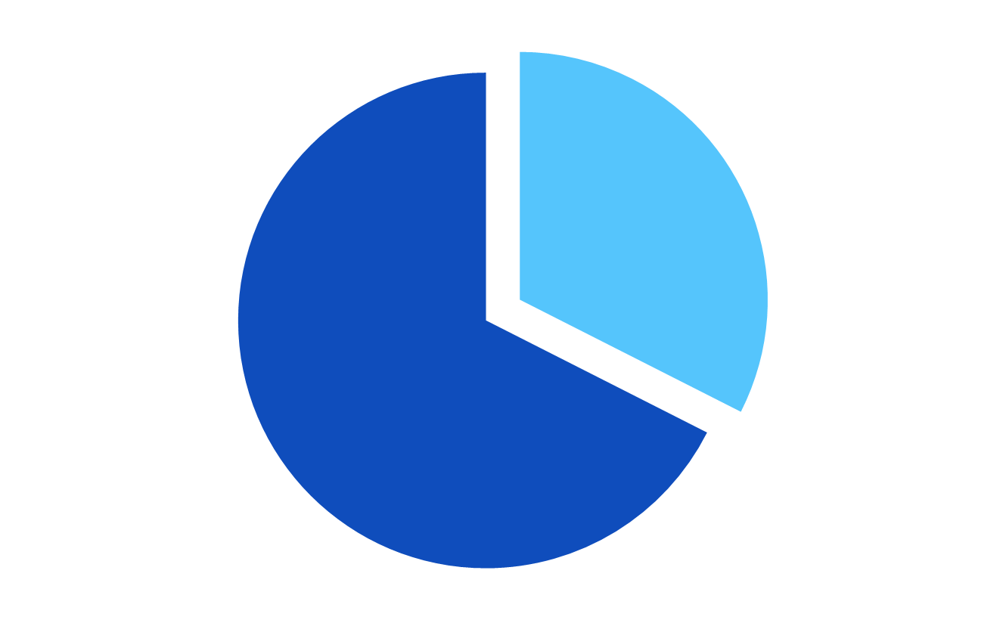
Global natural catastrophe losses totaled USD 2 trillion*
over the last decade, with ~70% uninsured
Insured Losses
USD 654 billion*
Uninsured Losses
USD 1.36 trillion *
* in 2015 USD
Source: Swiss Re Economic Research & Consulting and Cat Perils.
Notes:
The chart on the right hand side exhibits the development of natural catastrophe losses, split into insured and non-insured losses.
Over the last decade, there were total or economic losses of USD 1.8 trillion, of which 1.3 trillion were not insured.
Here, I have to add a disclaimer on the accuracy of the data.
Insurance loss data is quite reliable, it is based on insurance claims which are sometimes estimated, but generally with a high degree of confidence.
For overall economic losses, there is no standard method in place how to calculate such amounts. Hence, there is higher level of uncertainty.
Often the source for the numbers are local government agencies which sometimes tend to blow up figures in order to get more support from the central government, sometimes they may even play down the numbers for other reasons.
However, we found that the share of insured losses has been quite stable at around 30% of the overall losses.

Slide 21
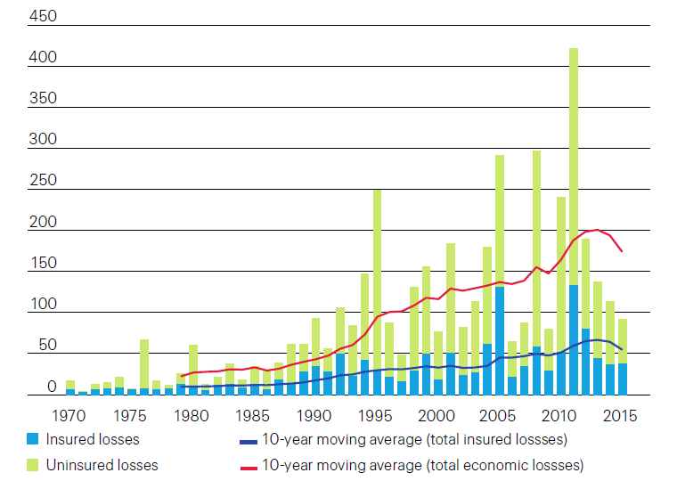
Total losses outpaced insured losses
Source: sigma 1/2016

Slide 22
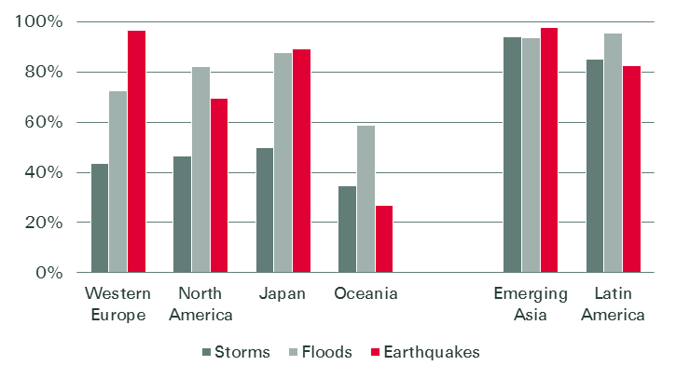
The protection gap varies by peril and by region
Nat cat protection gap by region and peril, 1975-2014
In the emerging markets, 80-98% of the losses are uninsured.
  Average uninsured portions have been around 55% for windstorms, 86% for floods, and 90% for earthquakes.
Source: Swiss Re sigma 5/2015

Slide 23
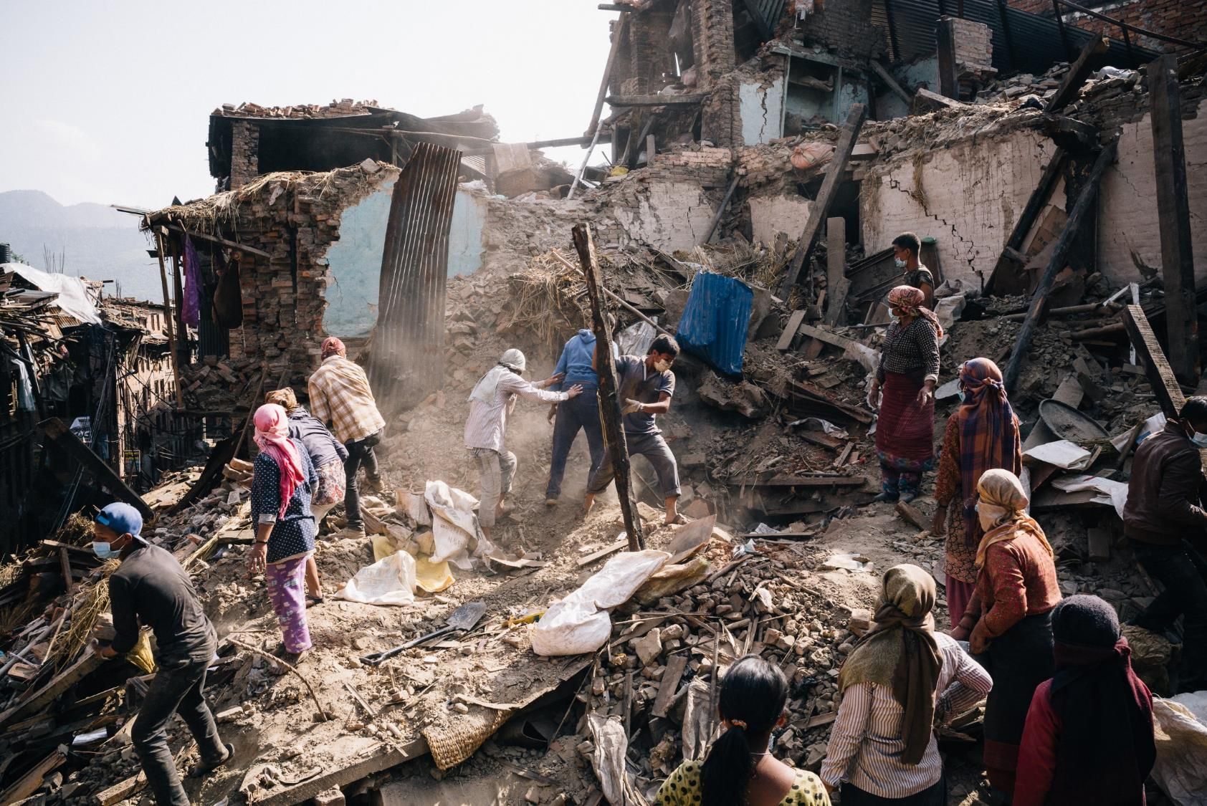
Mw 7.8 earthquake in Nepal
Mw 7.8 earthquake in Nepal
25 April–12 May 2015
Largest economic loss in 2015
9000 victims
Economic losses: USD 6 billion
Insured losses: USD 160 mn
500 000 homeless
24 000 injured
Worst disaster in Nepal since 1934 earthquake
Severe damage to the country’s cultural heritage

Slide 24



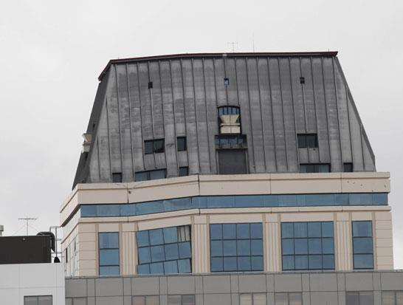
How to close the underinsurance gap?
Public/private
collaboration
Increase access and distribution
Mitigation, building standards, and zoning
Improve product design
Notes:
Just a few remarks what we can do to close the gap.
We need innovation to improve product design and to insure risks which are not insured or not properly insured yet, like cyber risks and supply chain risks.
We need public/private collaboration. We need a supportive regulatory environment, sometimes government involvement to improve coverage via mandatory schemes and government back-stops.
Governments can also help with risk mitigation, improving and enforcing building standards and zoning.
We need cheaper distribution channels to reach out to low-income households and better insurance-awareness for the increasing middle classes.
And we need better risk models, more and better risk data
With this, I hand over to Pavel.

Slide 25
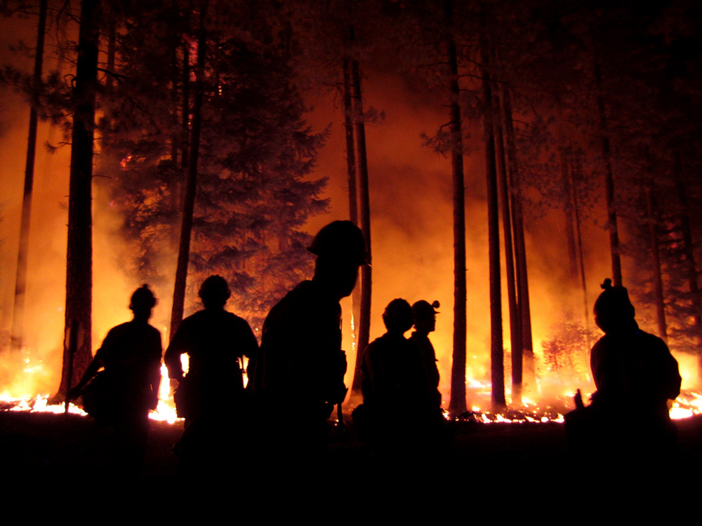
sigma
Natural catastrophes and man-made disasters in 2015
For more research visit:
www.swissre.com/sigma

Slide 26

Natural and Man Made Catastrophes in 2015:
Calm Before the Storm?
Swiss Re and the Insurance Information Institute
May 25, 2016
Download at www.iii.org/presentations
Robert P. Hartwig, Ph.D., CPCU, President & Economist
Insurance Information Institute ♦ 110 William Street ♦ New York, NY 10038
Tel: 212.346.5520 ♦ Cell: 917.453.1885 ♦ bobh@iii.org ♦ www.iii.org
Tel: 212.346.5520 ♦ Cell: 917.453. 1885 ♦ bobh@iii.org ♦ www.iii.org

Slide 27

Insurance Industry Financials Are Often Driven by Catastrophe Loss Activity
Past Few Years Have Been Unusually Quiet in the US
This Will Change…

Slide 28

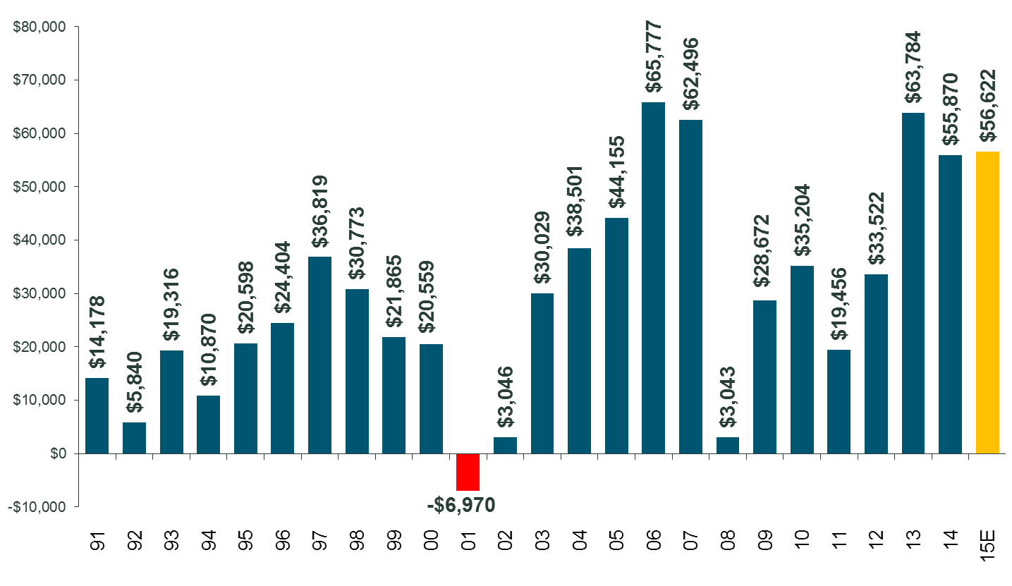
P/C Industry Net Income After Taxes
1991–2015
$ Millions
2005 ROE*= 9.6%
2006 ROE = 12.7%
2007 ROE = 10.9%
2008 ROE = 0.1%
2009 ROE = 5.0%
2010 ROE = 6.6%
2011 ROAS¹ = 3.5%
2012 ROAS¹ = 5.9%
2013 ROAS¹ = 10.2%
2014 ROAS¹ = 8.4%
2015 ROAS = 8.4%
Heavy CAT years such as 2011 and 2012 hit industry profits hard
ROE figures are GAAP; ¹Return on avg. surplus. Excluding Mortgage & Financial Guaranty insurers yields a 8.2% ROAS in 2014, 9.8% ROAS in 2013, 6.2% ROAS in 2012, 4.7% ROAS for 2011, 7.6% for 2010 and 7.4% for 2009; 2015E is annualized figure based actual figure through Q3 of $44.0
Sources: A.M. Best, ISO; Insurance Information Institute

Slide 29
ROE: Property/Casualty Insurance by Major Event, 1987–2015
(Percent)
P/C Profitability Is Both by
Cyclicality and Ordinary Volatility
Modestly higher CATs
Katrina, Rita, Wilma
Low CATs
Sept. 11
Hugo
Lowest CAT Losses in
15 Years
4 Hurricanes
Sandy
Andrew, Iniki
Record Tornado Losses
Northridge
Financial Crisis*
* Excludes Mortgage & Financial Guarantee in 2008 – 2014.
Sources: ISO, Fortune; Insurance Information Institute.

Slide 30
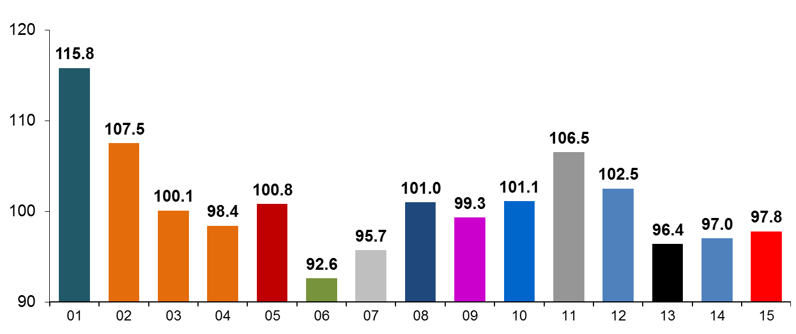
P/C Insurance Industry
Combined Ratio, 2001–2015*
Heavy Use of Reinsurance Lowered Net Losses
Higher CAT Losses, Shrinking Reserve Releases, Toll of Soft Market
As Recently as 2001, Insurers Paid Out Nearly $1.16 for Every $1 in Earned Premiums
Relatively Low CAT Losses, Reserve Releases
Relatively Low CAT Losses, Reserve Releases
Avg. CAT Losses, More Reserve Releases
3 Consecutive Years of U/W Profits: First Time Since 1971-73
Best Combined Ratio Since 1949 (87.6)
Sandy Impacts
Cyclical Deterioration
Lower CAT Losses
* Excludes Mortgage & Financial Guaranty insurers 2008--2014. Including M&FG, 2008=105.1, 2009=100.7, 2010=102.4, 2011=108.1; 2012:=103.2; 2013: = 96.1; 2014: = 97.0.
Sources: A.M. Best, ISO (2014-2015); Figure for 2010-2013 is from A.M. Best P&C Review and Preview, Feb. 16, 2016.

Slide 31
Profitability and Growth in Georgia, Florida, the Carolinas, Tennessee, Mississippi and Alabama’s P/C Insurance Markets
Analysis by Line and State Comparisons
31

Slide 32

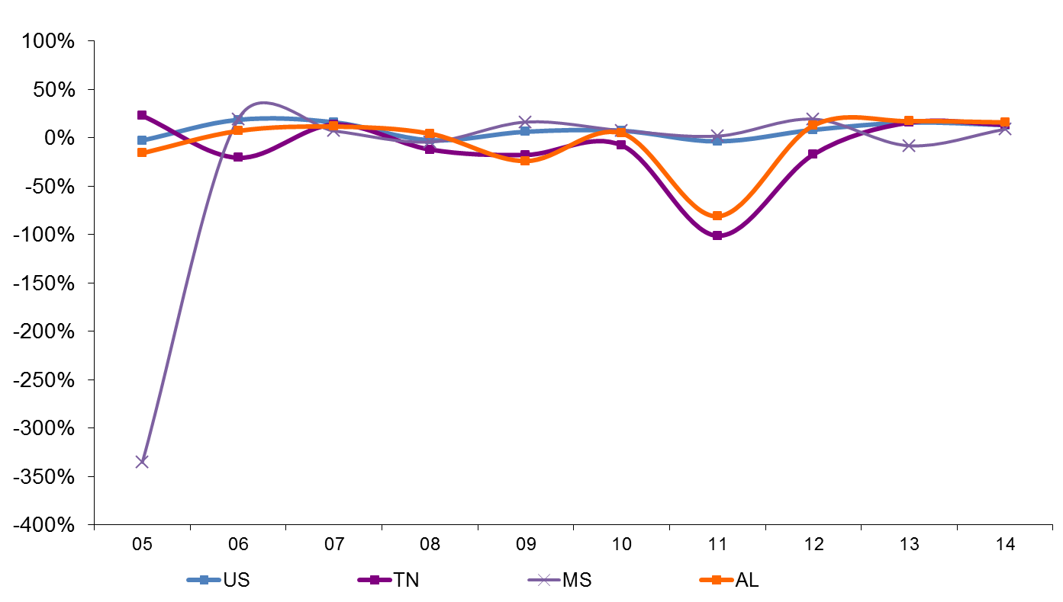
RNW Homeowners: TN, MS and AL vs. U.S., 2005-2014
(Percent)
Average 2005-2014
US: 7.6%
TN: -11.2%
MS: -26.8%
AL: -4.8%
Tuscaloosa tornado
Hurricane Katrina
Sources: NAIC.
32
Notes:
32

Slide 33
Top Ten Most Expensive And Least Expensive
States For Homeowners Insurance, 2013 (1)
Florida ranked as the most expensive state for homeowners insurance in 2013, with an average expenditure of $2,115. Mississippi was 5th ($1,395). Alabama was 8th ($1,323).
Rank | Most expensive states | HO average premium | Rank | Least expensive states | HO average premium
1 | Florida | $2,115 | 1 | Idaho | 561
2 | Texas (2) | 1,837 | 2 | Oregon | 568
3 | Louisiana | 1,822 | 3 | Utah | 609
4 | Oklahoma | 1,654 | 4 | Wisconsin | 665
5 | Mississippi | 1,395 | 5 | Washington | 676
6 | Kansas | 1,343 | 6 | Nevada | 687
7 | Rhode Island | 1,334 | 7 | Delaware | 709
8 | Alabama | 1,323 | 8 | Arizona | 724
9 | Connecticut | 1,274 | 9 | Ohio | 763
10 | Massachusetts | 1,263 | 10 | Maine | 776
Includes policies written by Citizens Property Insurance Corp. (Florida) and Citizens Property Insurance Corp. (Louisiana), Alabama Insurance Underwriting Association, Mississippi Windstorm Underwriting Association, North Carolina Joint Underwriting Association and South Carolina Wind and Hail Underwriting Association. Other southeastern states have wind pools in operation and their data may not be included in this chart. Based on the HO-3 homeowner package policy for owner-occupied dwellings, 1 to 4 family units. Provides “all risks” coverage (except those specifically excluded in the policy) on buildings and broad named-peril coverage on personal property, and is the most common package written.
The Texas Department of Insurance developed home insurance policy forms that are similar but not identical to the standard forms. In addition, due to the Texas Windstorm Association (which writes wind-only policies) classifying HO-1, 2 and 5 premiums as HO-3, the average premium for homeowners insurance is artificially high.
Note: Average premium=Premiums/exposure per house years. A house year is equal to 365 days of insured coverage for a single dwelling. The NAIC does not rank state average expenditures and does not endorse any conclusions drawn from this data.
Source: ©2016 National Association of Insurance Commissioners (NAIC). Reprinted with permission. Further reprint or distribution strictly prohibited without written permission of NAIC.

Slide 34
INVESTMENTS:
THE NEW REALITY
Investment Earnings Offset a Smaller Share of Catastrophe Losses than in the Past
Rates Must Pick Up a Larger Share
34

Slide 35
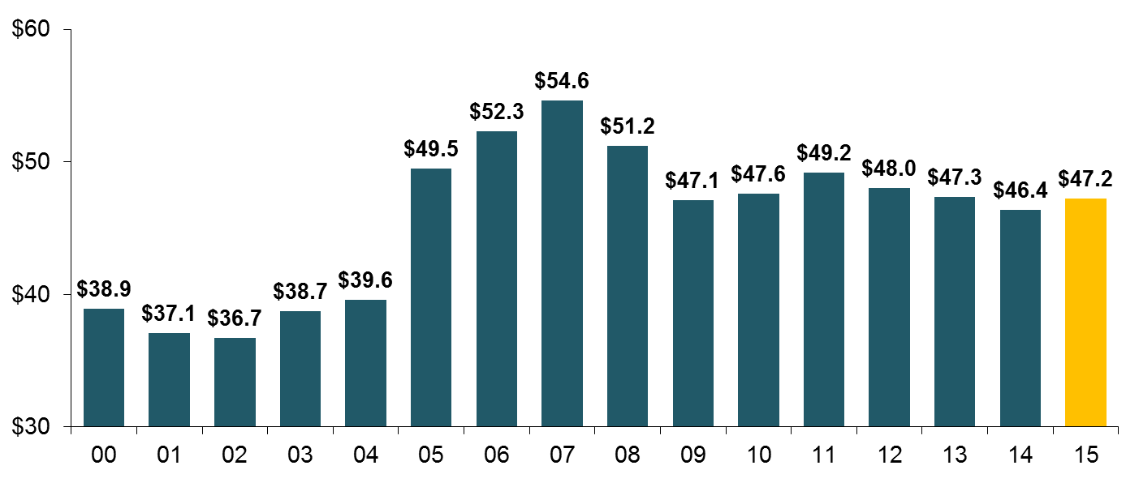
Property/Casualty Insurance Industry Investment Income: 2000–2015¹
Investment earnings are still below their 2007 pre-crisis peak
($ Billions)
Due to persistently low interest rates,
investment income fell in 2012, 2013 and 2014 but showed a small (1.9%) increase in 2015—a trend that may continue
¹ Investment gains consist primarily of interest and stock dividends. Sources: ISO; Insurance Information Institute.

Slide 36
CAPITAL/CAPACITY
(Re)Insurance Industry Is Very Well Capitalized

Slide 37
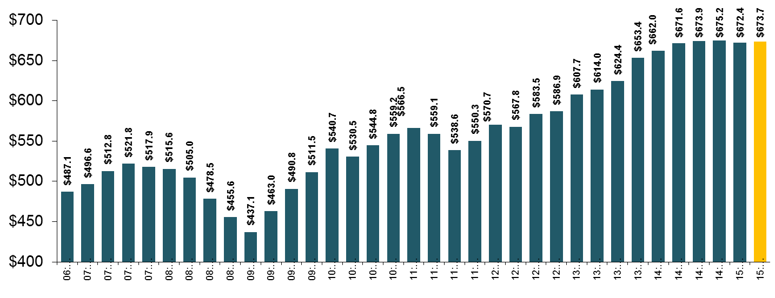
Policyholder Surplus,
2006:Q4–2015:Q4
($ Billions)
2007:Q3
Pre-Crisis Peak
Drop due to near-record 2011 CAT losses
Surplus as of 12/31/15 stood at a near-record high $673.7B
The industry now has $1 of surplus for every $0.76 of NPW,
close to the strongest claims-paying status in its history.
2010:Q1 data includes $22.5B of paid-in capital from a holding company parent for one insurer’s investment in a non-insurance business .
The P/C insurance industry entered 2016
in very strong financial condition.
Sources: ISO, A.M .Best.
12/01/09 - 9pm
Notes:
37

Slide 38
US Policyholder Surplus:
1975–2015*
($ Billions)
Surplus as of 12/31/15 was a near-record $673.7, down 0.2% from $675.2 of 12/31/14, and up 54.1% ($236.6B) from the crisis trough of $437.1B at 3/31/09
“Surplus” is a measure of underwriting capacity. It is analogous to “Owners Equity” or “Net Worth” in non-insurance organizations
The Premium-to-Surplus Ratio Stood at $0.76:$1 as of
12/31/15, a Near Record Low (at Least in Recent History)
* As of 12/31/15.
Source: A.M. Best, ISO, Insurance Information Institute.

Slide 39
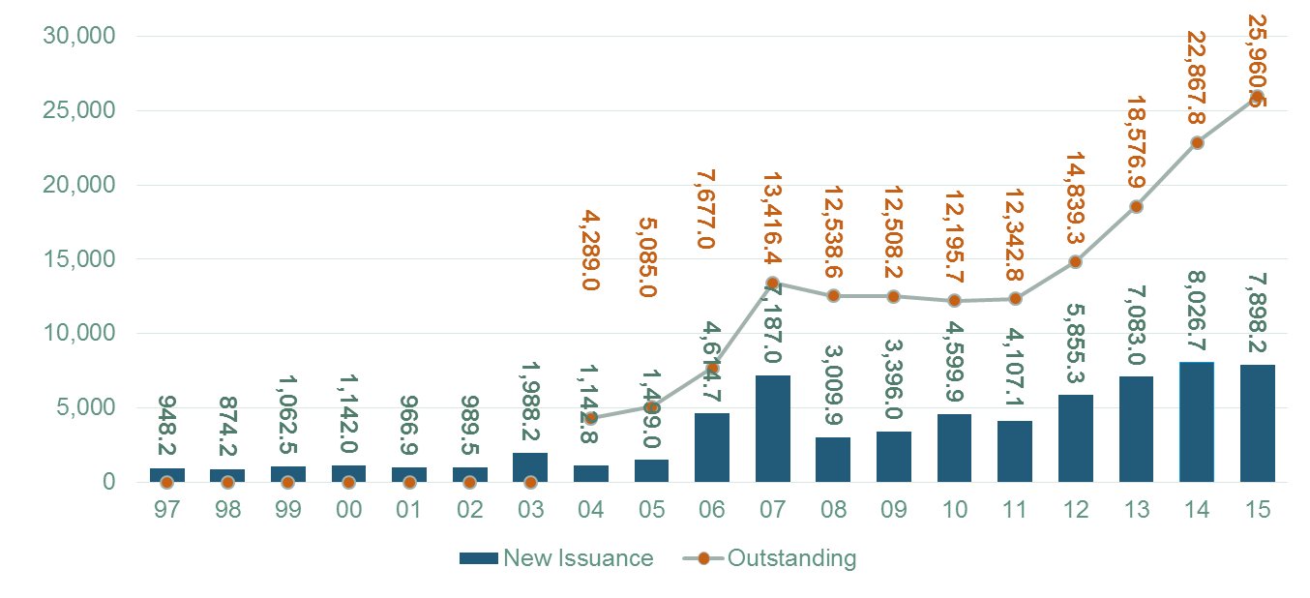
Catastrophe Bond Issuance and Outstanding: 1997-2015
Risk Capital Amount ($ Millions)
Cat Bond Issuance Declined Slightly in 2015 from 2014’s Record Pace. Lower Yields on Bonds Explain Some of the Contraction.
Source: Guy Carpenter, Artemis accessed at http://www.artemis.bm/deal_directory/cat_bonds_ils_issued_outstanding.html .

Slide 40
US Property CAT Rate on Line Index
& Global Reinsurance ROE
US Property CAT ROL
Global Reinsurance ROE
Near-record traditional capacity, alternative capital and low CAT activity have impacted markets
Source: Barclays PLC from Guy Carpenter; Insurance Information Institute.

Slide 41
Insured Catastrophe Losses
2013/14 and 2015 Experienced Below Average CAT Activity After Very High CAT Losses in 2011/12
Winter Storm Losses Far Above Average in 2014 and 2015

Slide 42
U.S. Insured Catastrophe Losses
($ Billions, $ 2015)
2012 was the 3rd most expensive year ever for insured CAT losses
2013/14/15 Were Welcome Respites from 2011/12, among the Costliest Years for Insured Disaster Losses in US History. Longer-term Trend is for more—not fewer—Costly Events
$15B in insured CAT losses though 12/31/15
*Estimate through 12/31/15 in 2015 dollars.
Note: 2001 figure includes $20.3B for 9/11 losses reported through 12/31/01 ($25.9B 2011 dollars). Includes only business and personal property claims, business interruption and auto claims. Non-prop/BI losses = $12.2B ($15.6B in 2011 dollars.)
Sources: Property Claims Service/ISO; Insurance Information Institute.
12/01/09 - 9pm
eSlide – P6466 – The Financial Crisis and the Future of the P/C
Notes:
42

Slide 43
Combined Ratio Points Associated with Catastrophe Losses: 1960 – 2016F*
Avg. CAT Loss Component of the Combined Ratio by Decade
1960s: 1.04 1970s: 0.85 1980s: 1.31 1990s: 3.39 2000s: 3.52 2010s: 5.47*
Catastrophe losses as a share of all losses reached a record high in 2011
Combined Ratio Points
The Catastrophe Loss Component of Private Insurer Losses Has Increased Sharply in Recent Decades
*2010s represent 2010-2015.
Notes: Private carrier losses only. Excludes loss adjustment expenses and reinsurance reinstatement premiums. Figures are adjusted for losses ultimately paid by foreign insurers and reinsurers.
Source: ISO (1960-2009); A.M. Best (2010-16E) Insurance Information Institute.

Slide 44
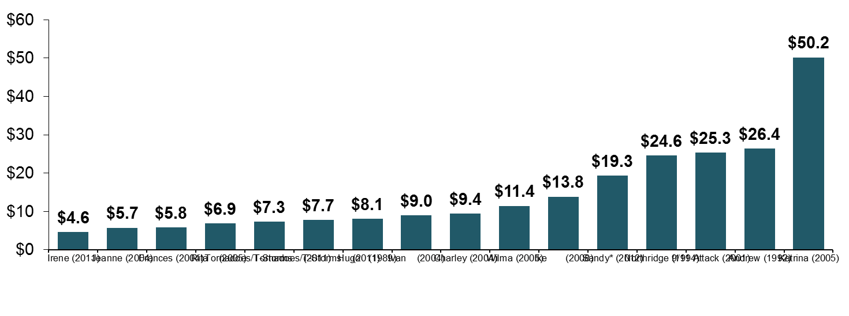
Top 16 Most Costly Disasters in U.S. History—Katrina Still Ranks #1
(Insured Losses, 2014 Dollars, $ Billions)
Storm Sandy in 2012 was the last mega-CAT to hit the US
Includes Tuscaloosa, AL, tornado
Includes Joplin, MO, tornado
12 of the 16 Most Expensive Events in US History Have Occurred Since 2004
Sources: PCS; Insurance Information Institute inflation adjustments to 2014 dollars using the CPI.

Slide 45
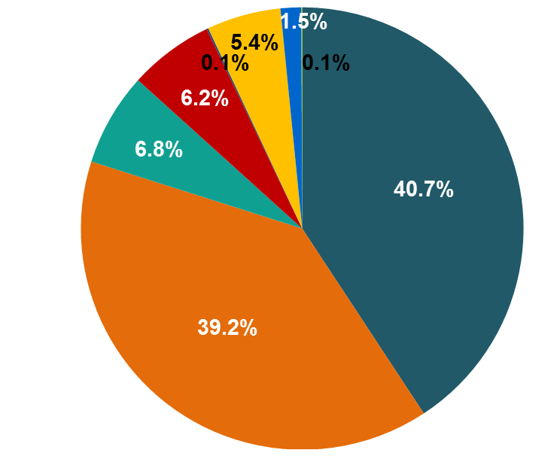
Inflation Adjusted U.S. Catastrophe Losses by Cause of Loss, 1995–2014¹
Wind/Hail/Flood (3), $21.4
Fires (4), $6.0
Winter storm losses were much above average in 2014/15 are will push this share up
Other (5), $0.2
Insured cat losses from 1995-2014 totaled $395.6B, an average of $19.8B per year or $1.65B per month
Geological Events, $0.5
Terrorism, $24.5
Winter Storms, $26.9
Hurricanes & Tropical Storms, $161.2
Tornado share of CAT losses is rising
Wind losses are by far cause the most catastrophe losses, even if hurricanes/TS are excluded.
Events Involving Tornadoes (2), $154.9
Catastrophes are defined as events causing direct insured losses to property of $25 million or more in 2014 dollars.
Excludes snow.
Does not include NFIP flood losses
Includes wildland fires
Includes civil disorders, water damage, utility disruptions and non-property losses such as those covered by workers compensation.
Source: ISO’s Property Claim Services Unit.

Slide 46
UNDERSINSURANCE: POLITICAL AND ECONOMIC CONSIDERATIONS IN THE U.S.
Vulnerable Economic Development, Subsidies and Underinsurance Are Inextricably Intertwined

Slide 47
The Four Types of Underinsurance
Entirely Uninsured
  People/Businesses in this group buy no insurance at all because:
    Unaware of it
    Belief that cost outweighs benefit
Insured, but Certain Perils Excluded
  Covered for many perils but some are excluded (e.g., flood, earthquake)
  Fail to completely insurer because:
    Unaware of availability of coverage
    Belief that cost outweighs benefit
    Lack of available coverage
Insured, but Policy Terms Restrictive
  Coverage is restrictive/limited, often due to limits of insurability
Insured, but Undervalued
  Perils are covered and level of coverage meets stated demand, but exposures are undervalued
Source: Swiss Re Economic Research & Consulting, sigma no. 5/2015.

Slide 48
Factors Influencing the Decision to Buy Property Insurance
Risk Awareness
  Vulnerability to (natural disaster) risk often poorly understood
  Awareness does not necessarily lead to insurance purchases
  Lack of awareness; perceptions on low-probability events
Knowledge about Insurance Products and their Availability
  Insurance ‘literacy’ is key
  Understanding of what’s covered, limits, premiums, claims process often lacking
Affordability
  As with any product, insurance buyers are price sensitive
  Budget constraints could be binding for low-income consumers
Trust in Insurers
  Stories of claim disputes, litigation have impact
Ease of Buying Insurance Products
  Insurance products are intangible and may seem abstract to many consumers
Reliance on Government Aid as a Substitute for Insurance
  Widespread expectation of government aid can reduce incentives to buy insurance, leading to a crowding out of private sector solutions
Source: Swiss Re Economic Research & Consulting, sigma no. 5/2015.

Slide 49
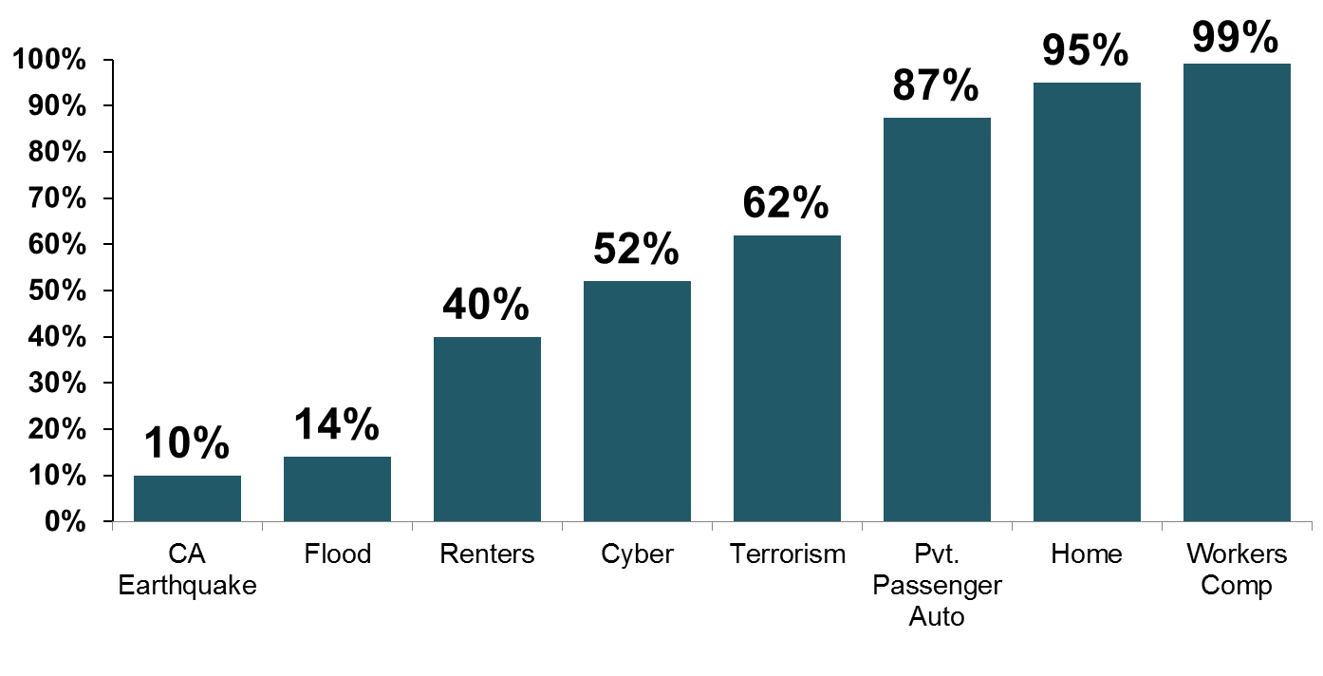
Take-Up Rates for Various Types of Insurance in the U.S.
Take-Up Rate
Take-up rates vary widely by type of coverage
Sources: CA Earthquake (WSJ, http://www.wsj.com/articles/california-pushes-homeowners-to-insure-against-earthquakes-1440980138 ); Flood and Renters (I.I.I. June 2015 Pulse Survey); Cyber (Advisen, 2015); Terrorism (Marsh Global Analytics, 2014 Terrorism Risk Insurance Report, April 2014; data for 2013); Pvt. Passenger Auto (Insurance Research Council, Uninsured Motorists, 2014 Edition, data for 2012); Home and Workers Comp (I.I.I. estimates); Insurance Information Institute research.

Slide 50
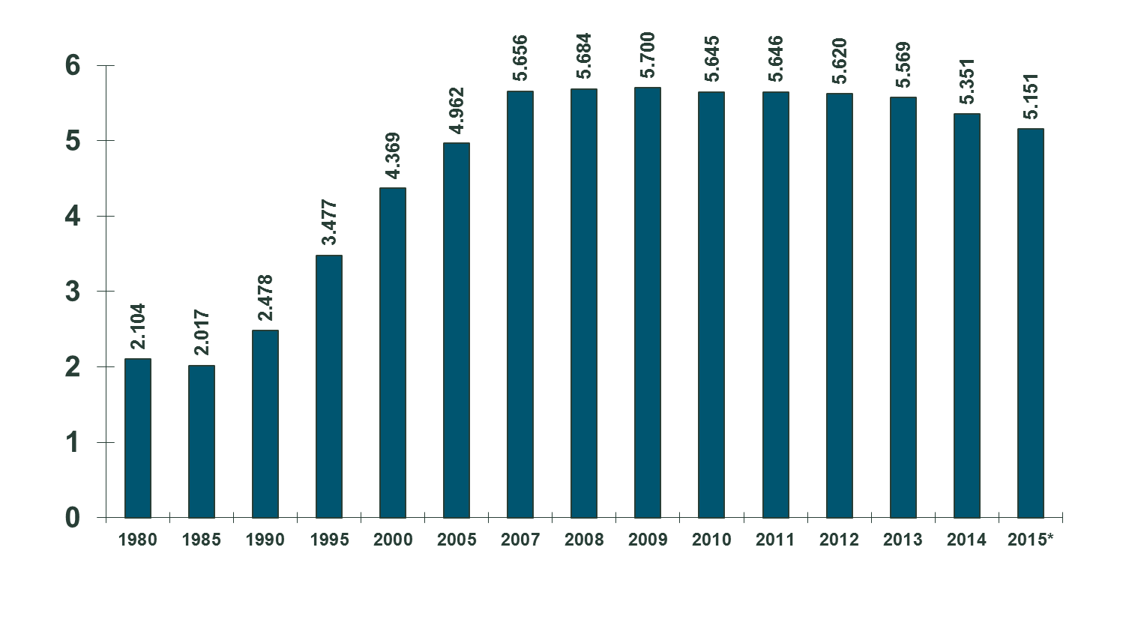
Number of National Flood Insurance Program Policies in Force at Year-End, 1980-2015*
(millions)
The number of NFIP policies in force has plunged by 549,000 or 9.6% since 2009, even as coastal development surges and sea levels rise
Source: National Flood Insurance Program.
* As of July, 2015

Slide 51
CONSUMER AWARENESS AND UNDERINSURANCE
Education of the Public Is a Difficult, Continuous Process
Case Study: Flood Insurance

Slide 52
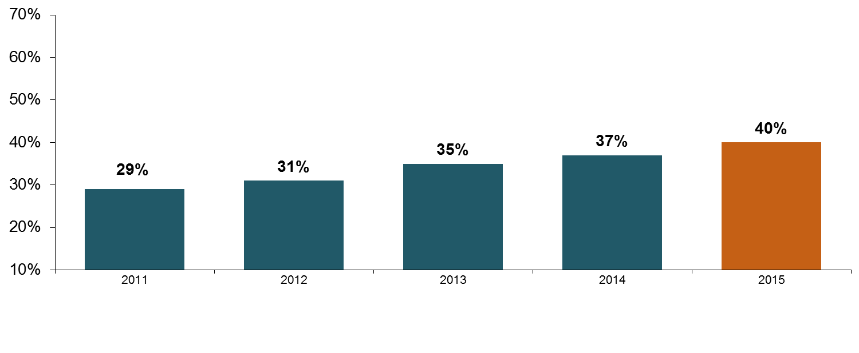
I.I.I. Poll: Home Insurance
Q. Do you have renters insurance? ¹
Americans are increasingly choosing to rent, but are slow to understand the need to insure, exacerbating the underinsurance gap
The Percentage of Renters Who Have Renters Insurance Has Been Rising Since 2011.
¹Asked of those who rent their home.
Source: Insurance Information Institute Annual Pulse Survey.

Slide 53
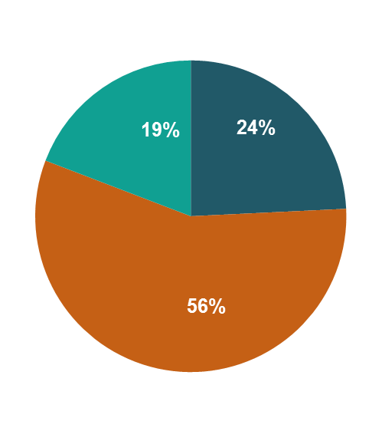
I.I.I. Poll: Home Insurance
Q. Does your homeowners policy cover damage from flooding during a hurricane?¹
Don’t know
Yes
No
More Than Half of Homeowners Know Their HO Insurance Does Not Cover Flood From a Hurricane, But A Significant Proportion Either Think It Does Or Do Not Know.
¹Asked of those who have home insurance.
Source: Insurance Information Institute Annual Pulse Survey.

Slide 54
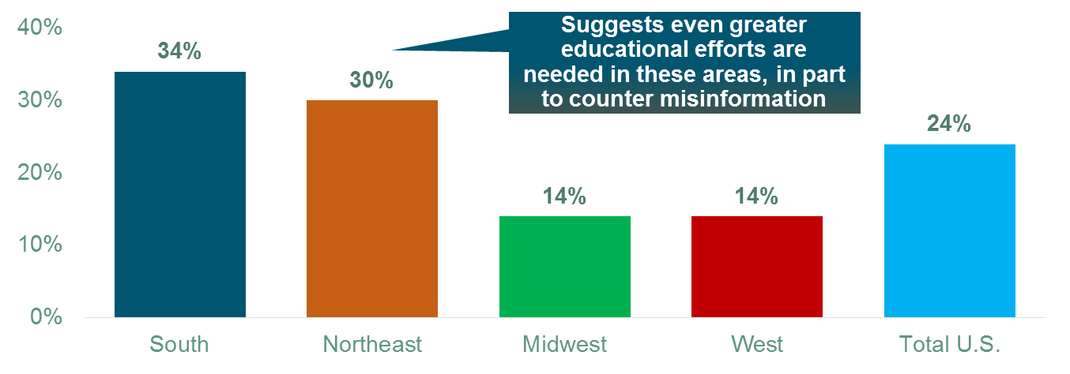
I.I.I. Poll: Home Insurance
Q. Does your homeowners policy cover damage from flooding during a hurricane?¹
Respondents answering “YES”
Homeowners in the South and Northeast Were Most Likely to Think Home Insurance Pays for Flood Damage.
¹Asked of those who have home insurance.
Source: Insurance Information Institute Annual Pulse Survey.

Slide 55
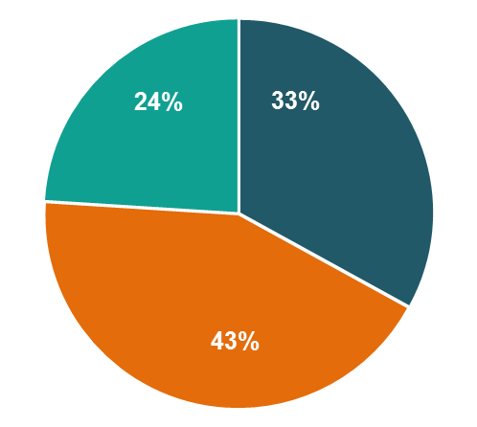
I.I.I. Poll: Superstorm Sandy Claims
Q. Do you think that the damages in these disputed claims from Hurricane Sandy were covered by homeowners insurance or flood insurance policies?¹
Don’t know
Home insurance
Flood insurance
Only 1/3 Third of Those Who Heard About Superstorm Sandy Claim Disputes Thought the Claims Were Related to Home Insurance while 43% Understood Correctly that the Claims are on Flood Policies.
¹Asked of those who had heard about disputes following Hurricane Sandy.
Source: Insurance Information Institute Annual Pulse Survey.

Slide 56
CYBER RISK AND INSURANCE
Cyber Risk is a Rapidly Emerging Exposure for Businesses Large and Small in Every Industry
Insurers Are Closing the Gaps

Slide 57






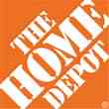

Data Breaches 2005-2015, by Number of Breaches and Records Exposed
# Data Breaches/Millions of Records Exposed
Millions
The 781 reported data breaches in 2015 was virtually unchanged form the record 783 reported in 2014. The number of exposed records soared to 169.1 million, and increase of 97.5%.
Source: Identity Theft Resource Center (updated as of Jan. 6, 2016);
http://www.idtheftcenter.org/images/breach/ITRCBreachReport2015.pdf

Slide 58
Data/Privacy Breach:
Many Potential Costs Can Be Insured
Data Breach Event
Costs of notifying affecting individuals
Defense and settlement costs
Lost customers and damaged reputation
Cyber extortion payments
Costs of notifying regulatory authorities
Regulatory fines at home & abroad
Business Income Loss
Forensic costs to discover cause

Slide 59
Estimated Cyber Insurance Premiums Written, 2014 – 2020F
Cyber insurance premiums written could more than triple to $7.5 billion by 2020
$ Billions
I.I.I.’s Cyber Risk paper issued Oct. 2015
Source: Advisen (2014 est.); PwC (2015, 2020); Insurance Information Institute.

Slide 60
THE ‘INTERNET OF THINGS’
The Advance of Technology Creates New Risks, New Gaps and New Solutions

Slide 61
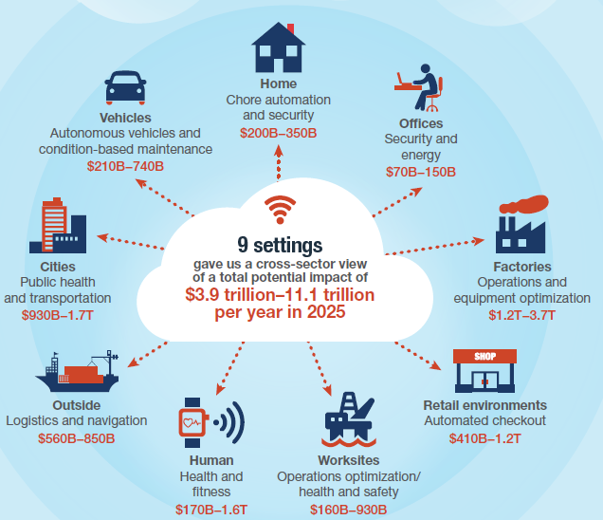
The Internet of Things and the
Insurance Industry
The “Internet of Things” will create trillions in economic value throughout the global economy by 2025
What opportunities, challenges will this create for insurers?
As new risks arise, new gaps will emerge as solutions generally lag
Sources: McKinsey Global Institute, The Internet of Things: Mapping the Value Beyond the Hype,
June 2015; Insurance Information Institute.
12/01/09 - 9pm
eSlide – P6466 – The Financial Crisis and the Future of the P/C
Notes:
61

Slide 62
Insurance Information Institute Online:
www.iii.org
Thank you for your time
and your attention!
Twitter: twitter.com/bob_Hartwig
Download at www.iii.org/presentations

Slide 63

Thank you to our panelists!
Robert Hartwig
President,
Insurance Information Institute
.
Thomas Holzheu
Chief Economist Americas,
Swiss Re

Slide 64
Natural and Man-made Catastrophes in 2015 – Calm Before the Storm?
Visit www.advisenltd.com at the end of this webinar to download:
  Copy of these slides
  Recording of today’s webinar

Slide 65

Register now!
Visit http://www.advisenltd.com/events/ for the conference & webinar schedule!

Slide 66
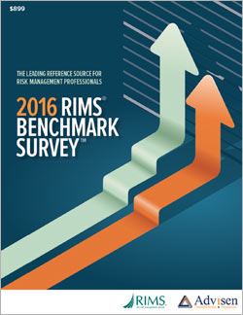
2016 RIMS Benchmark Survey
The RIMS Benchmark Survey includes industry data for more than 52,000 insurance programs from 1,457 organizations.
New Cyber Insurance Coverage Chapter!
New this year is a special chapter examining cyber
insurance coverage.
Key features of this chapter include:
Major coverage provisions
Limits purchased
Retentions assumed
Premiums paid
Major carrier market shares
This information will inform risk managers and their brokers in the
design and construction of a cyber insurance program.

Slide 67
Contact Us
Advisen Ltd.
1430 Broadway
8th Floor
New York, NY 10018
www.advisenltd.com
Phone +1.212.897.4800
advisenevents@advisen.com

