Slide 1
Disruption and Insurance
Challenges and Opportunities All Along the Value Chain

Slide 2
Greatest Threats, Opportunities
Whither Silicon Valley?
Greatest Opportunity
Greatest Threat
SOURCE: A.M. Best Winter 2016-17 Insurance Industry Survey.

Slide 3
Insurance Technology Financing – Change Is Coming
More Than Half This Funding Was in Two Deals (Zenefits/ Zhong An)
Investment ($ Millions)
Deals
Investment In Insurance Tech Is Rising. Number of Deals Set A Record Last Year.
SOURCES: CB Insights, Insurance Information Institute.

Slide 4
What Is A Value Chain?
Example: Local Newspapers
Create Product (Publish the Newspaper)
Gather Information (News, Ads)
Distribute Product (Deliver the Newspaper)
Improve World
Printing Press
Provide Information to Local Audience
This Industry Was Radically Disrupted by the Internet. Its Barriers to Entry Were Destroyed. Is Insurance Next?

Slide 5
Insurance Disruption Technology / Digitalization
Fundamental Changes
Opportunities
Challenges
Future of Auto
Future of Reduced Risk Pools
Automation / Efficiencies
New Product Lines (Cyber)
Emerging Technologies
Consumer Trust – Demonstrate the Societal Value
Big Data vs. Individual Privacy
New Market Entrants “Uber of Insurance”?
Regulatory Opportunities/Threats
Lemonade
Offered in CA, IL, NJ, NY
Barrier to Entry
US vs. Other Less Regulated Regions
Trust Pull-back – the Sandbox Approach
Notes:
Insurance Disruption
Technology / Digitalization
Fundamental changes
Future of auto insurance
Autonomous vehicles -- reduction of accidents
Future of reduced risk pools
Disparate Impact
Opportunities
Automation and efficiencies -- claims, underwriting, filings (?)
New product lines -- cyber, sharing economy
Emerging technologies -- cognitive computing, predictive analytics
Challenges
Consumer trust will be key -- demonstrate the societal value
Big data vs. personal/information privacy
New market entrants -- "Uber of Insurance"
Lemonade: Approved in State of New York
Regulatory -- Opportunity / Threat
Barrier to entry (for potential disrupters)
US -- 50+ individual regulatory bodies
Taxi vs. Insurance Regulator: One can put you in jail…
Pull back / curb
Consumer trust will play key role
Sandbox approach
US vs. other global regions with less regulatory burden
[TBD] Audience Relevance Section

Slide 6
The (Re)Insurance Value Chain
Where Could Disruption Lie?
Create Policy/ Treaty
Brains + Bank Account
Write Risk
Perform Loss Control
Settle Claims
Market Policy/ Treaty
Improve World
Price Risk
Protecting People & Organizations
Most Links in the Value Chain Have the Potential
to Be Disrupted in Next 10 Years.

Slide 7
Alternative Capital Potentially Disrupting the Bank Account
Alternative capacity has grown 350% since 2006. It has more than tripled in the past six years.
Source: Aon Benfield Analytics; Insurance Information Institute.

Slide 8
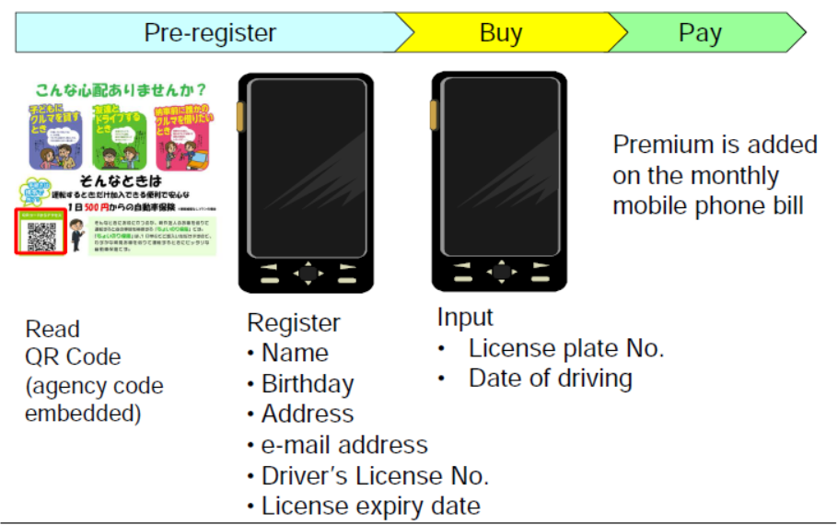
One-Day Auto Insurance

Slide 9
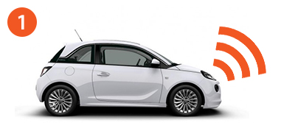
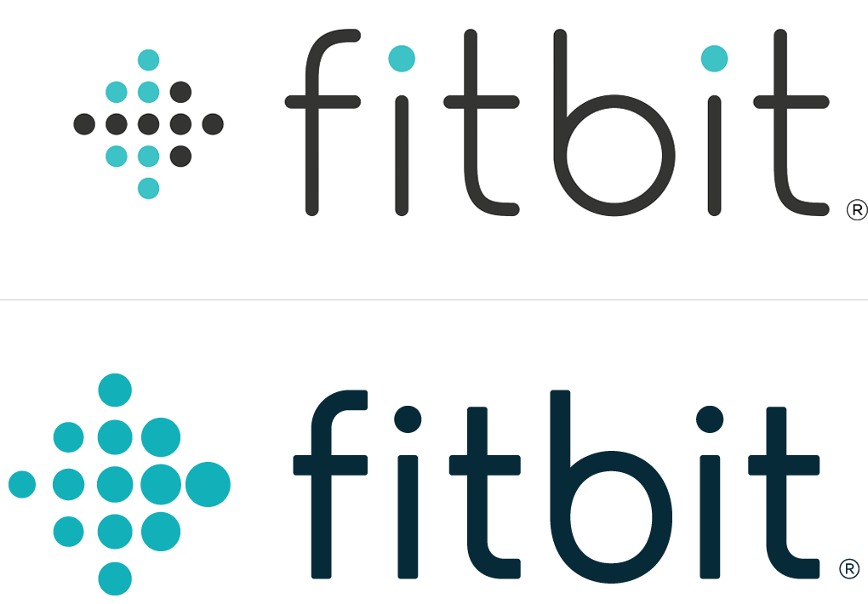
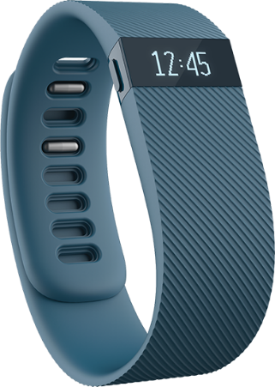
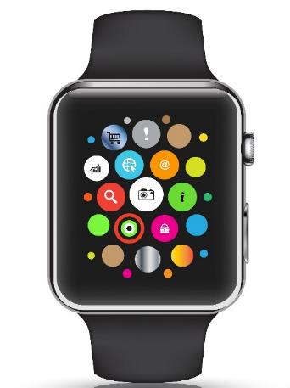
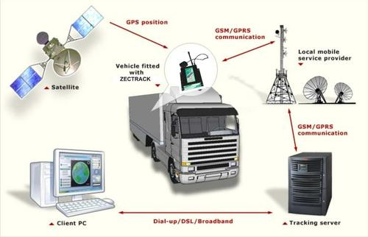

Loss Control Disruptor
The Internet of Things
Telematics Today
Telematics Tomorrow
9
12/01/09 - 9pm
eSlide – P6466 – The Financial Crisis and the Future of the P/C
Notes:
9
Gathering Big Data Affects
Underwriting
Pricing
Monitoring Could Affect
Loss Control
Pricing?

Slide 10
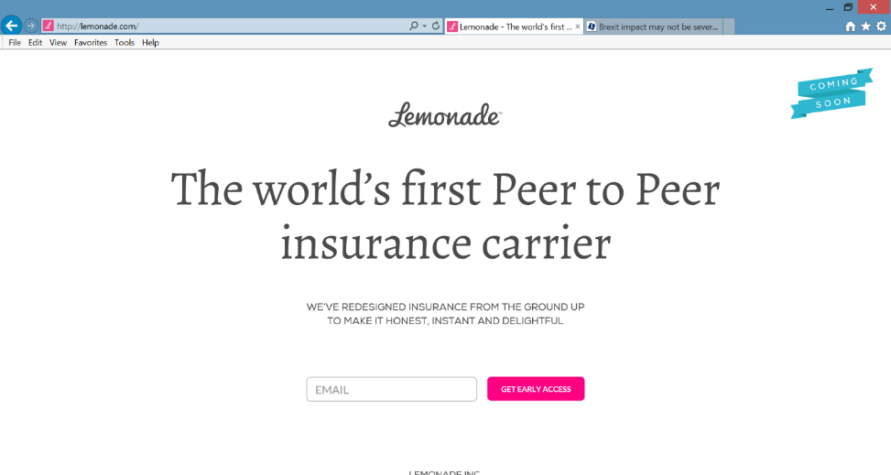
Peer-to-Peer (P2P) Insurance
Lemonade’s Model: Unknown
Taking on the Entire Value Chain
A Typical P2P Model
Resembles Mutuals/Reciprocals
People Join Small Group of Friends to Prefund Deductible or Bear Other Small Risk.
Leftover Deductible $$ Rolled Forward.
May Deter Fraud – You Wouldn’t Cheat Your Friends!
CEO Daniel Schreiber
Our Chief Behavioral Officer, Professor Dan Ariely, says that “If you tried to create a system to bring out the worst in humans, it would look a lot like the insurance of today.”
Source: “UberX-ing Insurance : Is Peer-to-Peer Insurance Viable?”, presentation by Jay Sarzen, Aite Group at Drinker Biddle Insurance Conference, June 21, 2016.

Slide 11
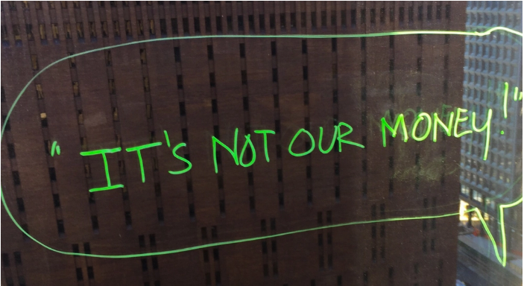

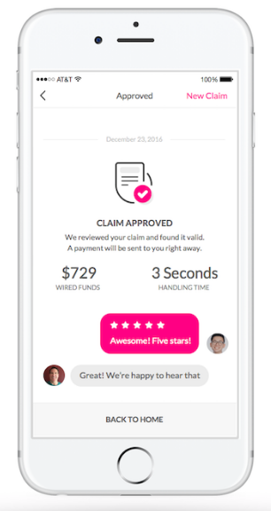
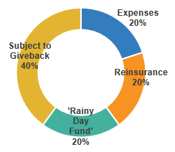
Claims Disruptor
Artificial Intelligence + Behavioral Economics
Notes:
AI Jim
IDs suspicious activity
Marries Artificial Intelligence, Behavioral Economics (file via video)
Bot handles simplest claims

Slide 12




























InsurTech Startups Have Broad Range…BUT…
Risk
Health
Insurance Marketplace
Digital Brokers
Peer to Peer
Health Navigators
Micro-duration Coverage
Telematics
Source: Aon.
Notes:
Based on our most recent count we are tracking over 500+ InsurTech Companies. Just a year ago that number was about half that. We are tracking companies across Risk and Health in a variety of themes. For us its more about business concepts than it is about individual companies.

Slide 13








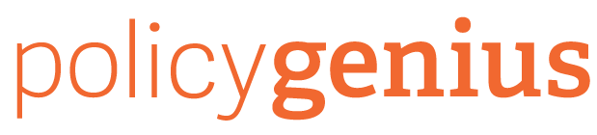




…With Broad Incumbent Support
$205M
$57M
$37M
$21M
$4M
Note: Total funding.
Source: Aon.
Notes:
Some examples of insurance company investments in InsurTech…. As you can see it is across a variety of themes or business concepts….
Metromile – Telematics
CoverHound and Policy Genius- Insurance Marketplaces
One Inc. – Cloud Based IT Platform and
Slice - Micro-Duration Coverage.
These investments create an opportunity to accelerate growth, improve efficiency, enhance the customer experience and “Speed to Market” for new products in emerging risk.

Slide 14
InsurTech Disruption: Threat or Opportunity?
Automation efficiencies can have powerful impact on industry
Focus of InsurTech in the insurance value chain¹, %
Future profits as a % of today’s profits
Only nine percent of InsurTechs aim to oust incumbents
Digitizing the business, auto insurance example
Disrupting the value chain
Short-term gain
Long-term decline
120-200
220-300
-20 to -60
15-55
155-195
Disintermediating incumbents from customers
100
-60 to -100
Improvements in growth, and loss-and-expense ratio²
Impact from improved vehicle safety³⁻⁴
Shift in liability to commercial product lines⁴
Improved loss-and-expense ratio⁴
Enabling the value chain
Today’s profits
2025 profits
2035 profits⁵
¹Insurtechs are insurance businesses, usually startups, that use technologically innovative apps, processes, or business models; 2016 data based on some 500 commercially well-known cases. ²Assumes a 3 to 5 percentage point improvement in loss ratio, a 2 to 4 percentage point improvement in operating expenses, and a 6 to 8 percentage point improvement in direct sales conversions. ³Includes growth in investment income as well premiums. Investment income modeled as a ﬂat percentage of premium in each year. ⁴Includes impact of semi- and fully autonomous vehicles. ⁵Assumes a 25 percent reduction in premiums as a result of telematics and sensors and a 50 percent risk transfer to commercial product liability.
Source: Panorama by McKinsey; Digital and Auto Insurers Value at Stake Analysis, McKinsey, 2016.

Slide 15







Successful Digital Transformation → Holistic Approach
Notes:
All industries being impacted

Slide 16
Summary
Disruption provides opportunities and challenges throughout the value chain

Slide 17
Thank you for your time and your attention!
www.iii.org
Download at www.iii.org/presentations

Slide 18
History
8/15 Created off presentation to FACI, 8/17, combined with previous Disruption slides
10/4 Reordered slides, reintroduced slide about loss control

