Slide 1
Insurance Market Trends and More
James Lynch chief actuary
Insurance Information Institute  Washington, DC  New York, NY 212.346.5533  jamesl@iii.org  www.iii.org

Slide 2
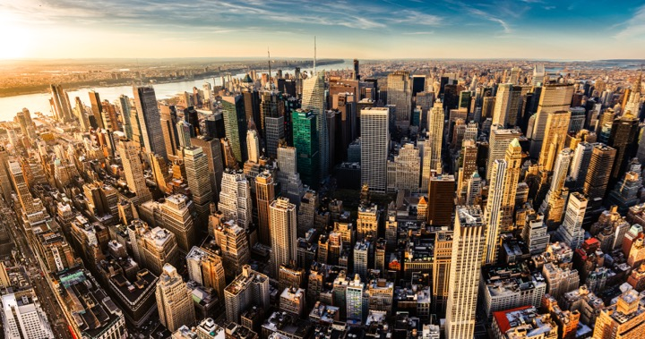
I.I.I. Mission Statement
Improving public understanding of insurance...
…what it does and how it works.
2

Slide 3
Over The Past 18 Months, However, Insurance Coverage Has Focused On…
Insurance Lawsuits
Travel & Pet Insurance
3%
Mortgage & Title Insurance
3%
18% on other P/C and life products
Crop Insurance
3%
Life Insurance & Long-Term Care
Auto Insurance
Wildfires
2%
Flood & Storms
Homeowner Insurance
28% on Nat Cat risks
NFIP
Cyber Insurance
30% on cyber insurance and digital trends
InsurTech
Count
Source: Quid, HPS Analysis, Excludes Health Insurance And Company Performance

Slide 4
Social Media Focuses More On NatCat Than Cyber, Auto and InsurTech
Traditional Media Coverage vs Social Shares
NFIP
Flood & Storms
Homeowner Insurance
Average Social Share
Travel Insurance
Insurance Lawsuits
Wildfires
Life Insurance & Long-Term Care
Crop Insurance
Cyber Insurance
Auto Insurance
InsurTech
Publisher Count

Slide 5
2018 I.I.I. Issue Focus Areas
Mapping Where Our Issues Stand As We Approach Q3
Inform
Own
Audiences
High
Insurance As Economic Capital
B2B
Nat Cat Resilience
B2C
Life
Cyber Risk
B2G
Pandemic Risk
Auto
Strategic Initiative
InsurTech
Public Discussion
To Begin 2H 2018
Manage
Elevate
Home/Rental
Political Risk
Terror
Low
Fraud
Industry Talent
Low
I.I.I. Opp/Risk
High

Slide 6
Disruptive Forces in the World – The New Norm
Catastrophes
Economics
Geopolitical
Technology

Slide 7
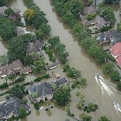
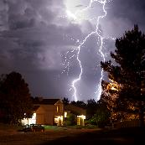
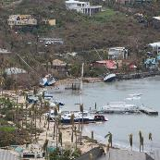
Catastrophes
Flooding events spurred 73% of federal disaster declarations
Thunderstorm related losses 2nd highest ever in U.S.
$14B insured wildfire losses; California estimated ~$11B
N.A. hurricane season record-breaking insured & economic losses; disasters affected >25 million Americans
Auto: Reaching epidemic proportions
Cyber: Risk continuing to increase

Slide 8
Economics
Strengthening Fundamentals:
All OECD economies growing – 1st in 10 yrs.
Tepid monetary policies; keeping interest rates at historical lows — moving slow...
Fiscal policies, i.e. tax reform and deregulation surfacing.

Slide 9
Geopolitical
Rise in Nationalism: Brexit, U.S. – Populist vote in Europe tripled since 2000*.
Political gridlock in Congress, with 2018 election lurking.
“Major conflict threat greatest since WWII“ – US Intelligence Report to Congress
* Source: Harvard University, Tony Blair Institute

Slide 10
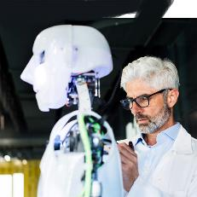
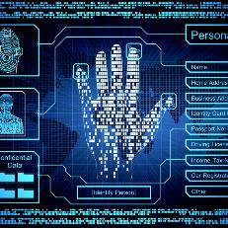
Technology
Robotics
Artificial Intelligence
“The Fourth Industrial Revolution”
Cyber meets Physical
Big Data
Internet of Things
Social Economy

Slide 11
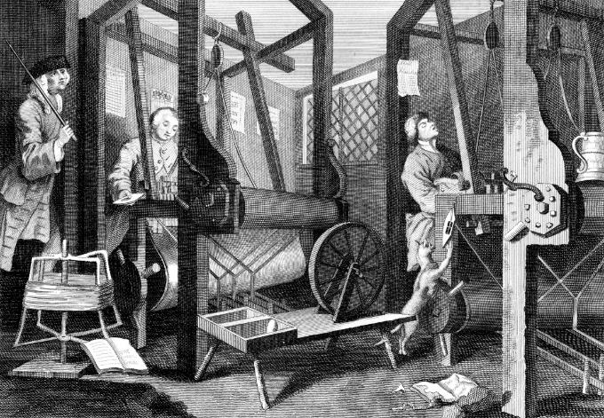
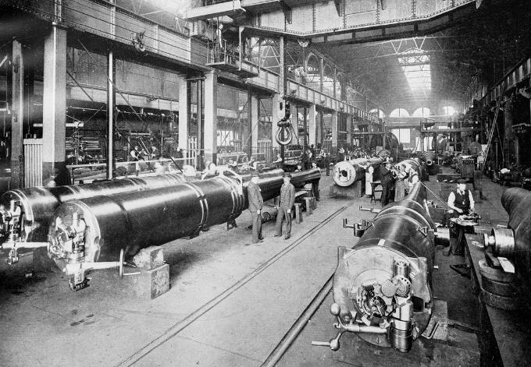
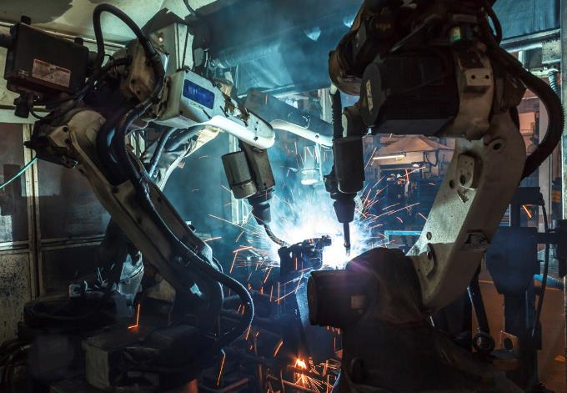
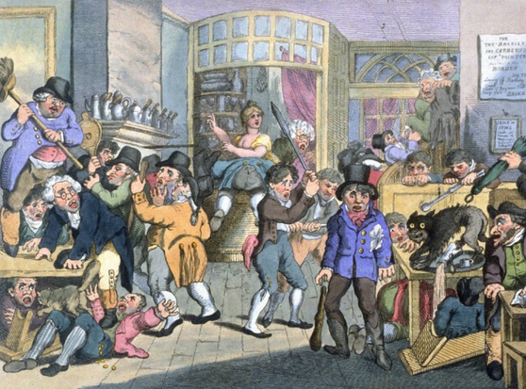
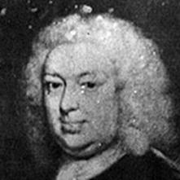
Insurance Leading Throughout History
???
1969
1870
1784
1648
Edward Lloyd’s Coffee House
Steam, Water, Mechanical Production
Division of Labor, Electricity, Mass Production
Electronics, IT, Automated Production
Cyber-Physical Systems

Slide 12
Insurance Industry Economic Trends

Slide 13
U.S. Insured Catastrophe Losses
Harvey, Irma, Maria*
2017 – Worst Ever for U.S. Insured Catastrophe Losses. Average Insured Loss per Year for 1989-2017 is $22.4 B.
*2017: Inflation-adjusted PCS estimate, subject to change.
Sources: Property Claims Service, a Verisk Analytics business; Insurance Information Institute.

Slide 14
Inflation Adjusted U.S. Catastrophe Losses by Cause of Loss, 1997–2016¹
Terrorism, $25.0
Fires (3), $8.4
Other (4), $0.8
Winter Storms, $28.2
Wind/Hail/Flood, $29.7
Events Including Tornadoes (2), $168.1
Hurricanes & Tropical Storms, $161.1
(1) Adjusted for inflation through 2016 by ISO using the GDP implicit price deflator. Excludes catastrophes causing direct losses less than $25 million in 1997 dollars. Does not include flood damage covered by the federally administered National Flood Insurance Program. (2) Includes other wind, hail, and/or flood losses associated with catastrophes involving tornadoes. (3) Includes wildland fires. (4) Includes losses from civil disorders, water damage, utility service disruptions, and any workers compensation catastrophes generating losses in excess of PCS's threshold after adjusting for inflation. Source: Property Claim Services (PCS)®, a unit of ISO®,a Verisk Analytics® business.

Slide 15
P/C Industry Net Income After Taxes*, First Half of Year
Billions, 2018 dollars
Industry Income Doubled in the First Half of 2018 vs. a Year Ago.
*adjusted for inflation using the BLS CPI calculator, to 2018 dollars Sources: ISO, a Verisk Analytics company; Insurance Information Institute.

Slide 16
P/C Insurance Industry Combined Ratio*
3 Consecutive Years of U/W Profits; 1st time since 1971-73
Higher CAT Losses, Shrinking Reserve Releases, Toll of Soft Market
Hurricanes, Wildfires Drive CR Higher.
Best Combined Ratio Since 1949 (87.6)
Sandy
Through Q2.
*Excludes Mortgage & Financial Guaranty insurers 2008-2014. Including M&FG, 2008=105.1, 2009=100.7, 2010=102.4, 2011=108.1; 2012:=103.2; 2013: = 96.1; 2014: = 97.0.
Sources: A.M. Best; ISO, a Verisk Analytics company; I.I.I. projection for 2018.

Slide 17
Policyholder Surplus By Quarter
Amount of Surplus
Change from Prior Quarter
Billions
Tax Law Increased Surplus at Year-End 2017 and Makes Surplus Growth a Bit More Volatile. $1.30 Surplus per $1 Premium.
17
Sources: ISO, A.M .Best.
12/01/09 - 9pm
eSlide – P6466 – The Financial Crisis and the Future of the P/C
Notes:
17

Slide 18
Net Premium Growth, Annual Change
Tax Reform Led to Spike in Net Written Premium in 2018 - $314B at Second Quarter.
All data through second quarter.
SOURCES:NAIC data sourced through S&P Global Intelligence, Bureau of Economic Affairs, Insurance Information Institute.

Slide 19
Direct Premium Growth, Annual Change
Rising Auto Rates Driving Premium Growth - $337B at Second Quarter.
All data through second quarter.
SOURCES:NAIC data sourced through S&P Global Intelligence, Bureau of Economic Affairs, Insurance Information Institute.

Slide 20
Commercial & Personal Lines NPW Growth
6.7%
3.3%
Commercial Lines is Prone to Much More Cyclical Volatility Than Personal Lines.
Note: Data include state funds beginning in 1998.
Sources: A.M. Best; Insurance Information Institute.

Slide 21
Consolidation/M&A
Booming Among Agents & Brokers
Mega-Deals Drive Value
Agencies Drive Volume
Sources: PriceWaterhouseCoopers, Optis Partners.

Slide 22
Commercial Lines Trends

Slide 23
Drivers of E&O Exposures
Revenues Top $7 Trillion This Year
Exposure Growth Climbs
By Type of Service
Miscellaneous E&O Services: Finance & Insurance; Real Estate, Rental & Leasing; Professional, Scientific & Technical Services.
Sources: U.S. Census Bureau Quarterly Services Survey, Insurance Information Institute.

Slide 24
Commercial Lines Rate Change
‘Material’ Increases in Auto, Property, Umbrella; Q2 Increases > Q1 Increases
Sources: Willis Towers Watson, MarketScout.

Slide 25
Liability Rate Changes
Slight Softening, Though Local Markets Vary
U.S. Casualty
U.S. Financial and Prof Liab
SOURCE: Marsh Insurance Market Index.

Slide 26
Property/Cyber Rate Changes
A Flat Market, Though Local Markets Vary
U.S. Property
U.S. Cyber
SOURCE: Marsh Insurance Market Index.

Slide 27
Personal Lines Trends

Slide 28
Driving Patterns Predict Claim Frequency
Billions of miles driven in prior year
Overall collision claims per 100 insured vehicles
The sharp rise in collision frequency in 2014-2016 appears to have peaked in the last year. However, claim severity will likely continue to rise as 2018 will see another 17 million new cars on the road.
The only force that could derail the relationship between miles driven and frequency would be a sharp and persistent rise in the cost of gasoline.
3,215
Recession
6.06
Sources: Federal Highway Administration; Rolling four-quarter average frequency from Fast Track Monitoring System; Insurance Institute for Highway Safety; Insurance Information Institute.

Slide 29
Road Safety
Better Economy = More Drivers = More Accidents
14 Percent of Injury Crashes
Economic well-being
Distracted driving
Safety Devices Can Be Expensive
Why rates go up
Speed
Still
Kills
Expensive auto parts
Faster driving
Legalized marijuana
It’s Not Funny
Source: Insurance Information Institute research.

Slide 30
To rent or to buy?
Millions of renter-occupied housing units
Millions of owner-occupied housing units
From 2004 to 2016:Q4, the number of renter-occupied housing units grew by about 10.5 million units (+34%), but there was no growth in the number of owner-occupied housing units for 12 years. This streak appears to have ended in 2016:Q4. This is good news for homeowners insurance premium growth.
Sources: U.S. Census Bureau at http://www.census.gov/housing/hvs/data/histtabs.html, Table 8; Insurance Information Institute.

Slide 31
Insurance and Innovation

Slide 32
Insurance Disruption: Technology / Digitalization
Fundamental Changes
Opportunities
Challenges
Future of Auto
Future of Reduced Risk Pools
Automation / Efficiencies
New Product Lines (Cyber)
Emerging Technologies
Consumer Trust – Demonstrate the Societal Value
Big Data vs. Individual Privacy
New Market Entrants “Uber of Insurance”?
Regulatory Opportunities/Threats
Lemonade
Offered in CA, GA, IL, NJ, NV, NY, OH, PA, TX
Barrier to Entry
US vs. Other Less Regulated Regions
Trust Pull-back – the Sandbox Approach

Slide 33
InsurTech Disruption: Threat or Opportunity?
Automation efficiencies can have powerful impact on industry
Focus of InsurTech in the insurance value chain¹, %
Future profits as a % of today’s profits
Only nine percent of InsurTechs aim to oust incumbents
Digitizing the business, auto insurance example
Disrupting the value chain
Short-term gain
Long-term decline
120-200
220-300
-20 to -60
15-55
155-195
Disintermediating incumbents from customers
100
-60 to -100
Improvements in growth, and loss-and-expense ratio²
Impact from improved vehicle safety³⁻⁴
Shift in liability to commercial product lines⁴
Improved loss-and-expense ratio⁴
Enabling the value chain
Today’s profits
2025 profits
2035 profits⁵
¹Insurtechs are insurance businesses, usually startups, that use technologically innovative apps, processes, or business models; 2016 data based on some 500 commercially well-known cases. ²Assumes a 3 to 5 percentage point improvement in loss ratio, a 2 to 4 percentage point improvement in operating expenses, and a 6 to 8 percentage point improvement in direct sales conversions. ³Includes growth in investment income as well premiums. Investment income modeled as a ﬂat percentage of premium in each year. ⁴Includes impact of semi- and fully autonomous vehicles. ⁵Assumes a 25 percent reduction in premiums as a result of telematics and sensors and a 50 percent risk transfer to commercial product liability.
Source: Panorama by McKinsey; Digital and Auto Insurers Value at Stake Analysis, McKinsey, 2016.

Slide 34
InsurTech Startups Have Broad Range…BUT…
Risk
Health
Insurance Marketplace
Digital Brokers
Peer to Peer
Health Navigators
Micro-duration Coverage
Telematics
Source: Aon.

Slide 35
…With Broad Incumbent Support
$205M
$57M
$37M
$21M
$4M
Note: Total funding.
Source: Aon.

Slide 36
Four Main Effects on Insurance in the Fourth Industrial Revolution
Customer Expectations
Amazon raises the bar
AI and robotics
Product Enhancement
More personalized and/or digitally-enhanced
Value focus on risk mitigation and resilience
Collaborative innovation
Speed of innovation requires new forms of collaboration to keep up
Organizational forms
Talent, culture, and organizational forms will have to be rethought
Source: https://www.weforum.org/agenda/2016/01/the-fourth-industrial-revolution-what-it-means-and-how-to-respond/

Slide 37
Challenges the Insurance Industry Faces in Innovation
Sources: PricewaterhouseCoopers, Global Insurtech Report - 2017

Slide 38
Agents Respond – New Agencies:
Use Facebook to keep in touch with customers/prospects (83% vs. 59%).
Include agency website and social media strategies in marketing plan
(82% vs. 64% and 83% vs. 53%, respectively).
Strongly agree that agency has seen cost savings by using paperless
communication options offered by carriers, as well as by offering
them to customers (52% vs. 27% and 50% vs. 27%, respectively).
Strongly agree insureds are just as likely to accept e‐documents as
paper documents (54% vs. 33%).
Text with clients as a form of communication (62% vs. 41%).
Source: Independent Insurance Agents of America, Agency Universe Study, 2016

Slide 39
Successful Digital Transformation → Holistic Approach

Slide 40
Insurance Leadership

Slide 41
Insurance & Economic Leadership
Sustainable Business Model
Strong Jobs Pool/Provider
Economic Growth Promoter/Facilitator
2010
$612B
3.1%
US GDP³
Bank Failures: 157
2.8M Employed
Premium Taxes Paid⁴ $19.2B
Insurance Impairments¹: 8
Bond Investment⁵ $489B
Policyholder Surplus:
~$761B
End Q2/18
Need to Fill 400K+ by 2022²
Charity/Volunteerism⁶ 15%
¹Life/Health and P/C Insurance; ²PC 360 http://www.propertycasualty360.com/2013/04/17/insurance-industry-crisis-400000-positions-to-fill?slreturn=1476304299; ³U.S. Bureau of Economic Analysis, 2017; ⁴U.S. Department of Commerce, 2015; ⁵Federal Reserve, 2015; ⁶2011–2014, Insurance Industry Charitable Foundation.

Slide 42
Insurance: A Critical Factor in the Economy
Source: US Bureau of Economic Analysis https://www.bea.gov/iTable/iTable.cfm?ReqID=51&step=1#reqid=51&step=51&isuri=1&5114=a&5102=5.

Slide 43
How Insurance Drives Economic Growth
Safety/
Security
Economic/ Financial Stability
Development
Insurers are financial first responders
Insurers are capital protectors
Insurance is a partner in social policy
Insurers are community builders
Insurance enables infrastructure improvements
Insurers are risk mitigators
Insurance sustains the supply chain
Insurers are capital infusers
Insurers are innovation catalysts
Insurers are credit facilitators
Notes:
43

Slide 44
Thank you!
www.iii.org

