Slide 1
Trends, Challenges and Opportunities in the P/C Insurance Industry in 2017 & Beyond
The Institutes’ Management Development Program
University of Wisconsin
Madison, WI
October 18, 2016
Robert P. Hartwig, Ph.D., CPCU, Special Consultant ♦ Insurance Info. Inst.
Co-Director, Center for Risk and Uncertainty Mgmt. ♦ University of South Carolina
Cell: 917.453.1885 ♦ bobh@iii.org ♦ www.iii.org

Slide 2
P/C (Re)Insurance Industry Financial Overview
The Past Few Years Have Been Very Similar and Reasonably Good
2

Slide 3
P/C Industry Net Income After Taxes
1991–2016:Q2
$ Millions
2005 ROE*= 9.6%
2006 ROE = 12.7%
2007 ROE = 10.9%
2008 ROE = 0.1%
2009 ROE = 5.0%
2010 ROE = 6.6%
2011 ROAS¹ = 3.5%
2012 ROAS¹ = 5.9%
2013 ROAS¹ = 10.2%
2014 ROAS¹ = 8.4%
2015 ROAS = 8.4%
2016:H1 ROAS = 6.4%*
Net income in Q2:2016 on an annualized basis was on track to fall short of full-year 2015
ROE figures are GAAP; ¹Return on avg. surplus. Excluding Mortgage & Financial Guaranty insurers yields a 8.2% ROAS in 2014, 9.8% ROAS in 2013, 6.2% ROAS in 2012, 4.7% ROAS for 2011, 7.6% for 2010 and 7.4% for 2009; 2015E is annualized figure based actual figure through Q3 of $44.0
Sources: A.M. Best, ISO; Insurance Information Institute

Slide 4
Profitability Peaks & Troughs in the P/C Insurance Industry, 1975 – 2016:H1
ROE
1977:19.0%
History suggests next ROE peak will be in 2016-2017
1987:17.3%
10 Years
1997:11.6%
2006:12.7%
10 Years
2015: 8.4%
9 Years
2013 9.8%
2016:H1 6.4%
1975: 2.4%
1984: 1.8%
1992: 4.5%
2001: -1.2%
*Profitability = P/C insurer ROEs. 2011-15 figures are estimates based on ROAS data. Note: Data for 2008-2014 exclude mortgage and financial guaranty insurers.
Source: Insurance Information Institute; NAIC, ISO, A.M. Best, Conning

Slide 5
ROE: Property/Casualty Insurance by Major Event, 1987–2016:H1
(Percent)
P/C Profitability Is Both by
Cyclicality and Ordinary Volatility
Modestly higher CATs
Katrina, Rita, Wilma
Low CATs
Sept. 11
Hugo
Lowest CAT Losses in
15 Years
4 Hurricanes
Sandy
Andrew, Iniki
Northridge
Record Tornado Losses
Financial Crisis*
* Through 2016:H1. Excludes Mortgage & Financial Guarantee in 2008 – 2014.
Sources: ISO, Fortune; Insurance Information Institute.

Slide 6
P/C Insurance Industry ROE: Magnitude of Cyclicality, Volatility Changes Over Time, 1950-2015
1950 - 1970
Low
Volatility
1971 - 1992
Extreme
Volatility
1993 - 2008
Moderate
Volatility
2009 - Present
Modest
Volatility
.
Source: Insurance Information Institute

Slide 7
P/C Insurance Industry
Combined Ratio, 2001–2016:Q2*
Heavy Use of Reinsurance Lowered Net Losses
Relatively Low CAT Losses, Reserve Releases
Higher CAT Losses, Shrinking Reserve Releases, Toll of Soft Market
As Recently as 2001, Insurers Paid Out Nearly $1.16 for Every $1 in Earned Premiums
Relatively Low CAT Losses, Reserve Releases
Avg. CAT Losses, More Reserve Releases
3 Consecutive Years of U/W Profits: First Time Since 1971-73
Sandy Impacts
Best Combined Ratio Since 1949 (87.6)
Cyclical Deterioration
Lower CAT Losses
Elevated CATs
* Excludes Mortgage & Financial Guaranty insurers 2008--2014. Including M&FG, 2008=105.1, 2009=100.7, 2010=102.4, 2011=108.1; 2012:=103.2; 2013: = 96.1; 2014: = 97.0.
Sources: A.M. Best, ISO (2014-2015); Figure for 2010-2013 is from A.M. Best P&C Review and Preview, Feb. 16, 2016.

Slide 8
Number of Years with Underwriting Profits by Decade, 1920s–2010s
Number of Years with Underwriting Profits
Underwriting Profits Were Common Before the 1980s
(40 of the 60 Years Before 1980 Had Combined Ratios Below 100) –
But Then They Vanished. Not a Single Underwriting Profit Was
Recorded in the 25 Years from 1979 Through 2003
* 2009 combined ratio excl. mort. and finl. guaranty insurers was 99.3, which would bring the 2000s total to 4 years with an u/w profit.
**Data for the 2010s is for the period 2010 through 2015.
Note: Data for 1920–1934 based on stock companies only.
Sources: Insurance Information Institute research from A.M. Best Data.
8
12/01/09 - 9pm
eSlide – P6466 – The Financial Crisis and the Future of the P/C
Notes:
8

Slide 9
P/C Insurance Loss Reserve Development, 1992 – 2017E*
Reserve releases are expected to gradually taper off slowly, but will continue to benefit the bottom line and combined ratio through at least 2017
Reserve Change
Source: A.M. Best; Barclays research for estimates.

Slide 10
Policyholder Surplus,
2006:Q4–2016:Q2
($ Billions)
2007:Q3
Pre-Crisis Peak
Drop due to near-record 2011 CAT losses
Surplus as of 6/30/16 stood at a record high $680.64B
The industry now has $1 of surplus for every $0.76 of NPW,
close to the strongest claims-paying status in its history.
2010:Q1 data includes $22.5B of paid-in capital from a holding company parent for one insurer’s investment in a non-insurance business .
The P/C insurance industry entered 2016
in very strong financial condition.
Sources: ISO, A.M .Best.
10
12/01/09 - 9pm
eSlide – P6466 – The Financial Crisis and the Future of the P/C
Notes:
10

Slide 11
US Policyholder Surplus:
1975–2016*
($ Billions)
Surplus as of 6/30/16 was a record $680.6, up 1.0% from $673.7 of 12/31/15, and up 55.7% ($243.5B) from the crisis trough of $437.1B at 3/31/09
“Surplus” is a measure of underwriting capacity. It is analogous to “Owners Equity” or “Net Worth” in non-insurance organizations
The Premium-to-Surplus Ratio Stood at $0.76:$1 as of
12/31/15, a Near Record Low (at Least in Recent History)
* As of 6/3016.
Source: A.M. Best, ISO, Insurance Information Institute.

Slide 12
RNW All Lines, 2005-2014 Average:
Highest 25 States
(Percent)
The most profitable states over the past decade are widely distributed geographically, though none are in the Gulf region
Profitability Benchmark: All P/C
US: 7.7%
Source: NAIC; Insurance Information Institute.

Slide 13
RNW All Lines, 2005-2014 Average:
Lowest 25 States
(Percent)
Some of the least profitable states over the past decade were hit hard by catastrophes
Source: NAIC; Insurance Information Institute.

Slide 14
Net Premium Growth (All P/C Lines): Annual Change, 1971—2016:Q2
(Percent)
1975-78
1984-87
2000-03
Net Written Premiums Fell 0.7% in 2007 (First Decline Since 1943) by 2.0% in 2008, and 4.2% in 2009, the First 3-Year Decline Since 1930-33.
2016 Q2: 3.0%
2015: 3.4%
2014: 4.2
2013: 4.4%
2012: +4.2%
Outlook
2016F: 3.0%
2017F: 2.9%
Shaded areas denote “hard market” periods
Sources: A.M. Best (1971-2013), ISO (2014-16).

Slide 15
NPW Premium Growth: Peaks & Troughs in the P/C Insurance Industry, 1926 – 2015
ROE
Post WW II Peak:
1947: 26.2%
1970-90: Peak premium growth was much higher in this period while troughs were comparable. Rapid inflation, economic volatility, high interest rates, tort environment all played roles
Start of WW II
1941: 15.8%
Economic Shocks, Inflation:
1976: 22.0%
Tort Crisis
1985/86: 22.2%
Post-9/11
2002:15.3%
1988-2000: Period of inter-cycle stability
2015 3.4%
1950-70: Extended period of stability in growth and profitability. Low interest rates, low inflation, “Bureau” rate regulation all played a role
2010-20XX? Post-recession period of stable growth?
Twin Recessions; Interest Rate Hikes
1987: 3.7%
Great Recession:2010: -4.9%
Great Depression
1932: -15.9% max drop
Note: Data through 1934 are based on stock companies only. Data include state funds beginning in 1998.
Source: A.M. Best; Insurance Information Institute.

Slide 16
Commercial Lines NPW Premium Growth:
1975 – 2015E
ROE
Commercial lines is prone to more cyclical volatility that personal lines. Recently, growth has stabilized in the 4% to 5% range.
Economic Shocks, Inflation:
1976: 22.2%
Tort Crisis
1986: 30.5%
Post-9/11
2002: 22.4%
Post-Hurricane Andrew Bump:
1993: 6.3%
1988-2000: Period of inter-cycle stability
Post Katrina Bump:
2006: 7.7%
2015E 3.3%
2010-20XX? Post-recession period of stable growth?
Recessions:
1982: 1.1%
Great Recession:2009: -9.0%
Note: Data include state funds beginning in 1998.
Source: A.M. Best; Insurance Information Institute.

Slide 17
U.S. INSURANCE MERGERS AND ACQUISITIONS,
P/C SECTOR, 1994-2015 (1)
M&A activity in the P/C sector in 2015 totaled $39.6B, its highest level since 2000
($ Millions)
(1) Includes transactions where a U.S. company was the acquirer and/or the target.
Source: Conning proprietary database.

Slide 18
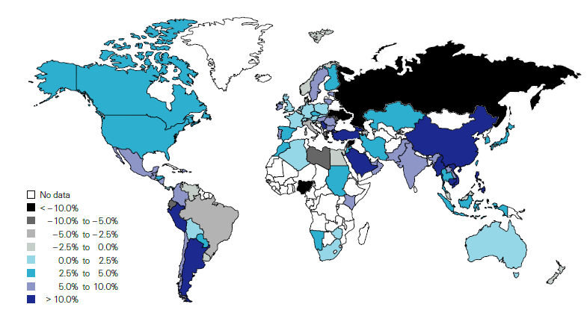
Non-Life Insurance: Global Real (Inflation Adjusted) Premium Growth, 2015
Real non-life premium growth was stronger in the US in 2015 than in most of Europe
Market | Life | Non-Life | Total
Advanced | 2.5 | 2.6 | 2.5
Emerging | 12.0 | 7.8 | 9.8
World | 4.0 | 3.6 | 3.8
Source: Swiss Re, sigma, No. 3/2016.
18
12/01/09 - 9pm
eSlide – P6466 – The Financial Crisis and the Future of the P/C
Notes:
18

Slide 19
INVESTMENTS:
THE NEW REALITY
Investment Performance is a Key Driver of Profitability
Depressed Yields Will Necessarily Influence Underwriting & Pricing
19

Slide 20
S&P 500 Index Returns, 1950 – 2016*
Annual Return
Stock market is off to its worst start ever but volatility is endemic to stock markets—and may be increasing—but there is no persistent downward trend over long periods of time
Fed Raises Rate
Tech Bubble Implosion
2016*:
+6.5%
Energy Crisis
Financial Crisis
*Through Oct. 12 2016.
Source: NYU Stern School of Business: http://pages.stern.nyu.edu/~adamodar/New_Home_Page/datafile/histretSP.html Ins. Info. Inst.

Slide 21
Property/Casualty Insurance Industry Investment Income: 2000–2016:Q2¹
Investment earnings are still 19% below their 2007 pre-crisis peak
($ Billions)
Due to persistently low interest rates, investment income fell in 2012, 2013 and 2014 but showed a small (1.9%) increase in 2015—another drop in 2016 seems likely.
*Annualized figure based on actual Q2:2016 net investment income earned of $22.067B.
¹ Investment gains consist primarily of interest and stock dividends. Sources: ISO; Insurance Information Institute.

Slide 22
U.S. Treasury Security Yields:
A Long Downward Trend, 1990–2016*
Yields on 10-Year U.S. Treasury Notes have been essentially below 5% for more than a decade.
Despite the Fed’s December 2015 rate hike, yields remain low though short-term yields have seen some gains; Yield curve is flattening.
Since roughly 80% of P/C bond/cash investments are in 10-year or shorter durations, most P/C insurer portfolios will have low-yielding bonds for years to come.
*Monthly, constant maturity, nominal rates, through August 2016.
Sources: Federal Reserve Bank at http://www.federalreserve.gov/releases/h15/data.htm. National Bureau of Economic Research (recession dates); Insurance Information Institute.
22
12/01/09 - 9pm
eSlide – P6466 – The Financial Crisis and the Future of the P/C
Notes:
22

Slide 23
Distribution of Invested Assets: P/C Insurance Industry, 2013
$ Billions
Total Invested Assets = $1.5 Trillion
Source: Insurance Information Institute Fact Book 2015, A.M. Best.

Slide 24
Net Investment Yield on Property/ Casualty Insurance Invested Assets, 2007–2016P*
(Percent)
Estimated book yield in 2016 is down about 140 BP from pre-crisis levels
The yield on invested assets remains low relative to pre-crisis yields. The Fed’s plan to raise interest rates in late 2015 has pushed up some yields, albeit quite modestly.
Sources: A.M. Best; 2015E-2016P figures from A.M. Best P/C Review and Preview, Feb. 2016; Insurance Information Institute

Slide 25
Interest Rate Forecasts: 2016 – 2021F
Yield (%)
3-Month Treasury
10-Year Treasury
10-year yields are actually down in 2016
A full normalization of interest rates is unlikely until 2019, more than a decade after the onset of the financial crisis.
Sources: Blue Chip Economic Indicators (10/16 for 2016 and 2017; for 2018-2021 10/16 issue); Insurance Info. Institute.

Slide 26
Annual Inflation Rates, (CPI-U, %),
1990–2017F
Annual Inflation Rates (%)
Inflation peaked at 5.6% in August 2008 on high energy and commodity crisis. The recession and the collapse of the commodity bubble reduced inflationary pressures in 2009/10
Inflationary expectations have slipped (due in part to falling energy costs) allowing the Fed to maintain low interest rates
Slack in the U.S. economy and falling energy prices suggests that inflationary pressures should remain subdued for an extended period of times
Sources: US Bureau of Labor Statistics; Blue Chip Economic Indicators, 10/16 (forecasts).

Slide 27
P/C Insurer Net Realized
Capital Gains/Losses, 1990-2016:Q2
Realized capital gains are down from their 2013 peak
($ Billions)
Insurers Posted Net Realized Capital Gains in 2010 - 2015 Following Two Years of Realized Losses During the Financial Crisis. Realized Capital Losses Were a Primary Cause of 2008/2009’s Large Drop in Profits and ROE.
*Annualized based on actual of $4.438B through Q2 2016
Sources: A.M. Best, ISO; Insurance Information Institute.
27
12/01/09 - 9pm
eSlide – P6466 – The Financial Crisis and the Future of the P/C
Notes:
27

Slide 28
Property/Casualty Insurance Industry Investment Gain: 1994–2016:Q2¹
($ Billions)
Investment gains in 2015 were unchanged from 2014; 2016 is running slightly behind 2015 and 17% below the pre-crisis peak
Total Investment Gains Were Flat in 2015 as Investment Income Rose Marginally and Realized Capital Gains Fell Slightly
¹ Investment gains consist primarily of interest, stock dividends and realized capital gains and losses.
* 2005 figure includes special one-time dividend of $3.2B; 2016 figure is annualized based on actual Q2 2016 figure of $26.505B.
Sources: ISO, SNL; Insurance Information Institute.

Slide 29
Reduction in Combined Ratio Necessary to Offset 1% Decline in Investment Yield to Maintain Constant ROE, by Line*
Lower Investment Earnings Place a Greater Burden on Underwriting and Pricing Discipline
*Based on 2008 Invested Assets and Earned Premiums
**US domestic reinsurance only
Source: A.M. Best; Insurance Information Institute.
29
12/01/09 - 9pm
eSlide – P6466 – The Financial Crisis and the Future of the P/C
Notes:
29

Slide 30
THE ECONOMY
The Strength of the Economy Will Greatly Influence Insurer Exposure Base Across Most Lines
30

Slide 31
US Real GDP Growth*
The Q4:2008 decline was the steepest since the Q1:1982 drop of 6.8%
Real GDP Growth (%)
Recession began in Dec, 2007
Q1 2014/15 GDP data were hit hard by this year’s “Polar Vortex” and harsh winter
Demand for Insurance Should Increase in 2016 as GDP Growth Continues at a Steady, Albeit Moderate Pace and Gradually Benefits the Economy Broadly
* Estimates/Forecasts from Blue Chip Economic Indicators.
Source: US Department of Commerce, Blue Economic Indicators 10/16; Insurance Information Institute.

Slide 32
US Unemployment Rate Forecast
Rising unemployment
eroded payrolls
and WC’s
exposure base.
Unemployment peaked at 10% in late 2009.
2007:Q1 to 2017:Q4F*
Jobless figures have been revised downwards for 2016
Unemployment forecasts have been revised modestly downwards. Optimistic scenarios put the unemployment as low as 4.3% by Q4 of 2017.
* = actual; = forecasts
Sources: US Bureau of Labor Statistics; Blue Chip Economic Indicators (10/16 edition); Insurance Information Institute.

Slide 33
Continued Business Investment Will
Spur Modest Commercial Exposure Growth
The level and direction of interest rates is likely to affect these growth rates.
Business investment was a major drag on the economy in 2016 and adversely impacts commercial property and liability insurance exposures. Growth should begin a modest recovery in 2017.
Sources: Blue Chip Economic Indicators, 10/2016 (history and forecasts for 2016 and 2017, 10/2016 for forecasts for 2018-2022; Insurance Information Institute.

Slide 34
Profitability & Politics
How Is Profitability Affected by the President’s Political Party?
34

Slide 35
P/C Insurance Industry ROE by Presidential Administration, 1950-2015*
OVERALL RECORD: 1950-2015*
Democrats 7.72%
Republicans 7.85%
Party of President has marginal bearing on profitability of P/C insurance industry
*Truman administration ROE of 6.97% based on 3 years only, 1950-52;.
Source: Insurance Information Institute

Slide 36
Trump vs. Clinton:
Issues that Matter to P/C Insurers
Issue | Trump | Clinton
Economy | Supply Side-Like Philosophy: Lower taxes→Faster real GDP growth; Deficits likely grow as tax cuts are combined with targeted increased spending on Homeland Security, Defense, etc. | Keynesian Philosophy: More government spending on infrastructure, education, social services; Deficits likely increase as tax increases likely difficult to pass
Interest Rates | May trend higher with larger deficits; Shift from monetary policy to fiscal focus (tax cuts, government spending) | Status quo at the Fed; Net impact on interest rates unclear
Taxes | Favors lower tax rates for corporate and personal income tax rates; Tax code overhaul? | Unlikely to reduce taxes or embark on major overhaul of tax code
International Trade | Protectionist Tendencies (appeal primarily to manufacturing sector) | Has criticized Trans-Pacific Partnership but is a realist on international matters
Tort System | Doesn’t like trial lawyers but seems to like filing lawsuits | Status Quo
Health Care | ACA should be repealed & replaced | Incremental Change

Slide 37
Auto & Home Insurance:
State of the Personal Lines Market
Auto Frequency and Severity Are an Immediate Challenge
Dearth of Major CATs (Until Recently), Pricing Discipline Has Helped Home
37

Slide 38
Return on Net Worth: All P-C Lines vs. Homeowners & Pvt. Pass. Auto, 1990-2014*
(Percent)
Average RNW: 1990-2013*
All P-C Lines: 7.8% PP Auto: 8.1% Homeowners: 4.3%**
Excluding 1992’s Hurricane Andrew
Pvt.Pass. Auto Has Consistently Outperformed the P-C Industry as a Whole. Homeowners Volatility is Associated Primarily With Coastal Exposure Issues
*Latest available.
**Excludes 1992, the year of Hurricane Andrew. If 1992 is included the resulting homeowners RNW is 1.9%
Sources: NAIC; Insurance Information Institute.
38
Notes:
38

Slide 39
RNW Pvt. Passenger Auto, 2005-2014 Average: Highest 25 States
(Percent)
Hawaii was the most profitable state for auto insurers from 2005-2014
Sources: NAIC; Insurance Information Institute

Slide 40
RNW Pvt. Passenger Auto,
2005-2014 Average: Lowest 25 States
(Percent)
Michigan was the least profitable state for auto insurers from 2005-2014
Sources: NAIC; Insurance Information Institute

Slide 41
RNW Homeowners Insurance,
2005-2014 Average: Highest 25 States
(Percent)
Hawaii was the most profitable state for home insurers from 2005-2014 due to the absence of hurricanes during this period
Sources: NAIC; Insurance Information Institute

Slide 42
RNW Homeowners Insurance,
2005-2014 Average: Lowest 25 States
(Percent)
Hurricanes Katrina and Rita made Louisiana and Mississippi the least profitable states for home insurers from 2005-2014
Sources: NAIC; Insurance Information Institute

Slide 43
Personal Lines Underwriting Performance
Auto, Home Underwriting Performance Exhibit Periods of Both Stability and Volatility
43

Slide 44
Private Passenger Auto Combined Ratio: 1993–2017F
Private Passenger Auto Underwriting Performance Is Showing the Strains of Rising Frequency (and Severity) Trends in Many States
Sources: A.M. Best (1990-2014); Conning (2015E-17F); Insurance Information Institute.

Slide 45
Homeowners Insurance Combined Ratio: 1990–2017F
Hurricane Andrew
Record tornado activity
Hurricane Ike
Hurricane Sandy
Homeowners Performance Has Improved Markedly Since the 2011/12’s Large Cat Losses. Extreme Regional Variation Can Be Expected Due to Local Catastrophe Loss Activity. Results in 2016 Will Be Impacted by Severe Spring Weather
Sources: A.M. Best (1990-2014); Insurance Information Institute (2015E-17F).

Slide 46
Loss Ratio Comparisons
Auto, Home Exhibit Wide Variety Across States
46

Slide 47
Claim Trends in Private Passenger Auto Insurance
Rising Frequencies and Severities in Many Coverages
Will that Pattern Be Sustained?
47

Slide 48
Return on Net Worth:
Personal Auto, 2005–2014
4.3%
Auto Insurance Profitability Has Been Stuck at Low Levels.
Source: National Association of Insurance Commissioners.

Slide 49
Auto Insurance Net Combined Ratios,
Yearly, 2005-2015
Loss Ratios Have Been Rising for A Decade.
2015 Return on Net Worth Is Likely Close to Zero or Negative.
Sources: National Association of Insurance Commissioners data, sourced from S&P Global Market Intelligence;
Insurance Information Institute.

Slide 50
A Half Century of Auto Insurance:
Frequency vs. Severity
In the Long Run, Frequency Falls. Severity Increases.
Frequency
Severity
1963
1988
2013
Sources: Insurance Institute for Highway Safety, Insurance Services Office, Insurance Information Institute.

Slide 51
Why Personal Auto Loss Ratios are Rising:
Severity & Frequency by Coverage, 2015 vs. 2014
Annual Change, 2015 Over 2014
Across All Personal Coverage Types (Except Comprehensive) in 2015, Frequency and Severity Rose. This Pattern is Likely to Continue in 2016.
Source: ISO/PCI Fast Track data; Insurance Information Institute.

Slide 52
Collision Coverage: Severity & Frequency Trends Are Both Higher in 2016
Annual Change, 2005 through 2016*
The Recession, High Fuel Prices Helped Temper Frequency and Severity, But this Trend Has Clearly Reversed, Consistent with Experience from Past Recoveries
*Four quarters ending with 2016 Q1.
Source: ISO/PCI Fast Track data; Insurance Information Institute

Slide 53
Collision Loss Ratio Trending Upward:
Private Passenger Auto, 2010 – 2016*
Loss Ratio
Collision Loss Ratios are Trending Steadily Upward
*2016 figure is for Q1.
Source: ISO/PCI Fast Track data; Insurance Information Institute

Slide 54
Bodily Injury: Severity Trend Is Up, Frequency Decline Has Ended—Rising?
Annual Change, 2005 through 2016*
Cost Pressures Will Increase if BI Frequency and Severity Trends Persist
*2016 figure is for Q1.
Source: ISO/PCI Fast Track data; Insurance Information Institute

Slide 55
Property Damage Liability: Severity and Frequency Are Up
Annual Change, 2005 through 2016*
Severity/Frequency Trends Have Been Volatile, But Rising Severity since 2011 Is a Concern
*2016 figure is for Q1.
Source: ISO/PCI Fast Track data; Insurance Information Institute

Slide 56
Comprehensive Coverage: Frequency and Severity Trends Are Volatile
Severe weather is a principal cause of the spikes in both frequency and severity
Annual Change, 2005 through 2016*
Weather Creates Volatility for Comprehensive Coverage
*2016 figure is for Q1.
Source: ISO/PCI Fast Track data; Insurance Information Institute

Slide 57
A Few Factors Driving Adverse Private Passenger Auto Loss Trends
More People Driving, Lower Gas Prices, Higher Speed Limits…
57

Slide 58
Why Are People
Driving More Miles? Jobs? 2006 - 2015
Billions of Miles Driven in Prior Year
Millions Employed
Recession
People Drive To and From Work and Drive to Entertainment. Out of Work, They Curtail Their Movement.
Sources: Federal Highway Administration (http://www.fhwa.dot.gov/policyinformation/travel_monitoring/tvt.cfm ); Seasonally Adjusted Employed from Bureau of Labor Statistics; Insurance Institute for Highway Safety; Insurance Information Institute.
58
12/01/09 - 9pm
eSlide – P6466 – The Financial Crisis and the Future of the P/C
Notes:
58

Slide 59
More People Working and Driving
=> More Collisions, 2006-2016
Overall Collision Claims Per 100 Insured Vehicles
Number Employed,
Millions
Recession
When people are out of work, they drive less. When they get jobs,
they drive to work, helping drive claim frequency higher.
Sources: Seasonally Adjusted Employed from Bureau of Labor Statistics; Rolling Four-Qtr Avg. Frequency from Insurance Services Office; Insurance Information Institute.
59
12/01/09 - 9pm
eSlide – P6466 – The Financial Crisis and the Future of the P/C
Notes:
59

Slide 60
Change in Auto Fatalities by State: Especially Severe in Georgia
GA’s auto fatality rate has increased at a pace nearly 3 times that of the US overall and far in excess of any other state in the region
2015 vs. 2014
Fatalities in Southeast Rising Faster Than USA as a Whole
SOURCE: Estimates from National Safety Council.

Slide 61
Personal Lines Growth Drivers
Rate and Exposure are Both Presently Important Growth Drivers
61

Slide 62
Monthly Change in Auto Insurance Prices, 1991–2016*
Cyclical peaks in PP Auto tend to occur roughly every 10 years (early 1990s, early 2000s and likely the early 2010s)
Pricing peak occurred in late 2010 at 5.3%, falling to 2.8% by Mar. 2012
“Hard” markets tend to occur during recessionary periods
Jul. 2016 reading of 6.3% is up from 5.4%
a year earlier. Current rate trend is strongest since 2002-03.
*Percentage change from same month in prior year; through July 2016; seasonally adjusted
Note: Recessions indicated by gray shaded columns.
Sources: US Bureau of Labor Statistics; National Bureau of Economic Research (recession dates); Insurance Information Institutes.
62
12/01/09 - 9pm
eSlide – P6466 – The Financial Crisis and the Future of the P/C
Notes:
62

Slide 63
Average Expenditures* on Auto Insurance, 1994-2015E
Annual Pct Changes
2001: 5.2%
2002: 8.6%
2003: 5.6%
2004: 1.5%
2005: -1.3%
2006: -1.8%
2007: -2.1%
2008: -1.0%
2009: -0.5%
2010: 0.6%
2011: 0.6%
2012: 2.3%
2013: 3.3%
The average expenditure on auto insurance now finally exceeds the pre-crisis high of $842 recorded in 2004, taking a full decade to recover, but on an inflation-adjusted basis premiums are still below 2004 levels
Across the U.S., auto insurance expenditures fell by 0.8% in 2008
and 0.5% in 2009 but rose 0.5% in 2010, 0.8% in 2011, 2.3% in 2012 and 3.3% in 2013; I.I.I. estimate is for +3.4% in 2014 and 2015.
* The NAIC data are per-vehicle (actually, per insured car-year)
Sources: NAIC for 1994-2013; Insurance Information Institute estimates for 2014-2015 based on CPI and other data.

Slide 64
Private Passenger Auto Insurance
Net Written Premium, 2000–2017F
PP Auto premiums written continue to recover from a period of flat growth attributable to the weak economy impacting new vehicle sales, car choice, and increased price sensitivity among consumers
PPA will generate $6B - $8B in new premiums annually through 2017
$ Billion
PPA NWP volume in 2014 was up $26.3B or 16.7% since the 2009 trough; By 2017 the gain is expected to be $46.8B or 29.7%
Sources: A.M. Best (1990-2014); Conning (2015-17F); Insurance Information Institute.

Slide 65
Homeowners Insurance
Net Written Premium, 2000–2016F
$ Billions
Homeowners insurance NWP continues to rise (up 150% 2000-2015F) despite very little unit growth during the real estate crash. Reasons include rate increases, especially in coastal zones, ITV endorsements (e.g., “inflation guards”), compulsory for mortgaged properties and resumption of home building activity
The Homeowners line will generate about $4B in new premiums annually through 2016
Sources: A.M. Best; Insurance Information Institute.

Slide 66
Personal Lines: Economic and Demographic Considerations
Auto, Home Are Sensitive to Underlying Economic Conditions
66

Slide 67
New Private Housing Starts, 1990-2022F
Job growth, low inventories of existing homes, still-low mortgage rates and demographics should continue to stimulate new home construction for several more years
(Millions of Units)
New home starts plunged 72% from 2005-2009; A net annual decline of 1.49 million units, lowest since records began in 1959
Insurers Are Continue to See Meaningful Exposure Growth in the Wake of the “Great Recession” Associated with Home Construction: Construction Risk Exposure, Surety, Commercial Auto; Potent Driver of Workers Comp Exposure
Source: U.S. Department of Commerce; Blue Chip Economic Indicators (10/16 for 2016-17; 10/16 for 2018-22F; Insurance Information Institute.

Slide 68
Auto/Light Truck Sales, 1999-2022F
Job growth and improved credit market conditions will boost auto sales in 2015 and beyond
Sales have returned to pre-crisis levels
(Millions of Units)
New auto/light truck sales fell to the lowest level since the late 1960s. Forecast for 2014-15 is still below 1999-2007 average of 17 million units, but a robust recovery is well underway.
Truck, SUV purchases are especially strong
Yearly car/light truck sales will likely continue at current levels, in part replacing cars that were held onto in 2008-12. PP Auto premium might grow by 3.5% - 5%.
Source: U.S. Department of Commerce; Blue Chip Economic Indicators (10/16 for 2016-17; 10/16 for 2018-21F; Insurance Information Institute.

Slide 69
Number of Registered Passenger Vehicles in US, 1999 – 2015E
Vehicle registrations are growing once again and now finally exceed pre-crisis peak
Vehicle registrations are expected to increase at an annual rate of about 1.5% per year in 2015 and 2016
Sources: Bureau of Transportation Statistics; Barclays Capital estimates, August 2015.

Slide 70
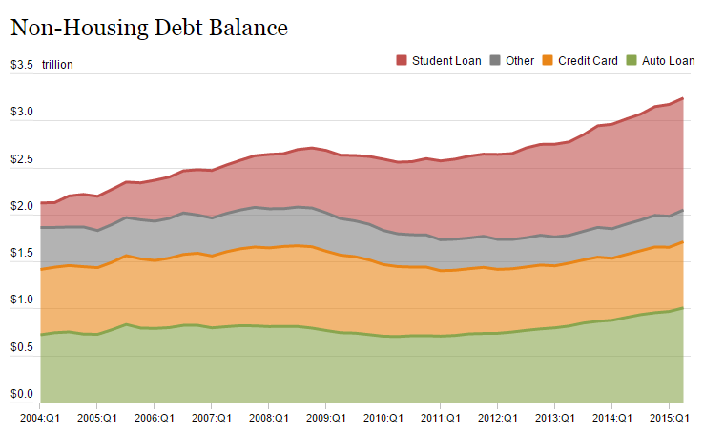
Auto Loans and Other Non-Housing Debt, 2004 – 2015*
Auto loan debt outstanding reached $1T for the first time ever in Q1 2015
Banks are becoming increasingly aggressive in marketing auto loans
*As of Q1 2015.
Source: Federal Reserve Bank of NY Consumer Credit Panel/Equifax; l. I.I.

Slide 71
Commercial Lines Underwriting Performance
71
Notes:
71

Slide 72
Commercial Lines Combined Ratio, 1990-2017F*
Commercial lines underwriting performance improved in 2013/14 but higher cats, diminishing prior year reserves and rising loss cost trends in some lines could push combined ratios higher
*2007-2012 figures exclude mortgage and financial guaranty segments.
Source: A.M. Best (1990-2014); Conning (2015E-17F) Insurance Information Institute.

Slide 73
Commercial Property Combined Ratio:
2007–2017F
Commercial Property Underwriting Performance Has Improved in Recent Years, Largely Due to Diminished CAT Activity
Source: Conning Research and Consulting.

Slide 74
General Liability Combined Ratio:
2005–2017F
Commercial General Liability Underwriting Performance Has Been Volatile in Recent Years
Source: Conning Research and Consulting.

Slide 75
Commercial Auto Combined Ratio: 1993–2017F
Commercial Auto Results Are Challenged as Rate Gains Barely Have Yet to Offset Adverse Frequency and Severity Trends
Sources: A.M. Best (1990-2014);Conning (2015E-2017F); Insurance Information Institute.

Slide 76
Workers Compensation Combined Ratio: 1994–2015P
WC results have improved markedly since 2011
Workers Comp Results Began to Improve in 2012. Underwriting Results Deteriorated Markedly from 2007-2010/11 and Were the Worst They Had Been in a Decade.
Sources: A.M. Best (1994-2009); NCCI (2010-2015P) and are for private carriers only; Insurance Information Institute.

Slide 77
Workers Compensation Premium:
Fifth Consecutive Year of Increase
Net Written Premium
$ Billions
p Preliminary
Source: NCCI from Annual Statement Data.
Includes state insurance fund data for the following states: AZ, CA, CO, HI, ID, KY, LA, MD, MO, MT, NM, OK, OR, RI, TX, UT.
Each calendar year total for State Funds includes all funds operating as a state fund that year.
Calendar Year

Slide 78
Workers Compensation Lost-Time
Claim Frequency Declined in 2015
Percent
Average Annual Change = –3.6%
(1994–2014)
*Adjustments primarily due to significant audit activity.
2015p: Preliminary based on data valued as of 12/31/2015.
Source: NCCI Financial Call data, developed to ultimate and adjusted to current wage an voluntary loss cost level; Excludes high deductible policies; 1994-2014: Based on data through 12/31/14. Data for all states where NCCI provides ratemaking services, excluding WV.
Frequency is the number of lost-time claims per $1M pure premium at current wage and voluntary loss cost level
Accident Year

Slide 79
Workers Compensation Medical Severity:
Small Decrease in 2015
Medical
Claim Cost ($000s)
Average Medical Cost per Lost-Time Claim
Medical severity for lost time claims was down 1% in 2015, the first decline in at least 20 years
Annual Change 1991–1993: +1.9%
Annual Change 1994–2001: +8.9%
Annual Change 2002–2010: +6.0%
Cumulative Change = 252%
(1991-2015p)
Accident Year
Accident Year
2015p: Preliminary based on data valued as of 12/31/2015.
1991-2013: Based on data through 12/31/2014, developed to ultimate
Based on the states where NCCI provides ratemaking services including state funds, excluding WV; Excludes high deductible policies.

Slide 80
Insured Catastrophe Losses
2013/14 and YTD 2015 Experienced Below Average CAT Activity After Very High CAT Losses in 2011/12
Winter Storm Losses Far Above Average in 2014 and 2015
80

Slide 81
U.S. Insured Catastrophe Losses
($ Billions, $ 2015)
2012 was the 3rd most expensive year ever for insured CAT losses
2013/14/15 Were Welcome Respites from 2011/12, among the Costliest Years for Insured Disaster Losses in US History. 2016 Is Off to a Costlier Start.
$11.0B in insured CAT losses though 6/30/16
*Through 6/30/16. 2016 figure stated in 2016 dollars.
Note: 2001 figure includes $20.3B for 9/11 losses reported through 12/31/01 ($25.9B 2011 dollars). Includes only business and personal property claims, business interruption and auto claims. Non-prop/BI losses = $12.2B ($15.6B in 2011 dollars.)
Sources: Property Claims Service/ISO; Insurance Information Institute.
81
12/01/09 - 9pm
eSlide – P6466 – The Financial Crisis and the Future of the P/C
Notes:
81

Slide 82
Inflation Adjusted U.S. Catastrophe Losses by Cause of Loss, 1996–2015¹
Other Wind/Hail/Flood (3), $19.9
Fires (4), $7.3
Winter storm losses were much above average in 2014/15 pushing this share up
Other (5), $0.8
Insured cat losses from 1996-2015 totaled $404.1B, an average of $20.2B per year or $1.68B per month
Terrorism, $24.6
Winter Storms, $30.4
Hurricanes & Tropical Storms, $158.6
Tornado share of CAT losses is rising
Wind losses are by far cause the most catastrophe losses, even if hurricanes/TS are excluded.
Events Involving Tornadoes (2), $158.6
Catastrophes are defined as events causing direct insured losses to property of $25 million or more in 2015 dollars.
Excludes snow.
Does not include NFIP flood losses
Includes wildland fires
Includes civil disorders, water damage, utility disruptions and non-property losses such as those covered by workers compensation.
Source: ISO’s Property Claim Services Unit.

Slide 83
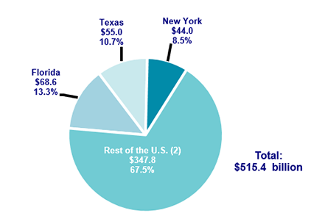
Top 3 States for Insured Catastrophe Losses, 1996-2005 (in 2015 Dollars)
Texas, Florida and New York lead the country in insured catastrophe losses over the past 20 years. These 3 states accounted for nearly 1/3 of all insured catastrophe losses over the past two decades
Source: PCS/Verisk for 2016 Insurance Fact Book, Insurance Information Institute.

Slide 84
Top 16 Most Costly Disasters in U.S. History—Katrina Still Ranks #1
(Insured Losses, 2014 Dollars, $ Billions)
Storm Sandy in 2012 was the last mega-CAT to hit the US
Includes Tuscaloosa, AL, tornado
Includes Joplin, MO, tornado
12 of the 16 Most Expensive Events in US History Have Occurred Since 2004
Sources: PCS; Insurance Information Institute inflation adjustments to 2014 dollars using the CPI.

Slide 85
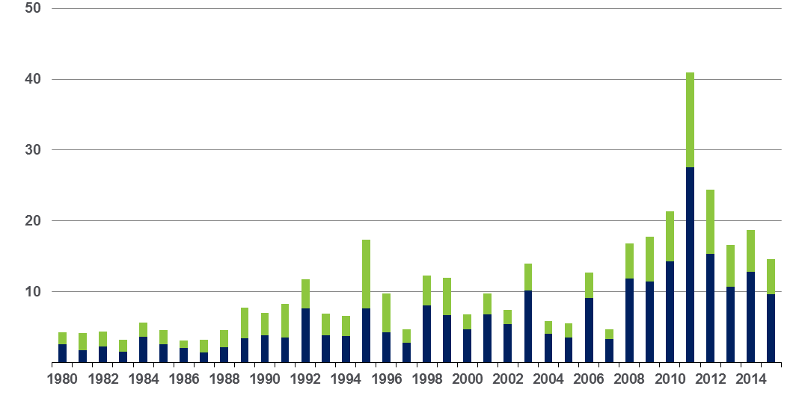
Convective Loss Events in the US
Overall and insured losses, 1980 – 2015
Overall losses
(in 2015 values)*
$ Billions
Insured losses
(in 2015 values)*
The period from 2008-2015 has been the most expensive on record for insured losses from “Convective Events” (severe thunderstorms, tornado, hail, lightning and flash flood)
*Losses adjusted to inflation based on CPI
Analysis contains:
severe storm, tornado, hail, flash flood and lightning
85
Source: Geo Risks Research, NatCatSERVICE

Slide 86
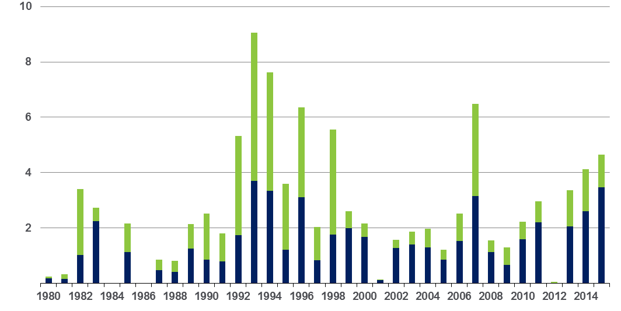
Winter Storm Losses in the US
1980 – 2015 (Overall and Insured Losses)*
$ Billions
Winter storm losses have been increasing rapidly in recent years
Overall losses
(in 2015 values)*
Insured losses
(in 2015 values)*
*Winter storms include also winter damages, blizzards and cold waves
*Losses adjusted to inflation based on CPI.
Source: Property Claim Services, MR NatCatSERVICE.
86

Slide 87
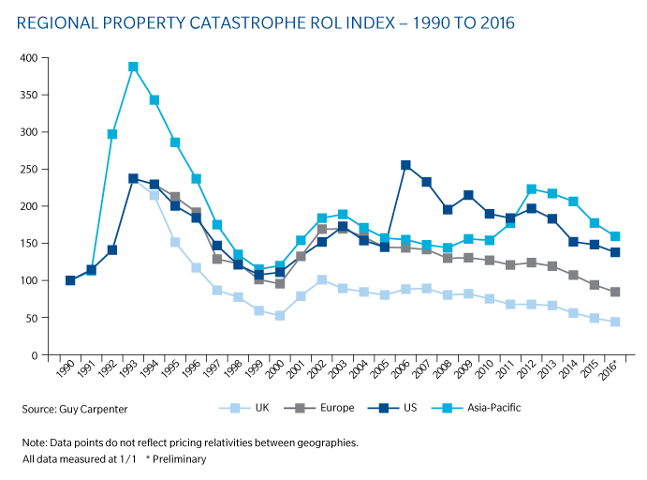
Regional Property Catastrophe ROL Index: 1990 – 2016
Record traditional capacity, alternative capital and low CAT activity have pressured reinsurance prices; ROEs are down only very modestly
Source: Guy Carpenter; Insurance Information Institute.

Slide 88
Alternative Capital as a Percentage of Traditional Global Reinsurance Capital
Alternative Capital’s Share of Global Reinsurance Capital Has More Than Doubled Since 2010.
2014 data is as of June 30, 2014.
Source: Aon Benfield Analytics; Insurance Information Institute.

Slide 89
INDUSTRY DISRUPTORS
Technology, Society and the Economy Are All Changing at a Rapid Pace
Thoughts on the Future
89

Slide 90
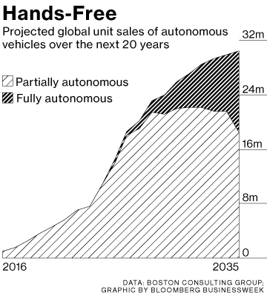
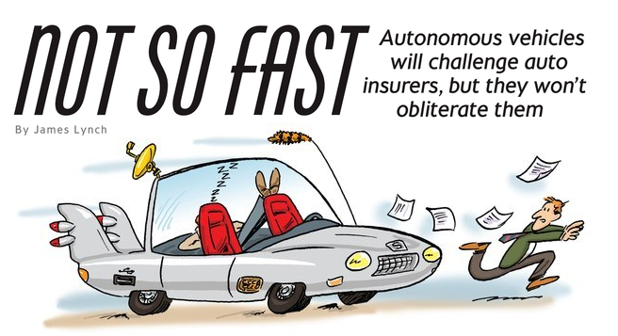
Media is Obsessed with Driverless Vehicles: Often Predicting the Demise of Auto Insurance
By 2035, it is estimated that 25% of new vehicle sales could be fully autonomous models
Questions
Are auto insurers monitoring these trends?
How are they reacting?
Will Google take over the industry?
Will the number of auto insurers shrink?
How will liability shift?
Source: Boston Consulting Group.

Slide 91




On-Demand/Sharing/Peer-to-Peer Economy Impacts Many Lines of Insurance
The “On-Demand” Economy is or will impact many segments of the economy important to P/C insurers
  Auto (personal and commercial)
  Homeowners/Renters
  Many Liability Coverages
  Professional Liability
  Workers Comp
Many unanswered insurance questions
Insurance solutions are increasingly available to fill the many insurance gaps that arise
91
12/01/09 - 9pm
eSlide – P6466 – The Financial Crisis and the Future of the P/C
Notes:
91

Slide 92
The Sharing Economy: An Update
The On-Demand Economy Will Transform the American Workforce and the P/C Insurance Industry Too
92

Slide 93

The Sharing Economy Has Grown— And Attracted Political Scrutiny

Slide 94

Political Skepticism About the
‘Gig’ Economy
"Many Americans are making extra money renting out a spare room, designing a website ... even driving their own car. This on demand or so called 'gig' economy is creating exciting opportunities and unleashing innovation, but it's also raising hard questions about workplace protections and what a good job will look like in the future."
--Hillary Clinton,
July 13, 2015
94
12/01/09 - 9pm
eSlide – P6466 – The Financial Crisis and the Future of the P/C
Notes:
94

Slide 95
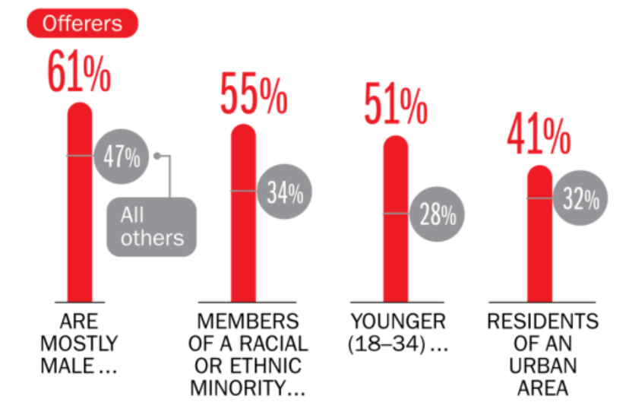
Americans Who Offer Services in the Sharing/Gig Economy Are Statistically More Prone to Workplace Injury
Young, urban minority males are the most likely to offer their services in the sharing economy.
Sources: The SelfEmployed.com accessed at https://www.theselfemployed.com/gig-economy/infographic-inside-the-new-economy/ based on a poll by Time magazine, Bursten-Marsteller and The Aspen Institute; Insurance Information Institute.

Slide 96






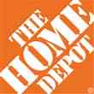

Data Breaches 2005-2015, by Number of Breaches and Records Exposed
# Data Breaches/Millions of Records Exposed
Millions
The total number of data breaches (+27.5%) hit a record high of 783 in 2014, exposing 85.6 million records. Through June 30, this year has seen 117.6 million records exposed in 400 breaches.*
*Figures as of June 30, 2015, from the Identity Theft Resource Center,
http://www.idtheftcenter.org/images/breach/ITRCBreachReport2015.pdf

Slide 97
AUTO TECHNOLOGY &
THE FUTURE OF AUTO INSURANCE
The Road to Fully Autonomous Vehicles: Long, Dark and Full of Potholes
Tales of the Death of Auto Insurance Are Greatly Exaggerated
97

Slide 98
Media is Obsessed with Driverless Vehicles: Often Predicting the Demise of Auto Insurance
By 2035, it is estimated that 25% of new vehicle sales could be fully autonomous models
Questions
Are auto insurers monitoring these trends?
How are they reacting?
Will Google take over the industry?
Will the number of auto insurers shrink?
How will liability shift?
Source: Boston Consulting Group.

Slide 99
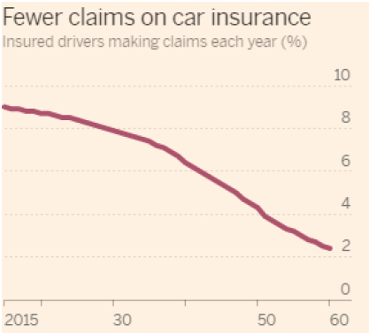
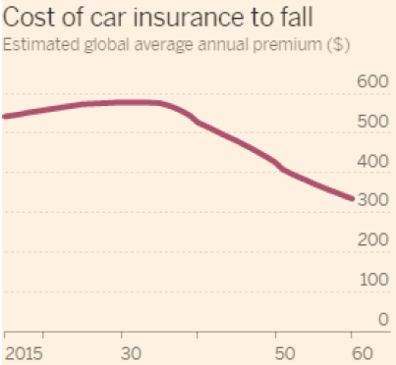
Media is Obsessed with Driverless Vehicles: Often Predicting the Demise of Auto Insurance
Some are predicting that the rise of autonomous vehicles will reduce claim frequency by 75% or more…
,,,and that this technology will cause average auto insurance premiums to plunge
Source: Autonomous Consulting as cited in the Financial Times: “Cost of Car Insurance to Plunge With Rise of Driverless Vehicles, June 28, 2016.

Slide 100
I.I.I. Poll: Auto Insurance
Q. Would you be willing to ride in a driverless car?
May 2015
May 2016
Don’t Know
Don’t Know
Yes
Yes
No
No
The Percentage Willing to Ride in a Driverless Car Rose Slightly.
71 Percent of People Over 64 Were Unwilling to Ride.
The Percentage Willing to Ride in a Driverless Car Rose Slightly;
71% of People Over 64 Were Unwilling to Ride.
Source: Insurance Information Institute Annual Pulse Survey.

Slide 101
I.I.I. Poll: Driverless Cars
Q. Would you be willing to ride in a driverless car?
The Percentage Willing to Ride in a Driverless Car Remains at 43%;
71% of People Over 64 Were Unwilling to Ride.
Source: Insurance Information Institute Annual Pulse Survey

Slide 102
I.I.I. Poll: Driverless Cars
Q. Would you be willing to ride in a driverless car?
The Percentage Willing to Ride in a Driverless Car Remains at 43%;
71% of People Over 64 Were Unwilling to Ride.
Source: Insurance Information Institute Annual Pulse Survey.

Slide 103
I.I.I. Poll: Driverless Cars
Why Americans Would Not Want to Ride in a Driverless Car,
May 2016¹
Safety Concerns Are Paramount Among Those Who Would Avoid Driverless Cars.
¹ Based on those who would not ride in a driverless car. Respondents could give more than one answer.
Source: Insurance Information Institute Annual Pulse Survey.

Slide 104
I.I.I. Poll: Telematics—
Consumers Still Hesitant
Q
Would you allow your auto insurer to collect information about how and when you drive in order to set your auto insurance premium?
Don’t Know
Allow if Premium Went Down
Not
Allow
Allow Whether or Not Premium Went Down
More Than Half of Auto Policyholders Would Allow Their Insurer to
Collect Their Driving Information in Order to Set Premiums.
¹Asked of those who have auto insurance.
Source: Insurance Information Institute Annual Pulse Survey.

Slide 105


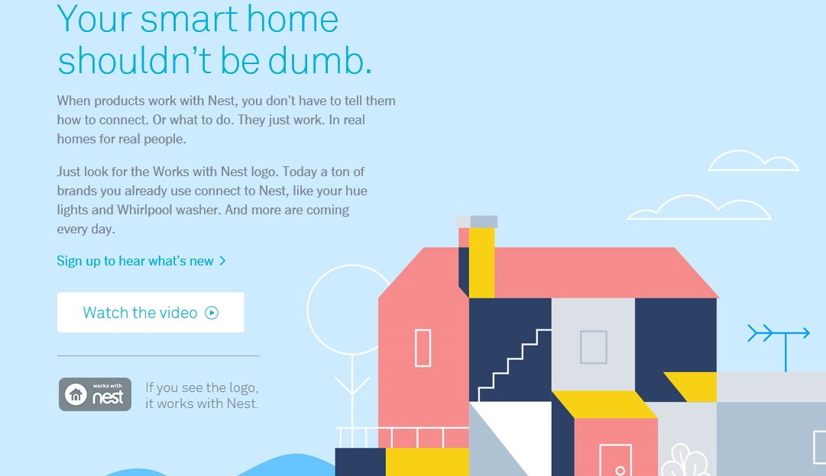
Telematics for Your Home:
The Internet of Things
The home is the next frontier for telematics
Rapidly becoming a crowded space
How and with whom will insurers partner?
Can control increasing array of household systems remotely
  Heat, A/C
  Fire, CO detection
  Security Systems
  Cameras/Monitors
  Appliances
  Lighting
Technology is adaptive
  Uses sensors and algorithms to learn about you
105
12/01/09 - 9pm
eSlide – P6466 – The Financial Crisis and the Future of the P/C
Notes:
105

Slide 106
THE ‘INTERNET OF THINGS’
Capturing Economic Value Amid a Shifting Insurer Value Chain
106

Slide 107
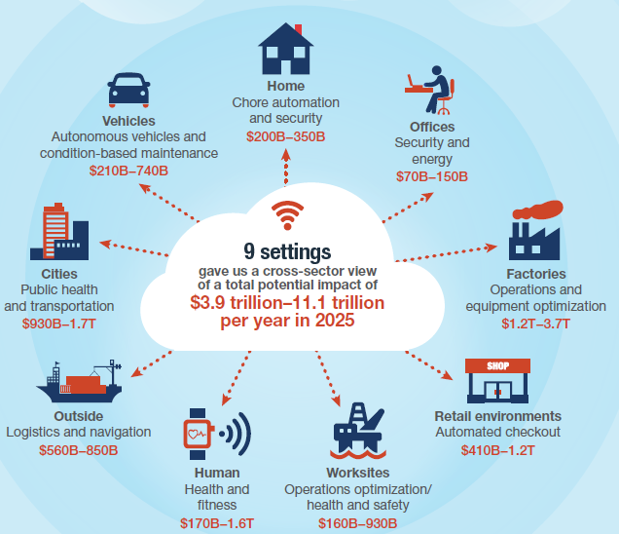
The Internet of Things and the Insurance Industry
The “Internet of Things” will create trillions in economic value throughout the global economy by 2025
What opportunities, challenges will this create for insurers?
What are the impact on the insurance industry “value chain”?
Sources: McKinsey Global Institute, The Internet of Things: Mapping the Value Beyond the Hype,
June 2015; Insurance Information Institute.
107
12/01/09 - 9pm
eSlide – P6466 – The Financial Crisis and the Future of the P/C
Notes:
107

Slide 108
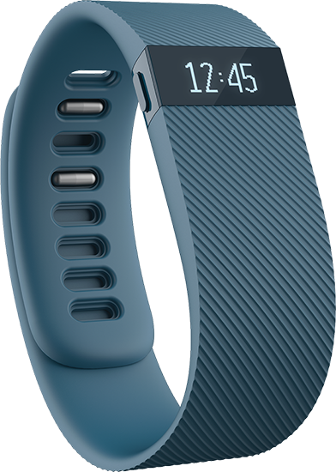
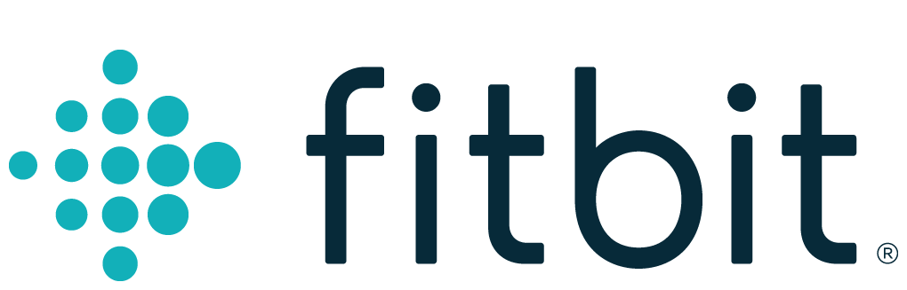
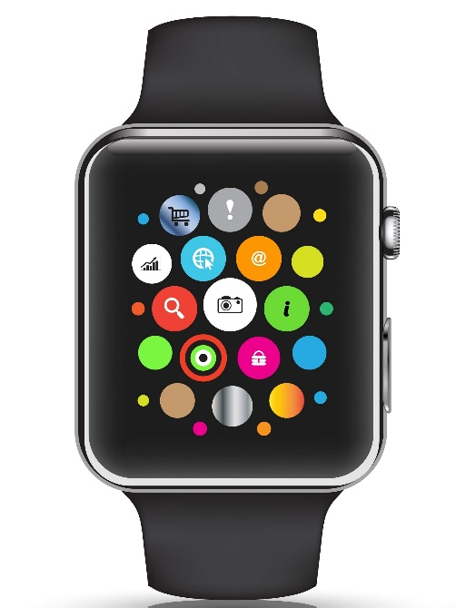

Wearables Show Significant Potential to Reduce Workplace Injury, Death
Wearables Today Can Monitor:
  Location
  Heart rate
  Temperature
  Steps/Exertion
  Sweat
  Sleep
In the Near Future Could Monitor:
  Glucose level
  Oxygen levels
  Pain
  Nausea
108
12/01/09 - 9pm
eSlide – P6466 – The Financial Crisis and the Future of the P/C
Notes:
108

Slide 109
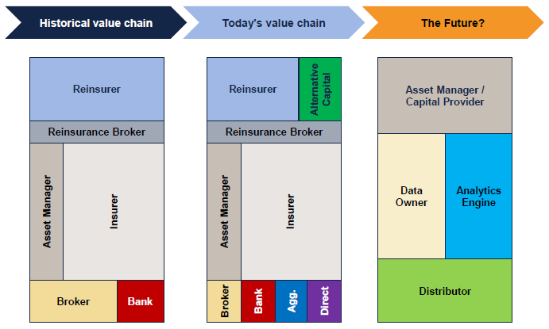
The Internet of Things and the Insurance Industry Value Chain
The Insurance Industry Value Chain Is Changing for Many Reasons
Source: Willis Capital Markets & Advisory; Insurance Information Institute.
109
12/01/09 - 9pm
eSlide – P6466 – The Financial Crisis and the Future of the P/C
Notes:
109

Slide 110
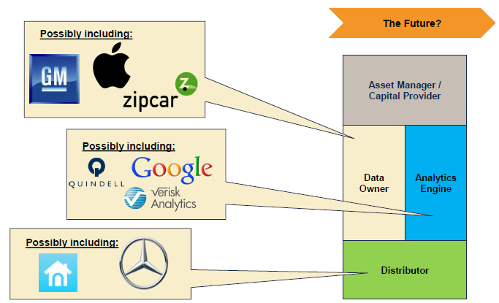
The Internet of Things and the Insurance Industry Value Chain
Who owns the data? Where does It flow? Who does the analytics? Who is the capital provider?
Source: Willis Capital Markets & Advisory; Insurance Information Institute.
110
12/01/09 - 9pm
eSlide – P6466 – The Financial Crisis and the Future of the P/C
Notes:
110

Slide 111
INSURANCE TECHNOLOGY:
FIN TECH ZEROES IN
Number and Value of Deals Is Increasing
In Search of the Elusive Insurance ‘Unicorn’
111

Slide 112
Insurance Technology Financing Trend: Change Is Coming
Insurance tech deals reached a new record in 2016:Q1
($ Millions)
Investment in insurance tech is rising
Source: CB Insights at https://www.cbinsights.com/blog/insurance-tech-overview-q1-2016/; Insurance Information Institute.

Slide 113
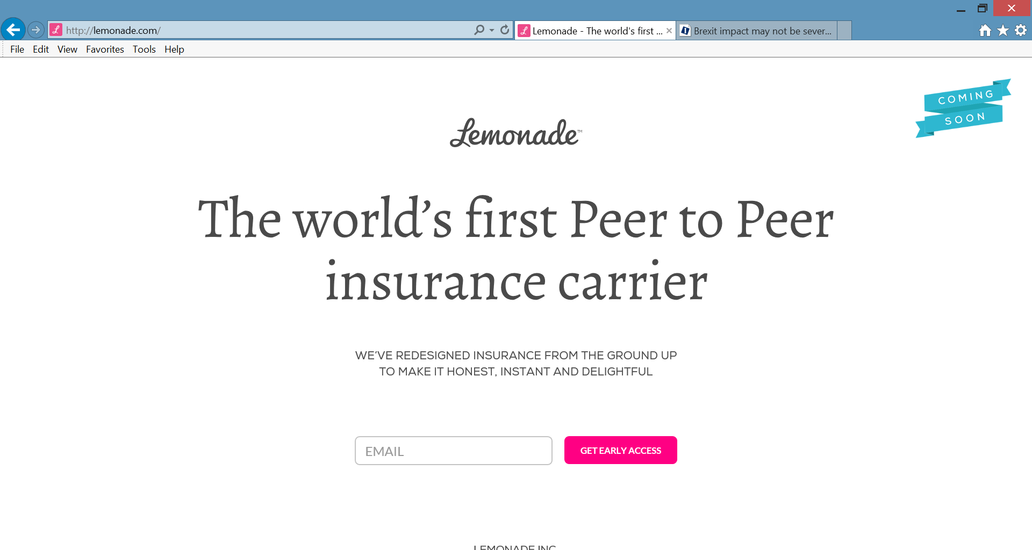
Lemonade: Peer-to-Peer (P2P) Insurance
Source: Lemonade.com accessed June 24, 2016.
113

Slide 114
Lemonade: Sour Words About Insurance
Daniel Schreiber here, with updates from Lemonade.
I’m thrilled to report that a few days ago, by unanimous vote of our board and shareholders, Lemonade became a Public Benefit Corporation, and was also awarded provisional ‘B-Corp’ certification. Both are firsts for an insurance carrier, and are points of tremendous pride for our team.
Rebuilding insurance as a social good, rather than a necessary evil, is now part of our legal mission. Our Chief Behavioral Officer, Professor Dan Ariely, says that “If you tried to create a system to bring out the worst in humans, it would look a lot like the insurance of today.” Working in partnership with nonprofits, and baking giving-back into our business model, holds the promise of a better insurance experience, and a more valuable insurance company.
In other news, I’m happy to say that we’re putting finishing touches on our product and will be ready to launch in New York within weeks. The final step is for us to get our license, and if all goes to plan, we’ll have that shortly.
Be sure to follow us on Twitter, Facebook, and LinkedIn to stay in the know.
Until next time,
Daniel
@daschreiber
114
Source: Email from Lemonade CEO Danieal Schreibeir, May 17, 2016.

Slide 115
Distribution Trends
Distribution by Channel Type Continues to Evolve Around the World
115

Slide 116
All P/C Lines Distribution Channels,
Direct vs. Independent Agents, 1983-2014
Independent agents steadily lost market share from the early 1980s through the early 2000s across all P/C lines, made some games in the mid-2000s, but then lost share again in the late 2000s. Loss rate has slowed in in the 2010s. Direct channels include exclusive agency companies, direct marketers and direct sales (e.g., internet)
Source: Insurance Information Institute; based on data from Conning and A.M. Best.

Slide 117
Personal Lines Distribution Channels, Direct vs. Independent Agents, 1972-2014
Independent agents have lost significant personal lines market share since the early 1970s. Although the trend slowed from 2000-2007, it may be accelerating again.
Source: Insurance Information Institute; based on data from Conning and A.M. Best.

Slide 118
Insurance Information Institute Online:
www.iii.org
Thank you for your time
and your attention!
Twitter: twitter.com/bob_Hartwig
Download at www.iii.org/presentations

