Slide 1
Insurance, the “Sharing Economy,” Millennials, & More
Western States Surplus Lines Conference
Whistler, British Columbia, Canada
July 14, 2016
Steven N. Weisbart, Ph.D., CLU, Senior Vice President & Chief Economist
Insurance Information Institute ♦ 110 William Street ♦ New York, NY 10038
Tel: 212.346.5540 ♦ Cell: 917.494.5945 ♦ stevenw@iii.org ♦ www.iii.org

Slide 2
The “On-Demand” (Sharing) Economy
The On-Demand Economy Will Transform the American Workforce
and the P/C Insurance Industry
2

Slide 3

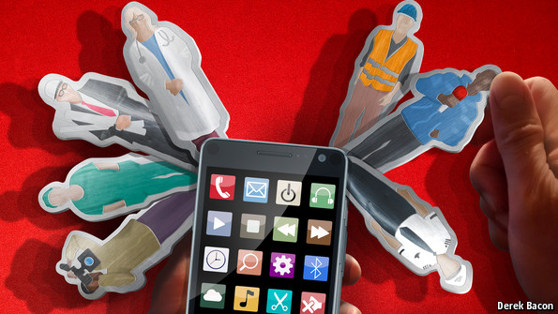

Labor on Demand: Huge Implications for the US Economy, Workers & Insurers
Will YOUR job be reduced to an app?

Slide 4




You Can Live Your Life with the Swipe of a Finger…
Get married…
…Move
…And if it doesn’t work out…

Slide 5
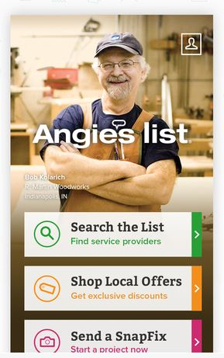


The “On-Demand” World is Not New…
Companies like Angie’s List (established in 1995 and going online in 1999) have been around for decades
The Geek Squad has been around since 1994…
Peapod sprouted way back in 1989!
Source: Insurance Information Institute.

Slide 6



…But the “On-Demand” World is Exploding as Is the Demand for “On-Tap” Workers
Need something done around the house…Click on Handy
Hate doing laundry? Washio will do it for you…
Hate doing just about everything? Taskrabbit will take on virtually all your “tasks”…
Source: Insurance Information Institute.

Slide 7
A number of new commercial online services have emerged in recent years
Some of these services offer on-demand access to goods or services with the click of a mouse or swipe of a smartphone app.
Others promote the commercialized sharing of products or expertise,
Still others seek to connect communities of interest and solve problems using open, collaborative platforms.
Sources Pew Research Center, May, 2016, “Shared, Collaborative and On Demand: The New Digital Economy”

Slide 8
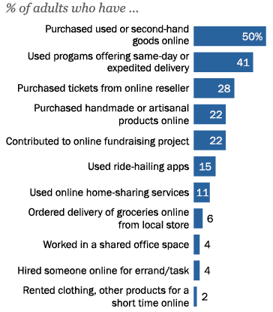
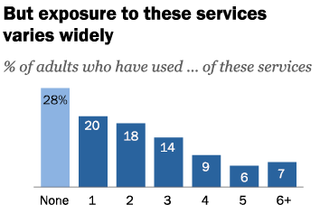
72% of Americans have used some type of shared or on-demand online service
22%
Nearly 1 in 4 adults have used at least 4 of these services
Sources: Pew Research Center, May, 2016, “Shared, Collaborative and On Demand: The New Digital Economy” ; I.I.I.

Slide 9
Exposure to these services is concentrated among certain demographic cohorts
College graduates – 39% of college graduates have used four or more of these services, compared with just 8% of those with a high school degree or less.
  At the same time, around one-quarter of college graduates have used none (11%) or only one (15%) of these services.
Those under the age of 45 –Around one-third of those ages 18-44 have used four or more of these services, and relatively few in this age range have no exposure at all to these services.
  By contrast, 44% of Americans ages 50 and older (and 56% of those ages 65 and older) have not used any of these 11 platforms.
Those with relatively high household incomes – 41% of Americans with an annual household income of $100,000 or more have used four or more of these services.
  This is three times the proportion among households earning less than $30,000 annually.
Sources: Pew Research Center, May, 2016, “Shared, Collaborative and On Demand: The New Digital Economy” ; I.I.I.

Slide 10
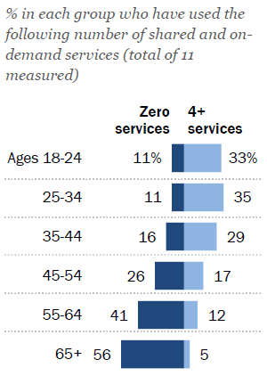
Older U.S. adults have little exposure to shared and on-demand services
1 in 3 adults 18-34 use at least 4 of these services
1 in 20 adults 65+ use at least 4 of these services; over half use none
Sources: Pew Research Center, May, 2016, “Shared, Collaborative and On Demand: The New Digital Economy” ; I.I.I.

Slide 11



On-Demand/Sharing/Peer-to-Peer Economy Impacts Many Lines of Insurance
The “On-Demand” Economy affects many segments of the economy important to P/C insurers
  Auto (personal and commercial)
  Homeowners/Renters
  Many Liability Coverages
  Professional Liability
  Workers Comp
Many insurance questions arise—some fairly simple, some complex
Insurance solutions are increasingly available to fill the many insurance gaps that arise
11
12/01/09 - 9pm
eSlide – P6466 – The Financial Crisis and the Future of the P/C
Notes:
11

Slide 12
Other Effects from the “Gig” Economy
Fewer fatal accidents
  Uber’s arrival was associated with a 6% drop in the fatal accident rate
    The drop in fatal night-time crashes was 18%
Fewer arrests for DUI
  Average annual rate of decline was 51.3%
Fewer arrests for non-aggravated assaults and for disorderly conduct
But an increase in vehicle thefts
Source: Dills, Angela K., and Mulholland, Sean E., “Ride Sharing, Fatal Crashes, and Crime (May 31, 2016). Available at SSRN: http://ssrn.com/abstract=2783797
12
12/01/09 - 9pm
eSlide – P6466 – The Financial Crisis and the Future of the P/C
Notes:
12

Slide 13
Technology and Employment
What Makes the On-Demand Economy Possible?
Why Does It Matter for Insurers?
13

Slide 14
The On-Demand Economy and American Workers: What Is Happening?
Witnessing the demise of the traditional understanding of what is meant by a “Good” job
  Concept born in the Industrial Age (1880-1980), is eroding
  Disintermediation of the firm as the place where labor, jobs matched
Accelerating trends that began in the 1970s and 1980s with
  Globalization,
  Automation, and
  the end of loyalty of firms to employees and of employees to firms
14
12/01/09 - 9pm
eSlide – P6466 – The Financial Crisis and the Future of the P/C
Notes:
14

Slide 15
The On-Demand Economy and American Workers: What Is Happening?
Technology offers new opportunities to match labor to jobs
  Owners of spare capacity (workers with time and skill) can be paired at low cost with those with a demand for that time and skill
  Bringing together labor and those who employ labor is not new
    BUT: Pairing occurs with a speed and breadth never before possible
15
12/01/09 - 9pm
eSlide – P6466 – The Financial Crisis and the Future of the P/C
Notes:
15

Slide 16
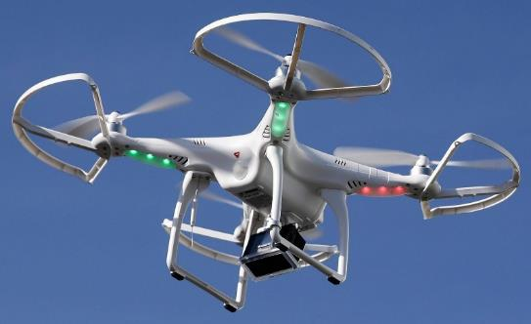
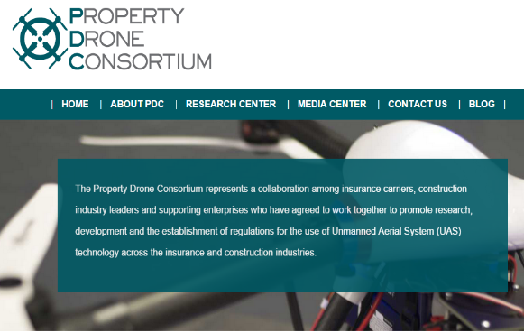
Send in the Drones: Drones Will Help Enable the On-Demand Economy
Drones or Unmanned Aerial Vehicle (UAV) technology is seeing rapid adoption rate in many industries, including insurance
~700,000 drones in US by year-end
FAA granting Section 333 exemptions for commercial use and testing of UAS
FAA will require most drones to be registered by year-end 2015.
At least 5 insurers have received permission to test
Will be adopted for use in many industries where speed of delivery is critical
Insurers partnering with construction industry to guide R&D and regulation of UAV use via Property Drone Consortium: www.propertydrone.org

Slide 17
What’s In Store for the American Worker: Two Schools of Thought
OPTIMISTIC OUTLOOK
Technology frees workers from the bonds of centralized, hierarchical institutions (the firm)
Enhanced coordination of “haves” with “needs” that bypass firms as intermediaries
Who Benefits?
  “Flexers”: People who value or require flexibility in work arrangements (stay-at-home parents, retirees, students, disabled)
  Professionals: People with portable skills that can be offered through online platforms (semi and high-skilled trades, professional services)
  Unemployed/Underemployed: Offers at least some opportunity to offer and utilize skills and generate income
Sources: Wall Street Journal; The Economist; Insurance Information Institute research.
17
12/01/09 - 9pm
eSlide – P6466 – The Financial Crisis and the Future of the P/C
Notes:
17

Slide 18
What’s In Store for the American Worker?
PESSIMISTIC OUTLOOK
On-Demand companies are software-driven marketplaces and position themselves as “platforms” rather than “employers”
Jobs reduced to freelanced, temporary “gigs”
Low skill workers and those who lack flexibility are left further behind
Workers treated as independent contractors without intrinsic or basic economic rights
What Is Potentially Lost or Compromised?
  Stability, Retirement Benefits, Sick Pay, Maternity Leave, Overtime
  Health Insurance, Liability Coverage, Workers Comp Coverage
Sources: Wall Street Journal; The Economist; Fortune; Insurance Information Institute research.
18
12/01/09 - 9pm
eSlide – P6466 – The Financial Crisis and the Future of the P/C
Notes:
18

Slide 19
Legal Liability Issues
On-Demand Platforms Have Struggled with Concepts of Liability
  There Has Been a General Resistance to Assuming Liability or Responsibility Unless Compelled to Do So
Companies Have Sought to Keep Much Liability as Possible on the Individual Who Offers their (Contracted) Labor or Resources
Long Legislative and Court Battles Lie Ahead, Including Determination of Who is an Employee vs. Independent Contractor
Insurance Solutions Becoming More Common
19
12/01/09 - 9pm
eSlide – P6466 – The Financial Crisis and the Future of the P/C
Notes:
19

Slide 20
Potential Consequences for Workers
Traditional insurance will often not cover a worker providing labor or resources through these platforms
    E.g., Auto ins. generally won’t cover you if you while driving for Uber
    Home ins. won’t cover for other than occasional rentals of property
Unless self-procured, on-demand worker (independent contactors) will generally have no workers comp recourse if injured on the job
20
12/01/09 - 9pm
eSlide – P6466 – The Financial Crisis and the Future of the P/C
Notes:
20

Slide 21
On-Demand Workers
Who Are They?
And Who’s Driving Demand for Them?
21

Slide 22
Age of People Who are Providing the Sharing/On-Demand Economy
Being a provider of services in the Sharing/On-Demand Economy is attractive to workers in the 25-44 age range (who want flexibility in raising families) as well as seniors age 65+ who see the offering their services on-demand as a way to augment retirement income
About 7% of US population are providers in the Sharing Economy, cutting across age and incomes; 51% of those familiar with the concept could see them selves as providers within the next two years.
Sources: PwC survey of 1,000 adults in the U.S., conducted online, December 2014; Insurance Information Institute.

Slide 23
Household Income: Providers of the Sharing/On-Demand Economy
Being a provider of services in the Sharing/On-Demand Economy is particularly attractive to workers with household incomes under $50,000
Remarkably, as of late 2014,
about 25% of providers in the Sharing Economy
have incomes of $100,000 and over.
Sources: PwC survey of 1,000 adults in the U.S., conducted online, December 2014; Insurance Information Institute.

Slide 24
Two On-Demand Economy
Case Studies
Labor Markets, Insurance Markets
are Affected
24

Slide 25
An UBER Case Study
Uber is the Best Known of the
On-Demand Companies
Wall Street Loves Uber
Vested Interests Hate Uber
25

Slide 26
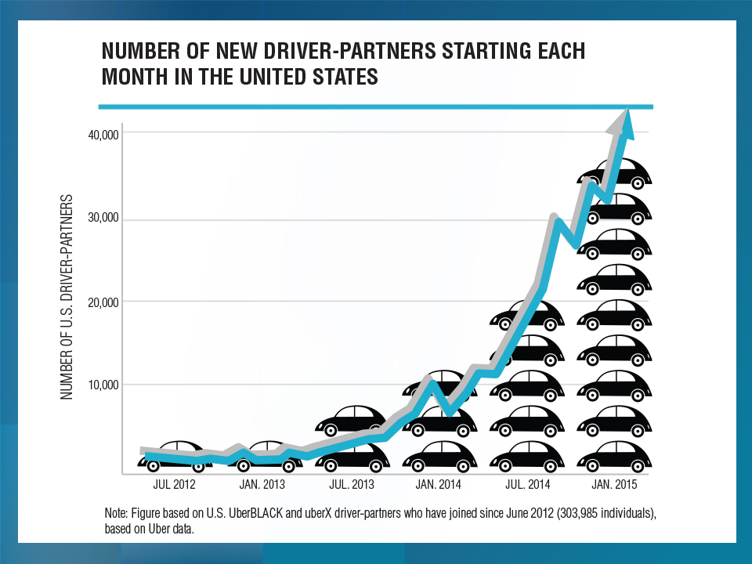
UBER Challenges
Are Uber drivers independent contractors or employees?
California DOL has ruled they’re employees
Different states may reach different conclusions
Determination significant impacts insurance framework

Slide 27
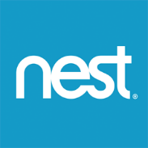
A NEST Case Study
Nest: A Leader in the “Internet of Things”
Collision Course or Cooperation with the Insurance Industry?
27

Slide 28
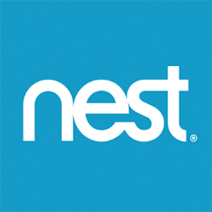

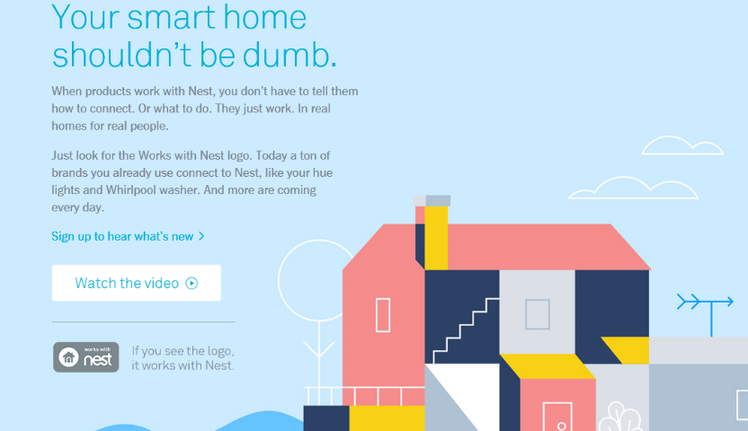
Telematics for Your Home:
The Internet of Things
The home is the next frontier for telematics
Rapidly becoming a crowded space
How and with whom will insurers partner?
Can control increasing array of household systems remotely
  Heat, A/C
  Fire, CO detection
  Security Systems
  Cameras/Monitors
  Appliances
  Lighting
Technology is adaptive
  Uses sensors and algorithms to learn about you
28
12/01/09 - 9pm
eSlide – P6466 – The Financial Crisis and the Future of the P/C
Notes:
28

Slide 29

Partnerships with Insurers: Selling Safety and Savings Simultaneously
Nest is actively seeking to partner with insurers. As of Nov. 1, 2015, Nest listed 2 insurance partners offering discounts in a number of states: American Family (MN) and Liberty Mutual (AL, CO, DE, IL, KY, ME, MN, PA, UT and WI)
Source: https://nest.com/insurance-partners/ accessed 11/1/15; Insurance Information Institute research.
29
12/01/09 - 9pm
eSlide – P6466 – The Financial Crisis and the Future of the P/C
Notes:
29

Slide 30

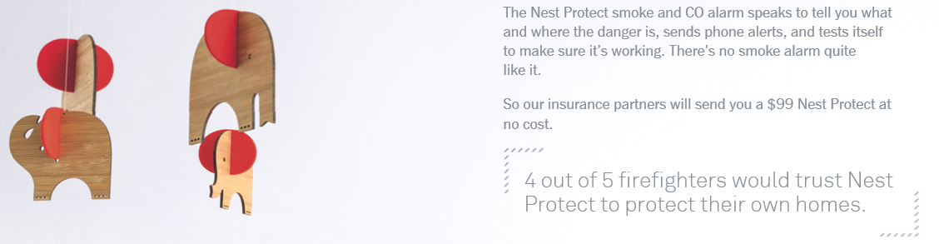
Partnerships with Insurers
Nest is selling its products via insurance partners
Source: https://nest.com/insurance-partners/ accessed 11/1/15; Insurance Information Institute research.
30
12/01/09 - 9pm
eSlide – P6466 – The Financial Crisis and the Future of the P/C
Notes:
30

Slide 31
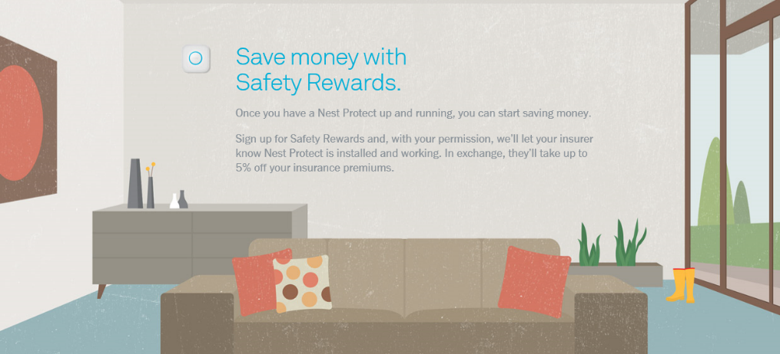
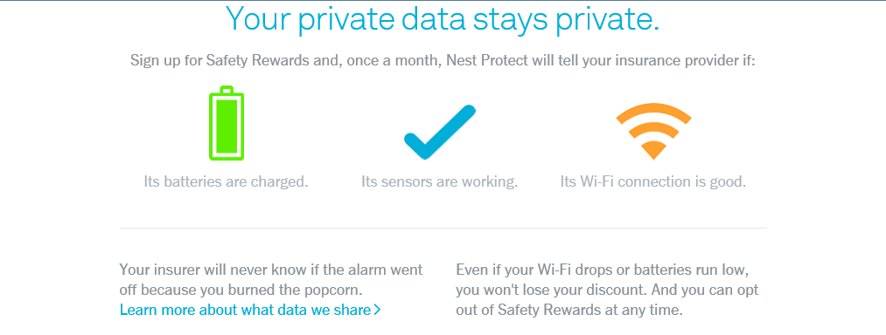
Partnerships with Insurers
Nest is selling its products via insurance partners
Source: https://nest.com/insurance-partners/ accessed 11/1/15; Insurance Information Institute research.
31
12/01/09 - 9pm
eSlide – P6466 – The Financial Crisis and the Future of the P/C
Notes:
31

Slide 32
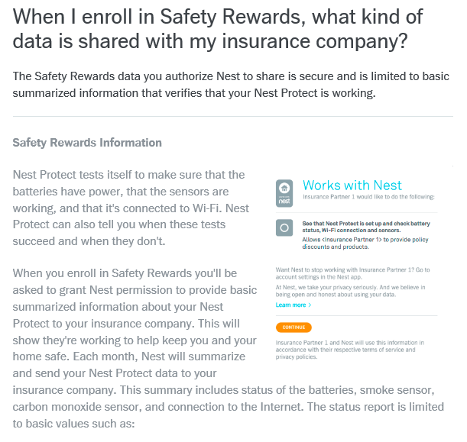
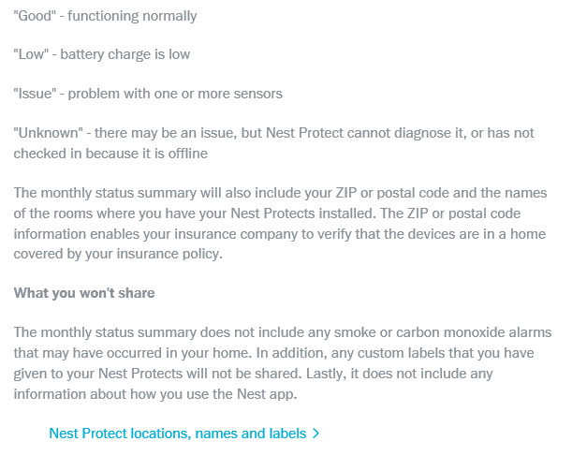
Partnerships with Insurers: Information Collected, Addressing Privacy Concerns
Privacy, control of data concerns get significant attention
Source: https://nest.com/support/article/When-I-enroll-in-Safety-Rewards-what-kind-of-data-is-shared-with-my-insurance-company accessed 11/1/15; Insurance Information Institute research.
32
12/01/09 - 9pm
eSlide – P6466 – The Financial Crisis and the Future of the P/C
Notes:
32

Slide 33
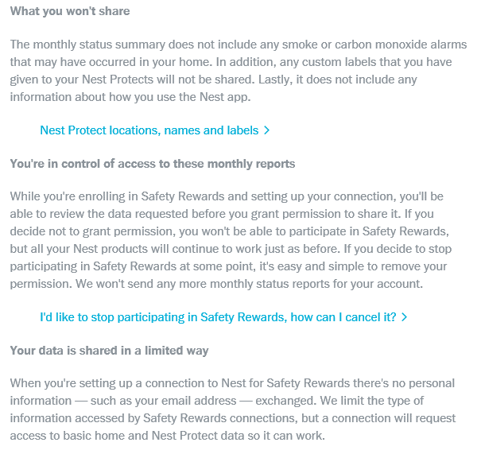
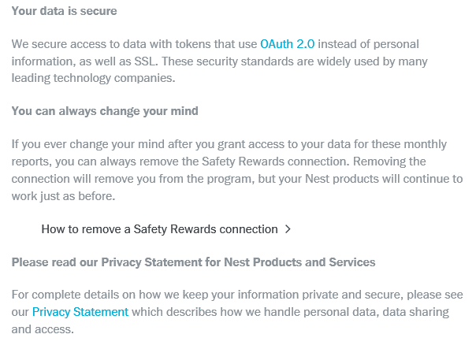
Partnerships with Insurers: Information Collected, Addressing Privacy Concerns
Privacy, control and security of data get significant attention
Source: https://nest.com/support/article/When-I-enroll-in-Safety-Rewards-what-kind-of-data-is-shared-with-my-insurance-company accessed 11/1/15; Insurance Information Institute research.
33
12/01/09 - 9pm
eSlide – P6466 – The Financial Crisis and the Future of the P/C
Notes:
33

Slide 34
Some Insurance Implications
of the On-Demand Economy
34

Slide 35
TNC Ridesharing Arrangements: Insurance Applicability
The concern was that TNCs were seeking to offload risk on to personal auto insurers. An increasing number of personal auto insurers have developed solution to ensure that coverage gaps are minimized
*From publically available sources as of June 2, 2015.
Source: ISO/Verisk.
35

Slide 36
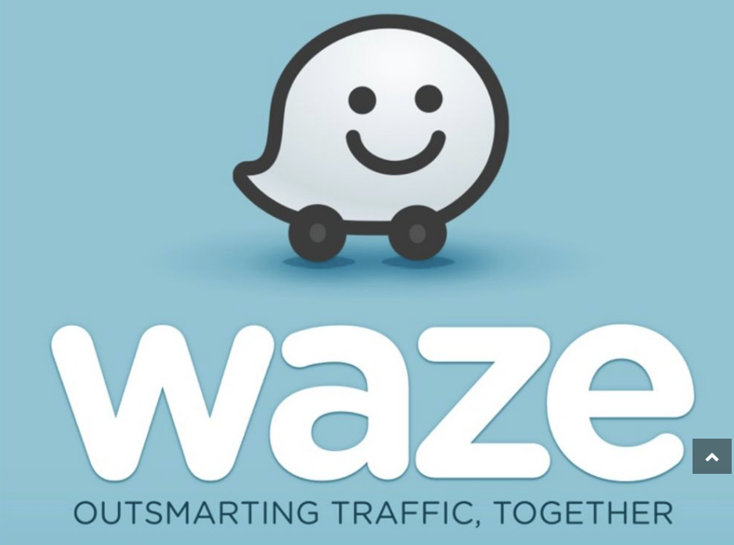
There’s a new ride-sharing service in town.
On May 16, Waze (owned by Google) unveiled a pilot carpooling service for approximately 25,000 commuters in California’s Bay Area.
Waze matches riders with drivers who’re already headed along similar routes during rush hours, and amazingly, charges riders a basic rate of only $0.54 a mile.
Since car insurance policies in states including California typically cover “not for profit, share-the-expense carpooling,” Waze Carpool may be able to avoid the scrutiny around insurance coverage that has at times sidelined Uber and Lyft.

Slide 37
Ridesharing Regulation/Legislation and Status of ISO Filings as of 9/30/15
Status Ride Sharing Legislation/Regulation
Status of ISO Filings
37
Source: ISO.

Slide 38
Homesharing Arrangements: Potential Host Exposure Concerns (Receives Rental Income)
Source: ISO/Verisk.
38

Slide 39
Homesharing Arrangements:
Potential Traveler Exposure Concerns
.
Source: ISO/Verisk.
39

Slide 40
Homesharing: ISO’s Proposed Changes*
.
*As of Oct. 6, 2015.
Source: ISO/Verisk.
40

Slide 41
Portrait of Millennials
41

Slide 42
The Generations Defined
Name | Birth Years | Age in 2016 | Generation Size (millions) in 2015
Millennials | 1981-1997 | 19 to 35 | 75.36
Generation X | 1965-1980 | 36 to 51 | 61.44
Baby Boom | 1946-1964 | 52 to 70 | 74.88
Silent Generation | 1928-1945 | 71 to 88 | 27.98
Greatest Generation | 1917-1927 | 89 to 99 | 3.63
Note: Different researchers define the generations slightly differently. These definitions are from the Pew Research Center. Sources: Census Bureau; I.I.I. calculations

Slide 43
Characteristics of Millennials vs. Boomers (when they were 18-33)
 | Boomers | Millennials
Percent Living in Metropolitan Area | 68% | 86%
Percent Married | 49% | 28%
Diversity: White as a Percent of Total | 77% | 57%
Percent with a Bachelor’s Degree | Male 17% Female 14% | Male 21% Female 27%
Median Household Income | $61,115 | $62,066
Percent Employed | Male 78% Female 60% | Male 68% Female 63%
Source: Pew Research, cited in Meeker, Internet Trends 2016, accessed at https://dq756f9pzlyr3.cloudfront.net/file/2016_internet_trends_report_final.pdf

Slide 44
Giant Age Cohort (Millenials) Is Approaching Home-Buying Stage
Number of People in 2015 (Millions)
Average Age, 1st Time Homebuyer
Millennial Generation
Average Age, Repeat Homebuyer
If prior patterns hold, the number of homes bought by current renters, and the number of new homes built, will rise in coming years
Sources: Census Bureau; CoreLogic; Insurance Information Institute.

Slide 45
Growth in Number of Households
=> Increased Demand for Housing
Net Change in Number of Occupied Residences (Thousands)
A spike, not a trend
Housing bubble
Bubble burst
If prior patterns hold, the number of homes bought by current renters, and the number of new homes built, will rise in coming years
Sources: Census Bureau; CoreLogic; Insurance Information Institute.

Slide 46
Self-Portrait of Millennials (from
a Harvard* Poll, Spring 2016)
*Institute of Politics, John F. Kennedy School of Government, Harvard University,
at http://Harvard.edu/youth-poll/Harvard-iop-spring-2016-poll
46

Slide 47
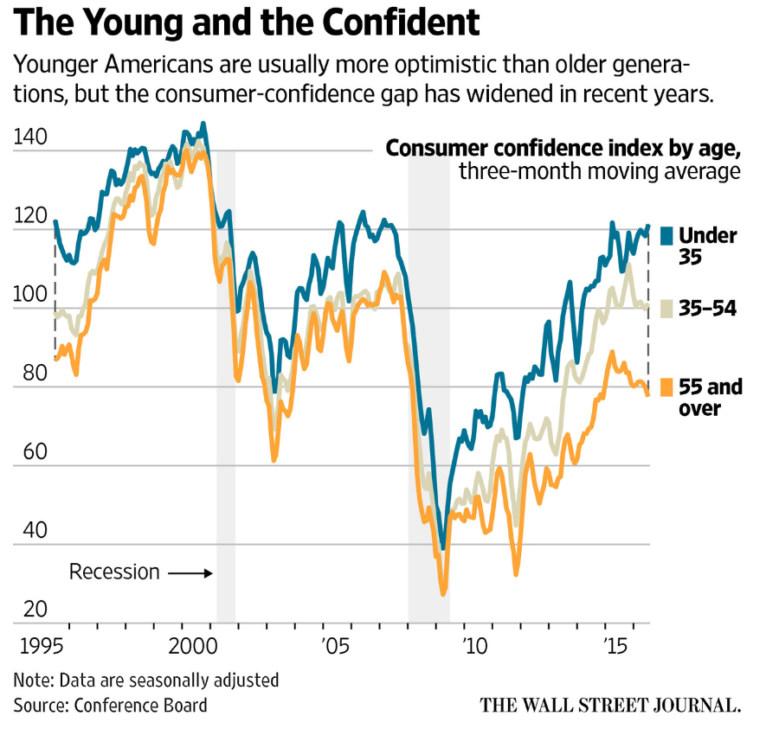
Millennials are More Optimistic Than Elders
People under 35 have been more optimistic than elders for over 20 years

Slide 48
Which of the Following Do You Support?
 | Yes | No | Decline to Answer
Socialism | 33% | 59% | 7%
Capitalism | 42% | 51% | 8%
Progressivism | 44% | 49% | 8%
Patriotism | 57% | 36% | 6%
Feminism | 49% | 45% | 6%
Social Justice Activism | 48% | 46% | 6%
Source: Institute of Politics, John F. Kennedy School of Government, Harvard University,
at http://Harvard.edu/youth-poll/Harvard-iop-spring-2016-poll questions 89-94.

Slide 49
“Basic health insurance is a right for all people, and if someone has no means of paying for it, the government should provide it”
Decline to answer: 4%
Strongly disagree: 9%
Strongly agree: 24%
Somewhat disagree: 11%
Neither agree nor disagree: 28%
Somewhat agree: 24%
Source: Institute of Politics, John F. Kennedy School of Government, Harvard University,
at http://Harvard.edu/youth-poll/Harvard-iop-spring-2016-poll question 97.

Slide 50
“What role, if any, do you believe the federal government should play in the regulation of Wall Street?”
Decline to answer: 4%
No role: 10%
Large: 30%
Minimal: 18%
Moderate: 37%
Source: Institute of Politics, John F. Kennedy School of Government, Harvard University,
at http://Harvard.edu/youth-poll/Harvard-iop-spring-2016-poll question 97.

Slide 51
Channel Preference for Home/Rental Insurance, by Age Category
Ages 18-29 30-49 50-64 65+
2/3 of Millennials purchase dwelling coverage directly from the company
How much of this is a generational preference vs. having very simple insurance needs?
Sources: “5 Reasons Millennials Aren’t Buying Insurance from Local Agents,” Eric Narisco, Sept. 16, 2015 from www.PropertyCasualty360.com based on a study by Effective Coverage and performed by ORC International.

Slide 52
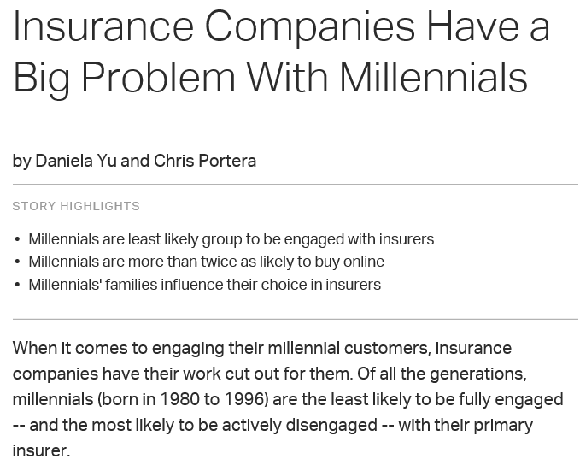
Source: Business Journal, March 5, 2015, accessed at
http://www.gallup.com/businessjournal/181829/insurance-companies-big-problem-millennials.aspx

Slide 53
Insurance Customers: Engagement
by Generation
Millennials are the least likely to be engaged with their insurer
Millennials are more twice as likely to buy online
Millennial’s families influence their choice in insurers
Sources: Gallup: “Insurance Companies Have a Big Problem with Millennials,” Daniela Yu and Chris Portera, March 5, 2015

Slide 54
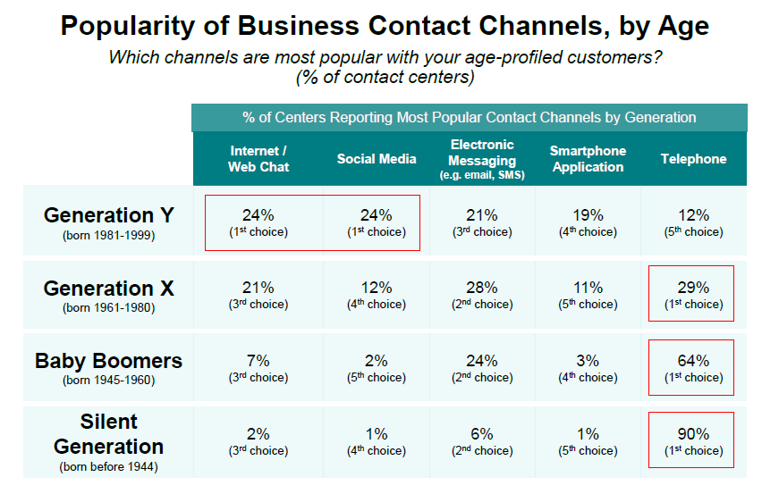
Best Ways for Businesses to Contact Millennials = Social Media & Chat
Source:

Slide 55
Gallup: Insurance companies see substantial business gains when they engage customers
Compared with their actively disengaged counterparts, engaged insurance customers
  are less sensitive about pricing when selecting and retaining a primary insurance carrier,
  spend more and buy a wider variety of products, including financial offerings, from their insurer than do actively disengaged customers, and
  they also stay with the company longer and are more likely to recommend it to others.

Slide 56
What Drives Millennials to Engage with Insurers
Services that Drive Millennial Engagement (in order of influence on engagement) | Percent of Customers That are Extremely Satisfied with this Service
Keeping your account and personal information secure | 50%
Ease of making changes to your coverage | 43%
Finding answers to your insurance questions | 35%
Offering the services you need online | 40%
Ease of managing your account | 44%
Ease of payment features | 52%
Ease of access to information about your policies | 42%
Ease of navigating the website | 34%
Data security and ease of making coverage changes are keys to successful engagement with Millennial insurance buyers
Source: Gallup: “Insurance Companies Have a Big Problem with Millennials,” Daniela Yu and Chris Portera, March 5, 2015

Slide 57
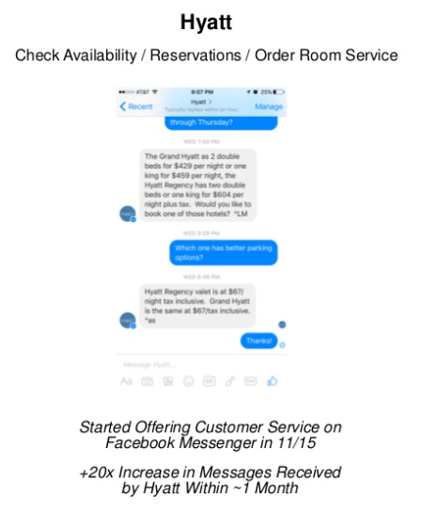
How to Communicate with Millennials:
Facebook Messenger?
Hyatt started offering Customer Service via Facebook Messenger in Nov 2015
Within a month, the volume of messages received rose by 20 times
Source:

Slide 58
Portrait of Millennials (from
“Marketing to Millennials”*
*Jeff Fromm and Christie Garton, Marketing to Millennials, American Management Association, 2013.
58

Slide 59
The New Rules of Marketing to Millennials: The Participation Economy
With Millennials, brands are no longer in control of their own image and message
Millennials derive value from being engaged in product development, advertising, social interactions, and other aspects of marketing
Old Model | New Model
Interruption | Engagement
Reaction | Interaction
Heavy Users | Engaged Participants
Big Promises | Personal Gestures
Passive Consumers | Active co-creators
Source: Jeff Fromm and Christie Garton, Marketing to Millennials, American Management Association, 2013, p. 5 and p.10.

Slide 60
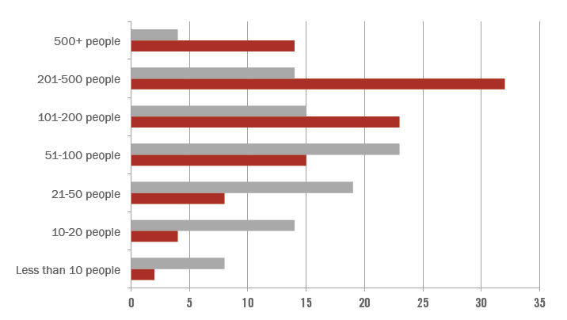
Millennials Have More Connections
(vs. Non-Millennials) on Social Networks
“Millennials report that they gain a psychological boost when engaging with their online friends.”
Millennials
Non-Millennials
Source: Jeff Fromm and Christie Garton, Marketing to Millennials, American Management Association, 2013, p.12.

Slide 61
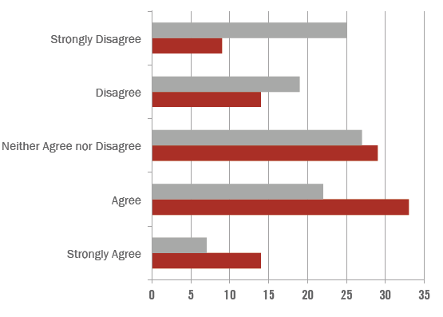
Statement: “My life feels richer now that I am connected to more people through social media”
Non-Millennials
Millennials
“Millennials are…off the chart [with]…their willingness to give companies feedback.”
Source: Jeff Fromm and Christie Garton, Marketing to Millennials, American Management Association, 2013, p.12.

Slide 62
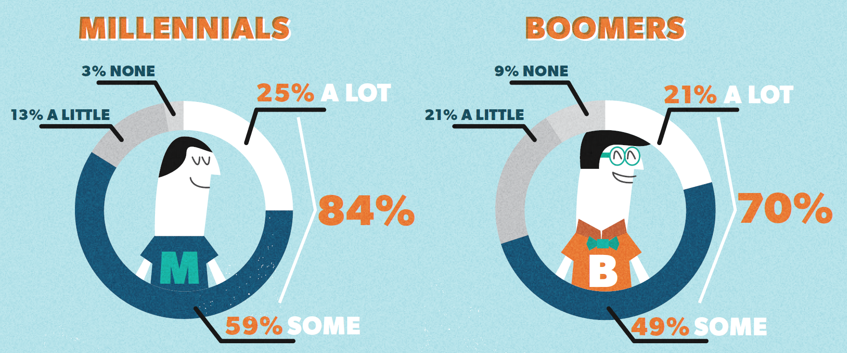
Millennials Won’t Buy Without Input From Others (User-Generated Content)
Source: “Talking to Strangers: Millennials Trust People Over Brands,” Bazaarvoice, January 2012.

Slide 63
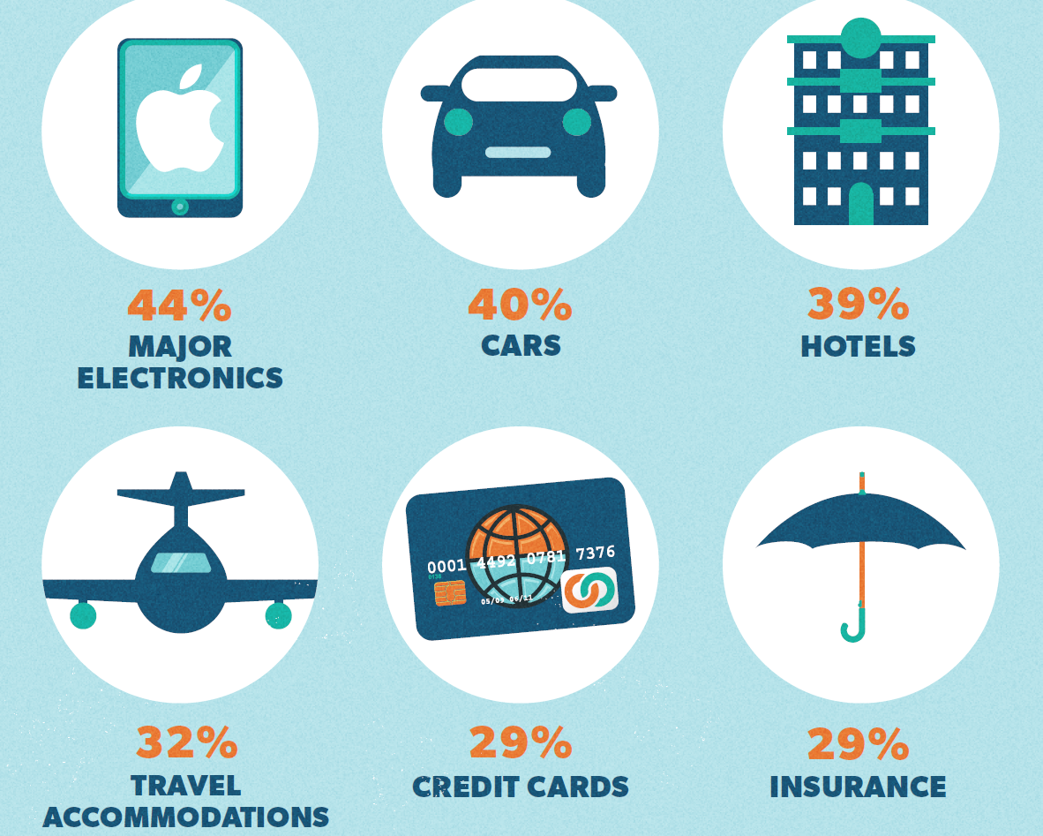
The Top Purchases Millennials Won’t Make Without User-Generated Content
Just personal lines?
Are you sure?
Source: “Talking to Strangers: Millennials Trust People Over Brands,” Bazaarvoice, January 2012.

Slide 64
Millennials as Employees
A Talent Gap Looms
Insurance Industry Employees Are Older than in Most Industries
64

Slide 65
Insurance Talents Crisis: Millennials Are the (Only) Solution
By 2020, insurers will have an estimated 400,000 job openings
The number of professionals 55 and older is 30 percent higher in the insurance industry than the rest of the economy
The number of insurance professionals over 55 has risen 74 percent during the past 10 years.
Sources: http://www.propertycasualty360.com/2013/04/17/insurance-industry-crisis-400000-positions-to-fill

Slide 66
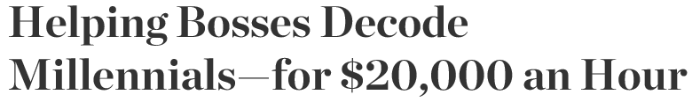
Millennials
  Expect work to be meaningful
  Crave frequent feedback
  Detest voice mail
One consultant “advises clients to strip out numbers from internal presentations because, she says, millennials find stories more compelling than figures.”
Source: Lindsay Gellman, Wall Street Journal, May 18, 2016.

Slide 67
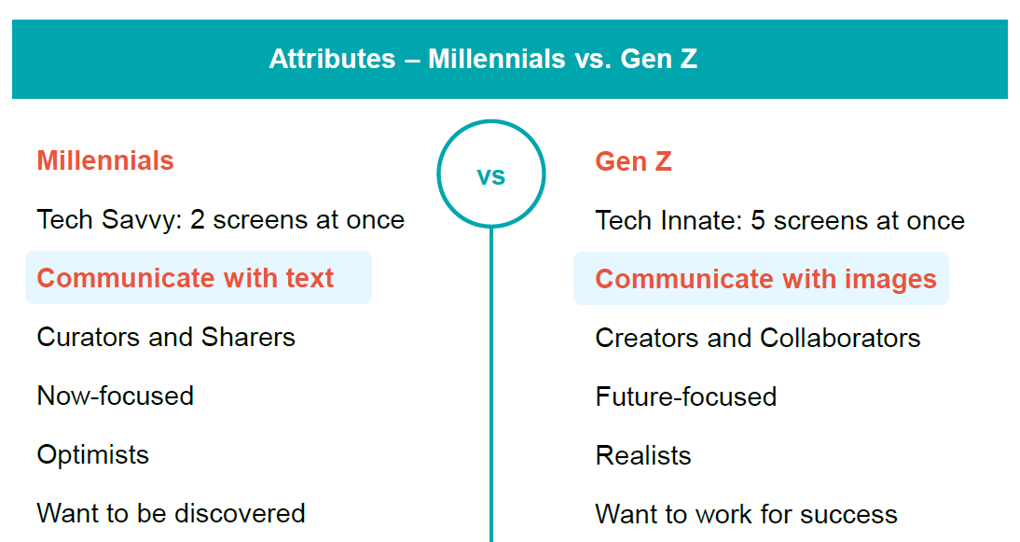
And What’s Coming After Millennials?
Source: Meeker, Internet Trends 2016, accessed at https://dq756f9pzlyr3.cloudfront.net/file/2016_internet_trends_report_final.pdf , slide #74.

Slide 68
Summary: Millennials
Millennials care what their social circles and influencers think
As a result of their online connections, they are empowered to participate and engage in the process of building brands—as well as tearing them down
So companies must vigilantly monitor what is being said about their brands—and be willing to participate in the conversation
Source: Jeff Fromm and Christie Garton, Marketing to Millennials, American Management Association, 2013, p.123.

Slide 69
Insurance Information Institute Online:
www.iii.org
Thank you for your time
and your attention!

