Slide 1
Are you financially
prepared for a wildfire?
BEFORE
DURING
AFTER
May 6, 2020
What to Do Before, During & After a Wildfire

Slide 2
Partners in Wildfire Prep: Working Together to Prepare & Rebuild After Wildfire
NEXT Webinar Coming on May 20, 2020

Slide 3
How Do Insurers Assess the Risk of My Home?
You WANT Insurers to Understand Your Risk
Insurers have access to property information
Technology is sophisticated
WUI property on-site inspections

Slide 4
What do Insurance Companies Consider in Underwriting Decisions?
Underwriting & rating factors include loss history, age of home, size, construction type and quality, contents, business in the home, foundation
WUI risk: location, construction, mitigation, slope, access, proximity & quality, fire protection, etc.
It’s NOT just the WUI risk that
determines insurability & rates

Slide 5
Do all insurance companies use the same underwriting guidelines?
Insurers have their own proprietary underwriting & rating guidelines
Consider & insure common risk factors, competitive differences are good for consumers, what type of insurance do YOU want to purchase?

Slide 6
Do You Understand Your Insurance Policy?
HOMEOWNERS INSURANCE
covers wind, rain, fire
does NOT cover flood,
landslide or earthquake damage
Consider your risk where you live
Homeowners insurance has a deductible determined by the homeowner
BE READY
Have your deductible in your savings

Slide 7
Do You Understand Your Insurance Policy?
TYPES OF POLICIES
Actual Cash Value (ACV)
Replacement Cost
TYPES OF COVERAGES
Additional Living Expenses
Coverage A
Covers
rebuilding
the home
Coverage B
Covers
rebuilding
detached structures like a garage
Coverage C
Covers personal
belongings: furniture, clothes, housewares, small appliances

Slide 8
How Do You Determine How Much
Coverage You Need?
GETTING THE DETAILS RIGHT & UPDATING YOUR POLICY
Square footage and local construction cost
Number of bedrooms & bathrooms
Number of windows & doors, fireplaces
Type of roof & siding
Type of finishes – countertops, flooring, appliances, cabinets
Land is not insured

Slide 9
How Do I Prevent Underinsurance?
DEMAND SURGE CAN INCREASE THE COST OF MATERIALS AND LABOR
Ask your agent or insurer about:
• Extended replacement cost coverage
• Building code upgrade coverage
• Automatic annual adjustments for inflation
• Do you need a small business or agricultural policy?

Slide 10
Will My Policy Replace All My Belongings?
Contents are Covered under Coverage C – Percentage of Coverage A
Update your Policy after Remodels & Home Improvements
Talk to Your Agent or Company
Keep receipts for major purchases in the cloud

Slide 11
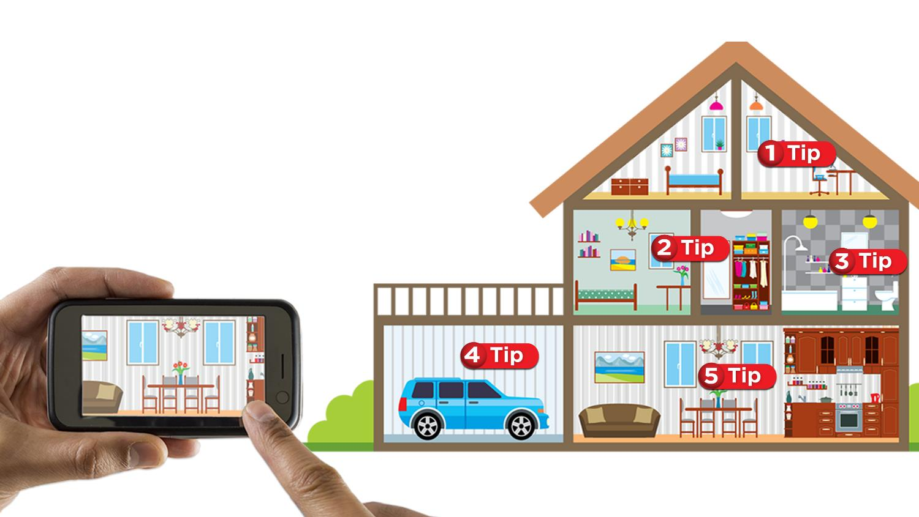
Home Inventory
Make a home inventory when you buy the policy
Update your home
inventory annually–
Talk to your agent
Use Your Insurers’ app or software– Keep it in the cloud
TIP 1: Scan and save receipts for major purchases
Technology is Your
Friend– Store Your
Inventory in the Cloud
TIP 2: Document when, where, and how much you paid for each item
TIP 3: Use your smartphone to document each room of your home
TIP 4: Describe the details of each room on your video, open drawers, closets, include your garage
TIP 5: Note special items like jewelry, antiques, high end furnishings, artwork or rare collections
Notes:
Click for each tip

Slide 12
What Should I Do if I Get Non-renewed by My Insurance Company?
ASK if there is something you can do to mitigate risk and keep your policy.
SHOP AND COMPARE insurance with a local broker who knows the area and represents several insurance companies.
PARTICIPATE in local mitigation efforts – Firewise USA, Fire Safe Councils, Fire Adapted Community Programs
UNDERSTAND options: Admitted, Surplus Lines,
CA FAIR Plan
CALL your Department of Insurance

Slide 13
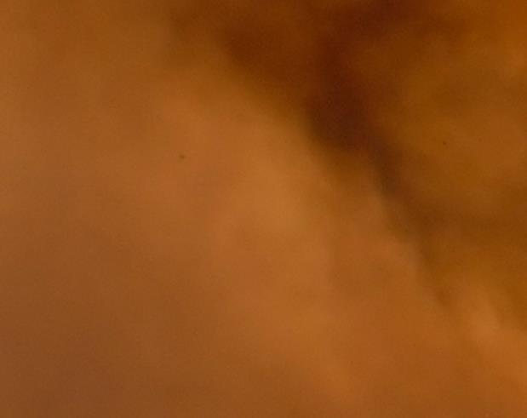
What Should I Do in an Evacuation?
Listen to local authorities - Evacuate and Get to Safety
Follow your family communication and evacuation plan – Follow social media
Contact your insurer to file a claim – call, click or text
Go to the Insurance Village at Disaster Assistance Center
Ask your insurer if ALE is covered during a mandatory evacuation
Save your receipts for hotel and meals – ALE may cover it
Notes:
- Click for each bullet.

Slide 14
How Do I Navigate the Insurance Claims Process?
DEBRIS REMOVAL—WORK WITH LOCAL AUTHORITIES AND INSURER
Keep a binder with contact information, scope of work, forms
In major disaster insurers may send multiple adjusters throughout claim
Independent adjusters work for your insurer
Public adjusters – Take a percentage of your insurance proceeds, negotiate on your behalf for a fee
GATHERING
3 BIDS WITH
COMPLETE
SCOPE
OF WORK
Compare bids, check references, only hire licensed contractors – Your adjuster will help
You have up to 3 years to rebuild with 6-month extensions
Manage your ALE expenses to cover the time to rebuild
WORKING
WITH
ADJUSTERS
Notes:
- Click on Working with Adjusters for tips
- Click on Gathering 3 bids for tips

Slide 15
What Should I Watch Out for During Rebuild?
Contractor Fraud & Abuse
Always check references & licenses, pay as work is completed & inspected
Keep Paying Your Mortgage
Your additional living expenses are covered in your policy
Continue paying your mortgage
Your bank as a lien holder may require two-party checks and inspect work before releasing insurance proceeds to contractor
Price Gouging
Report excessive rents, materials or labor
New law defines gouging as rates 10% higher than rates prior to wildfire
Report to your insurer, contact California Attorney General’s Office
Be sure to ask for a detailed rebuild bid; don’t settle for a vague estimate that doesn’t price out the materials and detail what is being build.
Maintain Insurance
Keep liability insurance on your property during rebuild

Slide 16
Possible Delays and Hurdles
Debris removal process
Demand surge pricing & labor/material shortages
Lien holders issuing 2-party checks
Getting complete bids
Making so many decisions
Getting overwhelmed by rebuilding process
Making decisions
sooner is better
Your insurer is there to work with you from beginning to end
Notes:
- Click for your insurer is there to work with you.
- Click again for "Making Decisions..." bubble.

Slide 17
Where Do You Go for Help?
Your Insurer, Agent or Adjuster
Your State Department of Insurance
Your State Attorney General’s Office
Your State Office of Emergency Services

Slide 18
Take-Aways from Today
INSURANCE IS A CRUCIAL FINANCIAL SAFETY NET
Insurance rebuilds homes, neighborhoods & communities
DON’T FORGET ABOUT INSURANCE
Look at insurance early during the home buying process – don’t wait until last minute
Take active role in assessing what coverage type & limits you need
Update your policy annually – report remodels or material upgrades always
Make and update your home inventory
Consider renters insurance
Make sure loved ones with paid-off homes maintain insurance
YOU ARE IN CONTROL
Your insurer is your partner before, during & after a wildfire
Coverage amounts are up to the policyholder to decide

