Slide 1
Mega-Trends Influencing the Workers Compensation Insurance Industry
12th Annual National Workers’ Compensation Insurance ExecuSummit
Uncasville CT, February 3, 2015
Steven N. Weisbart, Ph.D., CLU, Senior Vice President & Chief Economist
Insurance Information Institute ♦ 110 William Street ♦ New York, NY 10038
Office: 212.346.5540 ♦ Cell: (917) 494-5945 ♦ stevenw@iii.org ♦ www.iii.org

Slide 2
Presentation Outline: 6 Mega-Trends
A Growing Exposure Base, but with a Different Mix of Risks
Workplace Safety Improvement Continues, but “Room” for More
Inflation, WC-style
Low Investment Returns
The Aging Workforce
The Obesity Epidemic
2
12/01/09 - 9pm
eSlide – P6466 – The Financial Crisis and the Future of the P/C
Notes:
2

Slide 3
WC Profitability
3

Slide 4
Workers Comp
Return on Net Worth, 2002-2013
Profits down during and after a severe recession: cause and effect?
Sources: NAIC; Insurance Information Institute

Slide 5
Workers Comp Return on Net Worth, by State, 2013
12 states posted double-digit profit percentages in WC in 2013

Slide 6
Workers Comp Return on Net Worth, by State, 2013
Bottom 25 States

Slide 7
Workers Compensation
Combined Ratio: 1994–2014P
Does the WC line get in trouble once each decade?
Workers Comp underwriting results were the worst they have been in a decade but lately are improving.
Sources: A.M. Best; Insurance Information Institute. Data for 2000-2014P are from Exhibit 6, Best’s Special Report, “U.S. Workers Compensation Results Sustain Recent Improvement,” November 10, 2014.

Slide 8
A Growing Exposure Base, but with a Different Mix of Risks
Health Care, Education, Services
Will Lead
8
Notes:
8

Slide 9
Monthly Change in Nonfarm Employment, 2011 - 2014
Average Monthly Gain
2011: 173,600 2012: 186,300 2013: 194,250 2014*: 240,900
Thousands
The pace of job growth varies considerably from month to month.
*Seasonally adjusted. Oct 2014 and Nov 2014 are preliminary data. Monthly gain for 2014 is average for January-November
Sources: US Bureau of Labor Statistics; Insurance Information Institute

Slide 10
Nonfarm Payroll (Wages and Salaries),
Quarterly, 2005–2014:Q3
Billions
Latest (2014:Q3) was $7.46 trillion, a new peak
Prior Peak was 2008:Q3 at $6.54 trillion
Recent trough (2009:Q1) was $6.23 trillion, down 5.3% from prior peak
Note: Recession indicated by gray shaded column. Data are seasonally adjusted annual rates.
Sources: http://research.stlouisfed.org/fred2/series/WASCUR; National Bureau of Economic Research (recession dates); Insurance Information Institute.
10
12/01/09 - 9pm
eSlide – P6466 – The Financial Crisis and the Future of the P/C
Notes:
10

Slide 11
Workers Comp Net Written Premiums vs. Payroll, 1990-2014:Q3
Payroll Base* WC NWP
$Billions $Billions
7/90-3/91
3/01-11/01
12/07-6/09
WC premium volume dropped two years before the recession began
Continued Payroll Growth and Rate Increases
Suggest WC NWP Will Grow Again in 2015
*Private employment; Shaded areas indicate recessions.
Sources: NBER (recessions); Federal Reserve Bank of St. Louis at http://research.stlouisfed.org/fred2/series/WASCUR ; NCCI; I.I.I.

Slide 12
Construction Employment,
Jan. 2010—November 2014*
(Thousands)
Construction employment is +677,000 above
Jan. 2011 (+12.5%).
Construction and manufacturing employment constitute 1/3 of all workers comp payroll exposure.
*Seasonally adjusted; Oct and Nov 2014 are preliminary
Sources: US Bureau of Labor Statistics at http://data.bls.gov; Insurance Information Institute.
12
12/01/09 - 9pm
eSlide – P6466 – The Financial Crisis and the Future of the P/C
Notes:
12

Slide 13
Manufacturing Employment, Monthly,
January 2010—November 2014*
Manufacturing employment is 750,000+ above Jan. 2010 (+6.6%) and still growing.
(Thousands)
Manufacturing employment is a surprising source of strength in the economy. Employment in the sector is at a multi-year high.
*Seasonally adjusted; Oct and Nov 2014 are preliminary
Sources: US Bureau of Labor Statistics at http://data.bls.gov; Insurance Information Institute.
13
12/01/09 - 9pm
eSlide – P6466 – The Financial Crisis and the Future of the P/C
Notes:
13

Slide 14
U.S. Employment in Health Care & Social Services, Monthly, 1990–2014*
Millions
Employment in the health care and social service sector grew in virtually every month for the last 24 years, unaffected by recessions,…
…and this growth is expected to continue indefinitely
Cumulative growth
over 25 years: 100.1%
*As of Nov 2014 (Nov 2014 and Oct 2014 are preliminary); Seasonally adjusted
Note: Recessions indicated by gray shaded columns.
Sources: US Bureau of Labor Statistics; National Bureau of Economic Research (recession dates); Insurance Information Institute.

Slide 15
Workplace Safety Improvement Continues, but “Room” for More
The WC industry has certainly helped create/support the improvement
15
Notes:
15

Slide 16
Fewer Occupational Deaths
1992–2013p
Number of Fatal Injuries
The death rate per 100,000 full-time-equivalent workers was 3.2 in 2013,
down from 3.4 in 2012 and 3.5 in 2011.
p = preliminary; final data will be released in late Spring 2015
Source: U.S. Bureau of Labor Statistics, National Census of Fatal Occupational Injuries in 2013 (Preliminary Results), released September 11, 2014.
16
12/01/09 - 9pm
eSlide – P6466 – The Financial Crisis and the Future of the P/C
Notes:
16

Slide 17
Number of Workplace Homicides,
1992-2013

Slide 18
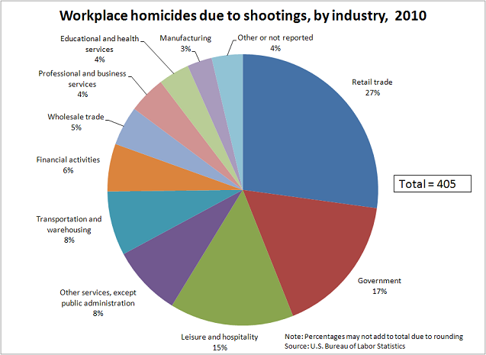

Slide 19
Private Industry: Fewer Injuries & Illnesses with Days Away from Work
Goods-producing, 2013 vs. 2003: down 43.7%
Service-producing, 2013 vs. 2003: down 24.3%
Number
Slight increase because employment rose.
The total number of illnesses and injuries dropped from 2003 to 2007 despite growth in employment and the aging of the workforce.
The drop continued through the Great Recession.
Source: U.S. Bureau of Labor Statistics, National Occupational Injuries and Illnesses Requiring Days Away from Work, 2013, Table 1, released December 16, 2014: http://www.bls.gov/news.release/osh2.t01.htm.
19
12/01/09 - 9pm
eSlide – P6466 – The Financial Crisis and the Future of the P/C
Notes:
19

Slide 20
Accidents per 10,000 Full-Time Private Workers, 2013
167,150 Lost-Time Injuries and Illnesses in the Healthcare Sector in 2013, 13% a Result of Violence.
Source: U.S. Bureau of Labor Statistics, National Occupational Injuries and Illnesses Requiring Days Away from Work, 2013, Table 1, released December 16, 2014: http://www.bls.gov/news.release/osh2.t01.htm.

Slide 21
Inflation and Claim Severity
The Low CPI Doesn’t
Reflect WC Cost Pressures
21
Notes:
21

Slide 22
Workers Compensation Medical Severity
Moderate Increase in 2011
Medical
Claim Cost ($000s)
Average Medical Cost per Lost-Time Claim
Cumulative Change = 245%
(1991-2011p)
Annual Change 1991–1993: +1.9%
Annual Change 1994–2001: +8.9%
Annual Change 2002–2010: +6.0%
Accident Year
2011p: Preliminary based on data valued as of 12/31/2011.
1991-2010: Based on data through 12/31/2010, developed to ultimate.
Based on the states where NCCI provides ratemaking services; Excludes high deductible policies.

Slide 23
WC Medical Severity No Longer Rising
Faster Than the Medical CPI Rate
The average annual growth in WC medical severity from 2002 through 2009 was over 6% vs. the medical CPI (about 4%), which itself was higher than the overall CPI…
…but since 2010 growth in WC medical severity has closely tracked the medical CPI
*I.I.I. estimate based on data through October 2014
Sources: CPI and Med CPI from US Bureau of Labor Statistics, WC med severity from NCCI based on NCCI states.

Slide 24
Workers Comp Indemnity Claim Costs, 1993-2013p
Average Indemnity Cost per Lost-Time Claim
Average indemnity costs per claim have been at or below $22,500 since 2008
Indemnity
Claim Cost ($ 000s)
Accident Year
2010p: Preliminary based on data valued as of 12/31/2011
1991–2010: Based on data through 12/31/2010, developed to ultimate
Based on the states where NCCI provides ratemaking services
Excludes high deductible policies
Notes:
24
Exhibit 11 of Article

Slide 25
WC Indemnity Severity No Longer Grows Faster than Wages, 1995-2013
NCCI data on WC severity is based on the states where NCCI provides ratemaking services. Excludes the effects of deductible policies.
Sources: NCCI, BLS, from Current Population Survey

Slide 26
Low Investment Returns
26

Slide 27
U.S. Treasury 2- and 10-Year Note Yields*: 1990–2014
Yields on 10-Year U.S. Treasury Notes have been essentially below 5% for over a dozen years.
U.S. Treasury 10-year note yields “spiked”
Since roughly 80% of P/C bond/cash investments are in 10-year or shorter durations, most P/C insurer portfolios will have low-yielding bonds for years to come.
*Monthly, constant maturity, nominal rates, through December 2014.
Sources: Federal Reserve Bank at http://www.federalreserve.gov/releases/h15/data.htm.
National Bureau of Economic Research (recession dates); Insurance Information Institutes.
27
12/01/09 - 9pm
eSlide – P6466 – The Financial Crisis and the Future of the P/C
Notes:
27

Slide 28
Long-Term Reduction in the Level of Investment Earnings: Outlook
Fed actions will likely keep interest rates low for at least 2015
In a prolonged period of low interest rates, each year maturing higher-rate bonds are replaced with lower rates, building in a low portfolio yield that will last for the duration of the newer bonds
Industry must be prepared to operate in an environment in which investment returns are a much smaller fraction of profits
  Drives rates higher? Regulators will not accept this
  Stiffens underwriting discipline? Yet to manifest itself
Source: Insurance Information Institute.
28
12/01/09 - 9pm
eSlide – P6466 – The Financial Crisis and the Future of the P/C
Notes:
28

Slide 29
The Aging Workforce
29
Notes:
29

Slide 30
Labor Force Participation Rate,
Ages 65-69, Quarterly, 1998:Q1-2014:Q4
Labor Force participation rate
1 in 3 in this age group are working. Virtually none of them are “baby boomers”
The brown bars indicate recessions.
The switch from DB pension plans (with early-retirement incentives) to DC plans (with, in effect, later-retirement incentives) might be partly responsible for raising this rate.
Not seasonally adjusted. Sources: US Bureau of Labor Statistics, US Department of Labor; Insurance Information Institute.

Slide 31
Labor Force Participation Rate,
Ages 70-74, Quarterly, 1998:Q1-2014:Q4
Labor Force participation rate
Nearly 1 in 5 in this age group is working.
15 years ago it was 1 in 8.
The labor force participation rate for workers 70-74 grew by about 50% since 1998.
Growth in the participation rate has stalled at about 19% since 2013.
Source: US Bureau of Labor Statistics, US Department of Labor; Insurance Information Institute.

Slide 32
Labor Force Participation Rate,
Ages 70-74, Quarterly, 1998:Q1-2014:Q4
Labor Force participation rate
Nearly 1 in 4 men and 1 in 7 women in this age group is working.
The percent of women working has nearly doubled.
The labor force participation rate for workers 70-74 grew by about 50% since 1998.
Growth in the participation rate has stalled at about 19% since 2013.
Source: US Bureau of Labor Statistics, US Department of Labor; Insurance Information Institute.

Slide 33
Labor Force Participation Rate, Quarterly
Ages 75 and over, 1998-2014:Q4
Labor Force participation rate
The labor force participation rate for workers 75 and over could hit 10% soon. This is close to what the rate was for the 70-74 group a decade ago.
In the last 15 years, the labor force participation rate for workers 75 and over grew from 4.5% to 8.6% (in 2013:Q1), but has since fallen slightly.
Sources: US Bureau of Labor Statistics, US Department of Labor; Insurance Information Institute.

Slide 34
Labor Force Participation Rate, Quarterly
Ages 75 and over, 1998-2014:Q4
Labor Force participation rate
Nearly 1 in 8 men in this age group is working.
The percent of women in this age group that is working has doubled.
The labor force participation rate for workers 75 and over has doubled since 1998,
but growth in the participation rate has slowed recently.
Source: US Bureau of Labor Statistics, US Department of Labor; Insurance Information Institute.

Slide 35
Fatal Work Injury Rates Improved Slightly
Since 2006 but Still Climb Sharply With Age
Fatal Work Injury Rate per 100,000 full-time-equivalent workers
The fatality rate for workers 65 and older was 4 times that of workers age 25-34. The workplace of the future will have to be completely redesigned to accommodate the surge in older workers.
2013 data are preliminary
Source: U.S. Bureau of Labor Statistics, at http://www.bls.gov/iif/oshwc/cfoi/cfch0012.pdf
35

Slide 36
Older Workers Lose More Days from Work Due to Injury or Illness
Median Days Away From Work
Youngest baby boomer is age 51 (in 2015)
Oldest baby boomer is age 69 (in 2015)
Median lost time of workers age 65+ is 2-3X that of workers age 25-34. These numbers are pretty stable—they haven’t changed much since 2008.
Source: US Bureau of Labor Statistics, Nonfatal Occupational Injuries and Illnesses Requiring Days Away From Work, 2013 (Table 10), released December 16, 2014.
36

Slide 37
Percent of Days-Away-from-Work Cases, by Days Lost and Age Group, 2012
Over one-third of days-lost cases of older workers involved a month or more away from work. And virtually 9 of 10 cases were
for at least two days, compared to 8 of 10 for the youngest workers.
Source: US Bureau of Labor Statistics, Nonfatal Occupational Injuries and Illnesses Requiring Days Away From Work, 2012 (Table 10), released November 26, 2013.
37

Slide 38
Percent of Days-Away-from-Work Cases, by Days Lost and Age Group, 2013
Over one-third of days-lost cases of older workers involved a month or more away from work. And over 9 of 10 cases were
for at least two days, compared to 8 of 10 for the youngest workers.
Source: US Bureau of Labor Statistics, Nonfatal Occupational Injuries and Illnesses Requiring Days Away From Work, 2012 (Table 10), released November 26, 2013.
38

Slide 39
Older Workers Are Much
More Likely to Break a Bone
Incidence Rate* (2012)
*per 10,000 full-time-equivalent workers
Source: US Bureau of Labor Statistics, US Department of Labor at http://www.bls.gov/news.release/pdf/osh2.pdf Table 14
39

Slide 40
Older Workers Are Much
More Likely to Break a Bone
Incidence Rate* (2013)
*per 10,000 full-time-equivalent workers
Source: US Bureau of Labor Statistics, US Department of Labor at http://www.bls.gov/news.release/pdf/osh2.pdf Table 14
40

Slide 41
Older Workers Are More Likely Than Younger Workers to Slip/Fall, but Less Likely to Overexert Themselves
Incidence Rate (2012)
Source/Nature of Injury:
41
Source: US Bureau of Labor Statistics, US Department of Labor at http://www.bls.gov/news.release/pdf/osh2.pdf Table 14

Slide 42
Older Workers Are More Likely Than Younger Workers to Slip/Fall, but Less Likely to Overexert Themselves
Incidence Rate (2013)
Source/Nature of Injury:
42
Source: US Bureau of Labor Statistics, US Department of Labor at http://www.bls.gov/news.release/pdf/osh2.pdf Table 14

Slide 43
The Obesity Epidemic
In 1994, in no state was the percent of adults who were obese as high as 20%.
By 2010, all 50 states had adult obesity rates of 20% or more. In 18 states in 2013,
30% of the adults were obese.
43
Notes:
43

Slide 44
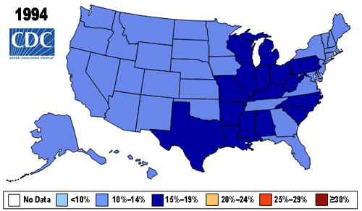
Obesity Trends Among U.S. Adults
BRFSS, 1994
Source: http://www.cdc.gov/obesity/data/trends.html#State

Slide 45
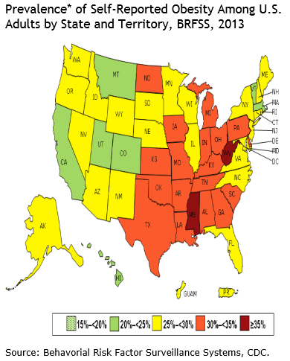
Obesity Trends Among U.S. Adults
BRFSS, 2013
Source: http://www.cdc.gov/obesity/data/trends.html#State

Slide 46
The Most Obese Workers File Twice as Many
WC Claims as Healthy-Weight Workers
The most obese have twice as many claims and 13 times more lost workdays than healthy weight workers
Source: Ostbye, T., et al, “Obesity and Workers Compensation,” Archives of Internal Medicine, April 23, 2007.
46

Slide 47
WC Medical Claims and Indemnity Costs are 5-10x Higher for the Most Obese Workers
Indemnity costs are 11 times higher for the most obese workers than for healthy-weight workers.
47
Source: Ostbye, T., et al, “Obesity and Workers Compensation,” Archives of Internal Medicine, April 23, 2007.

Slide 48
Additional (to WC) Costs of Obese Workers
Estimated Per Capita Costs
The most obese workers cost employers for greater medical care and by being less productive (by being absent more and being less productive when at work.
48
Source: Finkelstein, E., et al, “The Costs of Obesity in the Workplace,” Journal of Occupational and Environmental Medicine, Volume 52, No. 10 (October 2010), pp. 971-976.

Slide 49
Insurance Information Institute Online:
www.iii.org
Thank you for your time
and your attention!

