Slide 1
Workers Compensation and the New Economy: Trends, Challenges and Opportunities
Insurance Information Institute
May 10, 2016
Robert P. Hartwig, Ph.D., CPCU, President & Economist
Insurance Information Institute ♦ 110 William Street ♦ New York, NY 10038
Tel: 212.346.5520 ♦ Cell: 917.453.1885 ♦ bobh@iii.org ♦ www.iii.org

Slide 2
The Economy Will Impact Workers Compensation Growth and Performance
Workers Comp Is Among the Fastest Growing Major Commercial Lines
2

Slide 3
US Real GDP Growth*
The Q4:2008 decline was the steepest since the Q1:1982 drop of 6.8%
Real GDP Growth (%)
Recession began in Dec, 2007
Q1 2014/15 GDP data were hit hard by this year’s “Polar Vortex” and harsh winter
Demand for Insurance Should Increase in 2016 as GDP Growth Continues at a Steady, Albeit Moderate Pace and Gradually Benefits the Economy Broadly
* Estimates/Forecasts from Blue Chip Economic Indicators.
Source: US Department of Commerce, Blue Economic Indicators 5/16; Insurance Information Institute.

Slide 4
Real GDP by State Percent Change, 2015:II-2015:III - Highest 25 States
South Dakota was the economic growth juggernaut of the US in Q3 2015—by far
Only 9 states experienced growth in excess of 3%, which is what we would see nationally in a more typical recovery
Growth Benchmarks: Real GDP
US: 1.9%
Sources: U.S. Bureau of Economic Analysis; Insurance Information Institute.

Slide 5
Real GDP by State Percent Change, 2015:II-2015:III - Lowest 25 States
Growth rates in 10 states were below 1%
Arkansas, West Virginia and North Dakota were the only states to shrink
Sources: US Bureau of Economic Analysis; Insurance Information Institute.

Slide 6
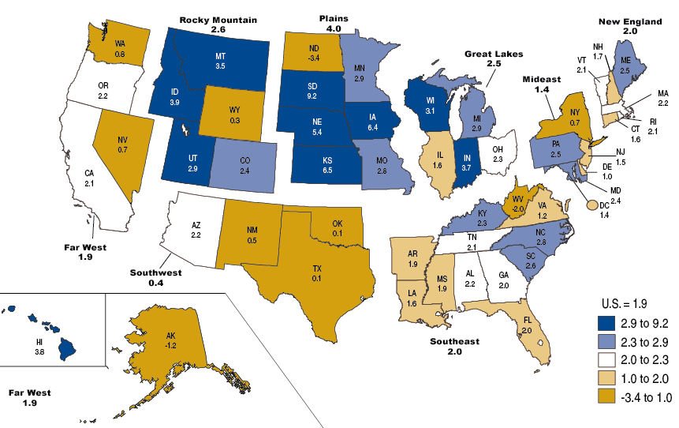
Percent Change in Real GDP by State, 2015:Q3
Sources: US Bureau of Economic Analysis; Insurance Information Institute.

Slide 7
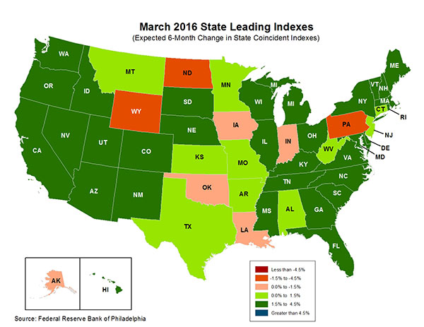
State-by-State Leading Indicators through September 2016
Growth in the West is finally beginning to pick up
The economic outlook for most of the US is generally positive, though oil and coal states are hurting
Sources: Federal Reserve Bank of Philadelphia at http://www.philadelphiafed.org/index.cfm ;Insurance Information Institute.

Slide 8
Business Bankruptcy Filings, 1980-2014
% Change Surrounding Recessions
1980-82 58.6%
1980-87 88.7%
1990-91 10.3%
2000-01 13.0%
2006-09 208.9%
2014 bankruptcies totaled 26,983, down 18.8% from 2013—the 5th consecutive year of decline. Business bankruptcies more than tripled during the financial crisis.
Significant Exposure Implications for All Commercial Lines as Business Bankruptcies Begin to Decline
Sources: American Bankruptcy Institute (1980-2012) at http://www.abiworld.org/AM/AMTemplate.cfm?Section=Home&TEMPLATE=/CM/ContentDisplay.cfm&CONTENTID=61633; 2013-14 data from United States Courts at http://news.uscourts.gov; Insurance Information Institute.
8
12/01/09 - 9pm
eSlide – P6466 – The Financial Crisis and the Future of the P/C
Notes:
8

Slide 9
Labor Markets Trends:
Recovery Continues in 2016
2015
Largest Job Gains in Many Years
Unemployment Rate Fell to Lowest Level Since 2008
Payrolls Expanded to Record High
9

Slide 10
Unemployment and Underemployment Rates: Still Falling
January 2000 through March 2016, Seasonally Adjusted (%)
For U-6, 8% to 10% is “normal.”
U-6 went from 8.0% in March 2007 to 17.5% in October 2009
U-6 was 9.8% in March 2016.
“Headline” unemployment was 5.0% in March 2016. 4% to 6% is “normal.”
High unemployment and underemployment constrained overall economic growth for years, but the job market is clearly improving.
Source: US Bureau of Labor Statistics; Insurance Information Institute.
10
12/01/09 - 9pm
eSlide – P6466 – The Financial Crisis and the Future of the P/C
Notes:
10

Slide 11
US Unemployment Rate Forecast
Rising unemployment eroded payrolls and WC’s exposure base.
Unemployment peaked at 10% in late 2009.
2007:Q1 to 2017:Q4F*
Jobless figures have been revised downwards for 2016
Unemployment forecasts have been revised modestly downwards. Optimistic scenarios put the unemployment as low as 4.4% by Q4 of 2016.
* = actual; = forecasts
Sources: US Bureau of Labor Statistics; Blue Chip Economic Indicators (4/16 edition); Insurance Information Institute.

Slide 12
Unemployment Rates by State, March 2016: Highest 25 States*
In March, 21 states had over-the-month unemployment rate decreases, 15 states had increases, and 14 states and the District of Columbia had no change.
Residual impacts of the housing collapse, weak economies are holding back several states
*Provisional figures for March 2016, seasonally adjusted.
Sources: US Bureau of Labor Statistics; Insurance Information Institute.

Slide 13
Unemployment Rates by State, March 2016:
Lowest 25 States*
In March, 21 states had over-the-month unemployment rate decreases, 15 states had increases, and 14 states and the District of Columbia had no change.
Strength in Energy, Agricultural States-most also avoided housing bust
*Provisional figures for March 2016, seasonally adjusted.
Sources: US Bureau of Labor Statistics; Insurance Information Institute.

Slide 14
Nonfarm Payroll (Wages and Salaries): Quarterly, 2005–2016:Q1
Billions
Latest (2016:Q1) was $8.03 trillion, a new peak--$1.80 trillion (29%) above 2009 trough
Prior Peak was 2008:Q3 at $6.54 trillion
Growth rates 2011:Q1 over 2010:Q1: 5.5% 2012:Q1 over 2011:Q1: 4.2% 2013:Q1 over 2012:Q1: 2.5% 2014:Q1 over 2013:Q1: 4.3% 2015:Q1 over 2014:Q1: 4.5% 2016:Q1 over 2015:Q1: 4.5%
Recent trough (2009:Q1) was $6.23 trillion, down 5.3% from prior peak
Note: Recession indicated by gray shaded column. Data are seasonally adjusted annual rates.
Sources: http://research.stlouisfed.org/fred2/series/WASCUR; National Bureau of Economic Research (recession dates); Insurance Information Institute.
14
12/01/09 - 9pm
eSlide – P6466 – The Financial Crisis and the Future of the P/C
Notes:
14

Slide 15
Payroll vs. Workers Comp Net Written Premiums, 1990-2015E
Payroll Base* WC NWP
$Billions $Billions
7/90-3/91
3/01-11/01
12/07-6/09
WC premium volume dropped two years before the recession began
WC net premiums written were down $14B or 29.3% to $33.8B in 2010 after peaking at $47.8B in 2005
Continued Payroll Growth and Rate Gains Suggest WC NWP Will Grow Again in 2016
*Private employment; Shaded areas indicate recessions. WC premiums are from NCCI through 2014; I.I.I. estimate for 2015.
Sources: NBER (recessions); Federal Reserve Bank of St. Louis at http://research.stlouisfed.org/fred2/series/WASCUR (annualized as of Q4 2015); NCCI; I.I.I.

Slide 16
CONSTRUCTION, MANUFACTURING & ENERGY OUTLOOK
Key Sectors Critical to the Economy and the P/C Insurance Industry
16

Slide 17
Value of New Private Construction: Residential & Nonresidential, 2003-2016*
2016: Value of new pvt. construction hits $846.2B as of Feb. 2016, up 69.0% from the 2010 trough but still 7.2% below 2006 peak
New Construction peaks at $911.8. in 2006
Billions of Dollars
Trough in 2010 at $500.6B, after plunging 55.1% ($411.2B)
$613.7
$447.9
$298.1
$261.8
$398.3
$238.8
Private Construction Activity Is Moving in a Positive Direction though Remains Well Below Pre-Crisis Peak; Residential Dominates
*2016 figure is a seasonally adjusted annual rate as of February.
Sources: US Department of Commerce http://www.census.gov/construction/c30/c30index.html ; Insurance Information Institute.
17
12/01/09 - 9pm
eSlide – P6466 – The Financial Crisis and the Future of the P/C
Notes:
17

Slide 18
Value of Construction Put in Place, 2016 vs. 2015*
Growth (%)
Private: +10.6%
Public: +9.2%
Public sector construction activity is finally beginning to create less drag up after years of decline
Private sector construction activity is up in both the residential and nonresidential segments
Overall Construction Activity is Up Again After Languishing in Early 2015; State/Local Sector Government Sector May Be Recovering as Budget Woes Ease in Some Jurisdictions
*seasonally adjusted data through February 2016. Source: U.S. Census Bureau, http://www.census.gov/construction/c30/c30index.html ; Insurance Information Institute.

Slide 19
New Private Housing Starts, 1990-2021F
Job growth, low inventories of existing homes, still-low mortgage rates and demographics should continue to stimulate new home construction for several more years
(Millions of Units)
New home starts plunged 72% from 2005-2009; A net annual decline of 1.49 million units, lowest since records began in 1959
Insurers Are Continue to See Meaningful Exposure Growth in the Wake of the “Great Recession” Associated with Home Construction: Construction Risk Exposure, Surety, Commercial Auto; Potent Driver of Workers Comp Exposure
Source: U.S. Department of Commerce; Blue Chip Economic Indicators (4/16 for 2016-17; 3/16 for 2018-21F; Insurance Information Institute.

Slide 20
Value of New Federal, State and Local Government Construction: 2003-2016*
Construction across all levels of government peaked at $314.9B in 2009
Austerity Reigns
Govt. construction MAY finally be turning around; still down $17.1B or 5.4% since 2009 peak
($ Billions)
Government Construction Spending Peaked in 2009, Helped by Stimulus Spending, but Contracted As State/Local Governments Grappled with Deficits and Federal Sequestration; Only Now Recovering
*2016 figure is a seasonally adjusted annual rate as of February; http://www.census.gov/construction/c30/historical_data.html
Sources: US Department of Commerce; Insurance Information Institute.

Slide 21
Construction Employment, Jan. 2010—March 2016*
(Thousands)
Construction employment is +1.237 million above Jan. 2011 (+22.8%) trough
Construction and manufacturing employment constitute 1/3 of all WC payroll exposure.
*Seasonally adjusted.
Sources: US Bureau of Labor Statistics at http://data.bls.gov; Insurance Information Institute.
21
12/01/09 - 9pm
eSlide – P6466 – The Financial Crisis and the Future of the P/C
Notes:
21

Slide 22
Construction Employment, Jan. 2003–March 2016
(Thousands)
Construction employment as of March 2016 totaled 6.672 million, an increase of 1.237MM jobs or 22.8% from the Jan. 2011 trough
Construction employment peaked at 7.726 million in April 2006
Gap between pre-recession construction peak and today: 1.05 million jobs
The “Great Recession” and housing bust destroyed 2.3 million constructions jobs
Construction employment troughed at 5.435 million in Jan. 2011, after a loss of 2.291 million jobs, a 29.7% plunge from the April 2006 peak
The Construction Sector Was a Growth Leader in 2014-16 as the Housing Market, Private Investment and Govt. Spending Recover. WC Insurers Continue to Benefit.
Note: Recession indicated by gray shaded column.
Sources: U.S. Bureau of Labor Statistics; Insurance Information Institute.
22
12/01/09 - 9pm
eSlide – P6466 – The Financial Crisis and the Future of the P/C
Notes:
22

Slide 23
MANUFACTURING & ENERGY SECTOR OVERVIEW & OUTLOOK
The U.S. Manufacturing and Energy Sectors Are Being Buffeted by a High Dollar, Weak Export Markets and Plunging Oil Prices
23

Slide 24
ISM Manufacturing Index
(Values > 50 Indicate Expansion)
January 2010 through April 2016
Manufacturing began to contract in late 2015 but seems to be rebounding
The manufacturing sector expanded for 70 of the 76 months from Jan. 2010 through Apr. 2016. Manufacturing sector has weakened recently due to weakness abroad, strong dollar and collapse in oil prices
Source: Institute for Supply Management at http://www.ism.ws/ismreport/mfgrob.cfm; Insurance Information Institute.

Slide 25
Dollar Value* of Manufacturers’ Shipments Monthly, Jan. 1992—Feb. 2016
$ Millions
The value of Manufacturing Shipments in Feb. 2016 was $462.8B—down 9% from the July 2014 record high of $508.1B
Weakness abroad, falling energy prices and a strong dollar are hurting the manufacturing sector, especially exports. Manufacturing growth leads to gains in many commercial exposures: WC, Commercial Auto, Marine, Property, and various Liability Coverages.
* Seasonally adjusted; Data published Apr. 4, 2016. Source: U.S. Census Bureau, Full Report on Manufacturers’ Shipments, Inventories, and Orders, http://www.census.gov/manufacturing/m3/
25
12/01/09 - 9pm
eSlide – P6466 – The Financial Crisis and the Future of the P/C
Notes:
25

Slide 26
Manufacturing Growth for Selected Sectors, 2016 vs. 2015*
Growth (%)
Durables: +1.3%
Non-Durables: -5.3%
Manufacturing of non-durable goods is weaker than for durables
Manufacturing Is Contracting Across a Number of Sectors, Especially Petroleum and Coal. Adverse Exposure Impacts Are Likely for: WC, Commercial Property, Commercial Auto and Certain Liability Coverages
*Seasonally adjusted; Date are YTD comparing data through February 2016 to the same period in 2015. Source: U.S. Census Bureau, Full Report on Manufacturers’ Shipments, Inventories, and Orders, http://www.census.gov/manufacturing/m3/

Slide 27
Manufacturing Employment, Jan. 2010—March 2016*
(Thousands)
Since Jan 2010, manufacturing employment is up (+831,000 or +7.3%) and is now falling
Manufacturing employment in March fell to its lowest level since Dec. 2014
Manufacturing employment has been a surprising source of strength in the economy. Global economic weakness, falling oil prices have hurt.
*Seasonally adjusted.
Sources: US Bureau of Labor Statistics at http://data.bls.gov; Insurance Information Institute.
27
12/01/09 - 9pm
eSlide – P6466 – The Financial Crisis and the Future of the P/C
Notes:
27

Slide 28
Employment in Oil & Gas Extraction, Jan. 2010—March 2016*
Employment peaked in Oct. 2014 at 201,500—its highest level since Dec. 1986.
(000)
Oil and gas extraction employment is down 11.2% since Oct. 2014 as oil prices sink
*Seasonally adjusted
Sources: US Bureau of Labor Statistics at http://data.bls.gov; Insurance Information Institute.
28
12/01/09 - 9pm
eSlide – P6466 – The Financial Crisis and the Future of the P/C
Notes:
28

Slide 29
POSITIVE LABOR MARKET DEVELOPMENTS
Key Factors Driving Workers Compensation Exposure
29

Slide 30
Average Weekly Hours of All Private Workers, March 2006—March 2016
(Hours Worked)
Hours worked plunged during the recession, impacting payroll exposures
Hours worked totaled 34.4 per week in March, just shy of the 34.6 hours typically worked before the “Great Recession”
*Seasonally adjusted
Note: Recessions indicated by gray shaded columns.
Sources: US Bureau of Labor Statistics at http://www.bls.gov/data/#employment; National Bureau of Economic Research (recession dates); Insurance Information Institute.
30
12/01/09 - 9pm
eSlide – P6466 – The Financial Crisis and the Future of the P/C
Notes:
30

Slide 31
Average Hourly Wage of All Private Workers, March 2006—March 2016
(Hourly Wage)
Wage gains continued during the recession, despite massive job losses
The average hourly wage was $26.43 in March 2016, up 19.8% from $21.22 when the recession began in Dec. 2007
*Seasonally adjusted
Note: Recessions indicated by gray shaded columns.
Sources: US Bureau of Labor Statistics at http://www.bls.gov/data/#employment; National Bureau of Economic Research (recession dates); Insurance Information Institute.
31
12/01/09 - 9pm
eSlide – P6466 – The Financial Crisis and the Future of the P/C
Notes:
31

Slide 32
ADVERSE LONG-TERM
LABOR MARKET DEVELOPMENTS
Key Factors Harming Workers Compensation Exposure and the Overall Economy
32

Slide 33
Labor Force Participation Rate, Jan. 2002—March 2016*
Labor Force Participation as a % of Population
Labor force participation remains far below pre-recession levels but has improved modestly in recent months
Large numbers of people are exiting (or not returning to the labor force)
*Defined as the percentage of working age persons in the population who are employed or actively seeking work.
Note: Recessions indicated by gray shaded columns.
Sources: US Bureau of Labor Statistics at http://www.bls.gov/data/; National Bureau of Economic Research (recession dates); Insurance Information Institute.
33
12/01/09 - 9pm
eSlide – P6466 – The Financial Crisis and the Future of the P/C
Notes:
33

Slide 34
Number of “Discouraged Workers,” Jan. 2002—March 2016
Thousands
“Discouraged Workers” are people who have searched for work for so long in vain that they actually stop searching and drop out of the labor force
Large numbers of people exited the labor force and were slow to return
There were 585,000 discouraged workers in March 2016, down from 738,000 a year earlier
In recent good times, the number of discouraged workers ranged from 200,000-400,000 (1995-2000) or from 300,000-500,000 (2002-2007).
Notes: Recessions indicated by gray shaded columns. Data are seasonally adjusted.
Sources: Bureau of Labor Statistics http://www.bls.gov/news.release/empsit.a.htm ; NBER (recession dates); Ins. Info. Inst.
34
12/01/09 - 9pm
eSlide – P6466 – The Financial Crisis and the Future of the P/C
Notes:
34

Slide 35
P/C Insurance Industry Financial Overview
2015: Second-Best Year in the Post-Crisis Era & Carbon Copy of 2014
Modest CATs, Reserve Releases
Workers Comp Helped Too
35

Slide 36
P/C Industry Net Income After Taxes 1991–2015
$ Millions
2005 ROE*= 9.6%
2006 ROE = 12.7%
2007 ROE = 10.9%
2008 ROE = 0.1%
2009 ROE = 5.0%
2010 ROE = 6.6%
2011 ROAS¹ = 3.5%
2012 ROAS¹ = 5.9%
2013 ROAS¹ = 10.2%
2014 ROAS¹ = 8.4%
2015 ROAS = 8.4%
Net income in 2015 was on par with 2014; ROE unchanged at 8.4%
ROE figures are GAAP; ¹Return on avg. surplus. Excluding Mortgage & Financial Guaranty insurers yields a 8.2% ROAS in 2014, 9.8% ROAS in 2013, 6.2% ROAS in 2012, 4.7% ROAS for 2011, 7.6% for 2010 and 7.4% for 2009; 2015E is annualized figure based actual figure through Q3 of $44.0
Sources: A.M. Best, ISO; Insurance Information Institute

Slide 37
Profitability Peaks & Troughs in the P/C Insurance Industry, 1975 – 2015
ROE
1977:19.0%
History suggests next ROE peak will be in 2016-2017
1987:17.3%
10 Years
1997:11.6%
2006:12.7%
10 Years
2015: 8.4%
2013 9.8%
9 Years
2014 8.4%
1975: 2.4%
1984: 1.8%
1992: 4.5%
2001: -1.2%
*Profitability = P/C insurer ROEs. 2011-15 figures are estimates based on ROAS data. Note: Data for 2008-2014 exclude mortgage and financial guaranty insurers.
Source: Insurance Information Institute; NAIC, ISO, A.M. Best, Conning

Slide 38
ROE: Property/Casualty Insurance by Major Event, 1987–2015
(Percent)
P/C Profitability Is Both by Cyclicality and Ordinary Volatility
Modestly higher CATs
Katrina, Rita, Wilma
Low CATs
Sept. 11
Hugo
Lowest CAT Losses in 15 Years
4 Hurricanes
Sandy
Andrew
Record Tornado Losses
Northridge
Financial Crisis*
* Excludes Mortgage & Financial Guarantee in 2008 – 2014.
Sources: ISO, Fortune; Insurance Information Institute.

Slide 39
P/C Insurance Industry Combined Ratio, 2001–2015*
Heavy Use of Reinsurance Lowered Net Losses
Relatively Low CAT Losses, Reserve Releases
Higher CAT Losses, Shrinking Reserve Releases, Toll of Soft Market
As Recently as 2001, Insurers Paid Out Nearly $1.16 for Every $1 in Earned Premiums
Relatively Low CAT Losses, Reserve Releases
Avg. CAT Losses, More Reserve Releases
3 Consecutive Years of U/W Profits: First Time Since 1971-73
Best Combined Ratio Since 1949 (87.6)
Sandy Impacts
Cyclical Deterioration
Lower CAT Losses
* Excludes Mortgage & Financial Guaranty insurers 2008--2014. Including M&FG, 2008=105.1, 2009=100.7, 2010=102.4, 2011=108.1; 2012:=103.2; 2013: = 96.1; 2014: = 97.0.
Sources: A.M. Best, ISO (2014-2015); Figure for 2010-2013 is from A.M. Best P&C Review and Preview, Feb. 16, 2016.

Slide 40
Underwriting Gain (Loss) 1975–2015*
Underwriting profit in 2015 totaled $8.7B
($ Billions)
Cumulative underwriting deficit from 1975 through 2013 was $493B
High cat, WC losses in 2011 led to the largest underwriting loss since 2002
Large Underwriting Losses Are NOT Sustainable in Current Investment Environment
* Includes mortgage and financial guaranty insurers in all years.
Sources: A.M. Best, ISO; Insurance Information Institute.

Slide 41
Number of Years with Underwriting Profits by Decade, 1920s–2010s
Number of Years with Underwriting Profits
Underwriting Profit in 2016?
Would be the first time since the 1970s with 4+ underwriting profits
Underwriting Profits Were Common Before the 1980s (40 of the 60 Years Before 1980 Had Combined Ratios Below 100) – But Then They Vanished. Not a Single Underwriting Profit Was Recorded in the 25 Years from 1979 Through 2003
* 2009 combined ratio excl. mort. and finl. guaranty insurers was 99.3, which would bring the 2000s total to 4 years with an u/w profit.
**Data for the 2010s is for the period 2010 through 2015.
Note: Data for 1920–1934 based on stock companies only.
Sources: Insurance Information Institute research from A.M. Best Data.
41
12/01/09 - 9pm
eSlide – P6466 – The Financial Crisis and the Future of the P/C
Notes:
41

Slide 42
P/C Insurance Loss Reserve Development, 1992 – 2017E*
Reserve releases are expected to gradually taper off slowly, but will continue to benefit the bottom line and combined ratio through at least 2017
Reserve Change
Source: A.M. Best; Barclays research for estimates.

Slide 43
Policyholder Surplus, 2006:Q4–2015:Q4
($ Billions)
2007:Q3 Pre-Crisis Peak
Drop due to near-record 2011 CAT losses
Surplus as of 12/31/15 stood at a near-record high $673.7B
The industry now has $1 of surplus for every $0.76 of NPW, close to the strongest claims-paying status in its history.
2010:Q1 data includes $22.5B of paid-in capital from a holding company parent for one insurer’s investment in a non-insurance business .
The P/C insurance industry entered 2016 in very strong financial condition.
Sources: ISO, A.M .Best.
43
12/01/09 - 9pm
eSlide – P6466 – The Financial Crisis and the Future of the P/C
Notes:
43

Slide 44
THE CHALLENGES OF GROWTH
Cycles, M&A and Lingering Scars of the ‘Great Recession’
44

Slide 45
Net Premium Growth (All P/C Lines): Annual Change, 1971—2015
(Percent)
1975-78
1984-87
2000-03
Net Written Premiums Fell 0.7% in 2007 (First Decline Since 1943) by 2.0% in 2008, and 4.2% in 2009, the First 3-Year Decline Since 1930-33.
Outlook
2016F: 3.9%
2017F: 3.8%
2015: 3.4%
2014: 4.2%
2013: 4.4%
2012: +4.2%
Shaded areas denote “hard market” periods
Sources: A.M. Best (1971-2013), ISO (2014-15).

Slide 46
NPW Premium Growth: Peaks & Troughs in the P/C Insurance Industry, 1926 – 2015
ROE
Post WW II Peak:
1947: 26.2%
1970-90: Peak premium growth was much higher in this period while troughs were comparable. Rapid inflation, economic volatility, high interest rates, tort environment all played roles
Start of WW II
1941: 15.8%
Economic Shocks, Inflation:
1976: 22.0%
Tort Crisis
1985/86: 22.2%
Post-9/11
2002:15.3%
1988-2000: Period of inter-cycle stability
2015 3.4%
1950-70: Extended period of stability in growth and profitability. Low interest rates, low inflation, “Bureau” rate regulation all played a role
2010-20XX? Post-recession period of stable growth?
Twin Recessions; Interest Rate Hikes
1987: 3.7%
Great Recession:2010: -4.9%
Great Depression
1932: -15.9% max drop
Note: Data through 1934 are based on stock companies only. Data include state funds beginning in 1998.
Source: A.M. Best; Insurance Information Institute.

Slide 47
Direct Premiums Written: Comm. Lines Percent Change by State, 2007-2015
Top 25 States
44 states showed commercial lines growth from 2007 through 2015
Growth Benchmarks: Commercial
US: 9.0%
Sources: NAIC via SNL Financial; Insurance Information Institute.

Slide 48
Direct Premiums Written: Comm. Lines Percent Change by State, 2007-2015
Bottom 25 States
Eight states still write less commercial business than they did in 2007
Sources: NAIC via SNL Financial; Insurance Information Institute.

Slide 49
Direct Premiums Written: Workers’ Comp Percent Change by State, 2007-2015*
Top 25 States
27 states showed positive growth in the workers comp line from 2007 – 2015 (up from 13 through 2013 and 5 through 2012).
*Excludes monopolistic fund states: ND, OH, WA, WY as well as WV, which transitioned to a competitive structure during this period.
Sources: NAIC data, sourced from S&P Global Market Intelligence; Insurance Information Institute.

Slide 50
Direct Premiums Written: Worker’s Comp Percent Change by State, 2007-2015*
Bottom 25 States
States with the poorest performing economies also produced some of the most negative net change in premiums of the past 8 years
*Excludes monopolistic fund states: ND, OH, WA, WY as well as WV, which transitioned to a competitive structure during this period.
Sources: NAIC data, sourced from S&P Global Market Intelligence; Insurance Information Institute.

Slide 51
U.S. INSURANCE MERGERS AND ACQUISITIONS, P/C SECTOR, 1994-2015E (1)
M&A activity in 2015 will likely reach its highest level since 1998
($ Millions)
M&A activity in the P/C sector was up sharply in 2015
(1) Includes transactions where a U.S. company was the acquirer and/or the target.
Source: Conning proprietary database; 2015 I.I.I. estimate.

Slide 52
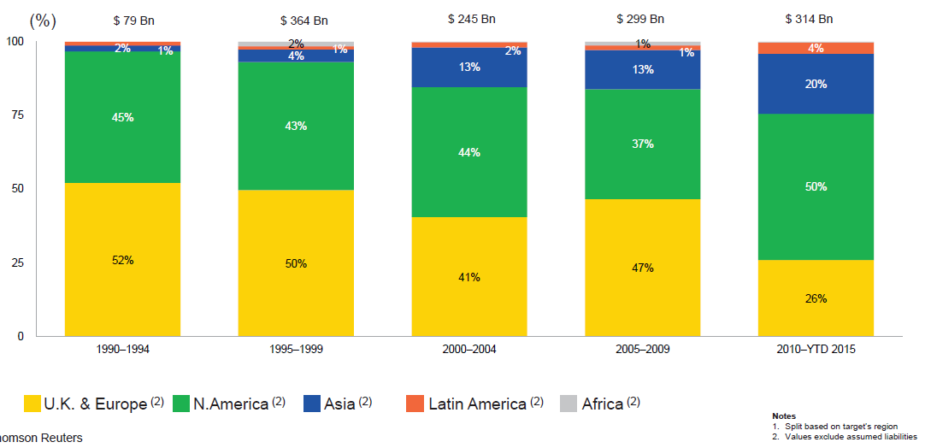
M&A Activity Is Shifting Toward North America and Asia and Away from Europe
Asian, N. American deal volumes were up sharply in 2015
.
Source: Thomson Reuters as of Oct. 2015 from Geneva Association Newsletter Insurance and Finance, Jan. 2016, presentation “Facts vs. Sentiment: Deals in the Insurance Sector,” by Aviva CEO Mark Wilson.

Slide 53
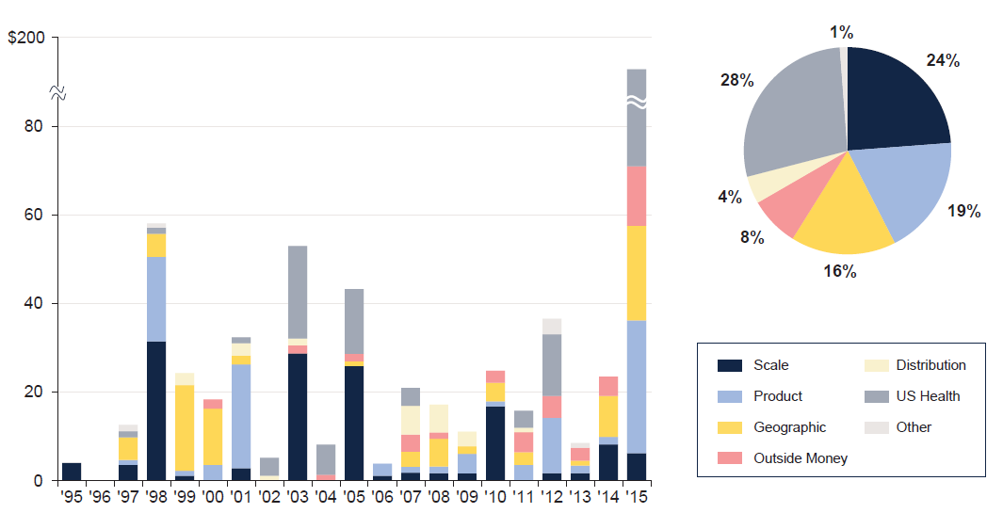
M&A: Deal Rationale by Dollar Amount
Scale drives most deals (excluding health sector)
Source: SNL Financial and WCMA estimates from Geneva Association Newsletter Insurance and Finance, Jan. 2016, presentation “What is the Logic Behind Consolidation? And Does It Create Value? A View from Outside,” by Brian Shea, Head of Willis Capital Markets & Advisory Europe (WCMA).
.

Slide 54
INVESTMENTS: THE NEW REALITY
Investment Performance is a Key Driver of Profitability
Depressed Yields Will Necessarily Influence Underwriting & Pricing
54

Slide 55
Property/Casualty Insurance Industry Investment Income: 2000–2015¹
Investment earnings are still below their 2007 pre-crisis peak
($ Billions)
Due to persistently low interest rates, investment income fell in 2012, 2013 and 2014 but showed a small (1.9%) increase in 2015—a trend that may continue
¹ Investment gains consist primarily of interest and stock dividends. Sources: ISO; Insurance Information Institute.

Slide 56
U.S. Treasury Security Yields: A Long Downward Trend, 1990–2016*
Yields on 10-Year U.S. Treasury Notes have been essentially below 5% for more than a decade.
Despite the Fed’s December 2015 rate hike, yield remain low though short-term yields have seen some gains
Since roughly 80% of P/C bond/cash investments are in 10-year or shorter durations, most P/C insurer portfolios will have low-yielding bonds for years to come.
*Monthly, constant maturity, nominal rates, through March 2016.
Sources: Federal Reserve Bank at http://www.federalreserve.gov/releases/h15/data.htm. National Bureau of Economic Research (recession dates); Insurance Information Institute.
56
12/01/09 - 9pm
eSlide – P6466 – The Financial Crisis and the Future of the P/C
Notes:
56

Slide 57
Distribution of Invested Assets: P/C Insurance Industry, 2014
$ Billions
Total Invested Assets = $1.533 Trillion
Source: Insurance Information Institute Fact Book 2016, A.M. Best.

Slide 58
Net Investment Yield on Property/ Casualty Insurance Invested Assets, 2007–2016P*
(Percent)
Estimated book yield in 2016 is down about 140 BP from pre-crisis levels
The yield on invested assets remains low relative to pre-crisis yields. The Fed’s plan to raise interest rates in late 2015 has pushed up some yields, albeit quite modestly.
Sources: A.M. Best; 2015E-2016P figures from A.M. Best P/C Review and Preview, Feb. 2016; Insurance Information Institute

Slide 59
Interest Rate Forecasts: 2016 – 2021
Yield (%)
3-Month Treasury
10-Year Treasury
The end of the Fed’s QE program in 2014 and a stronger economy have yet to push longer-term yields much higher
A full normalization of interest rates is unlikely until 2019, more than a decade after the onset of the financial crisis.
Sources: Blue Chip Economic Indicators (4/16 for 2016 and 2017; for 2018-2021 3/16 issue); Insurance Info. Institute.

Slide 60
Treasury Yield Curves: Pre-Crisis (July 2007) vs. April 2016*
Treasury yield curve remains near its most depressed level in at least 45 years. Investment income is depressed as a result. Fed began to raise rates in Dec. 2015, but yields unlikely to return to pre-crisis levels anytime soon
The Fed Began to Raise Rates in Dec. 2015 but Market Volatility and Weakness Abroad Have Made Additional Hikes Difficult
*As of April 22, 2016.
Source: Federal Reserve Board of Governors: http://www.federalreserve.gov/releases/h15/data.htm; Insurance Information Institute.

Slide 61
Annual Inflation Rates, (CPI-U, %), 1990–2017F
Annual Inflation Rates (%)
Inflation peaked at 5.6% in August 2008 on high energy and commodity crisis. The recession and the collapse of the commodity bubble reduced inflationary pressures in 2009/10
Inflationary expectations have slipped (due in part to falling energy costs) allowing the Fed to maintain low interest rates
Slack in the U.S. economy and falling energy prices suggests that inflationary pressures should remain subdued for an extended period of times
Sources: US Bureau of Labor Statistics; Blue Chip Economic Indicators, 4/16 (forecasts).

Slide 62
P/C Insurer Net Realized Capital Gains/Losses, 1990-2015
Realized capital gains rose sharply as equity markets rallied in 2013-14
($ Billions)
Insurers Posted Net Realized Capital Gains in 2010 - 2015 Following Two Years of Realized Losses During the Financial Crisis. Realized Capital Losses Were a Primary Cause of 2008/2009’s Large Drop in Profits and ROE.
Sources: A.M. Best, ISO; Insurance Information Institute.
62
12/01/09 - 9pm
eSlide – P6466 – The Financial Crisis and the Future of the P/C
Notes:
62

Slide 63
Property/Casualty Insurance Industry Investment Gain: 1994–2015¹
($ Billions)
Investment gains in 2015 were unchanged from 2014 and still well below the pre-crisis highs
Total Investment Gains Were Flat in 2015 as Investment Income Rose Marginally and Realized Capital Gains Fell Slightly
¹ Investment gains consist primarily of interest, stock dividends and realized capital gains and losses.
* 2005 figure includes special one-time dividend of $3.2B; 2015 figure is through Q3 2015.
Sources: ISO, SNL; Insurance Information Institute.

Slide 64
Property/Casualty Insurance Industry Investment Gain: 1994–2015:Q3¹
($ Billions)
Investment gains in 2015 will be similar to those earned in 2014 but still well below the pre-crisis highs
Total Investment Gains Were Down Slightly in 2014 as Low Interest Rates Pressured Investment Income but Realized Capital Gains Remained Robust
¹ Investment gains consist primarily of interest, stock dividends and realized capital gains and losses.
* 2005 figure includes special one-time dividend of $3.2B; 2015 figure is through Q3 2015.
Sources: ISO, SNL; Insurance Information Institute.

Slide 65
S&P 500 Index Returns, 1950 – 2016*
Annual Return
In 2016 the stock market had its worst start ever but has since recovered. Volatility is endemic to stock markets—and may be increasing—but there is no persistent downward trend over long periods of time
Fed Raises Rate
Tech Bubble Implosion
2016*:
+1.0%
Energy Crisis
Financial Crisis
*Through May 1, 2016.
Source: NYU Stern School of Business: http://pages.stern.nyu.edu/~adamodar/New_Home_Page/datafile/histretSP.html Ins. Info. Inst.

Slide 66
Workers Compensation Operating Environment
Workers Comp Results Have Improved Substantially in Recent Years
Can Gains Be Maintained?
66

Slide 67
Workers Compensation Combined Ratio: 1994–2015P
WC results have improved markedly since 2011
Workers Comp Results Began to Improve in 2012. Underwriting Results Deteriorated Markedly from 2007-2010/11 and Were the Worst They Had Been in a Decade.
Sources: A.M. Best (1994-2009); NCCI (2010-2015P) and are for private carriers only; Insurance Information Institute.

Slide 68
Commercial Lines Combined Ratio, 1990-2015F*
Commercial lines underwriting performance is expected to improve as improvement in pricing environment persists
*2007-2012 figures exclude mortgage and financial guaranty segments.
Source: A.M. Best (1990-2014F); Conning (2015F) Insurance Information Institute.

Slide 69
Workers Compensation Premium: Fifth Consecutive Year of Increase Net Written Premium
$ Billions
p Preliminary
Source: NCCI from Annual Statement Data.
Includes state insurance fund data for the following states: AZ, CA, CO, HI, ID, KY, LA, MD, MO, MT, NM, OK, OR, RI, TX, UT.
Each calendar year total for State Funds includes all funds operating as a state fund that year.
Calendar Year

Slide 70
2015 Workers Compensation Direct Written Premium Growth, by State*
PRIVATE CARRIERS: Overall 2015 Growth = +4.3%
While growth rates varied widely, most states experienced modest positive growth in 2015
*Excludes monopolistic fund states (in gray): OH, ND, WA and WY.
Source: NCCI.

Slide 71
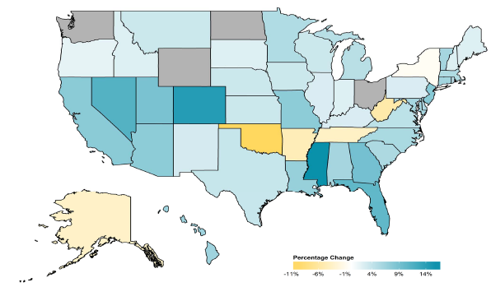
2014 Workers Compensation Direct Written Premium Growth, by State*
PRIVATE CARRIERS: Overall 2014 Growth = +4.6%
While growth rates varied widely, most states experienced positive growth in 2014
*Excludes monopolistic fund states (in gray): OH, ND, WA and WY.
Source: NCCI.

Slide 72
Workers Compensation Components of Written Premium Change, 2014 to 2015
Written Premium Change from 2014 to 2015
Net Written Premium—Countrywide | +2.9%
Direct Written Premium—Countrywide | +4.3%
Direct Written Premium—NCCI States | +2.5%
Components of DWP Change for NCCI States
Change in Carrier Estimated Payroll | +4.5%
Change in Bureau Loss Costs and Mix | -4.0%
Change in Carrier Discounting | -0.3%
Change in Other Factors | +2.2%
Combined Effect | +2.5%
Growth is now almost entirely payroll driven
Sources: Countrywide: Annual Statement data.
NCCI States: Annual Statement Statutory Page 14 for all states where NCCI provides ratemaking services.
Components: NCCI Policy data.

Slide 73
Workers Comp Approved Changes in Bureau Premium Level, 2000-2016p
Percent
Cumulative Change = –20.1%
(1994–2016p)
Accident Year
Note: Bureau premium level charges reflect approved changes in advisory rates, loss costs, assigned risk rates relative to those approved in NCCI states only IN and NC are filed in cooperation with state rating bureaus.
2016p: Preliminary based on data valued as of 4/15/2015.
Source: NCCI

Slide 74
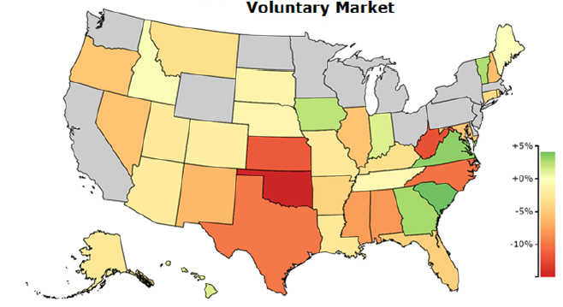
WC Approved or Filed and Pending Change in NCCI Premium Level by State*
Latest Change for Voluntary Market
Many states have seen rates rates drop recently
*As of 4/15/16. Excludes monopolistic fund states (in gray): OH, ND, WA and WY.
Source: NCCI.

Slide 75
WC Approved Changes in Bureau Premium Level (Rates/Loss Costs)
Percent
By Effective Date for Total Market
Cumulative 2000–2003
+17.1%
Cumulative 2011–2014
+11.8%
Cumulative 1994–1999
-27.8%
Cumulative 2004–2011
-30.8%
Cumulative
1990–1993
+36.3%
Approved rates/loss costs are down for the first time since 2010
Calendar Year
*States approved through 4/24/15.
Note: Bureau premium level changes are countrywide approved changes in advisory rates, loss costs and assigned risk rates as filed by applicable rating organization, relative to those previously approved.
Source: NCCI.

Slide 76
Workers Compensation Lost-Time Claim Frequency Declined in 2015
Percent
Average Annual Change = –3.6%
(1994–2014)
*Adjustments primarily due to significant audit activity.
2015p: Preliminary based on data valued as of 12/31/2015.
Source: NCCI Financial Call data, developed to ultimate and adjusted to current wage an voluntary loss cost level; Excludes high deductible policies; 1994-2014: Based on data through 12/31/14. Data for all states where NCCI provides ratemaking services, excluding WV.
Frequency is the number of lost-time claims per $1M pure premium at current wage and voluntary loss cost level
Accident Year

Slide 77
Workers Comp Indemnity Claim Costs: Slight Increase in 2015
Average Indemnity Cost per Lost-Time Claim
Indemnity
Claim Cost ($ 000s)
Average indemnity costs per claim were up 1% in 2015 to $23,500
+1%
+1.5%
+2.9%
Cumulative Change = 140%
(1991-2015p)
Accident Year
2014p: Preliminary based on data valued as of 12/31/2014.
1991-2013: Based on data through 12/31/2013, developed to ultimate
Based on the states where NCCI provides ratemaking services including state funds, excluding WV; Excludes high deductible policies.
Notes:
77
Exhibit 11 of Article

Slide 78
WC Indemnity Severity vs. Wage Inflation, 1995 -2015p
Indemnity severities usually outpace wage gains
Annual Change 1994–2014
Indemnity Claim Sev.: +4.6
US Avg. Weekly Wage: +3.4%
WC indemnity severity turned positive again in 2011
2014p: Preliminary based on data valued as of 12/31/2014; 1991-2010: Based on data through 12/31/2010, developed to ultimate. Based on the states where NCCI provides ratemaking services. Excludes the effects of deductible policies. CPS = Current Population Survey.
Source: NCCI; Insurance Information Institute

Slide 79
Workers Compensation Medical Severity: Moderate Increase in 2015
Medical
Claim Cost ($000s)
Average Medical Cost per Lost-Time Claim
Medical severity for lost time claims was down 1% in 2015, the first decline in at least 20 years
Annual Change 1991–1993: +1.9%
Annual Change 1994–2001: +8.9%
Annual Change 2002–2010: +6.0%
Cumulative Change = 252%
(1991-2015p)
Accident Year
Accident Year
2015p: Preliminary based on data valued as of 12/31/2015.
1991-2013: Based on data through 12/31/2014, developed to ultimate
Based on the states where NCCI provides ratemaking services including state funds, excluding WV; Excludes high deductible policies.

Slide 80
Annual Inflation Rates, (CPI-U, %), 1990–2017F
Annual Inflation Rates (%)
Inflation peaked at 5.6% in August 2008 on high energy and commodity crisis. The recession and the collapse of the commodity bubble reduced inflationary pressures in 2009/10
Inflationary expectations have slipped (due in part to falling energy costs) allowing the Fed to maintain low interest rates
Slack in the U.S. economy and falling energy prices suggests that inflationary pressures should remain subdued for an extended period of times
Sources: US Bureau of Labor Statistics; Blue Chip Economic Indicators, 4/16 (forecasts).

Slide 81
Workers Compensation Change in Medical Severity Comparison to Change in Medical Consumer Price Index (CPI)
Percent Change
Average Annual Change: 1994—2015
Lost-Time Medical Severity: +5.9%
US Medical CPI: +3.6%
Year
2015p: Preliminary based on data valued as of 12/31/2015.
Sources: Severity: 995-2013: Based on data through 12/31/2014, developed to ultimate
Based on the states where NCCI provides ratemaking services including state funds, excluding WV; Excludes high deductible policies.
US Medical CPI: US Bureau of Labor Statistics.

Slide 82
WC Medical Severity Generally Outpaces the Medical CPI Rate
Average annual increase in WC medical severity from 1995 through 2015 was well above the medical CPI (5.9% vs. 3.6%), but the gap has narrowing. Lost-time medical severities appear to on the rise again.
Sources: Med CPI from US Bureau of Labor Statistics, WC med severity from NCCI based on NCCI states.

Slide 83
Medical Cost Inflation vs. Overall CPI, 1995 – 2014*
Though moderating, medical inflation will continue to exceed inflation in the overall economy
Average Annual Growth Average 1995 – 2013
Healthcare: 3.8%
Total Nonfarm: 2.4%
*July 2014 compared to July 2013.
Sources: Med CPI from US Bureau of Labor Statistics, WC med severity from NCCI based on NCCI states.

Slide 84
U.S. Health Care Expenditures, 1965–2022F
$ Billions
From 1965 through 2013, US health care expenditures had increased by 69 fold. Population growth over the same period increased by a factor of just 1.6. By 2022, health spending will have increased 119 fold.
U.S. health care expenditures have been on a relentless climb for most of the past half century, far outstripping population growth, inflation of GDP growth
Sources: Centers for Medicare & Medicaid Services, Office of the Actuary at http://www.cms.gov/Research-Statistics-Data-and-Systems/Statistics-Trends-and-Reports/NationalHealthExpendData/NationalHealthAccountsProjected.html accessed 3/14/14; Insurance Information Institute.

Slide 85
National Health Care Expenditures as a Share of GDP, 1965 – 2022F*
% of GDP
Health care expenditures as a share of GDP rose from 5.8% in 1965 to 18.0% in 2013 and are expected to reach 19.9% of GDP by 2022
2022 19.9%
2010: 17.9%
2000: 13.8%
1990: 12.5%
Since 2009, heath expenditures as a % of GDP have flattened out at about 18%--the question is why and will it last?
1980: 9.2%
1965 5.8%
Sources: Centers for Medicare & Medicaid Services, Office of the Actuary at http://www.cms.gov/Research-Statistics-Data-and-Systems/Statistics-Trends-and-Reports/NationalHealthExpendData/NationalHealthAccountsProjected.html accessed 3/14/14; Insurance Information Institute.

Slide 86
Commercial Lines Pricing Trends
Survey Results Suggest Commercial Pricing Has Flattened Out
86

Slide 87
CIAB: Average Commercial Rate Change, All Lines, (1Q:2004–4Q:2015)
(Percent)
Q2 2011 marked the last of 30th consecutive quarter of price declines
Pricing as of Q4:2015 remained somewhat negative
KRW Effect
Note: CIAB data cited here are based on a survey. Rate changes earned by individual insurers can and do vary, potentially substantially.
Source: Council of Insurance Agents & Brokers; Insurance Information Institute

Slide 88
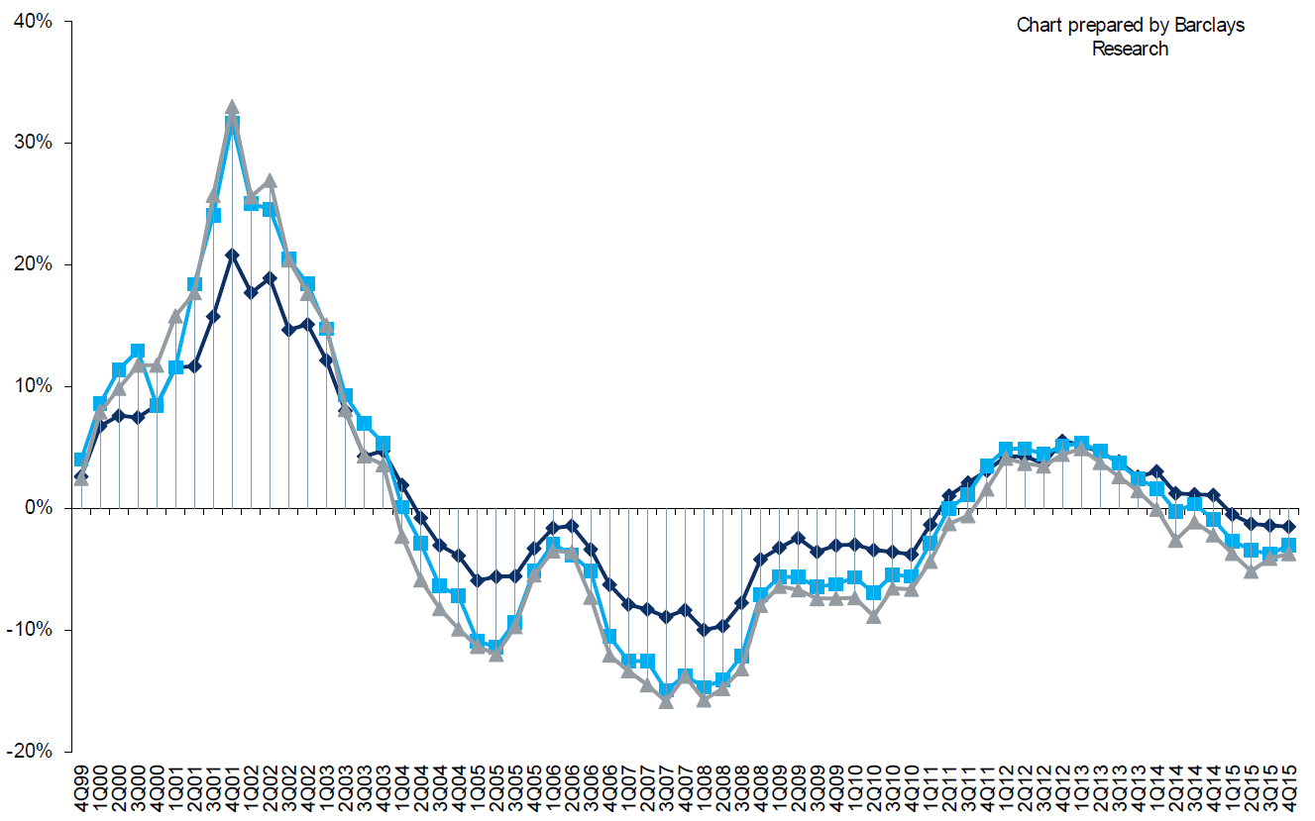
Change in Commercial Rate Renewals, by Account Size: 1999:Q4 to 2015:Q4
Percentage Change (%)
Peak = 2001:Q4 +28.5%
Pricing turned positive in Q3:2011, the first increase in nearly 8 years; Q4:2015 renewals were down 2.8%; Some insurers posted stronger numbers.
Pricing Turned Negative in Early 2004 and Remained that way for 7 ½ years
KRW : No Lasting Impact
Trough = 2007:Q3 -13.6%
Source: Council of Insurance Agents and Brokers; Barclay’s Capital; Insurance Information Institute.
Note: CIAB data cited here are based on a survey. Rate changes earned by individual insurers can and do vary, potentially substantially.

Slide 89
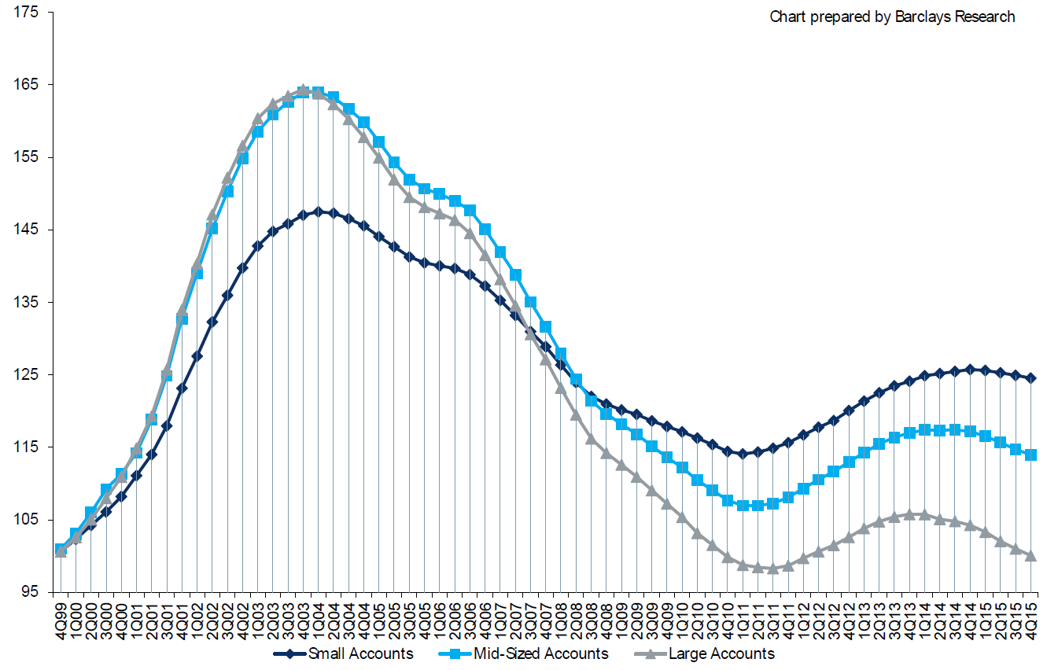
Cumulative Qtrly. Commercial Rate Changes, by Account Size: 1999:Q4 to 2015:Q4
1999:Q4 = 100
Pricing for smaller accounts has more stable than for larger accounts
Note: CIAB data cited here are based on a survey. Rate changes earned by individual insurers can and do vary, potentially substantially.
Source: Council of Insurance Agents and Brokers; Barclay’s Capital; Insurance Information Institute.

Slide 90
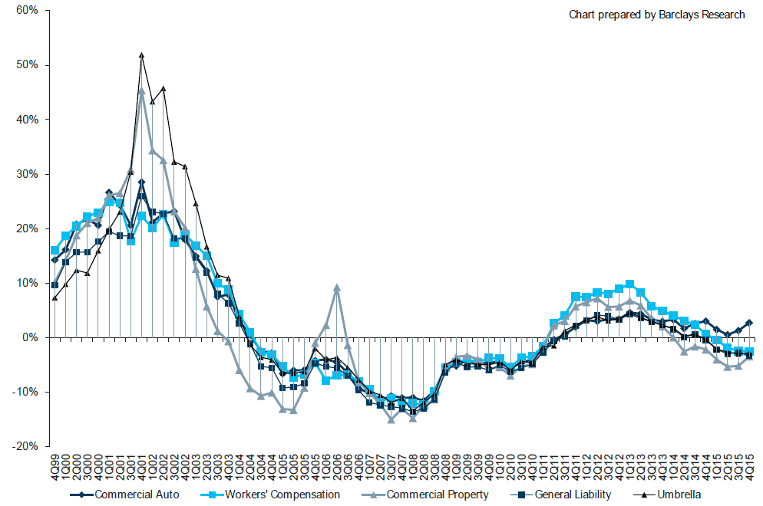
Change in Commercial Rate Renewals, by Line: 1999:Q4 to 2015:Q4
Percentage Change (%)
Peak = 2001:Q4
Commercial Auto is currently experiencing the strongest rate trend, supplanting WC
Source: Council of Insurance Agents and Brokers; Barclay’s Capital; Insurance Information Institute.
Note: CIAB data cited here are based on a survey. Rate changes earned by individual insurers can and do vary, potentially substantially.

Slide 91
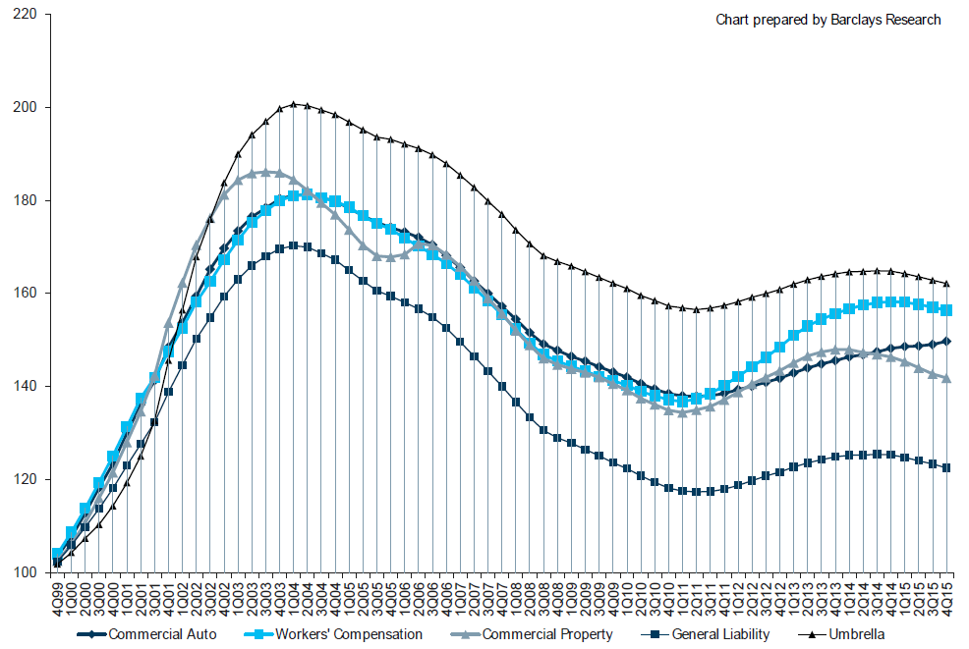
Cumulative Qtrly. Rate Changes, by Line: 1999:Q4 to 2015:Q4
1999:Q4 = 100
Commercial Auto is currently experiencing the strongest rate trend, supplanting WC
Note: CIAB data cited here are based on a survey. Rate changes earned by individual insurers can and do vary, potentially substantially.
Source: Council of Insurance Agents and Brokers; Barclay’s Capital; Insurance Information Institute.

Slide 92
Change in Commercial Rate Renewals, by Line: 2015:Q4
Commercial Auto rate increases are larger than any other line, followed by D&O and EPL
Percentage Change (%)
Major Commercial Lines Renewals Were Mixed to Down in Q4:2015; EPL, D&O and Commercial Auto Saw Gains
Note: CIAB data cited here are based on a survey. Rate changes earned by individual insurers can and do vary, potentially substantially.
Source: Council of Insurance Agents and Brokers; Insurance Information Institute.

Slide 93
Workers Comp and the ‘Gig’ Economy: An Update
The On-Demand Economy Will Transform the American Workforce and the P/C Insurance Industry Too
93

Slide 94

The Sharing Economy Has Grown— And Attracted Political Scrutiny

Slide 95

Political Skepticism About the ‘Gig’ Economy
"Many Americans are making extra money renting out a spare room, designing a website ... even driving their own car. This on demand or so called 'gig' economy is creating exciting opportunities and unleashing innovation, but it's also raising hard questions about workplace protections and what a good job will look like in the future."
--Hillary Clinton,
July 13, 2015
95
12/01/09 - 9pm
eSlide – P6466 – The Financial Crisis and the Future of the P/C
Notes:
95

Slide 96


Regulatory Issues Abound as Well, With Implications for Insurance Coverages
A driver for Uber is an employee, not a
contractor, according to a California
Ruling that eventually could push up costs
‘for the smartphone-based ride hailing service
and hurt the closely watched start-up's valuation.
The California Labor Commissioner's decision could ripple through the burgeoning industry of providing services via smartphones, with potential implications for other “crowdsourced” services such as Uber rival Lyft, chore service TaskRabbit, and cleaning service Homejoy.
--Reuters, June 18, 2015
96
12/01/09 - 9pm
eSlide – P6466 – The Financial Crisis and the Future of the P/C
Notes:
96

Slide 97
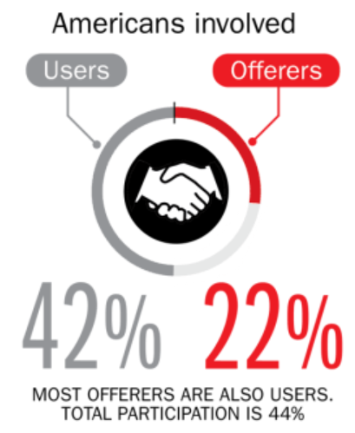
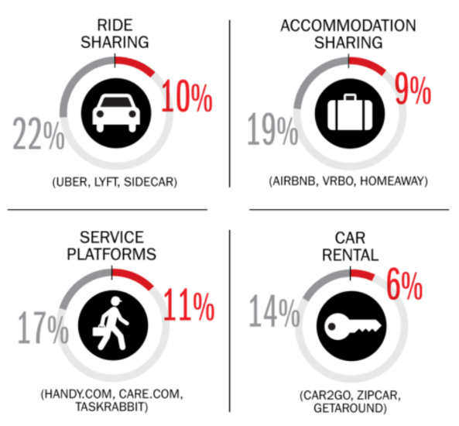
Percent of Americans Who Have Engaged in the “Gig/Sharing Economy” by Transaction
Drivers have significant WC exposures
Service platforms have the most direct link to WC; 11% of Americans have offered their services
About 22% of Americans have offered services in the sharing economy
Sources: The SelfEmployed.com accessed at https://www.theselfemployed.com/gig-economy/infographic-inside-the-new-economy/ based on a poll by Time magazine, Bursten-Marsteller and The Aspen Institute; Insurance Information Institute.

Slide 98
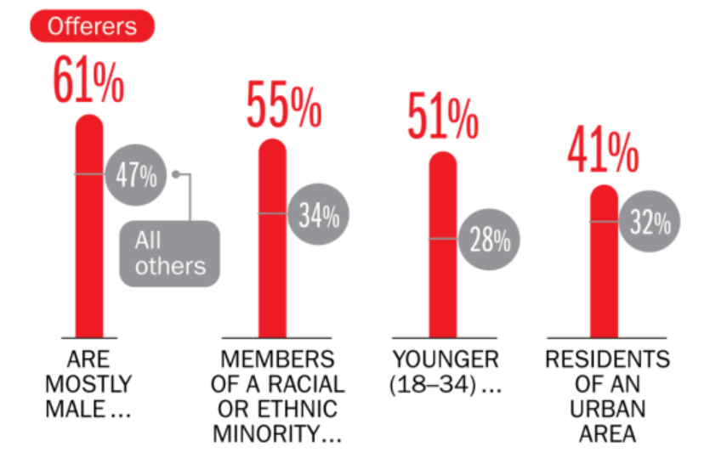
Americans Who Offer Services in the Sharing/Gig Economy Are Statistically More Prone to Workplace Injury
Young, Urban Minority Males Are the Most Likely to Offer their Services in the Sharing Economy
Sources: The SelfEmployed.com accessed at https://www.theselfemployed.com/gig-economy/infographic-inside-the-new-economy/ based on a poll by Time magazine, Bursten-Marsteller and The Aspen Institute; Insurance Information Institute.

Slide 99
Age of People Who are Providing the Sharing/On-Demand Economy
Being a provider of services in the Sharing/On-Demand Economy is attractive to workers in the 25-44 age range (who want flexibility in raising families) as well as seniors age 65+ who see the offering their services on-demand as a way to augment retirement income
About 7% of US population are providers in the Sharing Economy, cutting across age and incomes; 51% of those familiar with the concept could see themselves as providers within the next two years.
Sources: PwC survey of 1,000 adults in the U.S., conducted online, December 2014; Insurance Information Institute.

Slide 100
Household Income: Providers of the Sharing/On-Demand Economy
Being a provider of services in the Sharing/On-Demand Economy is particularly attractive to workers with household incomes under $50,000
About 7% of US population are providers in the Sharing Economy, cutting across age and incomes; 51% of those familiar with the concept could see them selves as providers within the next two years.
Sources: PwC survey of 1,000 adults in the U.S., conducted online, December 2014; Insurance Information Institute.

Slide 101
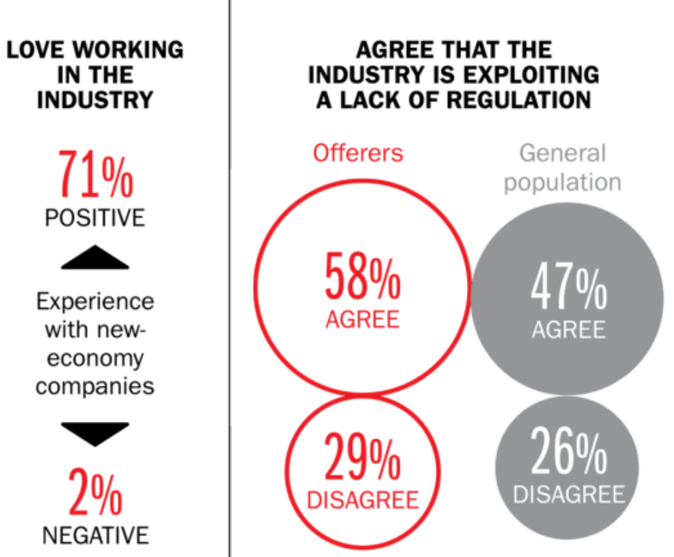
Americans Love Working in the Sharing Economy but Many Feel Exploited
Despite general satisfaction with sharing economy as an “industry,” there is a sense that workers are being exploited—especially by the workers themselves
Sources: The SelfEmployed.com accessed at https://www.theselfemployed.com/gig-economy/infographic-inside-the-new-economy/ based on a poll by Time magazine, Bursten-Marsteller and The Aspen Institute; Insurance Information Institute.

Slide 102
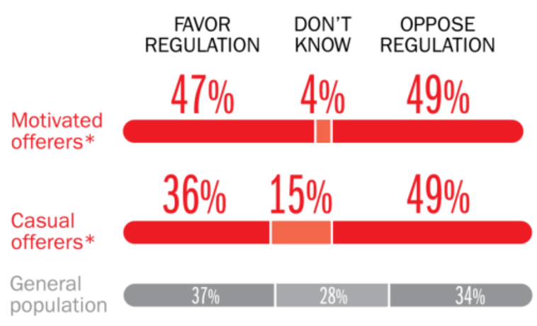
Opinions Are Split on Whether the Sharing Economy Needs More Regulation
The most frequent offerers of services though online platforms are equally divided over the need for more regulation
Sources: The SelfEmployed.com accessed at https://www.theselfemployed.com/gig-economy/infographic-inside-the-new-economy/ based on a poll by Time magazine, Bursten-Marsteller and The Aspen Institute; Insurance Information Institute.

Slide 103
THE ‘INTERNET OF THINGS’
Capturing Economic Value Amid a Shifting Insurer Value Chain
103

Slide 104
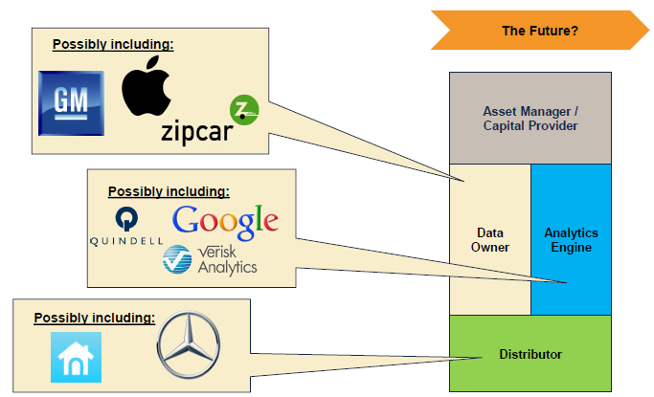

The Internet of Things and the Insurance Industry Value Chain
Who owns the data? Where does It flow? Who does the analytics? Who is the capital provider?
Source: Willis Capital Markets & Advisory; Insurance Information Institute.
104
12/01/09 - 9pm
eSlide – P6466 – The Financial Crisis and the Future of the P/C
Notes:
104

Slide 105
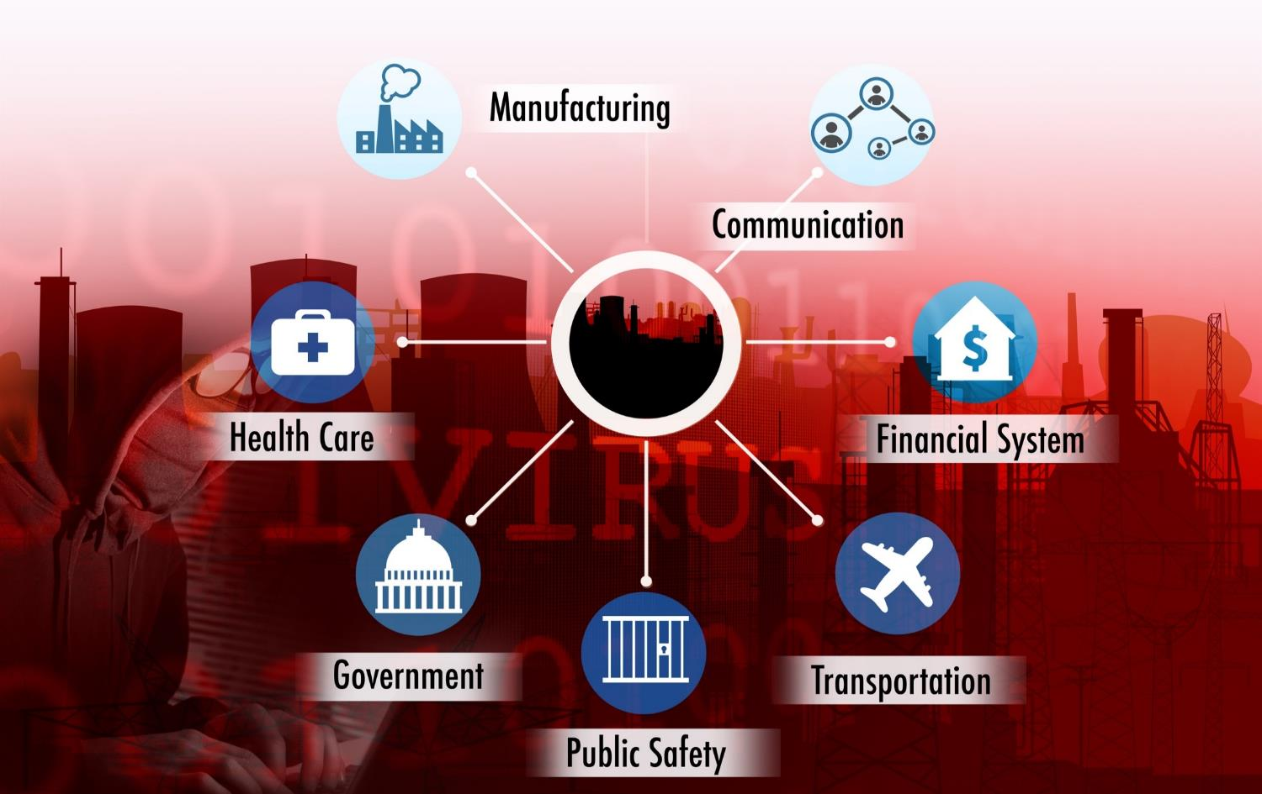
The ‘Internet of Things’ and ‘The Insurance-Net of Things’

Slide 106

The Insurance Industry’s Future Is in the Cloud…
Rail & Public
Transport
Aviation
The Cloud
Trucking & Fleet Vehicles
Marine Transport
Private Motor Vehicles

Slide 107


The Insurance Industry’s Future Is in the Cloud…
Human Beings
Rail & Public
Transport
Aviation
Trucking & Fleet Vehicles
The Cloud
Marine Transport
Private Motor Vehicles

Slide 108
Wearables and Beyond…
Where The Internet of Things
Meets Worker Comp
108

Slide 109




Wearables Show Significant Potential to Reduce Workplace Injury, Death
Wearables Today Can Monitor:
Location
Heart rate
Temperature
Steps/Exertion
Sweat
Sleep
In the Near Future Could Monitor:
Glucose level
Oxygen levels
Pain
Nausea
109
12/01/09 - 9pm
eSlide – P6466 – The Financial Crisis and the Future of the P/C
Notes:
109

Slide 110



Beyond Wearables: Ingestibles and Implantables, VR Could Have Big Impacts Too
Ingestibles:
Body chemistry
View malignancies
Detect diseases
Medication adherence
Implantables
Smart Fabrics
Virtual Reality
Computer simulated reality
Augmented Reality
Real world environment supplemented by computer generated inputs
110
12/01/09 - 9pm
eSlide – P6466 – The Financial Crisis and the Future of the P/C
Notes:
110

Slide 111
INSURANCE TECHNOLOGY:
FIN TECH ZEROES IN
Number and Value of Deals Is Increasing
In Search of the Elusive Insurance ‘Unicorn’
111

Slide 112
Insurance Technology Financing Trend: Change Is Coming
Insurance tech deals reached a new record in 2016:Q1
($ Millions)
Investment in insurance tech is rising
Source: CB Insights at https://www.cbinsights.com/blog/insurance-tech-overview-q1-2016/; Insurance Information Institute.

Slide 113
Insurance Tech Activity by Area of Interest, 2013 – 2016:Q1
With the ACA in the rear view window, non-health insurance tech accounts for the majority of investment
(Percent)
Silicon Valley and the Venture Capital community have the insurance industry in their sights. Most will fail. Some will succeed.
Source: CB Insights at https://www.cbinsights.com/blog/insurance-tech-overview-q1-2016/; Insurance Information Institute.

Slide 114
Insurance Information Institute Online:
www.iii.org
Thank you for your time and your attention!
Twitter: twitter.com/bob_hartwig
Download at www.iii.org/presentations

