Slide 1
Economic Forces Shaping the Workers Compensation Insurance Industry of Today and Tomorrow
Workers Compensation Educational Conference
Orlando, FL
August 25, 2015
Download at www.iii.org/presentations
Robert P. Hartwig, Ph.D., CPCU, President & Economist
Insurance Information Institute ♦ 110 William Street ♦ New York, NY 10038
Tel: 212.346.5520 ♦ Cell: 917.453.1885 ♦ bobh@iii.org ♦ www.iii.org

Slide 2
P/C Insurance Industry Financial Overview
Reasonably Strong Performance
Workers Comp Improvement Helped Too
2

Slide 3
P/C Industry Net Income After Taxes
1991–2015:Q1
2005 ROE*= 9.6%
2006 ROE = 12.7%
2007 ROE = 10.9%
2008 ROE = 0.1%
2009 ROE = 5.0%
2010 ROE = 6.6%
2011 ROAS¹ = 3.5%
2012 ROAS¹ = 5.9%
2013 ROAS¹ = 10.2%
2014 ROAS¹ = 8.4%
2015:Q1 ROAS = 10.8%
$ Millions
Net income fell modestly (-12.5%) in 2014 vs. 2013
ROE figures are GAAP; ¹Return on avg. surplus. Excluding Mortgage & Financial Guaranty insurers yields a 8.2% ROAS in 2014, 9.8% ROAS in 2013, 6.2% ROAS in 2012, 4.7% ROAS for 2011, 7.6% for 2010 and 7.4% for 2009.
Sources: A.M. Best, ISO; Insurance Information Institute

Slide 4
Profitability Peaks & Troughs in the P/C Insurance Industry, 1975 – 2015:Q1
ROE
1977:19.0%
History suggests next ROE peak will be in 2016-2017
1987:17.3%
10 Years
1997:11.6%
2006:12.7%
2015:Q1 10.8%
10 Years
2013 9.8%
9 Years
2014 8.2%
1975: 2.4%
1984: 1.8%
1992: 4.5%
2001: -1.2%
*Profitability = P/C insurer ROEs. 2011-14 figures are estimates based on ROAS data. Note: Data for 2008-2014 exclude mortgage and financial guaranty insurers.
Source: Insurance Information Institute; NAIC, ISO, A.M. Best, Conning

Slide 5
ROE: Property/Casualty Insurance by Major Event, 1987–2015:Q1
(Percent)
P/C Profitability Is Both by
Cyclicality and Ordinary Volatility
Modestly higher CATs
Katrina, Rita, Wilma
Low CATs
Sept. 11
Hugo
Lowest CAT Losses in
15 Years
4 Hurricanes
Sandy
Andrew
Record Tornado Losses
Northridge
Financial Crisis*
* Excludes Mortgage & Financial Guarantee in 2008 – 2014.
Sources: ISO, Fortune; Insurance Information Institute.

Slide 6
P/C Insurance Industry
Combined Ratio, 2001–2015:Q1*
Heavy Use of Reinsurance Lowered Net Losses
Relatively Low CAT Losses, Reserve Releases
Higher CAT Losses, Shrinking Reserve Releases, Toll of Soft Market
As Recently as 2001, Insurers Paid Out Nearly $1.16 for Every $1 in Earned Premiums
Relatively Low CAT Losses, Reserve Releases
Avg. CAT Losses, More Reserve Releases
Sandy Impacts
Best Combined Ratio Since 1949 (87.6)
Cyclical Deterioration
Lower CAT Losses
* Excludes Mortgage & Financial Guaranty insurers 2008--2014. Including M&FG, 2008=105.1, 2009=100.7, 2010=102.4, 2011=108.1; 2012:=103.2; 2013: = 96.1; 2014: = 97.0.
Sources: A.M. Best, ISO.

Slide 7
A 100 Combined Ratio Isn’t What It
Once Was: Investment Impact on ROEs
A combined ratio of about 100 generates an ROE of ~7.0% in 2012/13, ~7.5% ROE in 2009/10,
10% in 2005 and 16% in 1979
Combined Ratio / ROE
Lower CATs helped ROEs in 2013-15:Q1
Combined Ratios Must Be Lower in Today’s Depressed
Investment Environment to Generate Risk Appropriate ROEs
* 2008 -2014 figures are return on average surplus and exclude mortgage and financial guaranty insurers. 2014 combined ratio including M&FG insurers is 97.0; 2013 = 96.1; 2012 =103.2, 2011 = 108.1, ROAS = 3.5%.
Source: Insurance Information Institute from A.M. Best and ISO Verisk Analytics data.

Slide 8
Return on Net Worth (RNW) All Lines:
2004-2013 Average
Commercial lines have tended to be more profitable than personal lines over the past decade
Source: NAIC; Insurance Information Institute.

Slide 9
Underwriting Gain (Loss)
1975–2014*
Underwriting profit in 2014 totaled $12.3B
($ Billions)
Cumulative underwriting deficit from 1975 through 2013 was $493B
High cat losses in 2011 led to the highest underwriting loss since 2002
Large Underwriting Losses Are NOT Sustainable
in Current Investment Environment
* Includes mortgage and financial guaranty insurers in all years.
Sources: A.M. Best, ISO; Insurance Information Institute.

Slide 10
Policyholder Surplus,
2006:Q4–2015:Q1
($ Billions)
2007:Q3
Pre-Crisis Peak
Drop due to near-record 2011 CAT losses
Surplus as of 3/31/15 stood at a near-record high $671.7B
The industry now has $1 of surplus for every $0.73 of NPW,
close to the strongest claims-paying status in its history.
2010:Q1 data includes $22.5B of paid-in capital from a holding company parent for one insurer’s investment in a non-insurance business .
The P/C insurance industry entered 2015
in very strong financial condition.
Sources: ISO, A.M .Best.
10
12/01/09 - 9pm
eSlide – P6466 – The Financial Crisis and the Future of the P/C
Notes:
10

Slide 11
Commercial Lines NPW Premium Growth:
1975 – 2014E
ROE
Commercial lines is prone to more cyclical volatility that personal lines. Recently, growth has stabilized in the 4% to 5% range.
Economic Shocks, Inflation:
1976: 22.2%
Tort Crisis
1986: 30.5%
Post-9/11
2002: 22.4%
Post-Hurricane Andrew Bump:
1993: 6.3%
1988-2000: Period of inter-cycle stability
Post Katrina Bump:
2006: 7.7%
2014E 4.0%
2010-20XX? Post-recession period of stable growth?
Recessions:
1982: 1.1%
Great Recession:2009: -9.0%
Note: Data include state funds beginning in 1998.
Source: A.M. Best; Insurance Information Institute.

Slide 12
Direct Premiums Written: Comm. Lines
Percent Change by State, 2007-2014
Top 25 States
43 states showed commercial lines growth from 2007 through 2014
Growth Benchmarks: Commercial
US: 5.9%
Sources: SNL Financial LLC.; Insurance Information Institute.

Slide 13
Direct Premiums Written: Comm. Lines
Percent Change by State, 2007-2014
Bottom 25 States
Nearly half the states have yet to see commercial lines premium volume return to pre-crisis levels
States with the poorest performing economies also produced the most negative net change in premiums of the past 6 years
Sources: SNL Financial LLC.; Insurance Information Institute.

Slide 14
Direct Premiums Written: Workers’ Comp
Percent Change by State, 2007-2014*
Top 25 States
Only 21 states have seen works comp premium volume return to pre-crisis levels
*Excludes monopolistic fund states: ND, OH, WA, WY as well as WV, which transitioned to a competitive structure during this period.
Sources: SNL Financial LC.; Insurance Information Institute.

Slide 15
Direct Premiums Written: Worker’s Comp
Percent Change by State, 2007-2014*
Bottom 25 States
States with the poorest performing economies also produced some of the most negative net change in premiums of the past 7 years
*Excludes monopolistic fund states: ND, OH, WA, WY as well as WV, which transitioned to a competitive structure during this period.
Sources: SNL Financial LC.; Insurance Information Institute.

Slide 16
INVESTMENTS:
THE NEW REALITY
Investment Performance is a Key Driver of Profitability
Low Yields Have an Especially Large Influence on Profitability of Long-Tailed Lines Like WC
16

Slide 17
Property/Casualty Insurance Industry Investment Income: 2000–2015E¹
Investment earnings are still below their 2007 pre-crisis peak
($ Billions)
Due to persistently low interest rates,
investment income fell in 2012, 2013 and 2014.
¹ Investment gains consist primarily of interest and stock dividends. *2015 figure is estimated based on annualized data through Q1.
Sources: ISO; Insurance Information Institute.

Slide 18
U.S. Treasury Security Yields:
A Long Downward Trend, 1990–2015*
Yields on 10-Year U.S. Treasury Notes have been essentially below 5% for a full decade.
U.S. Treasury yields plunged to historic lows in 2013. Longer-term yields rebounded then sank fell again.
Since roughly 80% of P/C bond/cash investments are in 10-year or shorter durations, most P/C insurer portfolios will have low-yielding bonds for years to come.
*Monthly, constant maturity, nominal rates, through July 2015.
Sources: Federal Reserve Bank at http://www.federalreserve.gov/releases/h15/data.htm. National Bureau of Economic Research (recession dates); Insurance Information Institute.
18
12/01/09 - 9pm
eSlide – P6466 – The Financial Crisis and the Future of the P/C
Notes:
18

Slide 19
Book Yield on Property/Casualty Insurance Invested Assets, 2007–2015*
(Percent)
Book yield in 2015 is down 74 BP from pre-crisis levels
The yield on invested assets remains low relative to pre-crisis yields. The Fed’s plan to raise interest rates in late 2015 has already pushed up some yields, albeit quite modestly.
*2015 figure is the average of the four quarters ending in 2015:Q1.
Sources: SNL Financial; Insurance Information Institute

Slide 20
Reduction in Combined Ratio Necessary to Offset 1% Decline in Investment Yield to Maintain Constant ROE, by Line*
Lower Investment Earnings Place a Greater Burden on Underwriting and Pricing Discipline
*Based on 2008 Invested Assets and Earned Premiums
**US domestic reinsurance only
Source: A.M. Best; Insurance Information Institute.
20
12/01/09 - 9pm
eSlide – P6466 – The Financial Crisis and the Future of the P/C
Notes:
20
This shows the drop in Combined Ratio for each line of business that would be needed to maintain a constant ROE, given a 1-percentage-point drop in investment yield

Slide 21
S&P 500 Index Returns, 1950 – 2015*
Annual Return
Volatility is endemic to stock markets—and may be increasing—but there is no persistent downward trend over long periods of time
Fed Raises Rate
Tech Bubble Implosion
2015 YTD:
-8.1%
Energy Crisis
Financial Crisis
*Through August 24, 2015.
Source: NYU Stern School of Business: http://pages.stern.nyu.edu/~adamodar/New_Home_Page/datafile/histretSP.html Ins. Info. Inst.

Slide 22
Property/Casualty Insurance Industry Investment Gain: 1994–2015:Q1¹
($ Billions)
Investment gains in 2014 will rival the post-crisis high reached in 2013
Total Investment Gains Were Down Slightly in 2014 as Low Interest Rates Pressured Investment Income but Realized Capital Gains Remained Robust
¹ Investment gains consist primarily of interest, stock dividends and realized capital gains and losses.
* 2005 figure includes special one-time dividend of $3.2B; 2015 figure is through Q1 2015.
Sources: ISO; Insurance Information Institute.

Slide 23
2015
Non-Financial Challenges and Criticisms of Workers Comp
A Number of Issues Have Stirred Interest in Workers Compensation in 2015
23

Slide 24
Challenges Raised in the Workers Comp Line
Opt Out Legislation: Coalition of large employers is aggressively pushing for legislation that would allow them to forego purchasing WC coverage in favor of creating their own programs while also seeking to specify the criteria for claiming and the size of benefits
  Allowed in TX for many years and passed in OK in 2014
  Failed in TN in 2015; Lobbying in AL, FL, GA, NC, SC
Challenges to Exclusive Remedy: Assertion that after reforms in several states the WC “Grand Bargain” has been breached and that benefits are now insufficient
  Objective of trial lawyers is to tap into the tort system
ProPublica/NPR Attack Series: “The Demolition of Workers Comp” (Published in March 2015)

Slide 25
Labor Markets Trends:
Recovery Continues in 2015
In 2014…
Largest Increase in Jobs Since 1997
Unemployment Rate Fell to Lowest Level Since 2008
Payrolls Expanded to Record High
25

Slide 26
Unemployment and Underemployment Rates: Still Too High, But Falling
January 2000 through July 2015, Seasonally Adjusted (%)
U-6 soared from 8.0% in March 2007 to 17.5% in
October 2009; Stood at 10.4% in June 2015.
8% to 10% is “normal.”
“Headline” unemployment was 5.3% in July 2015. 4.5% to 5.5% is “normal.”
Stubbornly high unemployment and underemployment constrain overall economic growth, but the job market is continuing to improve.
Source: US Bureau of Labor Statistics; Insurance Information Institute.
26
12/01/09 - 9pm
eSlide – P6466 – The Financial Crisis and the Future of the P/C
Notes:
26

Slide 27
Monthly Change in Private Employment
3,042,000 jobs were created in 2014, the most since 1997
January 2007 through July 2015 (000s, Seasonally Adj.)
Jobs Created
2014: 3.042 Mill
2013: 2.452 Mill
2012: 2.315 Mill
2011: 2.396 Mill
2010: 1.282 Mill
210,000 private sector jobs were created in July.
Monthly losses in Dec. 08–Mar. 09 were the largest in the
post-WW II period
Private Employers Added 12.84 Million Jobs Since Jan. 2010 After Having Shed 5.01 Million Jobs in 2009 and 3.76 Million in 2008 (State and Local Governments Have Shed Hundreds of Thousands of Jobs)
Source: US Bureau of Labor Statistics: http://www.bls.gov/ces/home.htm; Insurance Information Institute

Slide 28
US Unemployment Rate Forecast
Rising unemployment
eroded payrolls
and WC’s
exposure base.
Unemployment peaked at 10% in late 2009.
2007:Q1 to 2016:Q4F*
Jobless figures have been revised downwards for 2015/16
Unemployment forecasts have been revised modestly downwards. Optimistic scenarios put the unemployment as low as 5.0% by Q4 of 2015.
* = actual; = forecasts
Sources: US Bureau of Labor Statistics; Blue Chip Economic Indicators (8/15 edition); Insurance Information Institute.

Slide 29
Unemployment Rates by State, June 2015:
Highest 25 States*
In June, 21 states and the District of Columbia had over-the-month unemployment rate decreases, 12 states had increases, and 17 states had no change.
*Provisional figures for June 2015, seasonally adjusted.
Sources: US Bureau of Labor Statistics; Insurance Information Institute.

Slide 30
Unemployment Rates by State, June 2015:
Lowest 25 States*
In June, 21 states and the District of Columbia had over-the-month unemployment rate decreases, 12 states had increases, and 17 states had no change.
*Provisional figures for June 2015, seasonally adjusted.
Sources: US Bureau of Labor Statistics; Insurance Information Institute.

Slide 31
POSITIVE LABOR MARKET DEVELOPMENTS
Key Factors Driving Workers Compensation Exposure
31

Slide 32
Average Weekly Hours of All Private Workers, Mar. 2006—April 2015
(Hours Worked)
Hours worked plunged during the recession, impacting payroll exposures
Hours worked totaled 34.5 per week in April, just shy of the 34.6 hours typically worked before the “Great Recession”
*Seasonally adjusted
Note: Recessions indicated by gray shaded columns.
Sources: US Bureau of Labor Statistics at http://www.bls.gov/data/#employment; National Bureau of Economic Research (recession dates); Insurance Information Institute.
32
12/01/09 - 9pm
eSlide – P6466 – The Financial Crisis and the Future of the P/C
Notes:
32

Slide 33
Average Hourly Wage of All Private Workers, Mar. 2006—April 2015
(Hourly Wage)
The average hourly wage was $24.87 in April 2015, up 17.2% from $21.22 when the recession began in Dec. 2007
Wage gains continued during the recession, despite massive job losses
*Seasonally adjusted
Note: Recessions indicated by gray shaded columns.
Sources: US Bureau of Labor Statistics at http://www.bls.gov/data/#employment; National Bureau of Economic Research (recession dates); Insurance Information Institute.
33
12/01/09 - 9pm
eSlide – P6466 – The Financial Crisis and the Future of the P/C
Notes:
33

Slide 34
ADVERSE LONG-TERM
LABOR MARKET DEVELOPMENTS
Key Factors Harming Workers Compensation Exposure and the Overall Economy
34

Slide 35
Labor Force Participation Rate,
Jan. 2002—April 2015*
Labor Force Participation as a % of Population
Labor force participation continues to shrink despite a falling unemployment rate
Large numbers of people are exiting (or not returning to the labor force)
*Defined as the percentage of working age persons in the population who are employed or actively seeking work.
Note: Recessions indicated by gray shaded columns.
Sources: US Bureau of Labor Statistics at http://www.bls.gov/data/; National Bureau of Economic Research (recession dates); Insurance Information Institute.
35
12/01/09 - 9pm
eSlide – P6466 – The Financial Crisis and the Future of the P/C
Notes:
35

Slide 36
Number of “Discouraged Workers,”
Jan. 2002—April 2015
Thousands
“Discouraged Workers” are people who have searched for work for so long in vain that they actually stop searching and drop out of the labor force
Large numbers of people are exiting (or not returning to) the labor force
There were 756,000 discouraged workers in March 2015
In recent good times, the number of discouraged workers ranged from 200,000-400,000 (1995-2000) or from 300,000-500,000 (2002-2007).
Notes: Recessions indicated by gray shaded columns. Data are seasonally adjusted.
Sources: Bureau of Labor Statistics http://www.bls.gov/news.release/empsit.a.htm ; NBER (recession dates); Ins. Info. Inst.
36
12/01/09 - 9pm
eSlide – P6466 – The Financial Crisis and the Future of the P/C
Notes:
36

Slide 37
CONSTRUCTION INDUSTRY OVERVIEW & OUTLOOK
The Construction Sector Is Critical to the Economy and the P/C Insurance Industry
37

Slide 38
Value of New Private Construction: Residential & Nonresidential, 2003-2015*
2015: Value of new pvt. construction hits $766.4B as of June 2015, up 53.1% from the 2010 trough but still 17.5% below 2006 peak
New Construction peaks at $911.8. in 2006
Billions of Dollars
Trough in 2010 at $500.6B, after plunging 55.1% ($411.2B)
$15.0
$613.7
$394.8
$298.1
$261.8
$371.6
$238.8
Private Construction Activity Is Moving in a Positive Direction though Remains Well Below Pre-Crisis Peak; Residential Dominates
*2015 figure is a seasonally adjusted annual rate as of June.
Sources: US Department of Commerce http://www.census.gov/construction/c30/c30index.html ; Insurance Information Institute.
38
12/01/09 - 9pm
eSlide – P6466 – The Financial Crisis and the Future of the P/C
Notes:
38

Slide 39
Value of Construction Put in Place, June 2015 vs. June 2014*
Growth (%)
Private: +13.7%
Public: +8.0%
Public sector construction activity is finally beginning to create less drag up after years of decline
Private sector construction activity is up in both the residential and nonresidential segments
Overall Construction Activity is Up Again After Languishing in Early 2015; State/Local Sector Government Sector May Be Recovering as Budget Woes Ease in Some Jurisdictions
*seasonally adjusted
Source: U.S. Census Bureau, http://www.census.gov/construction/c30/c30index.html ; Insurance Information Institute.

Slide 40
Value of Private Construction Put in Place, by Segment, June 2015 vs. June 2014*
Growth (%)
Led by the Manufacturing, Lodging, Office and Amusement & Recreations segments, Private nonresidential sector construction activity continues to rise after plunging during the “Great Recession.”
Private Construction Activity is Up in Most Segments, though the Key Residential Construction Sector Weakened in Late 2014/Early 2015; Mixed Outlook for 2015, though Expansion Should Continue
*seasonally adjusted
Source: U.S. Census Bureau, http://www.census.gov/construction/c30/c30index.html ; Insurance Information Institute.

Slide 41
Value of Public Construction Put in Place, by Segment, June 2015 vs. June 2014*
Public sector construction activity finally up in most segments after many months of decline, pushing up public entity risk exposures
Residential, Amusement & Recreation and Highway & Street projects lead public sector construction
Growth (%)
Public Construction Activity is Beginning to Recover from its Long Contraction which Will Drive Demand in Many Commercial Insurance Lines
*seasonally adjusted
Source: U.S. Census Bureau, http://www.census.gov/construction/c30/c30index.html ; Insurance Information Institute.

Slide 42
Value of New Federal, State and Local Government Construction: 2003-2015*
Construction across all levels of government peaked at $314.9B in 2009
Austerity Reigns
Govt. construction MAY finally be turning around; still down $16.7B or 5.3% since 2009 peak
($ Billions)
Government Construction Spending Peaked in 2009, Helped by Stimulus Spending, but Contracted As State/Local Governments Grappled with Deficits and Federal Sequestration; Only Now Recovering
*2015 figure is a seasonally adjusted annual rate as of June; http://www.census.gov/construction/c30/historical_data.html
Sources: US Department of Commerce; Insurance Information Institute.

Slide 43
New Private Housing Starts, 1990-2021F
Job growth, low inventories of existing homes, low mortgage rates and demographics should continue to stimulate new home construction for several more years
(Millions of Units)
New home starts plunged 72% from 2005-2009; A net annual decline of 1.49 million units, lowest since records began in 1959
Insurers Are Continue to See Meaningful Exposure Growth in the Wake of the “Great Recession” Associated with Home Construction: Construction Risk Exposure, Surety, Commercial Auto; Potent Driver of Workers Comp Exposure
Source: U.S. Department of Commerce; Blue Chip Economic Indicators (8/15); Insurance Information Institute.

Slide 44
U.S.: Pct. Of Private Housing Unit Starts
In Multi-Unit Projects, 1990-2015
Units in Multiple-Unit Projects
as Percent of Total
A NEW NORMAL?
In 5 of the last 7 years, over 30% of housing unit starts were in 5+-unit projects
For the U.S. as a whole, the trend toward multi-unit housing projects (vs. single-unit homes) is recent. Commercial insurers with Workers Comp, Construction risk exposure, and Surety benefit.
*January through April 2015; April is preliminary; calculations based on seasonally adjusted at annual rates
Sources: U.S. Census Bureau, New Residential Construction in April 2015 and earlier releases; next release June 16, 2015; Insurance Information Institute calculations.

Slide 45
Rental-Occupied Housing Units as % of Total Occupied Units, Quarterly, 1990:Q1-2015:Q1
Trend down began in 1994:Q3 from 36.2% in Q2
Increasing percent of renters
Increasing percent of owners
Latest was 36.3% in 2015:Q1
Trough in 2004:Q2 and Q4 at 30.8%
Since the Great Recession ended in June 2009, renters occupied 5.7 million more units (+15.6%).
Sources: US Census Bureau, Residential Vacancies & Home Ownership in the First Quarter of 2015 (released April 28, 2015) and earlier issues; Insurance Information Institute. Next Census Bureau report to be released on July 28, 2015.
45
12/01/09 - 9pm
eSlide – P6466 – The Financial Crisis and the Future of the P/C
Notes:
45

Slide 46
Rental Vacancy Rates, Quarterly,
1990:Q1-2015:Q1
Percent vacant
Peak vacancy rate 11.1% in 2009:Q3
Latest vacancy rate was 7.1% in 2015:Q1
Vacancy rate 10.4% in 2004:Q1
Before the 2001 recession, rental vacancy rates were 8% or less.
We’re below those levels now. => More multi-unit construction?
Sources: US Census Bureau, Residential Vacancies & Home Ownership in the First Quarter of 2015 (released April 28, 2015) and earlier issues; Insurance Information Institute. Next Census Bureau report to be released on July 28, 2015.
46
12/01/09 - 9pm
eSlide – P6466 – The Financial Crisis and the Future of the P/C
Notes:
46

Slide 47
Construction Employment,
Jan. 2010—July 2015*
(Thousands)
Construction employment is +948,000 above
Jan. 2011 (+17.4%) trough
Construction and manufacturing employment constitute 1/3 of all WC payroll exposure.
*Seasonally adjusted.
Sources: US Bureau of Labor Statistics at http://data.bls.gov; Insurance Information Institute.
47
12/01/09 - 9pm
eSlide – P6466 – The Financial Crisis and the Future of the P/C
Notes:
47

Slide 48
Construction Employment,
Jan. 2003–July 2015
(Thousands)
Construction employment as of July 2015 totaled 6.383 million, an increase of 948,000 jobs or 17.4% from the Jan. 2011 trough
Construction employment peaked at 7.726 million in April 2006
Gap between pre-recession construction peak and today: 1.34 million jobs
The “Great Recession” and housing bust destroyed 2.3 million constructions jobs
Construction employment troughed at 5.435 million in Jan. 2011, after a loss of 2.291 million jobs, a 29.7% plunge from the April 2006 peak
The Construction Sector Was a Growth Leader in 2014 as the Housing Market, Private Investment and Govt. Spending Recover. WC Insurers Will Benefit.
Note: Recession indicated by gray shaded column.
Sources: U.S. Bureau of Labor Statistics; Insurance Information Institute.
48
12/01/09 - 9pm
eSlide – P6466 – The Financial Crisis and the Future of the P/C
Notes:
48

Slide 49
ENERGY SECTOR
America’s Energy Boom Has Been a Strong Driver of the Economic Recovery, but Prices Are Falling
Workers Comp Has Benefited from the Energy Boom, But Exposures Will Suffer as Energy Prices Swoon
49

Slide 50
U.S. Crude Oil Production, 2005-2016P
Millions of Barrels per Day
Crude oil production in the U.S. is expected to increase by 90.6% from 2008 through 2016—and could overtake Saudi Arabia as the world’s largest oil producer
Source: Energy Information Administration, Short-Term Energy Outlook (January 15, 2015) , Insurance Information Institute.

Slide 51
U.S. Natural Gas Production, 2000-2013
Trillions of Cubic Ft. per Year
The U.S. is already the world’s largest natural gas producer—recently overtaking Russia. This is a potent driver of commercial insurance exposures
Source: Energy Information Administration, Short-Term Energy Outlook (April 8, 2014) , Insurance Information Institute.

Slide 52
Employment in Oil & Gas Extraction,
Jan. 2010—July 2015*
(000)
Oil and gas extraction employment was up 28.8% by Oct. 2014 but falling energy prices have taken their toll
Employment in the O&G segment is down 3.8% since its Oct. 2014 peak
*Seasonally adjusted
Sources: US Bureau of Labor Statistics at http://data.bls.gov; Insurance Information Institute.
52
12/01/09 - 9pm
eSlide – P6466 – The Financial Crisis and the Future of the P/C
Notes:
52

Slide 53
MANUFACTURING SECTOR
A Potent Driver of Jobs, Workers Comp Payroll Exposure
America’s Manufacturing Renaissance Has Hit a Rough Patch with the High Dollar/Chinese Devaluation, Weak Export Markets
53

Slide 54
ISM Manufacturing Index
(Values > 50 Indicate Expansion)
January 2010 through April 2015
Manufacturing continues to expand in 2015
The manufacturing sector expanded for 62 of the 64 months from Jan. 2010 through Apr. 2015. Pace of recovery has been uneven due to economic turbulence in the U.S., Europe and China and the high dollar.
Source: Institute for Supply Management at http://www.ism.ws/ismreport/mfgrob.cfm; Insurance Information Institute.

Slide 55
Manufacturing Growth for Selected Sectors, 2015 vs. 2014*
Growth (%)
Durables: +3.0%
Non-Durables: -9.7%
Manufacturing of durable goods is stronger than nondurables in 2015
Impact of falling energy prices
Manufacturing Is Expanding in Many Sectors But Declining Energy Prices Are Dragging Down Industry Figures. Continued Gortwh Across a Number of Sectors that Will Contribute to Growth in Insurable Exposures Including: WC, Commercial Property, Commercial Auto and Many Liability Coverages
*Seasonally adjusted; Date are YTD comparing data through February 2015 to the same period in 2014.
Source: U.S. Census Bureau, Full Report on Manufacturers’ Shipments, Inventories, and Orders, http://www.census.gov/manufacturing/m3/

Slide 56
Auto/Light Truck Sales, 1999-2021F
Job growth and improved credit market conditions will boost auto sales in 2014 and beyond
Sales have returned to pre-crisis levels
(Millions of Units)
New auto/light truck sales fell to the lowest level since the late 1960s. Forecast for 2014-15 is still below 1999-2007 average of 17 million units, but a robust recovery is well underway.
Truck, SUV purchases by contractors are especially strong
Yearly car/light truck sales will likely continue at current levels, in part replacing cars that were held onto in 2008-12. New vehicles will generate more physical damage insurance coverage but will be more expensive to repair. PP Auto premium might grow by 5% - 6%.
Source: U.S. Department of Commerce; Blue Chip Economic Indicators (8/15 and 3/15); Insurance Information Institute.

Slide 57
Manufacturing Employment,
Jan. 2010—July 2015*
(Thousands)
Since Jan 2010, manufacturing employment is up (+890,000 or +7.8%)
and still growing.
Manufacturing employment is a surprising source of strength in the economy. Employment in the sector is at a multi-year high.
*Seasonally adjusted.
Sources: US Bureau of Labor Statistics at http://data.bls.gov; Insurance Information Institute.
57
12/01/09 - 9pm
eSlide – P6466 – The Financial Crisis and the Future of the P/C
Notes:
57

Slide 58
The “On-Demand” (Sharing) Economy
The On-Demand Economy Will Transform the American Workforce and the P/C Insurance Industry Too
58

Slide 59



Labor on Demand: Huge Implications for the US Economy, Workers & Insurers
Will YOUR job be reduced to an app?

Slide 60



The “On-Demand” World is Not New…
Companies like Angie’s List (established in 1995 and going online in 1999) have been around for decades
The Geek Squad has been around since 1994…
Peapod sprouted way back in 1989!
Source: Insurance Information Institute.

Slide 61



…But the “On-Demand” World is Exploding as Is the Demand for “On-Tap” Workers
Need something done around the house…Click on Handy
Hate doing laundry? Washio will do it for you…
Hate doing just about everything? Taskrabbit will take on virtually all your “tasks”…
Source: Insurance Information Institute.

Slide 62




You Can Live Your Life with the Swipe of a Finger…
Get married…
…Move
…And if it doesn’t work out…

Slide 63



Some Players in the On-Demand Economy
Have Become Household Names
Rent a place…
…Need a Lyft?
…This ride has taken Wall Street to the stratosphere

Slide 64


On-Demand/Sharing/Peer-to-Peer Economy Impacts Many Lines of Insurance
The “On-Demand” Economy is or will impact many segments of the economy important to P/C insurers
  Auto (personal and commercial)
  Homeowners/Renters
  Many Liability Coverages
  Professional Liability
  Workers Comp
Many unanswered insurance questions
Insurance solutions are increasingly available to fill the many insurance gaps that arise
64
12/01/09 - 9pm
eSlide – P6466 – The Financial Crisis and the Future of the P/C
Notes:
64

Slide 65
Technology and Employment
What Makes the On-Demand Economy Possible?
Why Does It Matter for Insurers?
65

Slide 66
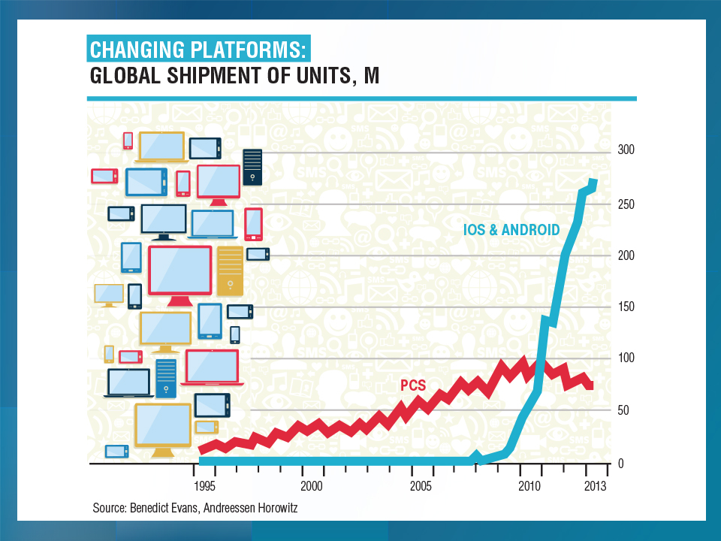
GLOBAL SHIPMENTS OF SMARTPHONES (MILLIONS)
Smartphones are the breakthrough technology behind the on-demand economy
2015: ~50% of adults globally have a smartphone
2020: About 80% will own one

Slide 67
Growth in Temporary Workers vs.
All Nonfarm Employment, 2010-2015*
Annual Percent Change
Demand for temporary workers has increased 2 to 3 times faster than for workers overall in recent years
*Through March 2015.
Source: US Bureau of Labor Statistics , Insurance Information Institute.

Slide 68
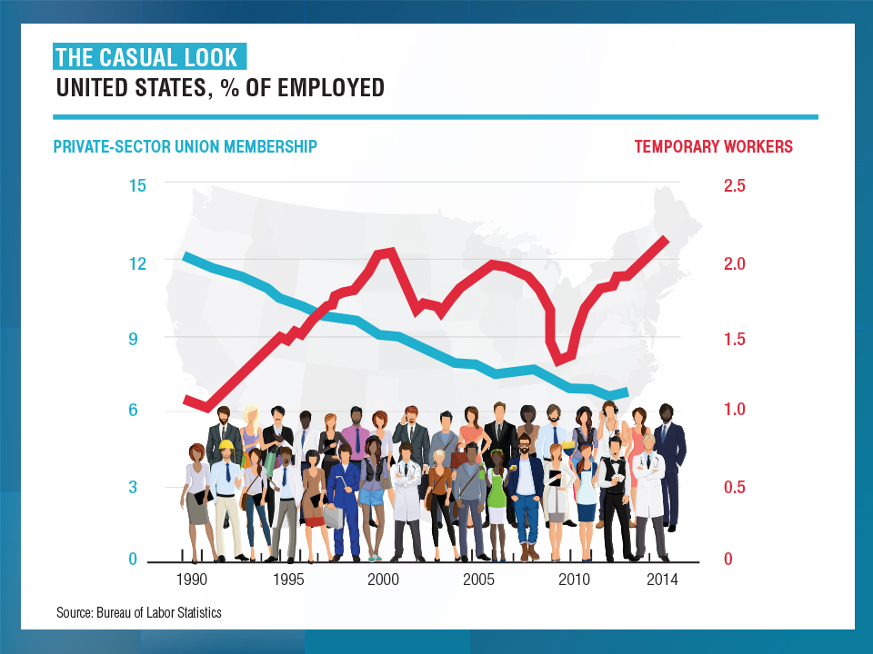

Slide 69
The On-Demand Economy and American Workers: What Is Happening?
Technology is Fundamentally Transforming How Resources are Allocated and Used in the Economy
Labor is No Exception to this Transformation
Technology Offers New Opportunities to Match Labor to Jobs
  Owners of spare capacity (workers with time and skill) can be paired at low cost with those with a demand for that time and skill
  Bringing together labor and those who employ labor is not new
  BUT: Pairing occurs with a speed and breadth never before possible
Witnessing the Demise of the Traditional Understanding of What is Meant by a “Good” Job
  Concept born in the Industrial Age (1880-1980), is eroding
  Disintermediation of the firm as the place where labor, jobs matched
Accelerating Trends that Started with Labor Strife, Globalization and Automation that Began in the 1970s and 1980s
69
12/01/09 - 9pm
eSlide – P6466 – The Financial Crisis and the Future of the P/C
Notes:
69

Slide 70
What’s In Store for the American Worker, Labor Force and Workers Comp
THE NEW AMERICAN WORKER: Two Schools of Thought
OPTIMISTIC OUTLOOK
  Technology frees workers from the bonds of centralized, hierarchical institutions (the firm)
  Enhanced coordination of “haves” with “needs” that bypass firms as intermediaries
Who Benefits?
  “Flexers”: People who value or require flexibility in work arrangements (stay-at-home parents, retirees, students, disabled)
  Professionals: People with portable skills that can be offered through online platforms (semi and high-skilled trades, professional services)
  Unemployed/Underemployed: Offers at least some opportunity to offer and utilize skills and generate income
Sources: Wall Street Journal; The Economist; Insurance Information Institute research.
70
12/01/09 - 9pm
eSlide – P6466 – The Financial Crisis and the Future of the P/C
Notes:
70

Slide 71
What’s In Store for the American Worker, Labor Force and Workers Comp
PESSIMISTIC OUTLOOK
  On-Demand companies are software-driven marketplaces and position themselves as “platforms” rather than “employers”
  Enormous valuations (e.g., $40B for Uber on $2B in earnings) reflect the extraction of resources that otherwise would go to benefits, investments in safety, training, etc.
    Uber’s valuation was greater than that of 72% of the S&P500 at YE 2014
    Valued more than Delta Airlines, Kraft Foods, CBS, Macy’s, Hilton, Aflac…
  Jobs reduced to freelanced, temporary “gigs”
  Low skill workers and those who lack flexibility are left further behind
  Workers treated as independent contractors without intrinsic or basic economic rights
What Is Potentially Lost or Compromised?
  Stability, Retirement Benefits, Sick Pay, Maternity Leave, Overtime
  Health Insurance, Liability Coverage, Workers Comp Coverage
Sources: Wall Street Journal; The Economist; Fortune; Insurance Information Institute research.
71
12/01/09 - 9pm
eSlide – P6466 – The Financial Crisis and the Future of the P/C
Notes:
71

Slide 72
Potential Consequences for Insurers
On-Demand Platforms Have Struggled with Concepts of Liability
There Has Been a General Resistance to Assuming Liability or Responsibility Unless Compelled to Do So
Companies Have Sought to Keep as Much Liability as Possible on the Individual Offering their (Contracted) Labor or Resources
Minding the Gap
  Traditional insurance will often not cover a worker engaged in offering labor or resources through these platforms
  E.g., Auto ins. generally won’t cover you if you while driving for Uber
  Home ins. won’t cover for other than occasional rentals of property
  Unless self-procured, on-demand worker (independent contactors) will generally have no workers comp recourse if injured on the job
Long Legislative and Court Battles Lie Ahead
Insurance Solutions Becoming More Common
72
12/01/09 - 9pm
eSlide – P6466 – The Financial Crisis and the Future of the P/C
Notes:
72

Slide 73
On-Demand Workers
Who Are They?
And Who’s Driving Demand for Them?
73

Slide 74
Percent of People Who Have Engaged in an “On Demand/Sharing Economy” Transaction
Percent
The majority of the US population has yet to engage in the “On Demand” economy
About 19% of the US population has engaged in an “On Demand/Sharing Economy” Transaction
Sources: PwC survey of 1,000 adults in the U.S., conducted online, December 2014; Insurance Information Institute.

Slide 75
Age of People Who are Providing the Sharing/On-Demand Economy
Being a provider of services in the Sharing/On-Demand Economy is attractive to workers in the 25-44 age range (who want flexibility in raising families) as well as seniors age 65+ who see the offering their services on-demand as a way to augment retirement income
About 7% of US population are providers in the Sharing Economy, cutting across age and incomes; 51% of those familiar with the concept could see them selves as providers within the next two years.
Sources: PwC survey of 1,000 adults in the U.S., conducted online, December 2014; Insurance Information Institute.

Slide 76
Household Income: Providers of the Sharing/On-Demand Economy
Being a provider of services in the Sharing/On-Demand Economy is particularly attractive to workers with household incomes under $50,000
About 7% of US population are providers in the Sharing Economy, cutting across age and incomes; 51% of those familiar with the concept could see them selves as providers within the next two years.
Sources: PwC survey of 1,000 adults in the U.S., conducted online, December 2014; Insurance Information Institute.

Slide 77
The On-Demand Economy and
Wall Street
Wall Street Loves the On-Demand Economy
Labor Markets, Insurance Markets Will Be Impacted
77

Slide 78
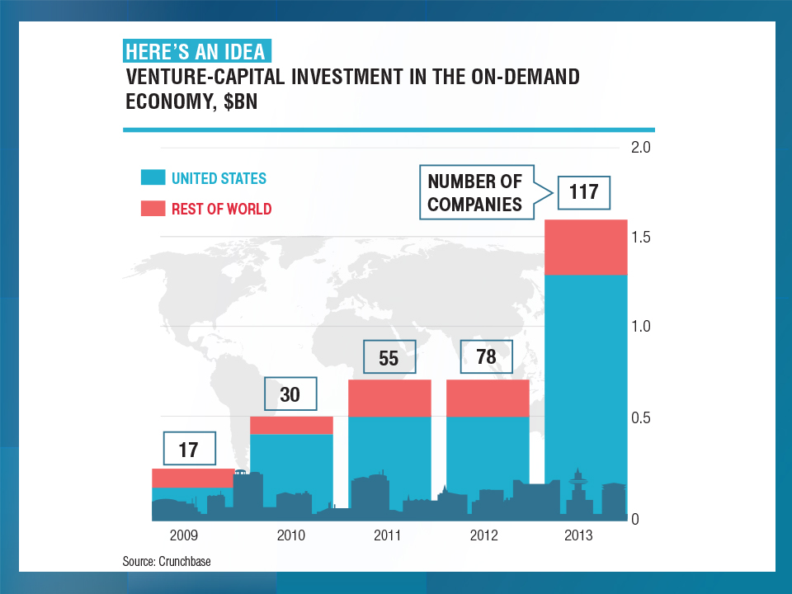

Slide 79
An UBER Case Study
Uber is the Best Known of the
On-Demand Companies
Wall Street Loves Uber
Vested Interests Hate Uber
79

Slide 80
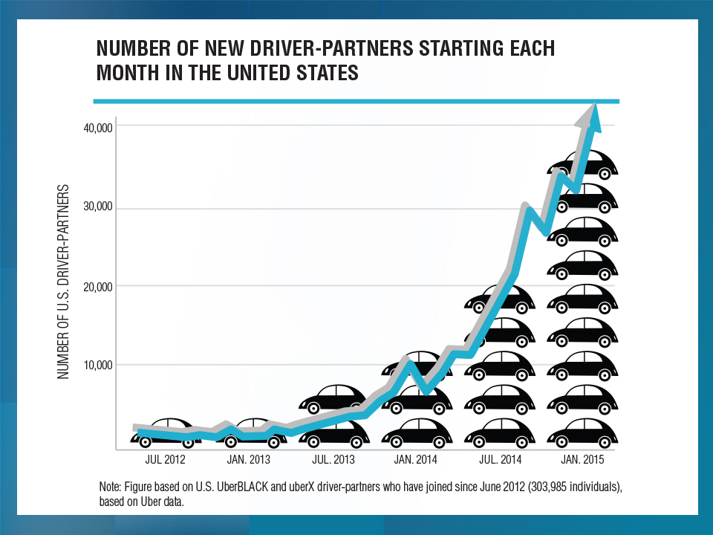
Uber says drivers are independent contractors. State of California says they’re employees. Big impacts for several lines of insurance including WC!

Slide 81
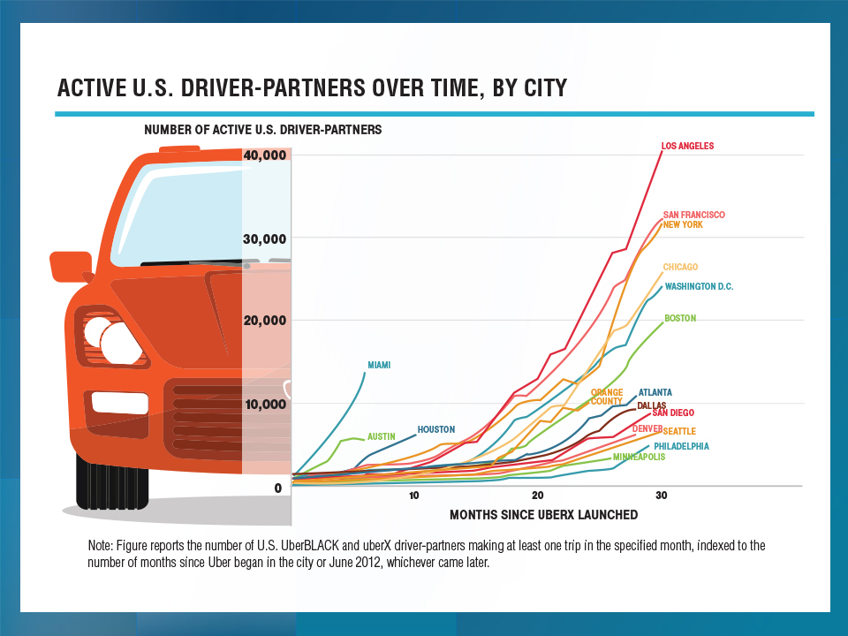

Slide 82
Looking Ahead:
Disruptive Forces Rule
Technology’s Impacts on the Economy, the Workforce and the Insurance Industry Will Be Significant
82

Slide 83
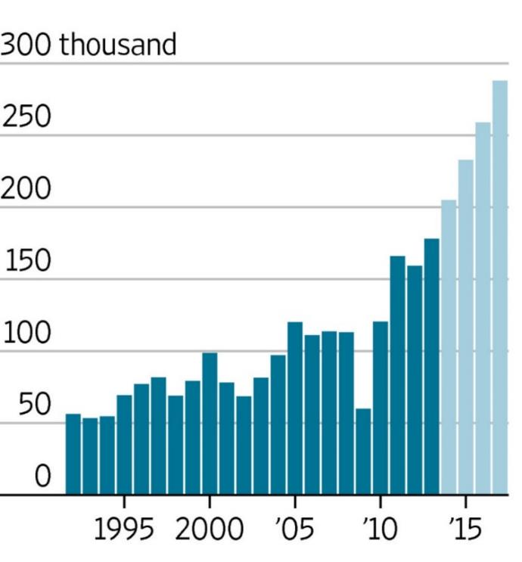
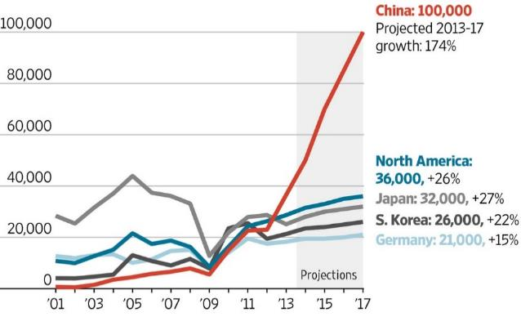
Worldwide Industrial Robot Installations,
1992-2017F
Worldwide installations of industrial robots exceeded 200,000 in 2014—a new record and will approach 300,000 by 2017
36,000 installations are expected in North America by 2017
*Estimate.
Sources: Outlook on World Robotics 2014, International Federation of Robotics; Insurance Information Institute.

Slide 84
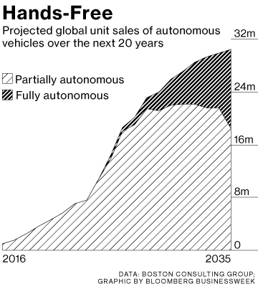
Future Shock: Many More Transformative Technologies Are Around the Corner
By 2035, it is estimated that 25% of new vehicle sales could be fully autonomous models (more than 4 million people work in transportation occupations today)
Up Next
Driverless cars
Driverless trucks, trains, planes and ships
Wearable devices
Implantable devices
Artificial intelligence
Advanced robotics
Source: Boston Consulting Group.

Slide 85
Insurance Information Institute Online:
www.iii.org
Thank you for your time
and your attention!
Twitter: twitter.com/bob_hartwig
Download at www.iii.org/presentations

