Slide 1
Property/Casualty 2017:
An Overview of the Industry
Western States Surplus Lines Conference
Las Vegas, NV
June 12, 2017
James Lynch, Chief Actuary
Insurance Information Institute  110 William Street  New York, NY 10038
212.346.5533  jamesl@iii.org  www.iii.org
Notes:
Introduction

Slide 2
The P/C Insurance Industry:
Financial Update & Outlook
Higher Cats Create Slight U/W Loss

Slide 3
P/C Industry Net Income After Taxes*
1997-2016
The median profit for this 20-year period is about $40 billion.
$ Millions, 2016 dollars
*adjusted for inflation using the BLS CPI calculator, to 2016 dollars
Sources: A.M. Best; ISO, a Verisk Analytics company; Insurance Information Institute.

Slide 4
Policyholder Surplus, Quarterly,
2006:Q4–2016:Q4
Surplus as of 12/31/16 stood at $700.9B
($ Billions)
2007:Q3
Pre-Crisis Peak
Drop due to near- record 2011 CAT losses
Surplus grew by 4.0% over 12/31/2015
The industry now has $1 of surplus for every $0.75 of NPW,
the strongest claims-paying status in its history.
2010:Q1 data includes $22.5B of paid-in capital from a holding company parent for one insurer’s investment in a non-insurance business.
The P/C insurance industry entered 2017
in very strong financial condition.
Sources: ISO, A.M .Best.
4
12/01/09 - 9pm
eSlide – P6466 – The Financial Crisis and the Future of the P/C
Notes:
4

Slide 5
Net Premium Growth (All P/C Lines):
Annual Change, 2007-2016
Premium Growth Has Followed Economic Growth, Inflation.
SOURCES: A.M. Best (2007-2013), ISO (2014-16), Federal Reserve Bank of St. Louis (FRED), Insurance Information Institute.

Slide 6
Commercial & Personal Lines NPW Growth:
1996-2016
5.7%
-1.3%
Commercial Lines is Prone to
Much More Cyclical Volatility Than Personal Lines.
Note: Data include state funds beginning in 1998.
Sources: A.M. Best; Insurance Information Institute.

Slide 7
Investments
Investment Performance is a
Key Driver of Profitability
Depressed Yields Will Necessarily Influence Underwriting & Pricing

Slide 8
P/C Insurer Portfolio Yields,
2002-2016
(Yield on Invested Assets)
P/C Carrier Yields Have Been Falling for Over a Decade, Reflecting the Long Downtrend in Prevailing Interest Rates.
Sources: NAIC data, sourced from S&P Global Market Intelligence; ISO, a Verisk Analytics company; Insurance Information Institute.

Slide 9
10-Year Treasury Forecast
Yield (%)
On June 10 the yield was 2.18%.
Virtually all of the 53 forecasts in the Blue Chip survey expect
continual increases in the yield of long-term bonds in 2017-18.
Sources: Blue Chip Economic Indicators (6/10); CNBC.com (June 10 yield); Insurance Information Institute.

Slide 10
New Money vs. Embedded Yields,
U.S. Insurers, 1985-2016
Falling yields means less investment income, putting upward pressure on rates.
As long as new money rates are below the rates of maturing bonds,
the portfolio yield will continue to sink.
p: Preliminary
Sources: NCCI, ISO, a Verisk Analytics company, U.S. Treasury (5-year note as proxy for new money yield for 2016);
Insurance Information Institute.
10
12/01/09 - 9pm
eSlide – P6466 – The Financial Crisis and the Future of the P/C
Notes:
10

Slide 11
Underwriting Performance

Slide 12
P/C Insurance Industry
Combined Ratio, 2001-2016*
3 Consecutive Years of U/W Profits; 1st time since 1971-73
Heavy Use of Reinsurance Lowered Net Losses.
Higher CAT Losses, Shrinking Reserve Releases, Toll of Soft Market
A return to more usual underwriting loss.
Best Combined Ratio Since 1949 (87.6)
Sandy
*Excludes Mortgage & Financial Guaranty insurers 2008-2014.
Including M&FG, 2008=105.1, 2009=100.7, 2010=102.4, 2011=108.1; 2012:=103.2; 2013: = 96.1; 2014: = 97.0.
Sources: A.M. Best; ISO, a Verisk Analytics company; I.I.I.

Slide 13
U.S. Insured Catastrophe Losses, 1989-2016
($ billions, 2016 dollars)
2013/14/15 Were Welcome Respites from 2011/12, Which Were
Among the Costliest Years for Insured Disaster Losses in U.S. History.
Longer-term Trend is for More – Not Fewer – Costly Events.
*2016 estimate is subject to change
Note: 2001 figure includes $20.3B for 9/11 losses reported through 12/31/01 ($25.9B 2011 dollars). Includes only business and personal property claims, business interruption and auto claims. Non-prop/BI losses = $12.2B ($15.6B in 2011 dollars).
Sources: Property Claims Service, a Verisk Analytics business; Insurance Information Institute.

Slide 14
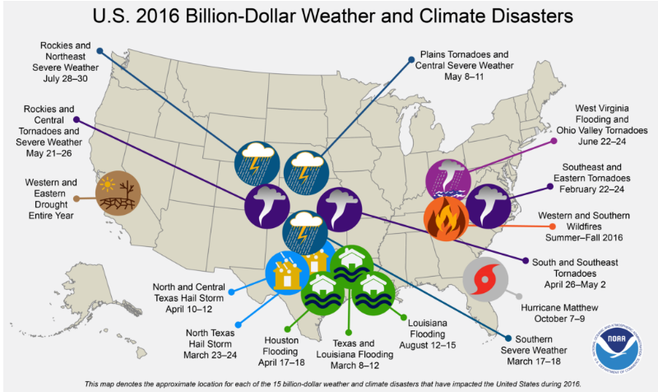
Billion-Dollar Events
Events with economic costs greater than $1 billion.
SOURCE: National Oceanic and Atmospheric Administration.

Slide 15
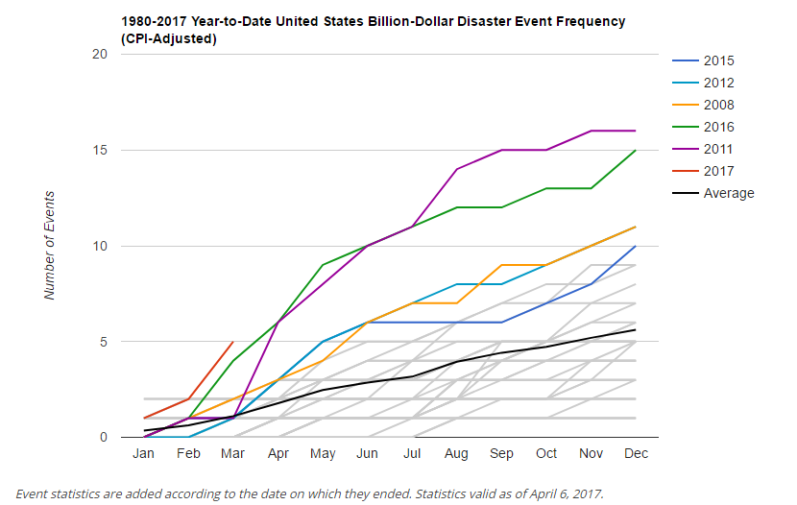
Billion-Dollar Events
2011
2016
2017
Events with economic losses greater than $1 billion, adjusted for inflation.
SOURCE: National Oceanic and Atmospheric Administration.

Slide 16
P/C Direct Written Premium by Line
(Billions of Dollars)
LOB | 2015 | 2016
Personal Auto | 199.9 | 214.6
Homeowners | 93.3 | 95.7
GL (incl Products) | 65.7 | 66.9
WC | 57.6 | 58.5
Fire & Allied Lines | 42.2 | 40.6
CMP | 39.7 | 39.9
Comm Auto | 31.3 | 33.1
Other | 61.9 | 63.0
Total | 591.8 | 612.3
Auto Premiums Rising; Property Falling.
Sources: NAIC Data, sourced from S&P Global Market Intelligence, Insurance Information Institute.

Slide 17
P/C Direct Incurred LR by Line
(Billions of Dollars)
LOB | 2015 | 2016
Personal Auto | 68% | 73%
Homeowners | 50% | 53%
GL (incl Products) | 56% | 60%
WC | 57% | 55%
Fire & Allied Lines | 46% | 54%
CMP | 45% | 51%
Comm Auto | 66% | 69%
Other | 43% | 46%
Total | 57% | 60%
Auto Costs, Cats Drive Loss Ratios Higher.
Sources: NAIC Data, sourced from S&P Global Market Intelligence, Insurance Information Institute.

Slide 18
Commercial Lines Rates

Slide 19
Rate Changes
Rates Soft/Flat, Especially in Reinsurance
U.S. Commercial Thru Q4 2016
Global Reinsurance
January Renewals
Sources: Willis Towers Watson Commercial Lines Insurance Pricing Survey, Marsh Insurance Market Index, Q4 2016, Insurance Information Institute.
Notes:
19

Slide 20
Rate Changes by LOB Thru Q4 2016
Slight Softening, Though Local Markets Vary
U.S. Casualty
U.S. Property
U.S. Financial and Prof Liab
U.S. Cyber
SOURCE: Marsh Insurance Market Index, Q4 2016

Slide 21
Commercial Rates (Pacific NW), Q1 2017
By Account Size
 | Down > 10% | Down 1-10% | No Change | Up 1-10% | Up > 10%
Small (<25K) | 0% | 38% | 38% | 15% | 0%
Medium (25-100K) | 0% | 36% | 43% | 14% | 0%
Large (100K+) | 15% | 46% | 23% | 8% | 0%
By Line of Business
 | Down > 10% | Down 1-10% | No Change | Up 1-10% | Up > 10%
Commercial Auto | 0% | 7% | 14% | 43% | 29%
Commercial Property | 0% | 50% | 36% | 14% | 0%
Cyber | 7% | 43% | 43% | 7% | 0%
D&O | 0% | 15% | 62% | 8% | 8%
General Liability | 0% | 36% | 64% | 0% | 0%
Terrorism | 0% | 0% | 77% | 0% | 0%
Umbrella | 0% | 14% | 57% | 14% | 7%
Workers Compensation | 0% | 43% | 50% | 7% | 0%
Rate Changes Can Vary Significantly Within States, Lines of Business or Individual Markets.
SOURCE: Council of Insurance Agents & Brokers, Insurance Information Institute.

Slide 22
Politics
Divisions Make Progress Difficult

Slide 23
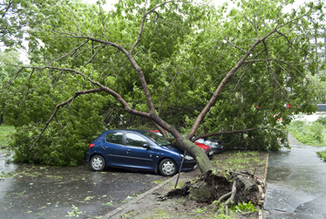
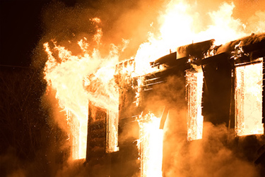

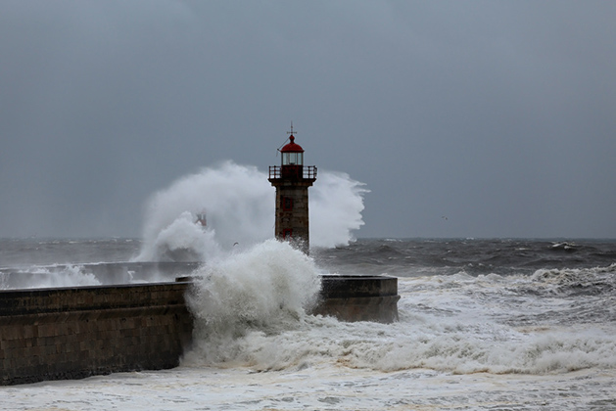
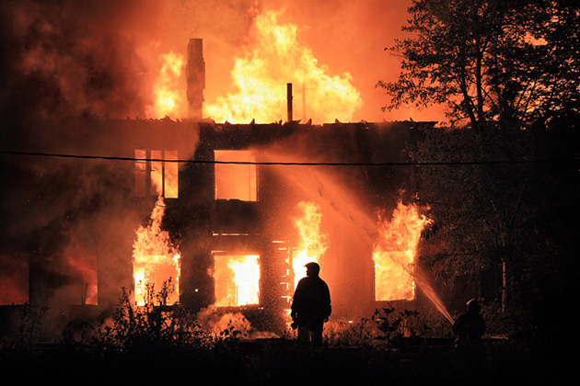
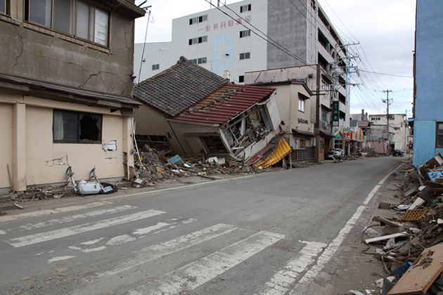
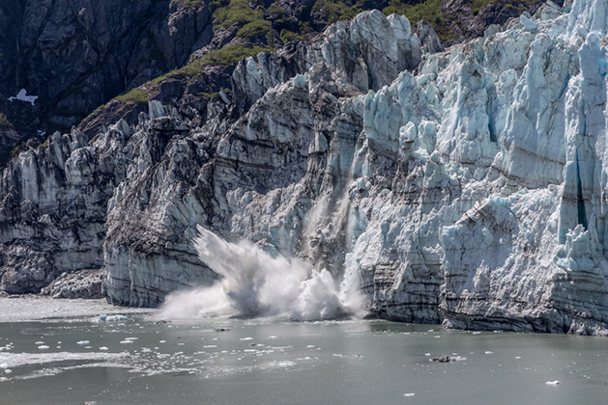
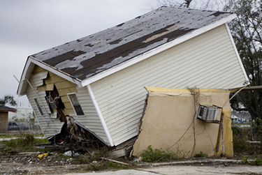

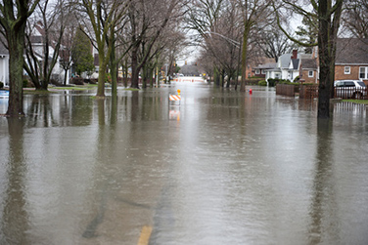
Disruption is Everywhere
Catastrophes – Increases in frequency and severity
Natural Catastrophes
Climate
Change
Wind
Fire
Earthquake
Water

Slide 24
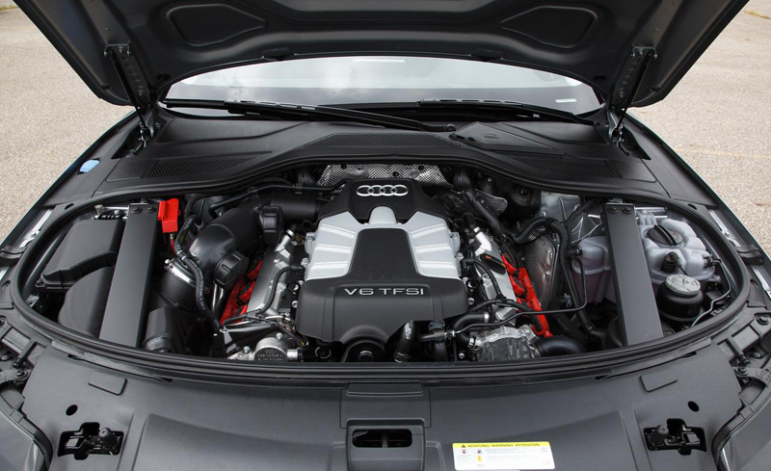
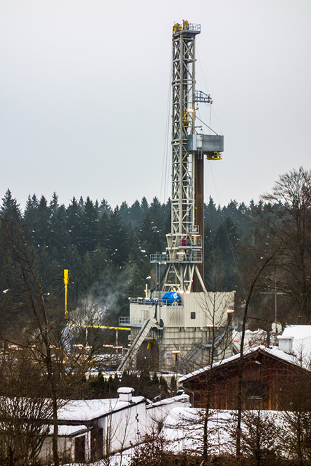
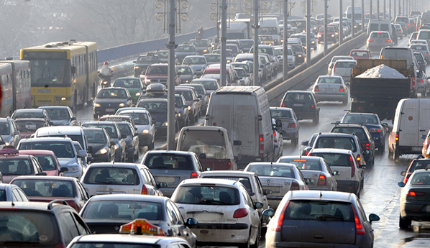


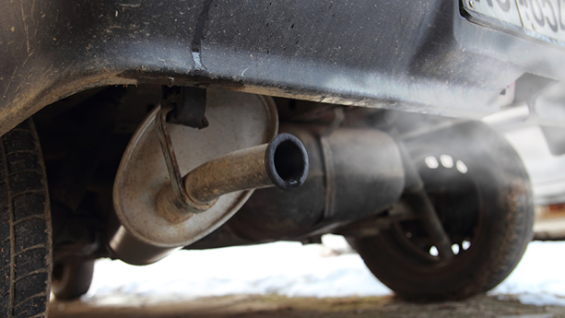
Disruption is Everywhere
Catastrophes – Increases in frequency and severity
Man-Made Catastrophes
Cyber
Autos
“Induced”
Earthquakes

Slide 25




Globalization
Geopolitical Polarization
Rise of Nationalism
Regional
Tensions
Global Trends Impacting
Domestic Market
Regulatory Trends
"Conduct of Business"
TPP
Capital/Solvency
Dodd-Frank
* Mainland purchases of insurance and related investment policies in the nine months ended September 2016 surged to a record high.
Notes:
Elected Officials: "Rise of Nationalism" -- US, France, Germany
Neither US presidential candidate supports TPP
Regions: Europe (EU/Brexit/Russia), Asia (China/North-South Korea/Japan), Middle East (Syria/Iraq)
Global trends impacting domestic market
Regulatory trends:
"Conduct of Business"
Capital/Solvency
Climate Change

Slide 26
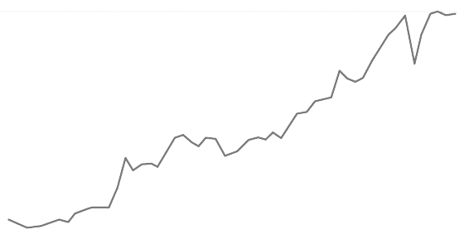
Economic Uncertainty
Global Growth...
US Growth...
  *Since 2008 we've had the longest period of relative trade stagnation since World War II...
  Investment
  Growth
  GDP
  1.6
...Monetary vs. Fiscal Policy
  Monetary: Low interest rates mean insurers are struggling to meet interest rate guarantees for life insurance and annuities must diversify their investment portfolios
  Fiscal: Supply-side debate heating up, i.e., tax reform
* The Peterson Institute for International Economics

Slide 27
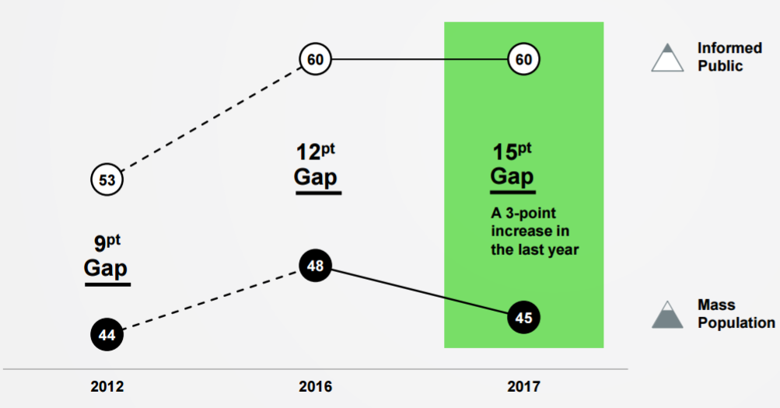
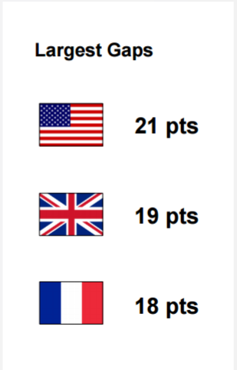
The Trust Gap
Average of trust in Government, NGOs, Media and Business.
SOURCE: Edelman Trust Barometer, 2017

Slide 28
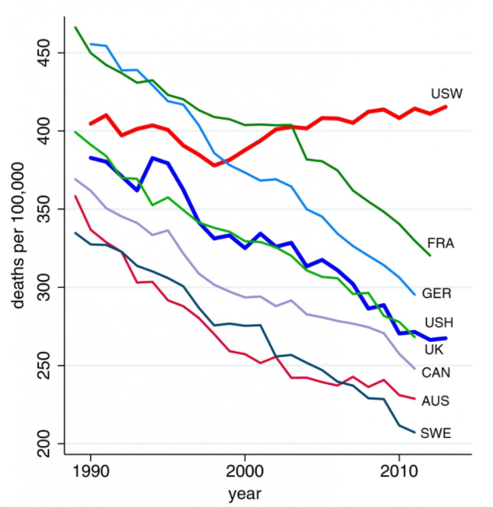
Stagnation’s Toll
Cumul Chg in Real Avg Income
Death Rates, 45-64
SOURCES: World Wealth and Income Database (from motherjones.com), Insurance Information Institute; Washington Post (from Proceedings of National Academy of Sciences).

Slide 29
Geopolitics – US

Slide 30

The ‘Bully Pulpit’ Evolution
Trump has potential to change the game…
@USTreasSec where is #TaxReform? Get R done!
@USAG #Waterboarding will #MakeAmericaGreat!
Notes:
Social media has been changing politics for the last several years.
Halls of legislatures and Congress – "Follow, Like!"
When I started – answering phones – messages, weekly reviews
Members are voting by their facebook and twitter accounts
Corporate advocacy sites – Crowd finding = grassroots.
Media is following as well vs. primary driver.

Slide 31
P/C Insurance Industry ROE by Presidential Party Affiliation
1950-2016*
Truman
Eisenhower
Kennedy/ Johnson
Nixon/
Ford
Carter
Reagan/
Bush I
Clinton
Bush II
Obama
BLUE = Democratic President RED = Republican President
.
*2016 data is through Q3.
Source: Insurance Information Institute

Slide 32
Federal and State Issues

Slide 33
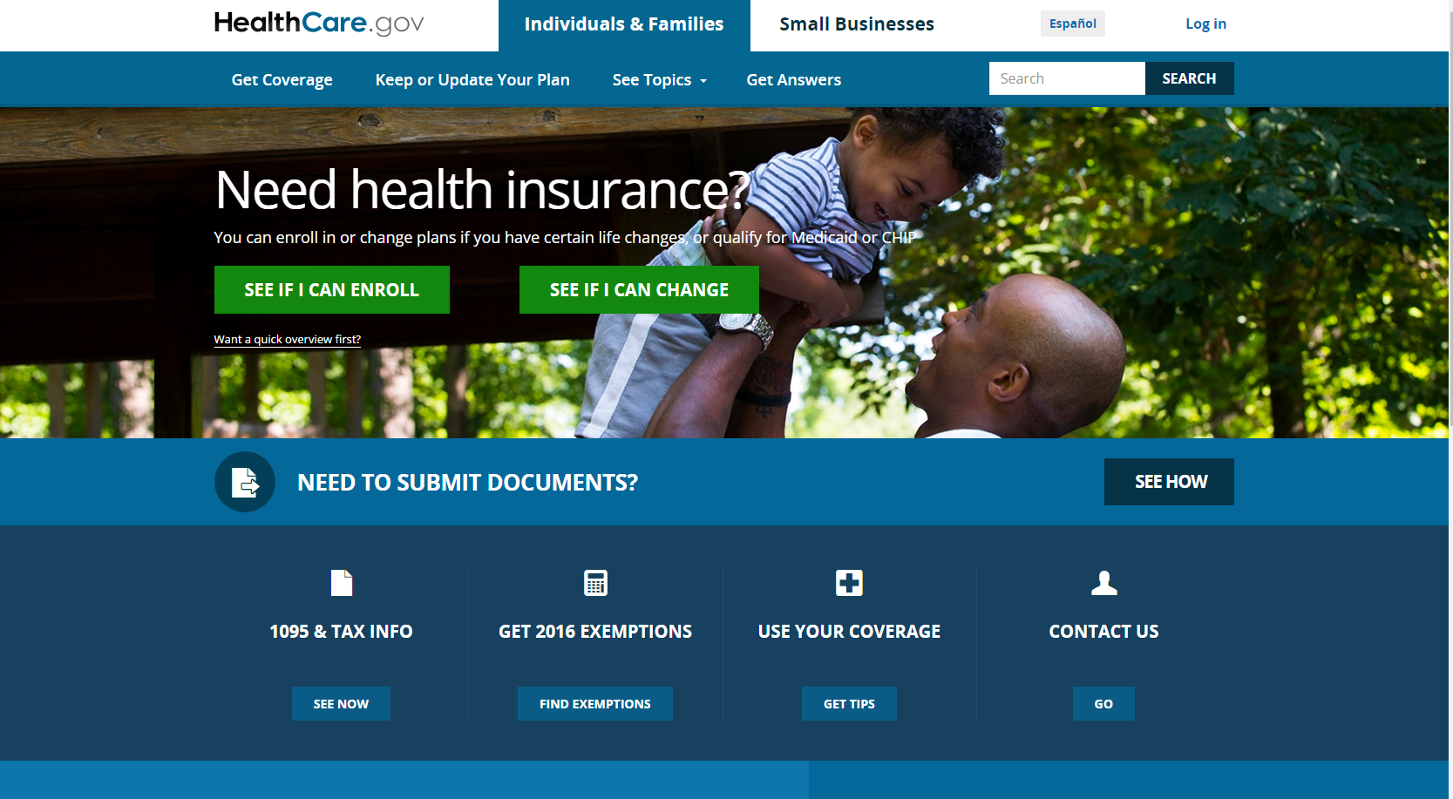
Affordable Care Act
Going …. Going ….. Maybe Not Going Anywhere
?
2016
Notes:
One WC issue that might depend on federal control: health care
Does ACA affect comp
New enrollees raise prices all around
New enrollees mean doctors stop accepting WC patients
Doctors have incentives to push claims into WC

Slide 34
But State Politics Drives Insurance
And Every State is Different
C-
WA
D
MT
D+
ND
A
ME
B+
OR
B
MN
A
ID
A-
WI
D+
NY
NH A-
VT A+
MA D-
RI C+
CT C+
NJ B-
DE D
MD C+
B-
SD
B
WY
C+
MI
B
NE
B+
IA
B-
PA
D
CA
B+
NV
B
OH
A
UT
A
IL
B
IN
C
CO
C
WV
B
VA
C
KS
B
MO
A-
KY
B- TN
F NC
A
AZ
B
NM
C
OK
C+
AR
B
SC
D
MS
C-
AL
C
GA
B-
TX
D
LA
= A
= B
= C
= D
= F
= NG
D-
AK
C
FL
D
HI
Not Graded: District of Columbia
Source: R Street Insurance Regulation Report Card, December 2016

Slide 35
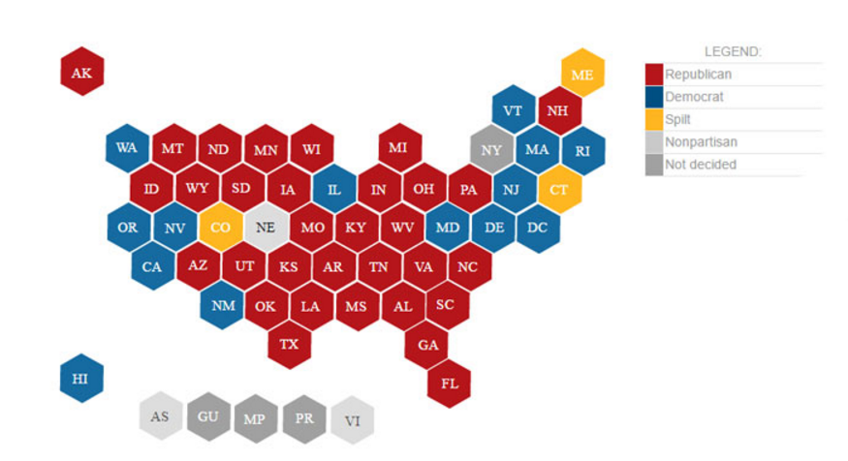
Republicans Control Most States . . .
In The November Election They Lost One Legislature Overall
Makeup Today
Seven chambers flipped control after the November 2016 elections.
* Nebraska: Unicameral, nonpartisan, Republican dominated. New York: not decided.
Source: National Conference of State Legislatures, Ballotpedia, Insurance Information Institute.
Notes:
Republicans controlled 69. They now control 68.
The Iowa Senate switched D to R; Kentucky House switched from D to R; Minnesota Senate switched D to R. The Nevada Senate switched R to D; Nevada Assembly switched R to D; New Mexico House switched R to D; and Alaska House switched R to D.

Slide 36
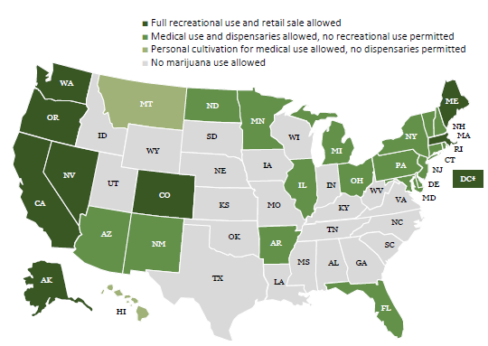
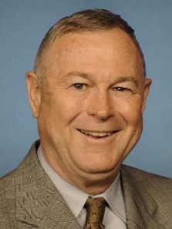
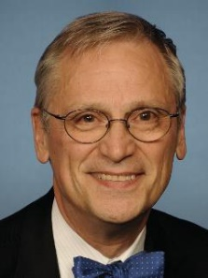
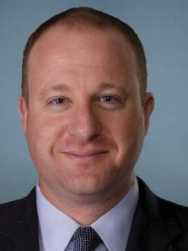
Medical Marijuana
Comp Caught in the Middle
Congressional Cannabis Caucus
Rohrbacher (CA)
Bluemenauer (OR)
Young
(AK)
Polis
(CO)
SOURCE: National Journal.
Notes:
There were 9 referenda on marijuana legalization. Only one failed – recreational use in Arizona.
Six states require use of medical marijuana in WC claims – CT, ME, MA, MN, NJ, NM
Six states forbid use of medical marijuana in WC claims – AZ, CO, MI, MT, OR, VT
It is illegal to use the banking system to purchase marijuana. So an insurer can’t write a check against to pay for the drug. They use cash.
Trump OK with med mare. Sessions, not so much. We wind up with one more conflict, Trump vs. his Cabinet.

Slide 37
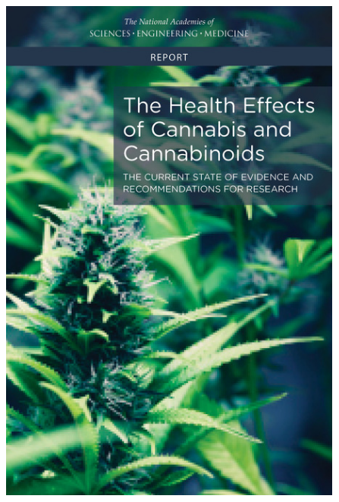
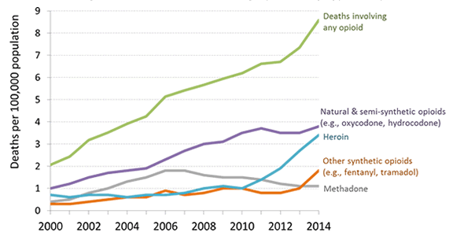
Medical Marijuana
Comp Caught in the Middle
Opioid Alternative?
https://www.nap.edu/catalog/24625/the-health-effects-of-cannabis-and-cannabinoids-the-current-state
Notes:
There is conclusive evidence or substantial evidence that marijuana:
Improves the lot of adults in chronic pain.
Increases the risk of motor vehicle crashes.
Increases the risk of developing schizophrenia and other psychoses.
There is moderate support suggesting that marijuana:
Improves short-term sleep outcomes for people with fibromyalgia or chronic pain.
Increases impairment of learning, memory and attention span.
Increases dependence on alcohol, tobacco and illicit drugs.
It is not possible to determine whether marijuana use is statistically correlated with occupational injuries.
47,000 drug deaths in USA in 2015

Slide 38
On the Horizon
Sharing Economy and Disruption

Slide 39
What Is A Value Chain?
Example: Local Newspapers
Create Product (Publish the Newspaper)
Gather Information (News, Ads)
Distribute Product (Deliver the Newspaper)
Improve World
Printing Press
Provide Information to Local Audience
This Industry Was Radically Disrupted by the Internet. Its Barriers to Entry Were Destroyed. Is Insurance Next?

Slide 40
Greatest Threats, Opportunities
Whither Silicon Valley?
Greatest Opportunity
Greatest Threat
SOURCE: A.M. Best Winter 2016-17 Insurance Industry Survey.

Slide 41
Insurance Technology Financing – Change Is Coming
Investment ($ Millions)
Deals
Investment In Insurance Tech Is Rising. Number of Deals Reached A Record in First Quarter.
SOURCES: CB Insights, Insurance Information Institute.

Slide 42
Insurance Technology Financing – Change Is Coming
More Than Half This Funding Was in Two Deals (Zenefits/ Zhong An)
Investment ($ Millions)
Deals
Investment In Insurance Tech Is Rising. Number of Deals Set A Record Last Year.
SOURCES: CB Insights, Insurance Information Institute.

Slide 43
Insurance Tech Activity by Area of Interest, 2013 – 2016:Q1
With the ACA in the rear view window, non-health insurance tech accounts for the majority of investment
(Percent)
Silicon Valley, Venture Capitalists Have Insurance Industry in Their Sights. Most Will Fail. Some Will Succeed.
Source: CB Insights at https://www.cbinsights.com/blog/insurance-tech-overview-q1-2016/; Insurance Information Institute.

Slide 44
The (Re)Insurance Value Chain
Where Could Disruption Lie?
Create Policy/ Treaty
Brains + Bank Account
Write Risk
Perform Loss Control
Settle Claims
Market Policy/ Treaty
Improve World
Price Risk
Protecting People & Organizations
Most Links in the Value Chain Have the Potential
to Be Disrupted in Next 10 Years.

Slide 45
Alternative Capital
Potentially Disrupting the Bank Account
Alternative capacity has grown 350% since 2006. It has more than tripled in the past six years.
Source: Aon Benfield Analytics; Insurance Information Institute.

Slide 46
The Internet
Will It Disrupt Marketing?
Lead Generators
  InsWeb, NetQuote, Insurance.com
  Site allows comparison shopping, sells lead to insurer
Call Center Agencies
  SelectQuote, Goji
  Call center employs agents
Digital agencies
  Esurance, Policy Genius
  Quote and buy online
But Customers Still Like Agents
Did You Compare Prices When Your Auto Policy Was Up for Renewal?
SOURCES: The New Age of Insurance Aggregators, http://insurancethoughtleadership.com/the-new-age-of-insurance-aggregators/; Insurance Information Institute November 2015 Pulse Survey.

Slide 47


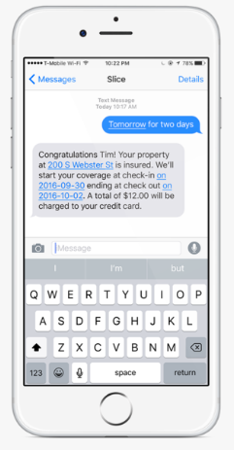



Pricing Disruptor: The Fragmented Risk
47
12/01/09 - 9pm
eSlide – P6466 – The Financial Crisis and the Future of the P/C
Notes:
47
The Insurance Contract Is Being Split into Tiny Pieces.
The Sharing/“On-Demand” Economy – Personal → Commercial → Personal
By-peril HO insurance
Ride-sharing insurance
Pay By Mile Insurance
Expect More As
Computers Get Stronger
Data Storage Gets Cheaper
Information Collection Grows
Workers comp – adjust rates for travel?

Slide 48
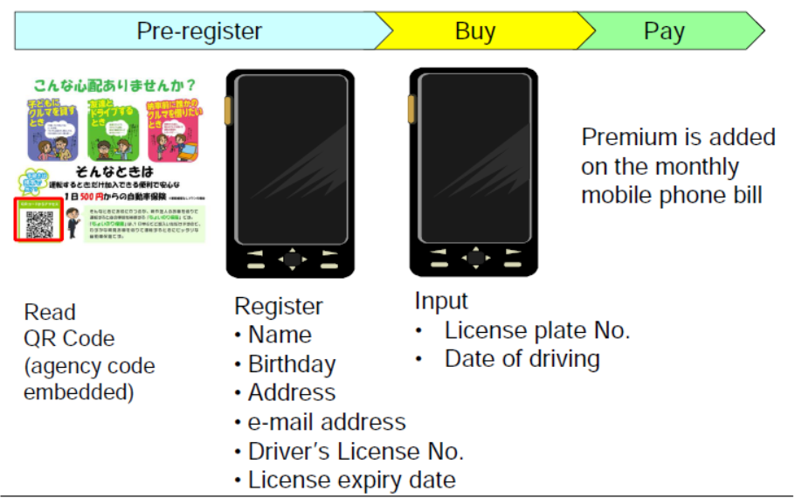
One-Day Auto Insurance

Slide 49

Pricing Disruptor: The Fragmented Risk
The Insurance Contract Is Being Split into Tiny Pieces.
  By-peril HO insurance – Rate Water, Theft, Liability Risk Separately
  The Sharing/“On-Demand” Economy – Personal Exposures Become Commercial Exposures, Then Switch Back
  Pay By Mile Insurance – Exposure Basis for Auto – Vehicle-Mile Replaces Vehicle-Year
Expect More As
  Computers Get Stronger
  Data Storage Gets Cheaper
  Information Collection Grows
49
12/01/09 - 9pm
eSlide – P6466 – The Financial Crisis and the Future of the P/C
Notes:
49

Slide 50

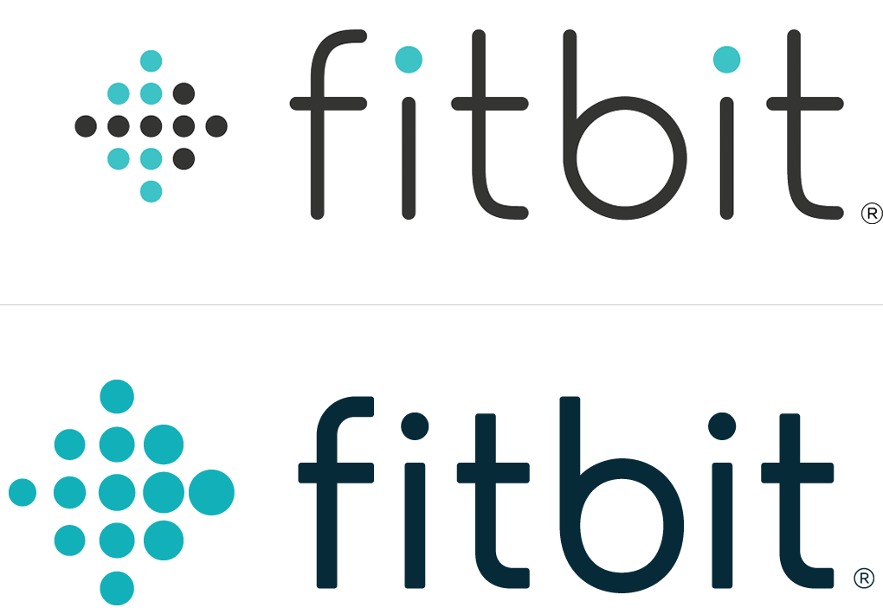
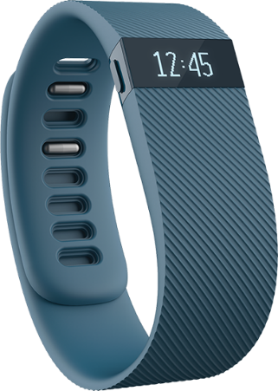
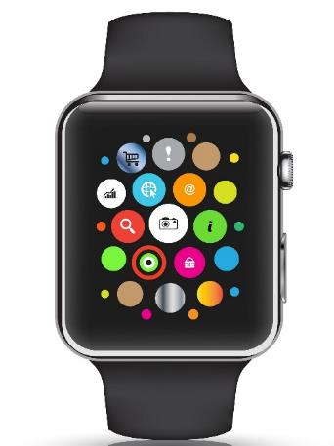
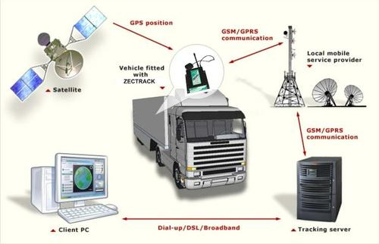

Loss Control Disruptor
The Internet of Things
Telematics Today
Telematics Tomorrow
50
12/01/09 - 9pm
eSlide – P6466 – The Financial Crisis and the Future of the P/C
Notes:
50
Gathering Big Data Affects
Underwriting
Pricing
Monitoring Could Affect
Loss Control
Pricing?

Slide 51
The Internet of Things
Gathering Big Data Affects
  Underwriting
  Pricing
Monitoring Could Affect
  Loss Control
  Pricing?
51
12/01/09 - 9pm
eSlide – P6466 – The Financial Crisis and the Future of the P/C
Notes:
51

Slide 52
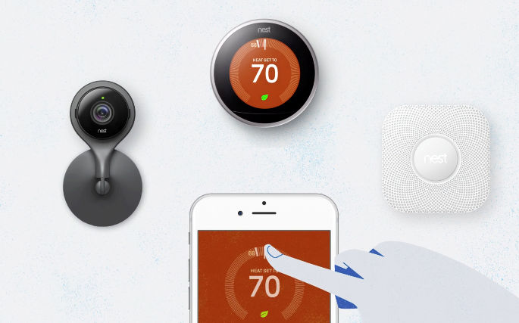

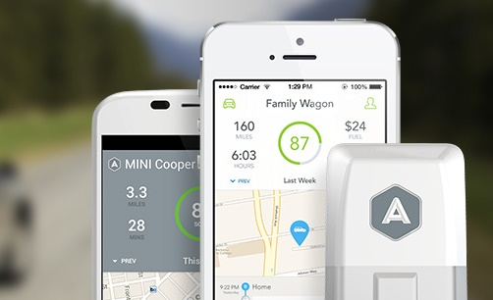
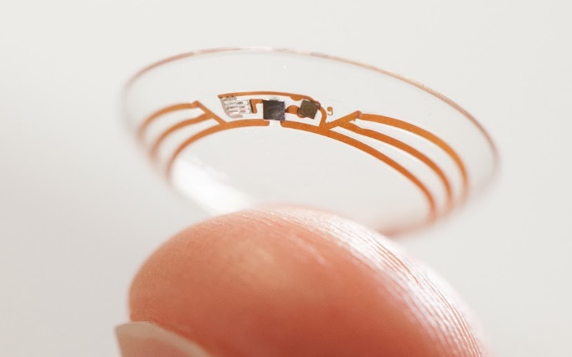
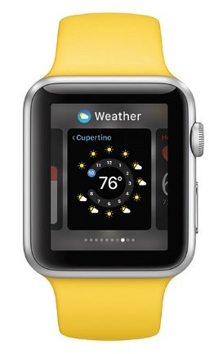
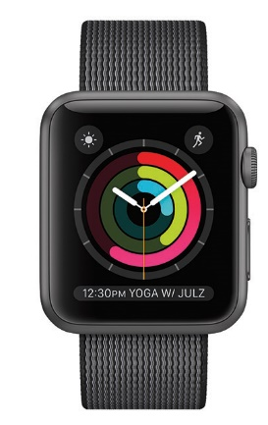
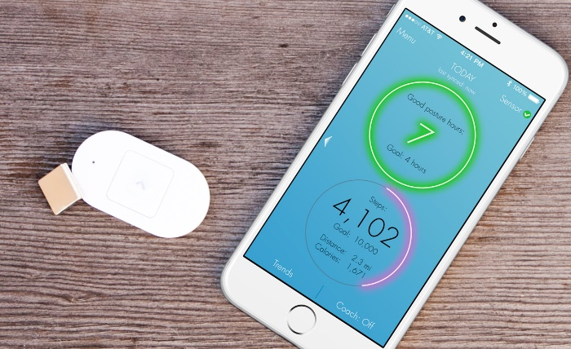
As For The Future…
IoT Could Disrupt UW, Claims, Loss Control
Image sources, clockwise: Nest, Jawbone, Automatic, Lumo, Apple, PSFK

Slide 53
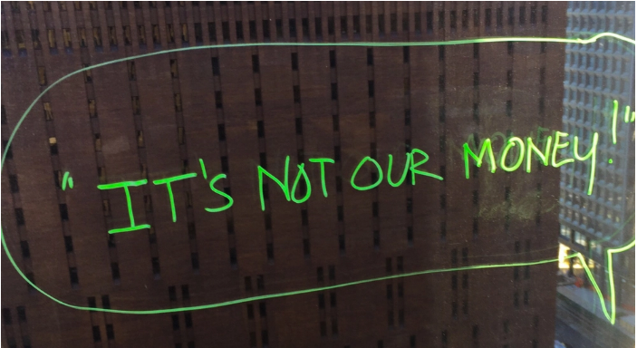

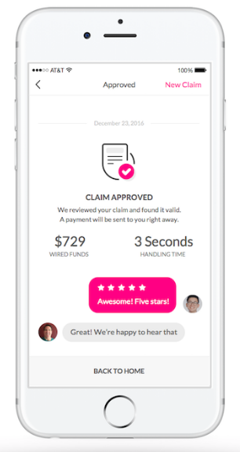
Claims Disruptor
Artificial Intelligence + Behavioral Economics
Notes:
AI Jim
IDs suspicious activity
Marries Artificial Intelligence, Behavioral Economics (file via video)
Bot handles simplest claims

Slide 54
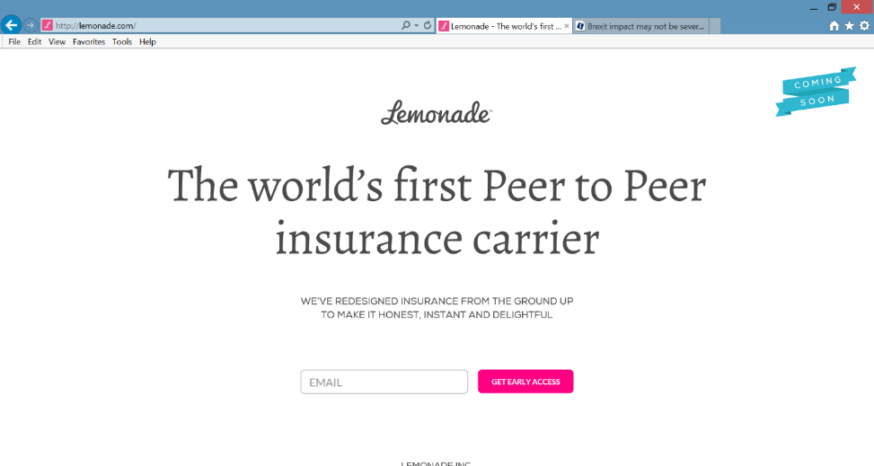
Peer-to-Peer (P2P) Insurance
Lemonade’s Model: Unknown
Taking on the Entire Value Chain
A Typical P2P Model
Resembles Mutuals/Reciprocals
People Join Small Group of Friends to Prefund Deductible or Bear Other Small Risk.
Leftover Deductible $$ Rolled Forward.
May Deter Fraud – You Wouldn’t Cheat Your Friends!
CEO Daniel Schreiber
Our Chief Behavioral Officer, Professor Dan Ariely, says that “If you tried to create a system to bring out the worst in humans, it would look a lot like the insurance of today.”
Source: “UberX-ing Insurance : Is Peer-to-Peer Insurance Viable?”, presentation by Jay Sarzen, Aite Group at Drinker Biddle Insurance Conference, June 21, 2016.

Slide 55
Summary
Higher catastrophe losses caused industry profits to deteriorate.
Low interest rates continue to dog industry results.
Commercial rates may be softening.
Political leaders face a complex, disruptive environment.

Slide 56
Thank you for your time and your attention!
Read our auto White Paper on Rising Personal Auto Costs at
www.iii.org

