Slide 1
P/C Insurance Industry Overview & Outlook
PCICS Summer Meeting Minneapolis, MN August 22, 2016
Steven N. Weisbart, Ph.D., CLU, Senior Vice President & Chief Economist
Insurance Information Institute ♦ 110 William Street ♦ New York, NY 10038
Tel: 212.346.5540 ♦ Cell: 917.494.5945 ♦ stevenw@iii.org ♦ www.iii.org

Slide 2
First, the Good News about the P/C Insurance Industry:
2013-15 Were Three Good Years in a Row
2016 Could Keep the String Going
2

Slide 3
Net Premium Growth: Annual Change, 1971—2016F
16 Years
16 Years?
1975-78
1984-87
2000-03
2016-19
Net Written Premiums Fell 0.7% in 2007 (First Decline Since 1943) by 2.0% in 2008, and 4.2% in 2009, the First 3-Year Decline Since 1930-33.
2016F: 4.5% 2015: 3.4% 2014: 4.2% 2013: 4.6% 2012: 4.3%
Shaded areas denote “hard market” periods
Sources: A.M. Best (historical and forecast), ISO, Insurance Information Institute.

Slide 4
U.S. Insured Catastrophe Losses
2012 was the 3rd most expensive year ever for insured CAT losses
($ Billions, $ 2015)
2013/14/15 were welcome respites from 2011/12—the latter being among the costliest years for insured disaster losses in US history. The longer-term trend is for more costly events.
*Estimate through 12/31/15 in 2015 dollars.
Note: 2001 figure includes $20.3B for 9/11 losses reported through 12/31/01 ($25.9B 2011 dollars). Includes only business and personal property claims, business interruption and auto claims. Non-prop/BI losses = $12.2B ($15.6B in 2011 dollars.)
Sources: Property Claims Service/ISO; Insurance Information Institute.
4
12/01/09 - 9pm
eSlide – P6466 – The Financial Crisis and the Future of the P/C
Notes:
4

Slide 5
Combined Ratio Points Associated with Catastrophe Losses: 1960 – 2015E*
Avg. CAT Loss Component of the Combined Ratio by Decade
1960s: 1.04 1970s: 0.85 1980s: 1.31 1990s: 3.39 2000s: 3.52 2010s: 5.46*
Catastrophe losses as a share of all losses reached a record high in 2011
Combined Ratio Points
The Catastrophe Loss Component of Private Insurer Losses Has Increased Sharply in Recent Decades
*2010s represent 2010-2015E.
Notes: Private carrier losses only. Excludes loss adjustment expenses and reinsurance reinstatement premiums. Figures are adjusted for losses ultimately paid by foreign insurers and reinsurers.
Source: ISO (1960-2009); A.M. Best (2010-15E) Insurance Information Institute.

Slide 6
P/C Insurance Industry Combined Ratio, 2001–2015*
Insurers Paid Nearly $1.16 for Every $1 in Earned Premiums
Higher CAT Losses, Shrinking Reserve Releases, Toll of Soft Market
Best Combined Ratio Since 1949 (87.6)
Heavy Use of Reinsurance Lowered Net Losses
* Excludes Mortgage & Financial Guaranty insurers 2008--2014. Including M&FG, 2008=105.1, 2009=100.7, 2010=102.4, 2011=108.1; 2012:=103.2; 2013: = 96.1; 2014: = 97.0.
Sources: A.M. Best, ISO.

Slide 7
P/C Industry Net Income After Taxes 1991–2015
$ Millions
2006 ROE = 12.7%
2007 ROE = 10.9%
2008 ROE = 0.1%
2009 ROE = 5.0%
2010 ROE = 6.6%
2011 ROAS¹ = 3.5%
2012 ROAS¹ = 5.9%
2013 ROAS¹ = 10.2%
2014 ROAS¹ = 8.4%
2015:ROAS = 8.4%
ROE figures are GAAP; ¹Return on avg. surplus. Excluding Mortgage & Financial Guaranty insurers yields a 8.2% ROAS in 2014, 9.8% ROAS in 2013, 6.2% ROAS in 2012, 4.7% ROAS for 2011, 7.6% for 2010 and 7.4% for 2009.
Sources: A.M. Best, ISO; Insurance Information Institute.

Slide 8
Profitability Peaks & Troughs in the P/C Insurance Industry, 1975 – 2016F
ROE
1977:19.0%
History suggests next ROE peak will be in 2016-2017, but that seems unlikely
1987:17.3%
10 Years
2006:12.7%
1997:11.6%
10 Years
2013 9.8%
2015=8.4%
2016F=6.3%
9 Years
2014 8.4%
1975: 2.4%
1984: 1.8%
1992: 4.5%
2001: -1.2%
*Profitability = P/C insurer ROEs. 2011-14 figures are estimates based on ROAS data. Note: Data for 2008-2014 exclude mortgage and financial guaranty insurers.
Source: Insurance Information Institute; NAIC, ISO, A.M. Best, Conning

Slide 9
Return on Net Worth (RNW) Largest Lines: 2005-2014 Average
Percent
Commercial lines have tended to be more profitable than personal lines over the past decade
Source: NAIC; Insurance Information Institute.

Slide 10
RNW All Lines, 2005-2014 Average, Vary Widely by State and Region
Southwest
Mountain
Far West
Great Lakes
Great Plains
Sources: NAIC; Insurance Information Institute
10
12/01/09 - 9pm
eSlide – P6466 – The Financial Crisis and the Future of the P/C
Notes:
10
In May for the first time in 2 years, Nevada overtook Michigan as the state with the highest unemployment rate

Slide 11
RNW All Lines, 2005-2014 Average, Vary Widely by State and Region
Southeast
Mid-Atlantic
New England
Sources: Sources: NAIC; Insurance Information Institute.
11
12/01/09 - 9pm
eSlide – P6466 – The Financial Crisis and the Future of the P/C
Notes:
11
This chart and the succeding one show that unemployment rates vary widely, not only by region, but within regions.

Slide 12
Policyholder Surplus, 2006:Q4–2016:Q1
($ Billions)
2007:Q3 Pre-Crisis Peak
Drop due to near-record 2011 CAT losses
Surplus as of 3/31/16 stood at $676.3B
The industry now has $1 of surplus for every $0.77 of NPW, close to the strongest claims-paying status in its history.
2010:Q1 data includes $22.5B of paid-in capital from a holding company parent for one insurer’s investment in a non-insurance business.
The P/C insurance industry entered 2016 in very strong financial condition.
Sources: ISO, A.M .Best.
12
12/01/09 - 9pm
eSlide – P6466 – The Financial Crisis and the Future of the P/C
Notes:
12

Slide 13
Modest Economic Growth in 2016-17 Should Increase the Exposure Base and Premium Volume
Both Commercial and Personal Lines Should Benefit
13

Slide 14
Real U.S. Quarterly GDP Growth Since the “Great Recession
“Advance” estimate
“GDP now” estimate as of August 12
Since the Great Recession ended, even 3% real growth (at an annual rate) in a quarter has been unusual. Through 2016:Q2, it happened only 7 times in 28 quarters—and not once in the most recent 7 quarters.
Data are quarterly changes at annualized rates.
Sources: US Department of Commerce, at http://www.bea.gov/national/index.htm#gdp ; Insurance Information Institute.

Slide 15
Length of US Business Cycles, 1929–Present*
Length of Expansions Greatly Exceeds Contractions
When Will the Next Recession Start? 2018?
Duration (Months)
Average Duration**
Recession = 10.4 Mos
Expansion = 60.5 Mos
*Through August 2016. ** Post-WW II period through end of 2001-2007 expansion.
Sources: National Bureau of Economic Research; Insurance Information Institute.

Slide 16
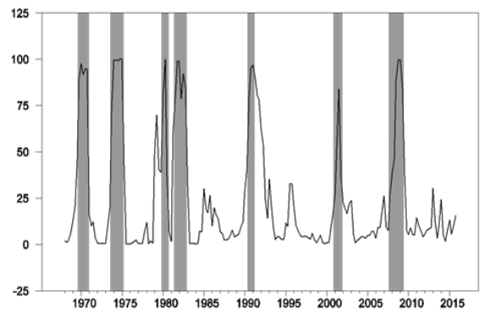
GDP-based Recession-Indicator Index, with data through 2016:Q1
Index
NBER-dated recessions tend to follow when the Index reaches 40%
Likelihood of a recession remains low (15.7%)
The plotted value for each date is based solely on information as it would have been publicly available and reported as of one quarter after the indicated date, with 2015:Q4 the last date shown on the graph. Shaded regions represent NBER-dated recessions; which were sometimes not reported until two years after a recession was determined to have ended, and were not used in any way in constructing the index.
Source: https://www.frbatlanta.org/cqer/research/gdpbased_RII.aspx (updated May 11, 2016); I.I.I.

Slide 17
Quarterly US Real GDP for 2016-17: August 2016 Forecasts
Real GDP Growth Rate (%)
Many of the 53 forecasts in the Blue Chip survey expect good growth in the third quarter of 2016 and slower growth in 2017.
Sources: Blue Chip Economic Indicators (8/16); Insurance Information Institute

Slide 18
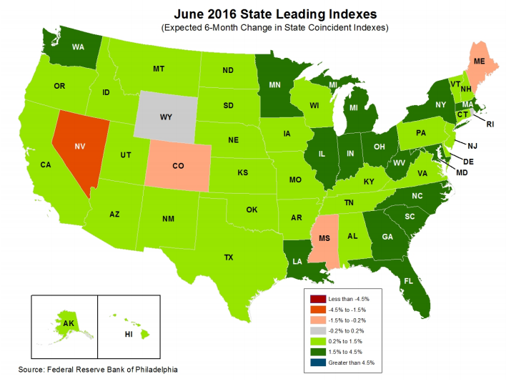
State-by-State Leading Indicators through December 2016
Near-term growth forecasts vary widely by state. Strongest growth = dark green (1.5%-4.5%); then light green; then gray; weakest = red
Sources: Federal Reserve Bank of Philadelphia at www.philadelphiafed.org/index.cfm , released August 1, 2016; Insurance Information Institute. Next release is August 29, 2016

Slide 19
Nonfarm Employment, Quarterly Change, 2011 – 2016*
Thousands
After a strong 2014-15, the pace of job growth has slowed somewhat.
*Seasonally adjusted; 2016:Q3 is July projected to the full quarter. June and July 2016 data are preliminary Sources: US Bureau of Labor Statistics; Insurance Information Institute

Slide 20
Unemployment and Underemployment Rates: Still Falling
January 2000 through July 2016, Seasonally Adjusted (%)
U-6 went from 8.0% in March 2007 to 17.5% in October 2009
For U-6, 8.0% to 9.5% is “normal.”
U-6 was 9.7% in July 2016.
“Headline” unemployment was 4.9% in July 2016. 4.5% to 5.5% is “normal.”
Based on the latest readings, it appears that the job market is now close to “normal”
Source: US Bureau of Labor Statistics; Insurance Information Institute.
20
12/01/09 - 9pm
eSlide – P6466 – The Financial Crisis and the Future of the P/C
Notes:
20

Slide 21
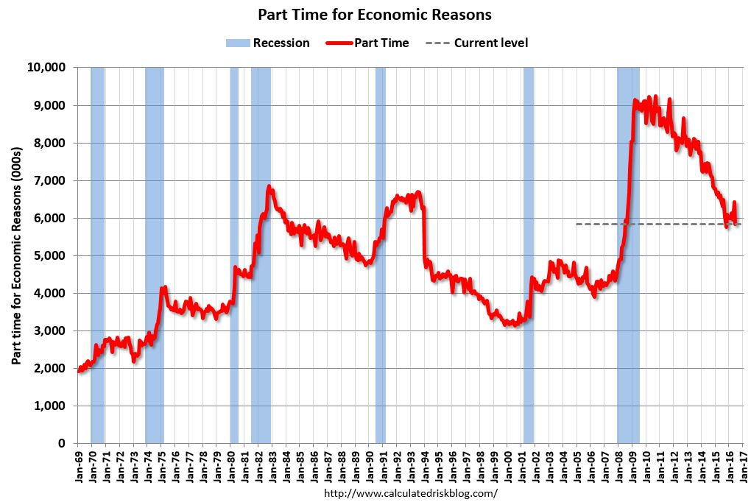
Labor Market Slack: Elevated Number of Involuntary Part-time Workers
July 2016: 5.94 million
In less than 18 months, 4.5 million additional people were involuntarily working part time
The “normal” range (since 1992)

Slide 22
Number of “Discouraged Workers”: Elevated, but Dropping Jan 1994 – July 2016
Thousands
A “discouraged worker” in a month did not actively look for work in the prior month for reasons such as --thinks no work available, --could not find work, --lacks schooling or training, --thinks employer thinks too young or old, and other types of discrimination.
Latest reading: 591,000 in July 2016.
Normal
In recent good times, the number of discouraged workers ranged from 200,000-400,000 (1995-2000) or from 300,000-500,000 (2002-2007).
Notes: Recessions indicated by gray shaded columns. Data are seasonally adjusted.
Sources: Bureau of Labor Statistics; National Bureau of Economic Research (recession dates).
22
12/01/09 - 9pm
eSlide – P6466 – The Financial Crisis and the Future of the P/C
Notes:
22

Slide 23
Full-time vs. Part-time Employment, Quarterly, 2003-2016:Q2
Full time, millions
Part-time, millions
Recession
New full-time peak
Pre-recession, most new jobs were full-time
Recession shifted employment growth from full-time to part-time
The Great Recession shifted employment from full-time to part-time. Full-time employment is finally above its pre-recession peak, but part-time hasn’t receded.
Data are seasonally-adjusted. Sources: US Bureau of Labor Statistics, US Department of Labor; Insurance Information Institute.

Slide 24
ISM Manufacturing Index (Values > 50 Indicate Expansion), January 2010-July 2016
Index
As of July, 5 Consecutive Months of Expansion
The Manufacturing Sector Expanded for 68 of the 72 Months from January 2010 Through December 2015. Manufacturing Contracted in 2015:Q4 and 2016:Q1 but is Expanding Again.
Sources: Institute for Supply Management; Insurance Information Institute.

Slide 25
ISM Non-Manufacturing Index (Values > 50 Indicate Expansion), January 2010-July 2016
Index
The Non-Manufacturing (Services) Sector Expanded in Every Month After January 2010. Compared to 2014-15,
the Pace of Expansion Has Slowed in 2016 But Not Ended.
Sources: Institute for Supply Management via https://research.stlouisfed.org/fred2/data/NMFCI.txt; Insurance Information Institute.

Slide 26

Brexit: Potential Effects on the UK
Brexit forecasts/questions for the UK:
UK labor costs will rise due to less outsourcing to foreign (i.e. EU) labor, so UK-produced goods will be less competitive
Lowered assurance of market access will discourage long-term investment in the UK
The UK economy will grow more slowly than it otherwise would, and might slip into recession
What will happen to the 2 million workers of EU-origin who now live in the UK? (6% of workers) Will they be forced to leave? Sell their homes?
Will the City of London continue to be the financial capital of Europe? Will headquarters move to Frankfurt?
12/01/09 - 9pm
eSlide – P6466 – The Financial Crisis and the Future of the P/C

Slide 27
Brexit: Potential Effects on the EU and the Global Economy
The free flow of financial capital, human capital and coordinated regulatory policy across EU states is, on net, good for Europe’s economy
Concern that UK’s action could initiate a domino effect of other countries leaving the EU
Economic integration is considered the cornerstone that has been keeping (most of) Europe free of war
The UK accounts for only 4% of global GDP
But a slowing UK economy will be a drag on the EU economy
The EU sends about 7% of its exports to the UK
UK is 3% of US Total Trade
eSlide – P6466 – The Financial Crisis and the Future of the P/C

Slide 28
Potential Effects of Brexit on the Insurance Industry
The Brexit vote has spiked uncertainty regarding the UK economy, resulting in:
Dollar appreciates vs. the pound and, to a lesser extent, vs. the euro
Increased demand for U.S. bonds, driving long-term interest rates down
Likely to delay Fed rate hikes
“Given that most insurance purchases are not discretionary in nature, demand does not change dramatically during times of economic weakness, particularly in lines such as auto and homeowners.
In addition, economic weakness can depress claims activity as well.”*
Does Brexit weaken Solvency II and efforts to implement European-like regulations in the US?
Probably not in the short term; longer-term, depends on UK-EU negotiations
Source: *Jay A. Cohen, BofAML, “Non-Life insurance should be defensive in volatile times,” June 24, 2016; I.I.I.

Slide 29
Effect of Brexit on Stocks of Publicly-Traded Insurance Companies
“Domestic P/C stocks have only modest exposure to currency and a slower-growth European economy.”*
“Non-life insurer stocks are likely to be defensive relative to the market.”**
“Companies with Lloyds operations may see a modest slowdown in the top line.”*
“Sometimes surety and D&O losses emerge from volatile markets and economies.”*
“Currency has been an ongoing pressure for many of the brokers. In addition, slower growth in Europe could be an additional headwind for most brokers.”*
But, “Global disruption tends to drive demand for consulting services.”**
Sources: *Robert Glasspiegel, Janney, “Insurance Stocks in a Brexit World,” June 27, 2016; **Jay A. Cohen, BofAML, “Non-Life insurance should be defensive in volatile times,” June 24, 2016.

Slide 30
Forces Affecting Personal Lines: Auto Insurance
30

Slide 31
Return on Net Worth: Personal Auto, 2005–2014
4.3%
Auto Insurance Profitability Has Been Stuck at Low Levels.
Source: National Association of Insurance Commissioners.

Slide 32
Auto Insurance Net Combined Ratios, Yearly, 2005-2015
Loss Ratios Have Been Rising for A Decade.
2015 Return on Net Worth Is Likely Close to Zero or Negative.
Sources: National Association of Insurance Commissioners data, sourced from S&P Global Market Intelligence; Insurance Information Institute.

Slide 33
A Half Century of Auto Insurance: Frequency vs. Severity
In the Long Run, Frequency Falls. Severity Increases.
Frequency
Severity
1963
1988
2013
Sources: Insurance Institute for Highway Safety, Insurance Services Office, Insurance Information Institute.

Slide 34
Why Personal Auto Loss Ratios are Rising: Severity & Frequency by Coverage, 2015 vs. 2014
Annual Change, 2015 Over 2014
Across All Personal Coverage Types (Except Comprehensive) in 2015, Frequency and Severity Rose. This Pattern is Likely to Continue in 2016.
Source: ISO/PCI Fast Track data; Insurance Information Institute.

Slide 35
Auto/Light Truck Sales Are Forecast to Continue in 2016 at the 2015 Level
(Millions of Units)
We’re back to new vehicle sales levels last seen pre-recession
Yearly car/light truck sales will likely continue at current levels, in part replacing cars that were held onto in 2008-12. But rising interest rates could eventually restrain demand for new vehicles.
Sources: US Department of Commerce; Blue Chip Economic Indicators, 8/16 issue (forecasts); Insurance Information Institute.

Slide 36
America is Driving More Again: Total Miles Driven*, 1996–2016
Billions
New miles driven records in 2016
From 1996 (and well before), miles driven rose virtually every month, even through recessions.
From November 2007 until January 2015, miles driven was below the prior peak for 87 straight months— over 7 years! Previous record (below prior peak( was in the early 1980s (39 months).
*Moving 12-month total. The data are through May 2016, the latest available. Note: Recessions indicated by gray shaded columns.
Sources: Federal Highway Administration (http://www.fhwa.dot.gov/policyinformation/travel_monitoring/tvt.cfm ); National Bureau of Economic Research (recession dates); Insurance Information Institute.
36
12/01/09 - 9pm
eSlide – P6466 – The Financial Crisis and the Future of the P/C
Notes:
36

Slide 37
Why Are We Driving More Miles? More Are Going to Work
Billions of Miles Driven in Prior Year (as of Quarter-End)
Millions Employed
Recession
Most Employed People Drive to and from Work, but when They’re Not Employed, They Drive Less (and not During “Rush Hour”)
Sources: Federal Highway Administration (http://www.fhwa.dot.gov/policyinformation/travel_monitoring/tvt.cfm); Seasonally Adjusted Nonfarm Employed from Bureau of Labor Statistics; Insurance Information Institute.
Notes:
37

Slide 38
More Miles Driven => More Collisions, 2006–2016
Billions of Miles Driven in Prior Year
Overall Collision Claims Per 100 Insured Vehicles
Recession
The more miles people drive, the more likely they are to get in an accident, helping drive claim frequency higher.
Sources: Federal Highway Administration (http://www.fhwa.dot.gov/policyinformation/travel_monitoring/tvt.cfm ); Rolling Four-Qtr Avg. Frequency from Insurance Services Office; Insurance Institute for Highway Safety; Insurance Information Institute.
38
12/01/09 - 9pm
eSlide – P6466 – The Financial Crisis and the Future of the P/C
Notes:
38

Slide 39
Collision Claims, 2005–2015: Frequency Trending Higher Since 2009
Annual Change, 2005 through 2015
For a Long Time, Claim Frequency Was Falling, But Since 2010 This Trend Seems to Have Reversed.
Source: ISO, a Verisk Analytics company; Insurance Information Institute.

Slide 40
Collision Claims: Severity Trending Higher in 2009–2015
Annual Change, 2005 through 2015
The Great Recession and High Fuel Prices Helped to Temper Claim Severity, But These Forces Have Clearly Reversed, Consistent with Experience from Past Recoveries.
Source: ISO, a Verisk Analytics company; Insurance Information Institute.

Slide 41
Collision Claims: Pure Premium (Losses per Insured Unit), 2011:Q4 to 2015:Q4
Over the Latest Four Years, the Collision Pure Premium Rose by 19.75%.
Note: Number of claims is for four quarters ending in quarter shown.
Source: ISO, a Verisk Analytics company; Insurance Information Institute.

Slide 42
Forces Affecting Personal Lines: Home Insurance
42

Slide 43
Forecast: Continued Growth in Private Housing Unit Starts, 1995-2019F
Rising mortgage rates could dampen the demand for new residential construction
(Millions of Units)
Housing unit starts plunged 72% from 2005-2009, down 1.49 million, to lowest level since records began in 1959
Housing starts are climbing slowly. Recently, the fastest growth is in multi-unit residences. Personal lines exposure will grow, and commercial insurers with Workers Comp, Construction risk exposure and Surety also benefit.
Sources: US Department of Commerce (history); Blue Chip Economic Indicators (8/2016), forecasts; Insurance Information Institute.

Slide 44
Number of Owner-Occupied & Renter-Occupied Housing Units, US, Quarterly, 1990:Q1-2016:Q2
Millions of Renter-Occupied Housing Units
Millions of Owner-Occupied Housing Units
Number of owner-occupied units has been stuck at roughly 75 million units since 2005:Q4
Trough in 2004:Q2 at 32.61 million units.
Latest renter-occupied was 43.86 million units in 2016:Q2.
Since 2004 the number of renter-occupied housing units has grown by over 10 million units (+31.4%), but there has been no growth in the number of owner-occupied housing units in over 10 years. When will this end?
Sources: US Census Bureau at http://www.census.gov/housing/hvs/data/histtabs.html , Table 3; Insurance Information Institute.
44
12/01/09 - 9pm
eSlide – P6466 – The Financial Crisis and the Future of the P/C
Notes:
44

Slide 45
Rental Vacancy Rates, Quarterly, 1990-2016
Percent vacant
Peak vacancy rate 11.1% in 2009:Q3
Latest vacancy rate was 6.7% in 2016:Q2
Vacancy rate 10.4% in 2004:Q1
Before the 2001 recession, rental vacancy rates were 8% or less. We’re below those levels now. => More multi-unit construction?
Sources: US Census Bureau, Residential Vacancies & Home Ownership in the Second Quarter of 2016 and earlier issues; Insurance Information Institute.
45
12/01/09 - 9pm
eSlide – P6466 – The Financial Crisis and the Future of the P/C
Notes:
45

Slide 46
US: Pct. Of Private Housing Unit Starts In Multi-Unit Projects, 1990-2016*
Units in Multiple-Unit Projects as Percent of Total
A NEW NORMAL? In 7 of the last 9 years, over 30% of housing unit starts were in 5+-unit projects
For the U.S. as a whole, the trend toward multi-unit housing projects (vs. single-unit homes) is recent. Commercial insurers with Workers Comp, Construction risk exposure, and Surety benefit.
*through July 2016 Based on seasonally-adjusted data. Sources: U.S. Census Bureau; Insurance Information Institute calculations.

Slide 47
I.I.I. Poll: Renters Insurance
Percentage of Renters Who Have Renters Insurance, 2011-2015
The Percentage Of Renters With Renters Insurance Has Been Growing, But Slowly
Source: Insurance Information Institute Annual Pulse Survey.

Slide 48
Giant Age Cohort (Millenials) Is Approaching Home-Buying Stage
Number of People in 2015 (Millions)
Average Age, 1st Time Homebuyer
Millennial Generation
Average Age, Repeat Homebuyer
If prior patterns hold, the number of homes bought by current renters, and the number of new homes built, will rise in coming years
Sources: Census Bureau; CoreLogic; Insurance Information Institute.

Slide 49
Growth in Number of Households => Increased Demand for Housing
Net Change in Number of Occupied Residences (Thousands)
A spike, not a trend
Housing bubble
Bubble burst
If prior patterns hold, the number of homes bought by current renters, and the number of new homes built, will rise in coming years
Sources: Census Bureau; CoreLogic; Insurance Information Institute.

Slide 50
Forces Affecting Commercial Lines
50

Slide 51
Private Nonresidential Fixed Investment, Quarterly: Recently, a New Peak
$ Billions*
2016:Q2 at $2167.3 B
Many economists expect business investment to rise in 2016
This is a measure of the growth of the commercial property exposure base. Business investment dipped in 2016:1H but is expected to grow slowly in 2016:2H. If so, commercial insurance premium volume will grow with it.
*Quarterly, at seasonally adjusted annual rate
Sources: Federal Reserve Board at http://research.stlouisfed.org/fred2/data/PNFIC96.txt . National Bureau of Economic Research (recession dates); Insurance Information Institutes.
51
12/01/09 - 9pm
eSlide – P6466 – The Financial Crisis and the Future of the P/C
Notes:
51

Slide 52
Nonfarm Payroll (Wages and Salaries): Quarterly, 2005–2016:Q1
Billions
Latest (2016:Q2) was $8.06 trillion, a new peak--$1.84T above 2009 trough
Prior Peak was 2008:Q3 at $6.54 trillion
Growth rates 2011:Q1 over 2010:Q1: 5.5% 2012:Q1 over 2011:Q1: 4.2% 2013:Q1 over 2012:Q1: 2.5% 2014:Q1 over 2013:Q1: 4.3% 2015:Q1 over 2014:Q1: 4.4% 2016:Q1 over 2015:Q1: 4.5%
Recent trough (2009:Q1) was $6.23 trillion, down 5.3% from prior peak
Note: Recession indicated by gray shaded column. Data are seasonally adjusted annual rates.
Sources: http://research.stlouisfed.org/fred2/series/WASCUR; National Bureau of Economic Research (recession dates); Insurance Information Institute.
52
12/01/09 - 9pm
eSlide – P6466 – The Financial Crisis and the Future of the P/C
Notes:
52

Slide 53
Inflation & Claims
Overall Inflation Has Been Low, but Prices for Some Items that Affect Claims Are Rising Notably Faster
53

Slide 54
Change* in the Consumer Price Index, 2004–2016
For two months in 2008, led by gasoline, the general price level was rising at a 5.5% pace
Lately, the CPI is rising at a 1.0% y-o-y pace
When gas prices dropped, the general price level was briefly lower than a year prior
Over the last decade, prices generally rose about 2% per year.
*Monthly, year-over-year, through June 2016. Not seasonally adjusted.
Sources: US Bureau of Labor Statistics; National Bureau of Economic Research (recession dates); Insurance Information Institutes.
54
12/01/09 - 9pm
eSlide – P6466 – The Financial Crisis and the Future of the P/C
Notes:
54

Slide 55
Change* in the Consumer Price Index, 2004–2016
Since 2004, the core CPI never rose faster than a 3% y-o-y pace
Lately, core CPI is rising at a 2.3% y-o-y pace
The core CPI continuously rose; for a few months, the rate of increase was under 1%
Over the last decade, prices generally rose about 2% per year.
*Monthly, year-over-year, through June 2016. Not seasonally adjusted.
Sources: US Bureau of Labor Statistics; National Bureau of Economic Research (recession dates); Insurance Information Institutes.
55
12/01/09 - 9pm
eSlide – P6466 – The Financial Crisis and the Future of the P/C
Notes:
55

Slide 56
Prices for Hospital Services: 12-Month Change,* 1998–2016
June 2016 Inpatient services +5.1%
June 2016 Outpatient services +2.3%
Prices for Hospital Services have risen at an annual rate of 4% (and often more) for the last 15 years, while the general price level rose by 2%/year.
*Percentage change from same month in prior year; through June 2016; seasonally adjusted
Sources: US Bureau of Labor Statistics; National Bureau of Economic Research (recession dates); Insurance Information Institute.
56
12/01/09 - 9pm
eSlide – P6466 – The Financial Crisis and the Future of the P/C
Notes:
56

Slide 57
Investment Performance: a Key Driver of Profitability
Depressed Yields Influence Underwriting & Pricing
57

Slide 58
US Treasury Note 10-Year Yields: A Long Downward Trend, 2000–2016*
Yields on 10-Year US Treasury Notes have been below 3% for 5 years: bonds bought in 2006 at 5% will be reinvested at 1.5% for 10 more years
US Treasury yields plunged to historic lows in 2013, then rebounded but are sinking again
Since roughly 80% of P/C bond/cash investments are in 5-to-10-year durations, most P/C insurer portfolios will have low-yielding bonds for years to come.
*Monthly, constant maturity, nominal rates, through July 2016.
Sources: Federal Reserve Bank at http://www.federalreserve.gov/releases/h15/data.htm; National Bureau of Economic Research (recession dates); Insurance Information Institute.
58
12/01/09 - 9pm
eSlide – P6466 – The Financial Crisis and the Future of the P/C
Notes:
58

Slide 59
P/C Insurer Portfolio Yields, 2002-2015
P/C carrier yields have been falling for over a decade, reflecting the long downtrend in prevailing interest rates. Even as prevailing rates rise in the next few years, portfolio yields are unlikely to rise quickly, since low yields of recent years are “baked in” to future returns.
Sources: NAIC, via SNL Financial; Insurance Information Institute.

Slide 60
Forecasts of Avg. Yield of 10-Year US Treasury Notes
Yield (%)
Virtually every one of the 53 forecasts in the Blue Chip survey anticipates that long-term interest rates will stay at unusually low levels through 2017
Sources: Blue Chip Economic Indicators (8/16); Insurance Information Institute

Slide 61
Distribution of Bond Maturities, P/C Insurance Industry, 2006-2015
Two main shifts over these years. From 2008 to 2011-12, from bonds with longer maturities to bonds with shorter maturities. But beginning in 2013, the reverse. Note, however, that the percentages in bonds with maturities over 10 years continues to drop.
Sources: SNL Financial; Insurance Information Institute.

Slide 62
P/C Insurers: Below-Investment-Grade (BIG) Bonds as a Percent of Total Bonds, 2001-2015
Chasing Yield? As a Group, P/C Carriers Have Increased the Percentage of Bond Investments in Riskier Instruments. Since 2006, That Percentage Has Risen About 250 Basis Points. As Interest Rates Rise, Will This Percentage Return to Pre-recession Levels?
Sources: NAIC data, sourced from S&P Global Market Intelligence; Insurance Information Institute.

Slide 63
P/C Insurer Groups Holdings of BIG** Bonds as a Percent of Total Bonds, 2014
Number of Groups
The 67 groups graphed are those with over $3 billion in cash & admitted assets as of year-end
P/C industry average
There is a wide disparity among insurance groups regarding holdings of below-investment-grade bonds. Some hold none (or almost none); a few have over 10% of their bond portfolio in BIGs.
*Below Investment Grade Sources: NAIC, via SNL Financial; Insurance Information Institute.

Slide 64
Other Things That Could Affect the Course of Interest Rates
Prices of world currencies (the value of the US Dollar vs. the Euro, the Yen, the Yuan and other major world currencies)
Prices of a number of commodities (especially oil)
Prevailing interest rates in other countries (determined, in part, by those countries’ central banks)
The demand for, and the supply of, loanable funds
64
12/01/09 - 9pm
eSlide – P6466 – The Financial Crisis and the Future of the P/C
Notes:
64

Slide 65
Selected Employment Trends
65
Notes:
65

Slide 66
By 2018, Will We Have More Jobs to Fill than People to Fill Them?
Even with modest growth in the U.S. economy and no radical change in immigration between now and 2018, we should be at or near “full employment” before then
This results from creating jobs faster than the growth in the size of the labor force
So if we get to “full employment” and keep creating jobs faster than the growth of the labor force, won’t we have job shortages then?
And won’t those shortages put pressure on wages, which in turn will fuel high inflation?
Reference: Barry Bluestone and Mark Melnik, After the Recovery: Help Needed The Coming Labor Shortage and How People in Encore Careers Can Help Solve it, (Boston: Dukakis Center for Urban and Regional Policy, 2010).
66
12/01/09 - 9pm
eSlide – P6466 – The Financial Crisis and the Future of the P/C
Notes:
66

Slide 67
Why Job Shortages by 2018 are Unlikely
If we follow the post-WWII historical pattern, we are likely to have another recession around 2018, give or take a year or so
This will cause some jobs to disappear
Also, many currently-filled jobs will open due to retirements of the first half of the huge “baby boom” generation
In 2018 the first half of the huge “baby boom” generation will be ages 65-72, and the second half will be ages 54-64
67
12/01/09 - 9pm
eSlide – P6466 – The Financial Crisis and the Future of the P/C
Notes:
67

Slide 68
Why Job Shortages by 2018 are Unlikely (cont’d)
Increases in productivity will likely enable us to do more work with fewer people.
Employers might shift jobs to labor markets outside of the U.S.
Also, there might be many fewer retirees than we might think
68
12/01/09 - 9pm
eSlide – P6466 – The Financial Crisis and the Future of the P/C
Notes:
68

Slide 69
Labor Force Participation Rate, Ages 65-69, Quarterly, 1998:Q1-2016:Q2
Labor Force participation rate
1 in 3 in this age group are working. This group is the oldest “baby boomers.”
The brown bars indicate recessions.
The switch from DB pension plans (with early-retirement incentives) to DC plans (with, in effect, later-retirement incentives) might be partly responsible for raising this rate.
Not seasonally adjusted. Sources: US Bureau of Labor Statistics, US Department of Labor; Insurance Information Institute.

Slide 70
Insurance Information Institute Online:
www.iii.org
Thank you for your time and your attention!

